Slide 2
Day
Sunday
Date
18th Sep 2021
Subject
We can 5
Unit
2 Sea Animals
Lesson
1 Finding out time
Page
10-11

Slide 3
objectives
*Pair work
*Role play
*Problem solving
strategies

Slide 4
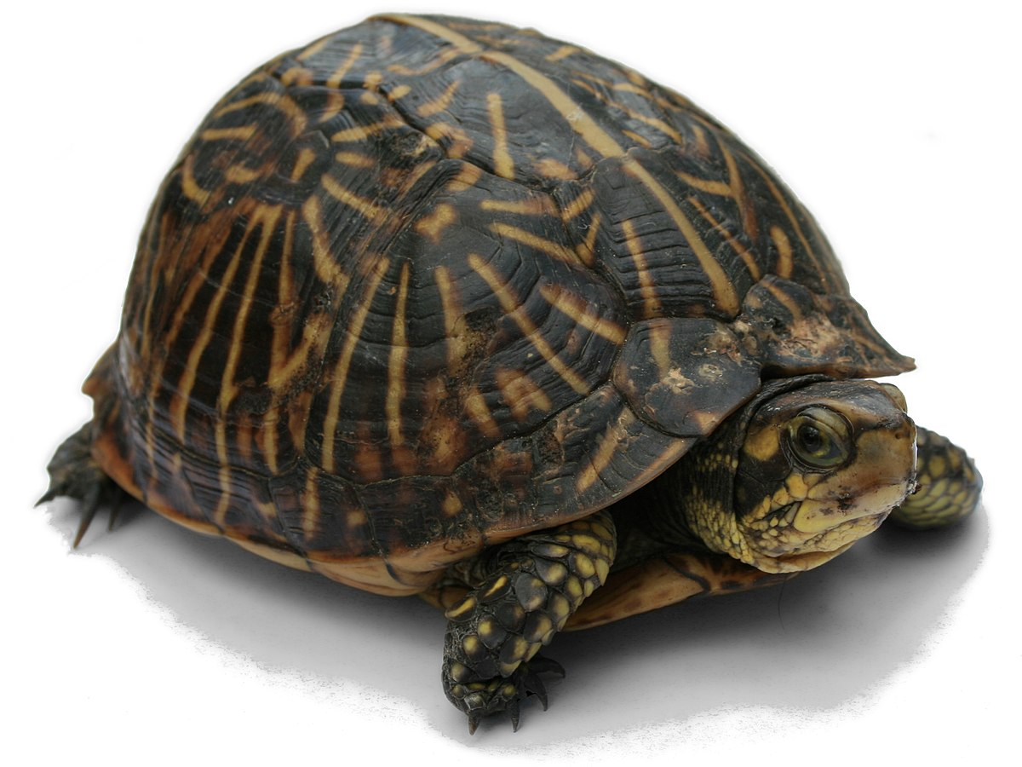
Who am I ?
I am slow
I am green
I have 4 legs
I have a backbone

Slide 5
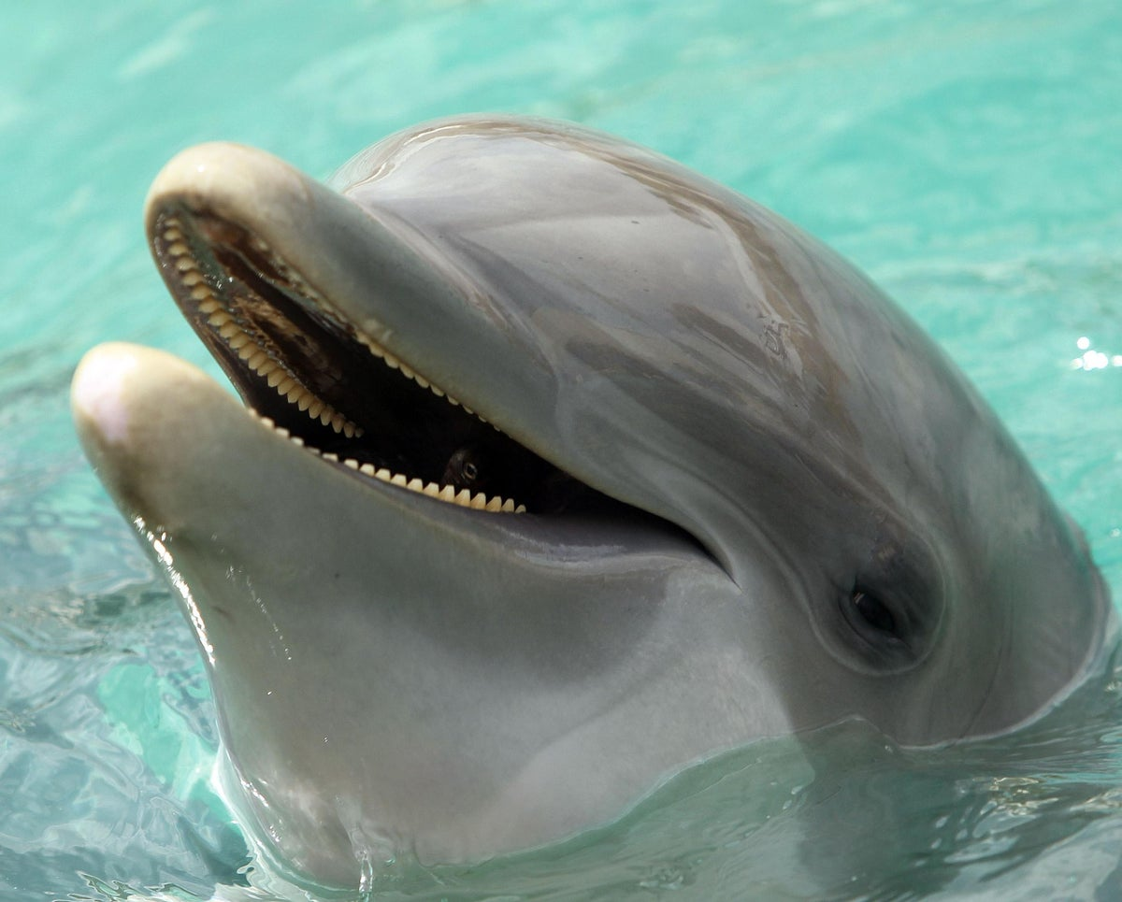
Who am I ?
I am cute
I am fast
I am smart
I like blow bubbles

Slide 6
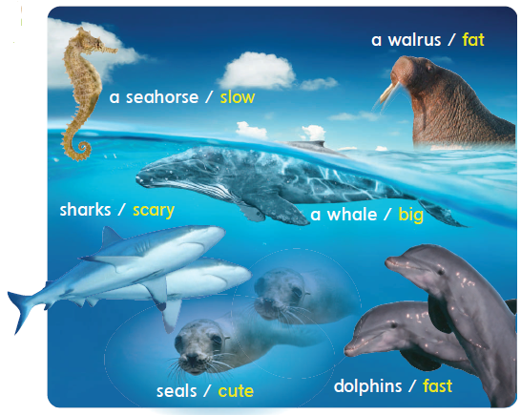
1
Listen
And
practice.

Slide 7
2
Ask your partner and get the real answers
seahorse
cute
sharks
cute

Slide 8
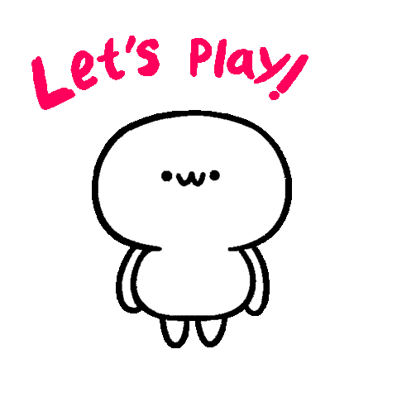

Slide 9
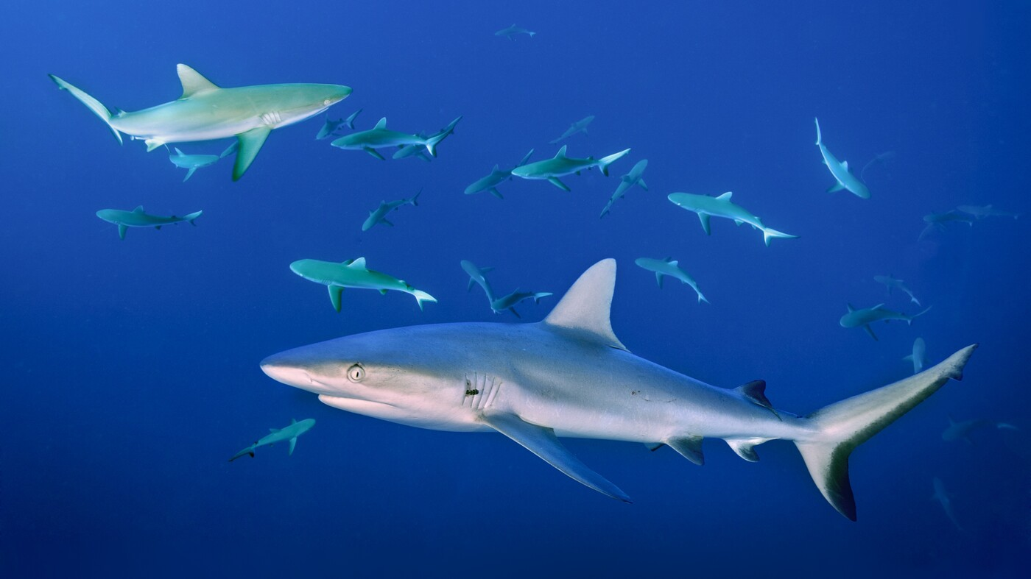
Sharks
A Seahorse
What’s this?
What do you think about it?
Dolphins
A whales
Seals
A walrus
Scary
slow
fat
Big
Cute
Fat

Slide 10
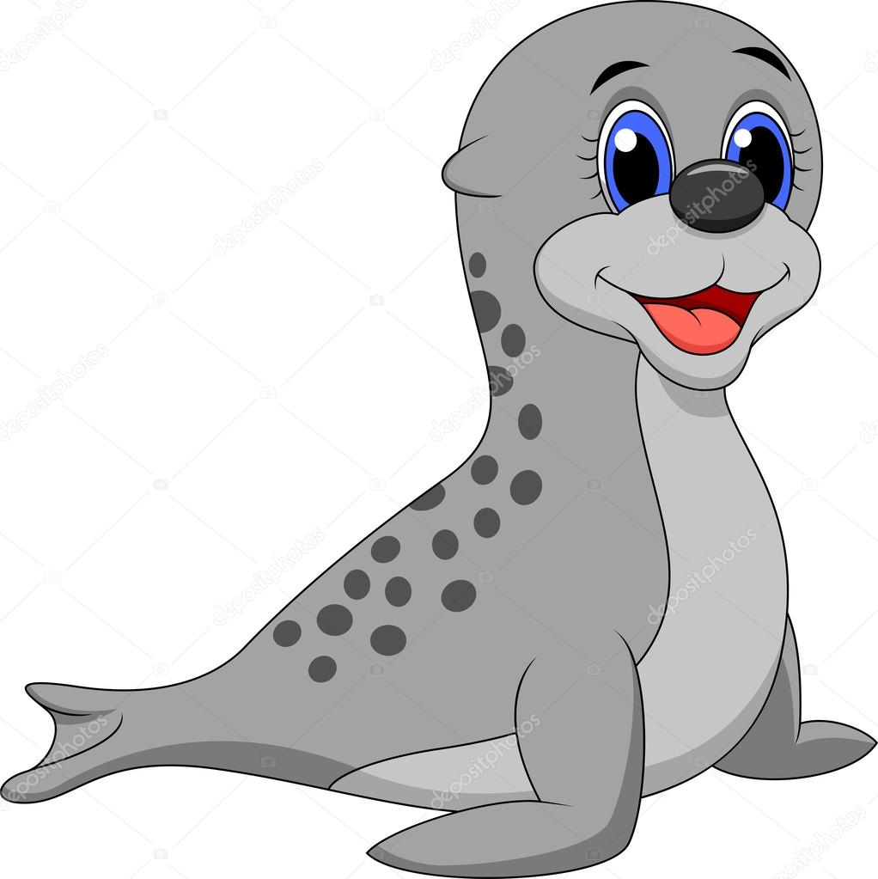
Sharks
A Seahorse
What’s this?
What do you think about it?
Dolphins
A whales
Seals
A walrus
Scary
slow
fat
Big
Cute
Fat

Slide 11
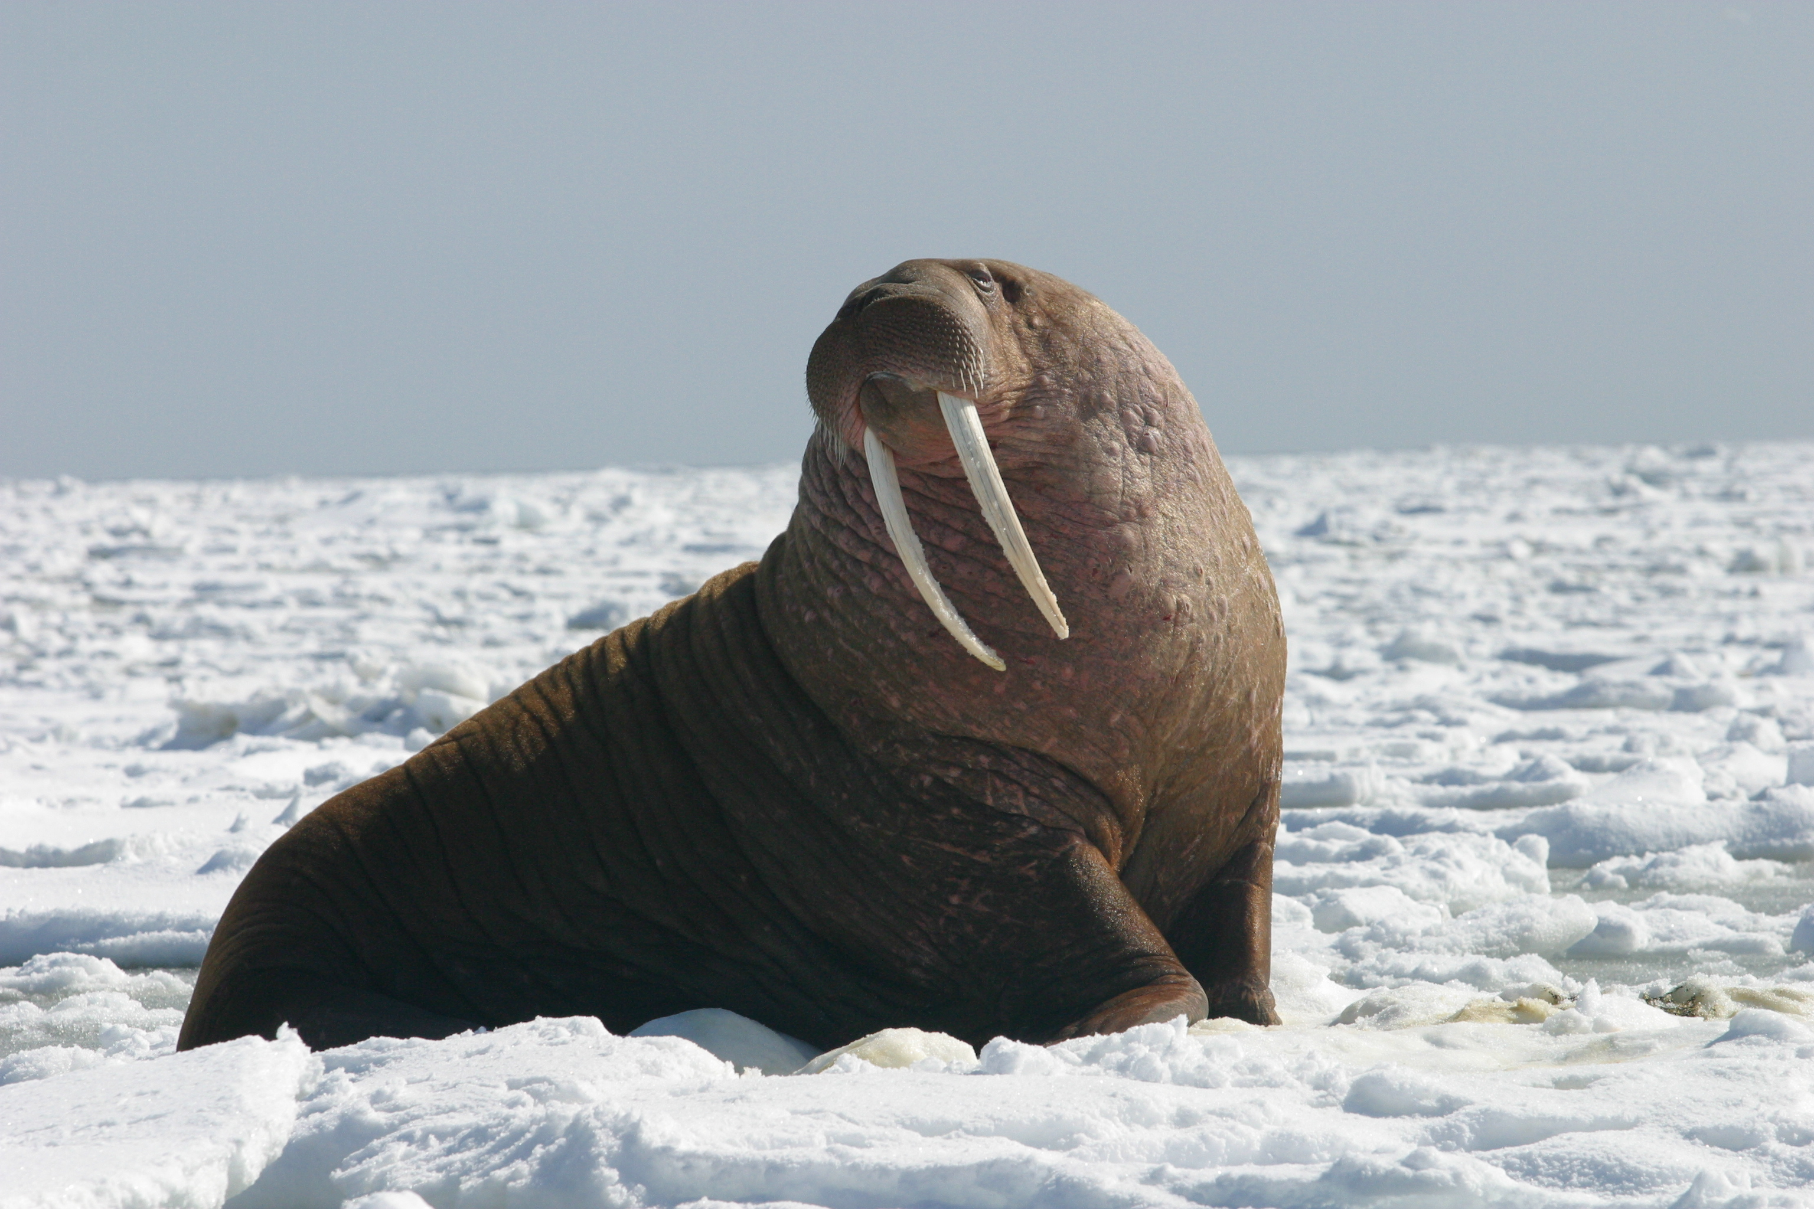
Sharks
A Seahorse
What’s this?
What do you think about it?
Dolphins
A whales
Seals
A walrus
Scary
slow
fat
Big
Cute
Fat

Slide 12
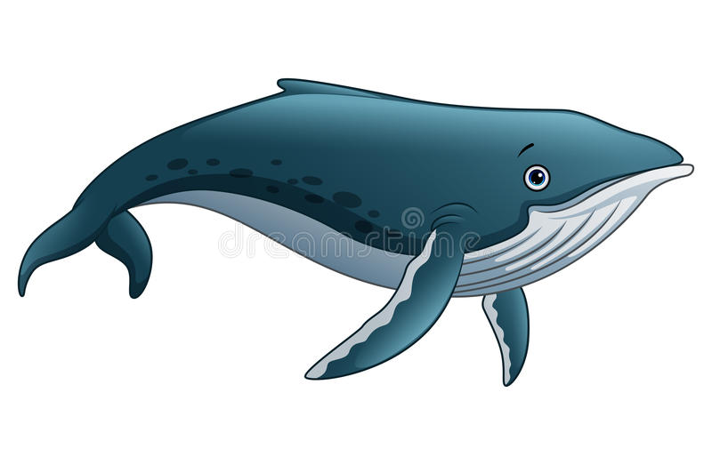
Sharks
A Seahorse
What’s this?
What do you think about it?
Dolphins
A whale
Seals
A walrus
Scary
slow
fat
Big
Cute
Fat

Slide 13
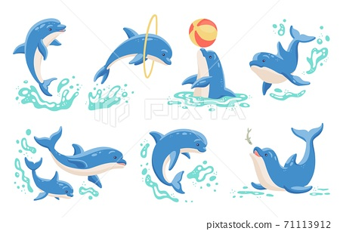
Sharks
A Seahorse
What’s this?
What do you think about it?
Dolphins
A whales
Seals
A walrus
Scary
slow
fat
Big
Cute
Fast

Slide 14
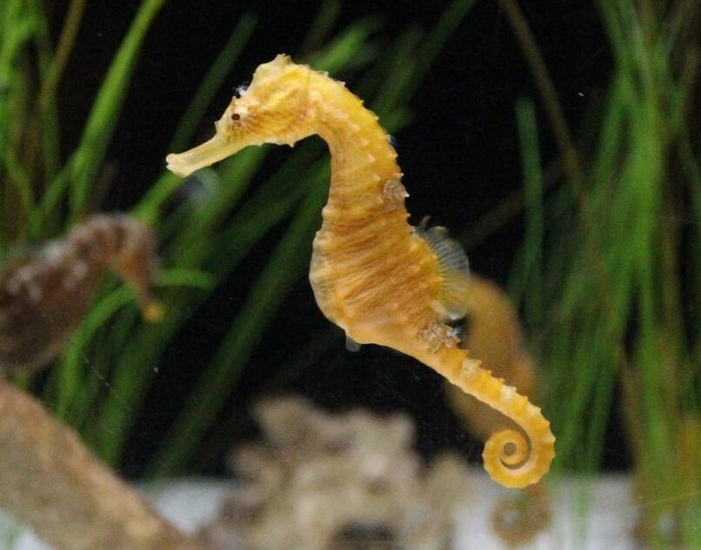
Sharks
A Seahorse
What’s this?
What do you think about it?
Dolphins
A whales
Seals
A walrus
Scary
slow
fat
Big
Cute
Fat

Slide 15
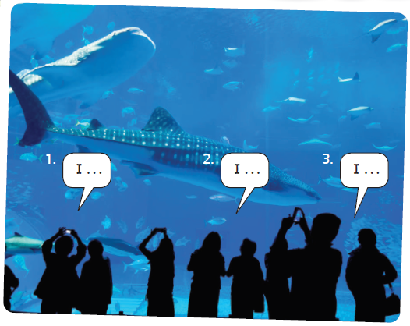
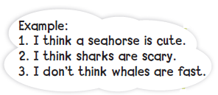
3
My opinion
Can you use the pictures from Exercise 1 to say three sentences about sea animals?

Slide 16
79-80

Slide 18
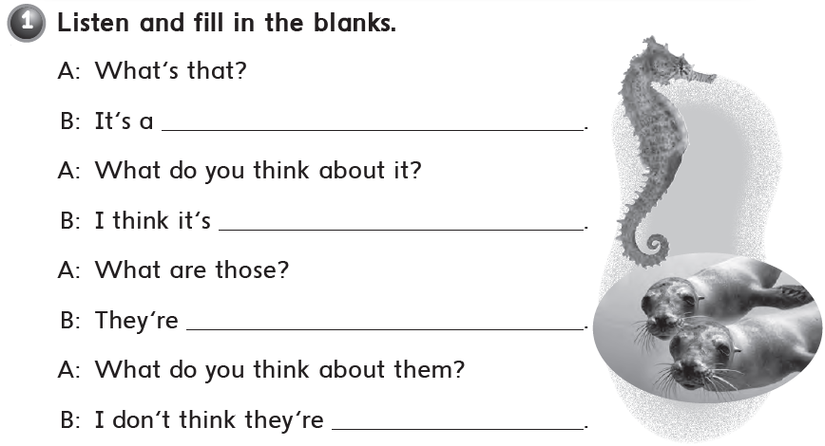
sea horse .
cute
seals .
cute

Slide 19
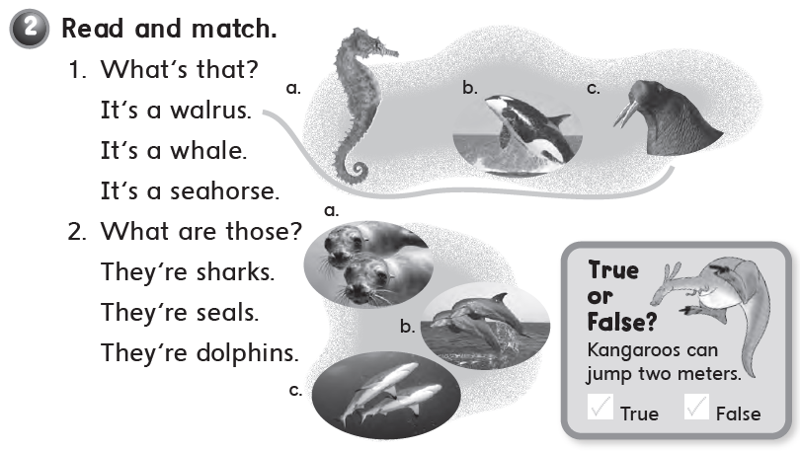

Slide 21
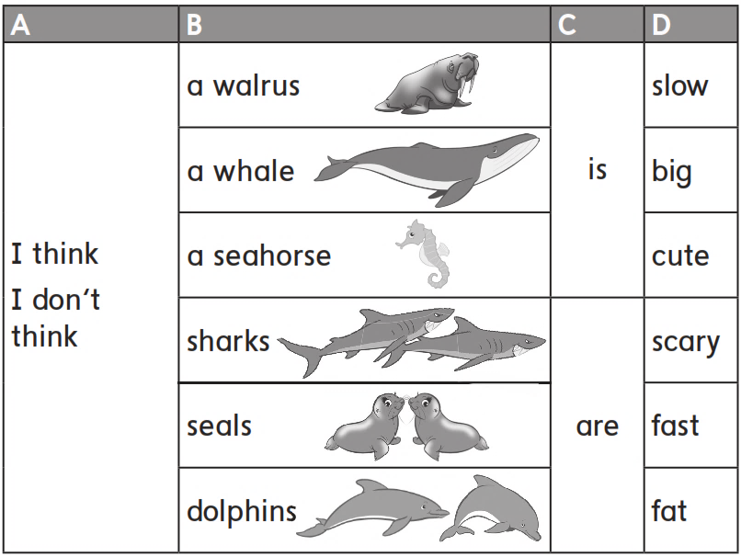

Slide 22
a sea horse is slow .
a whale is big .
a walrus is cute .
dolphins are scary .

