Slide 2
Day
Thursday
Date
7th Oct 2021
Subject
We can 5
Unit
2 Sea Animals
Lesson
Grammar in Action
Page
10-11

Slide 3
objectives
*Pair work
*Role play
*Problem solving
strategies

Slide 5
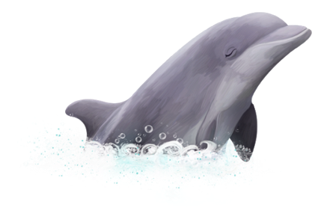

Slide 8
- A walrus is cute.
- A seahorse is cuter than the walrus.
- The dolphin is the cutest.

Slide 9
bigger than
smaller than
the biggest
the smallest
taller than
shorter than
the tallest
the shortest

