Slide 1


Ministry of Education
Mubarak Al-Kabeer Edu.Area
Al Qablia School for Girls

Slide 2


Mock Test
Grade Six
Teacher:Mrs.Nehad Zaki
H.O.D:Mrs.Samah Al Zamel
Supervisor:Mrs.Hanan Bu Rezzq
Headmistress:Mrs.Nadia Al Kandari

Slide 4
forest
purify
experiment
communicate

Slide 6
4-
5-
6-

Slide 7
Someone else has made the decisions about everything in it
They prefer watching TV.

Slide 9
Cars are used to move from one place to another.
isn't he

Slide 10

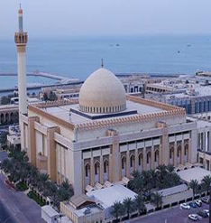
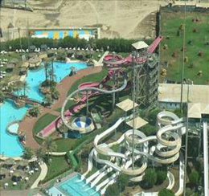

Slide 11
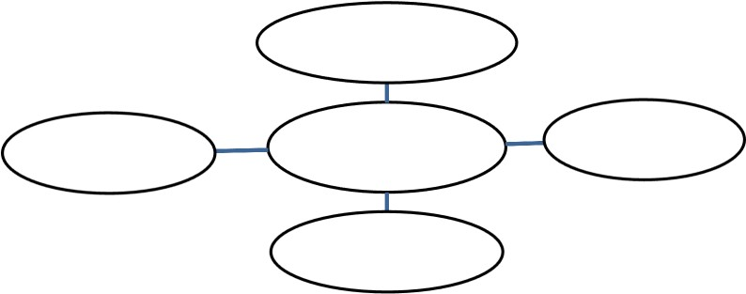
The Plan of The Topic

Slide 13
Planning | Exposition of ideas and coherence | Paragraphing and number of sentences | Grammar | spelling | Handwriting | Punctuation | Total Mark
1 | 8 | 2 | 1 | 1 | 1 | 1 | 15

Slide 14
blow
fortnight
final
simply

Slide 15

Good Luck

