Slide 1


Ministry of Education
Mubarak Al-Kabeer Edu.Area
Al Qablia School for Girls

Slide 2


Mock Test
Grade Eight
Teacher:Mrs.Nehad Zaki
H.O.D:Mrs.Samah Al Zamel
Supervisor:Mrs.Hanan Bu Rezzq
Headmistress:Mrs.Nadia Al Kandari

Slide 4
  B)Fill in the spaces with the most suitable words from the list: (4 × 1½= 6Ms)
(defend - dramatic – allow – outwit - electrical)
5-The Earth has experienced a/ an…………………………. increase in temperature.
6-My parents don’t………………………… me to watch TV more than two hours a day.
7-I went to the local…………………………. shop to buy a light bulb for my bedroom.
8-My aunt is very intelligent; she always finds ways to………………………… her rivals.
dramatic
allow
electrical
outwit

Slide 7
11-The underlined pronoun “it” in the
(1st ) paragraph refers to:
a- letter
b- time
c- telephone
d- communication
12- How did people communicate in the near past?
a- They used smart phones.
b- They sent faxes and letters.
c- They used mobile computers.
d- They sent text messages and e-mails.

Slide 8
13- According to the text, all the following statements are NOT TRUE except:
a- Technology is going to stand still in the future.
b- We can’t connect mobile computers to the Internet.
c- Communication in the past was the same as nowadays.
d- Smart phones are one of the most popular means of communication.
14- The purpose of the writer in writing the passage is to:
a- compare between past and modern computers.
b- inform us about how people can call each other.
c- explain how communication changes over time.
d- persuade people to use modern means of communication.

Slide 9
Answer the following questions : ( 2 x 2 = 4 Ms)
15- Why aren’t old means of communication used as before?
.....................................................................................................................................................
16– How will communication change in the future?
...................................................................................................................................................
* Because of new technology.
Scientists predict that we will be able to send text messages by the power of thought.
/ A special helmet connected to our brain will turn what we are thinking
into a digital form enabling us to communicate to other people that we know.

Slide 11
Do as required between brackets : ( 3×2 = 6 Ms)
If I have enough time, ………………………. (Complete)
22.“ Never stay up late to keep your body healthy.” (Complete / Reported speech)
My mother advised me ............................................................................................................
23.We [ attend ] our cousin’s birthday party tonight. ( Correct the verb )
...................................................................................................................................................
I will / can / may( play )
not stay up late to keep my body healthy.
will attend / are attending / are going to attend

Slide 13
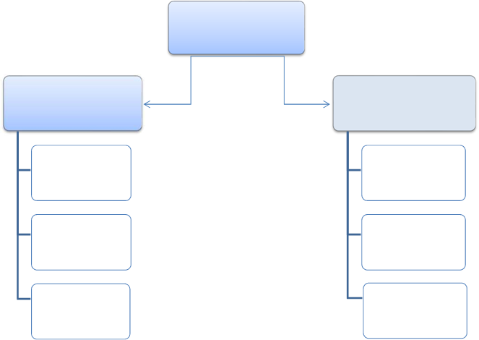
The Plan of The Topic

Slide 15
Rubrics |  | Mark | Total Mark
Planning (mind mapping / graphic organizers ) | 3 |  | 20
Exposition of ideas and coherence | 10
Paragraphing and number of sentences | 3
Grammar | 1
Spelling | 1
Handwriting and Punctuation | 2
Two marks to be deducted from the total mark for changing the format.
Off point planning / topics receive zero.

Slide 16

Good Luck

