Slide 1


Ministry of Education
Mubarak Al-Kabeer Edu.Area
Al Qablia School for Girls

Slide 2


Mock Test
Grade Seven
Teacher:Mrs.Nehad Zaki
H.O.D:Mrs.Samah Al Zamel
Supervisor:Mrs.Hanan Bu Rezzq
Headmistress:Mrs.Nadia Al Kandari

Slide 4
achievements
containers
download
admire

Slide 6
9-The best title for the passage is:
  Sea Snorkeling equipment
  Surfboard Riding activities
  Water Activities Safety Rules
  Divers under Water
10-The underlined word ‘properly’ in the “2nd” paragraph means:
  slowly
  happily
  cheerfully
  correctly

Slide 7
11-The underlined word ‘they’ in the “2nd” paragraph refers to:
  scuba divers
  surfboard riders
  swimming areas
  big waves
12-People who like boating can communicate with others:
  using a radio
  By first aid kits
  with flashlights
  using ropes

Slide 8
13-At the beach, lifeguards can save lives by:
  planning long trips
  checking the equipment
  giving safety instructions
  watching the weather forecast
14-What is the purpose of the writer in this passage?
  to encourage people to go on sea trips
  to list the swimming and water activities
  to persuade readers to explore life under water
  to help us stay safe when practising water sports

Slide 9
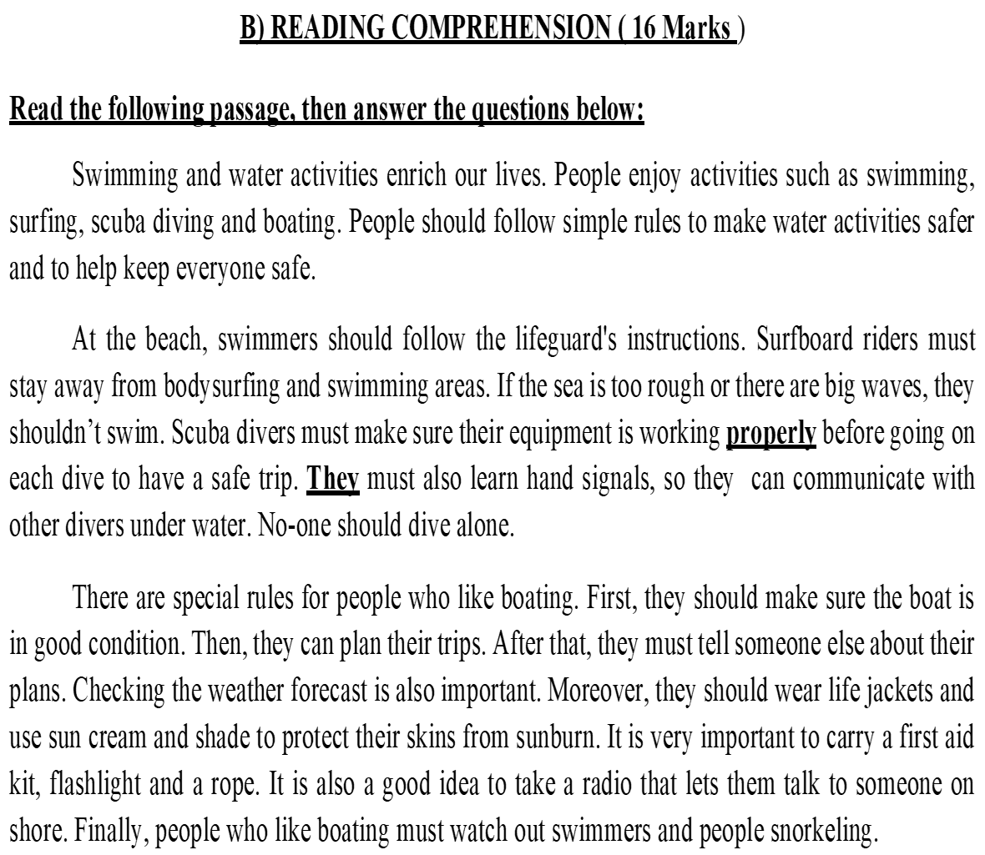
Answer the following questions: ( 2 x 2 = 4 Marks )
15-What should surfboard riders do to be safe?
………………………………………………………………………………………………………
16-Why should people on the beach wear sun cream?
………………………………………………………………………………………………………
Surfboard riders must stay away from bodysurfing and swimming areas. / If the
waves are too rough or too big, they shouldn’t swim.
To protect their skins from sunburn.

Slide 10
II-WRITING (30 MARKS)
A)GRAMMAR( 11 Marks)
A-Choose the correct answer between brackets : ( 4 x 2 = 8 Marks )
17-An inventor is the person (which /who/ where) makes new things. He does scientific experiments (in / on / under) his lab. He should (observe/ observed / observes) how things work accurately. I (am / was / would be) going to buy a book about Arab inventors this week.

Slide 11
B-Do as required between brackets : ( 2 x 1½= 3 Marks )
18-People used to travel on camels long time ago. (Ask a question)
………………………………………………………………………………………………………
19-The librarian organised all the books on the shelves. (Change into passive)
………………………………………………………………………………………………………
How did people use to travel long time ago? Who used to travel on camels long time ago?
When did people use to travel on camels?
All the books on the shelves were organised (by the librarian)

Slide 13
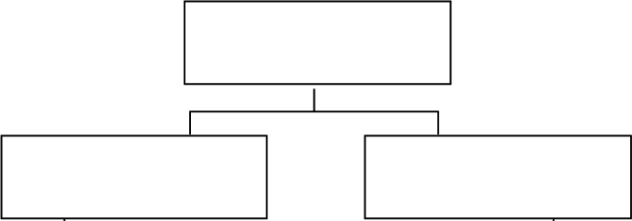
The Plan of The Topic

Slide 15
Rubrics | Planning | Exposition of ideas & coherence | Paragraphing & number of sentences | Grammar | Spelling | Handwriting | Punctuation
 | 1 | 8 | 2 | 1 | 1 | 1 | 1
Two marks to be deducted from the total mark for changing the format.
Off point planning / topics receive zero.

Slide 16
SPELLING ( 4 Marks )
Rewrite the underlined words correctly:(4 x1 = 4 Marks)
The pyramids are an example of ancinet Egyptians’ engineering skills.
……………………………………………………………………………………….
If you visited poor countries, you would relaise the value of fresh water.
………………………………………………………………………………………..
Some scientists say that dark-skinned people rarley develop skin cancer.
…………………………………………………………………………………………
Passengers are only allowed one piece of hand luggega on board.
…………………………………………………………………………………………
ancient
realize
rarely
luggage

Slide 17

Good Luck

