Slide 1




Slide 2
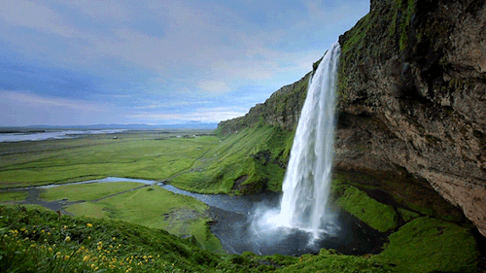
Teach_me_Plz
And
Mr. Mohamed Hassan
Present

Slide 3
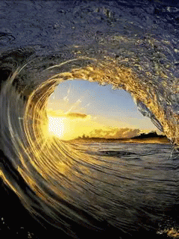
The New Syllabus Based On Competences

Slide 4
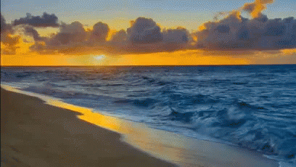
Module One
Explorations
Unit One
Explorers

Slide 5
9
2
3
1

Slide 6
9
Look for
Link
quit - stop
inconstant

Slide 7
9
We enjoyed our journey in the wilderness.
They will organize an expedition to the North Pole.
I can’t walk on cracked ice.

Slide 8
9
You can ask the science teacher.
It is a fantastic idea.
Be careful! / It is dangerous.

Slide 9
10
What does Sara do?
Where does she live?
What does she eat for breakfast?
How many children does she have?

Slide 10
reads
did
ate
watched
don’t like
cooks
writes

Slide 11
You don’t know the answer.
Do you know the answer?
You don’t know the answer.
What time did he have breakfast?
Some school girls wear uniforms.
What do some school girls wear?
He cut his hair.
He didn’t cut his hair.
She doesn’t do her homework every day.
Does she do her homework every day?

