Slide 1
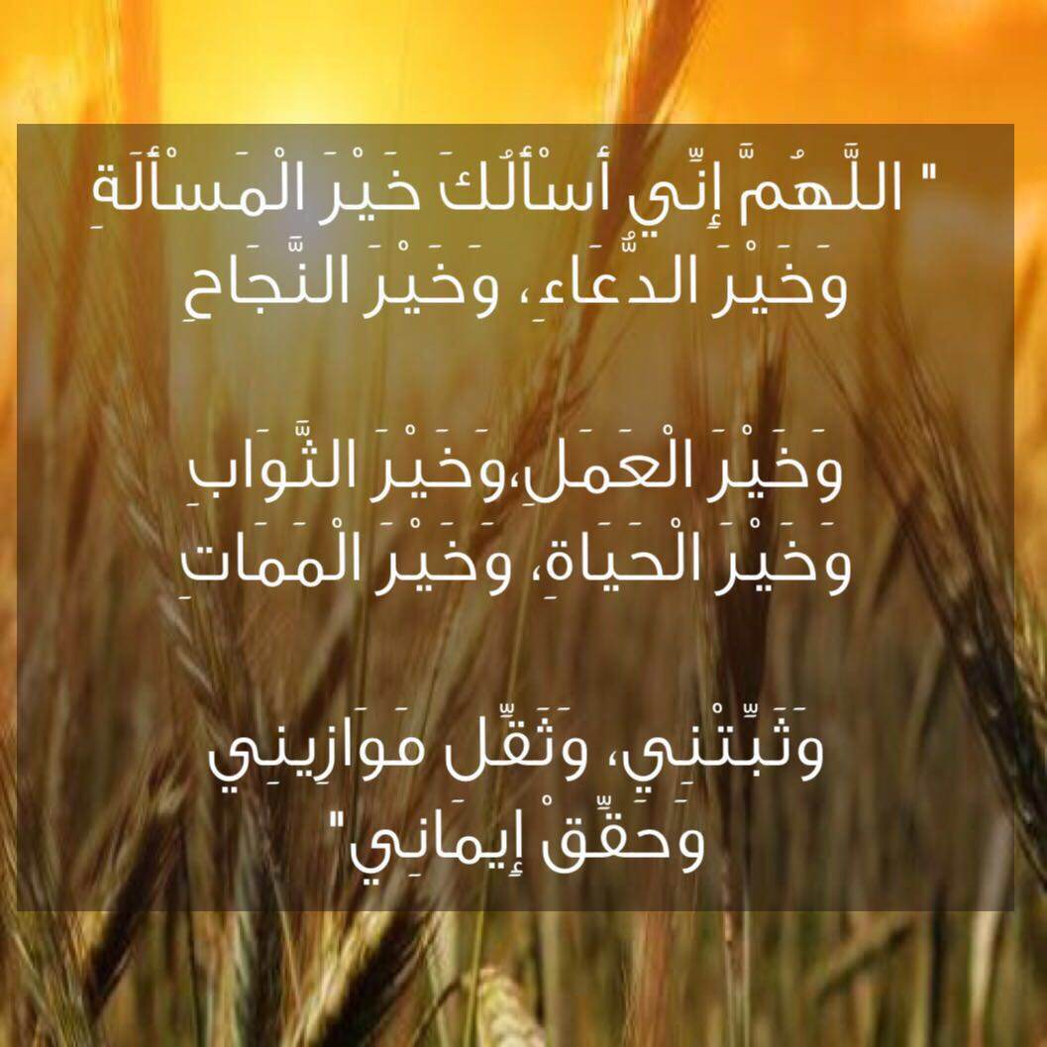




Slide 2
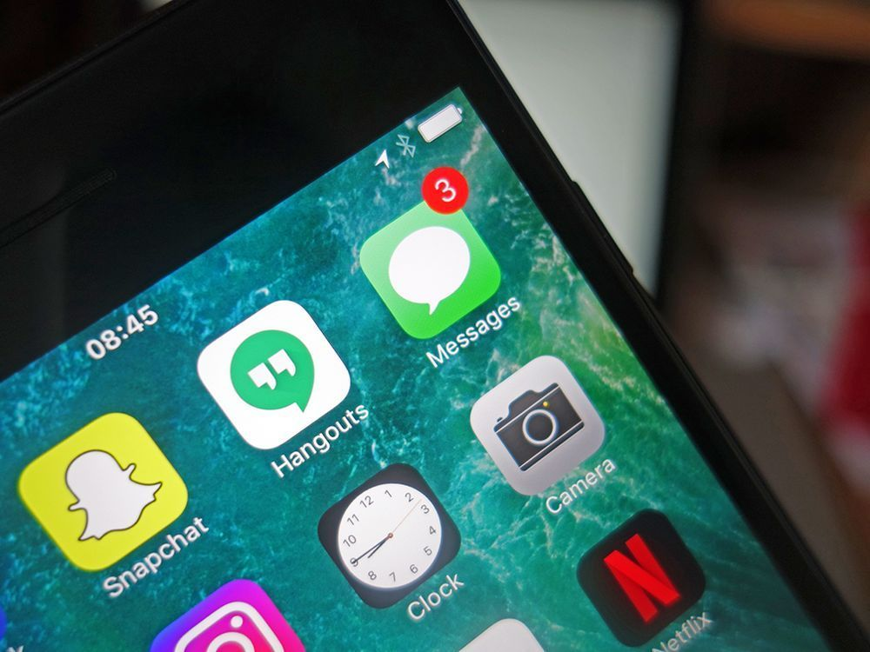


Messages

Slide 3
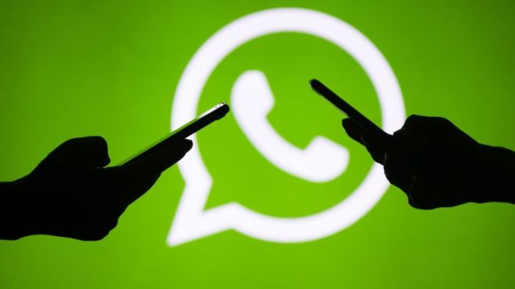
Opener!

Slide 4



Slide 5
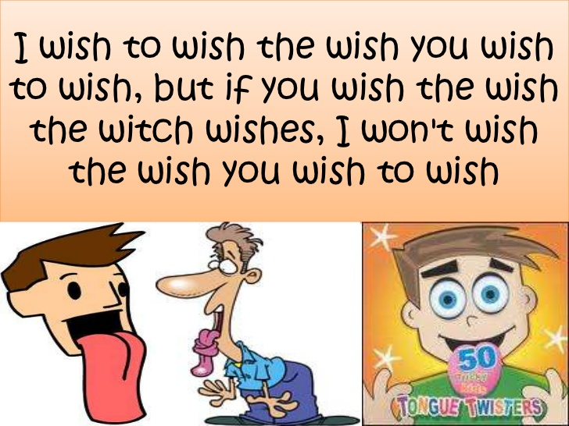

Slide 6
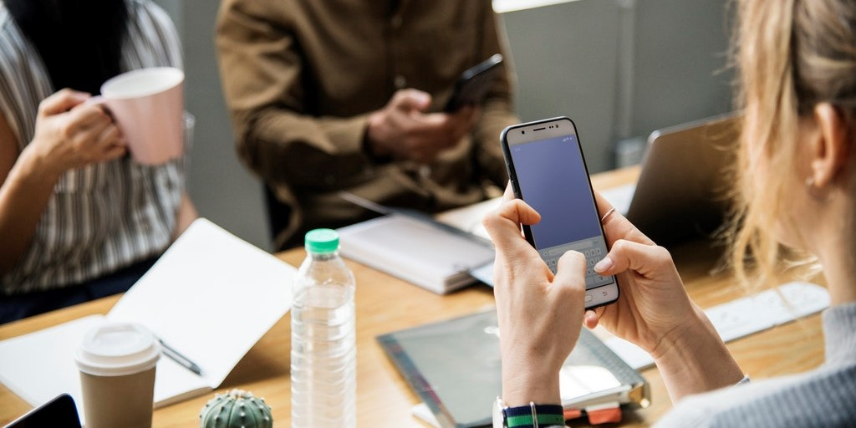
Watch a movie, and then mention ways of sending messages.

Slide 7


Slide 8
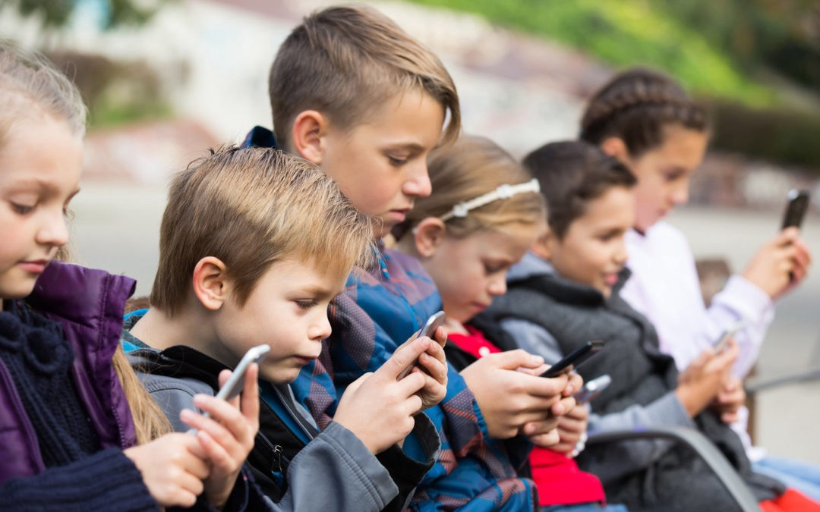
Why are messages important?
Why do you think people send messages?

Slide 9
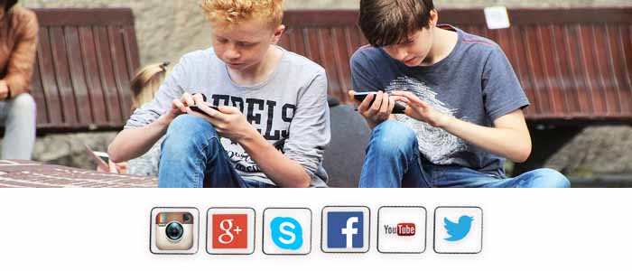
It's a way of communication and exchanging information.

Slide 10
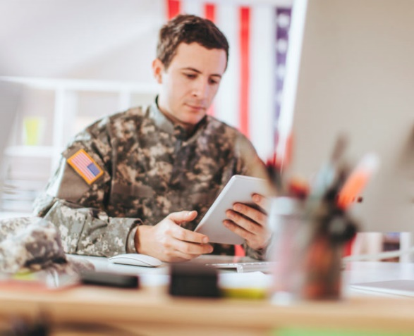
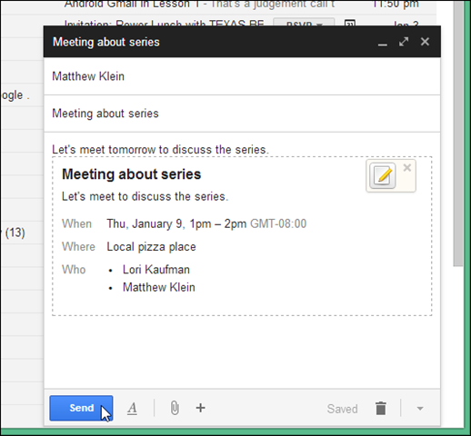
It’s also a way of inviting or applying for a job.

Slide 11
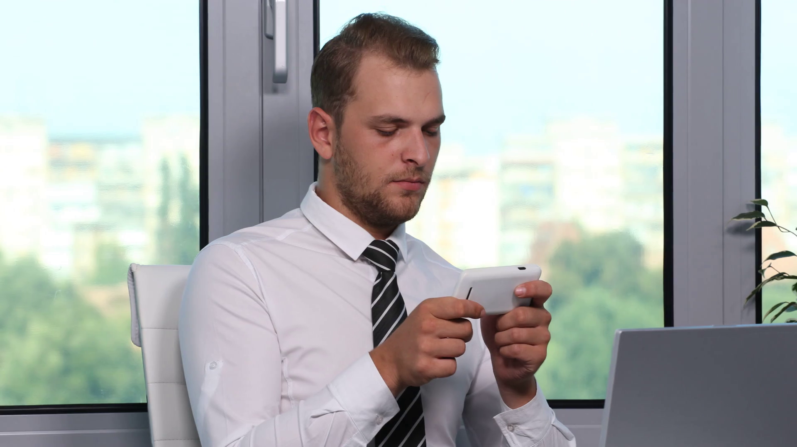
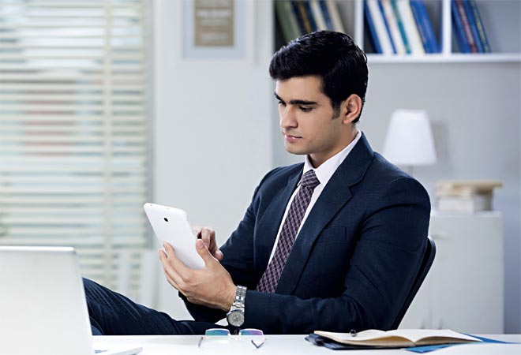


A businessman can send a message to rearrange a meeting, a schedule or important things with a colleague.

Slide 12

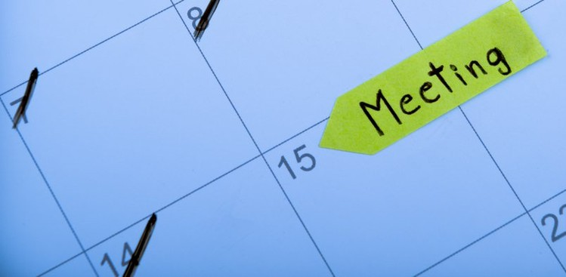
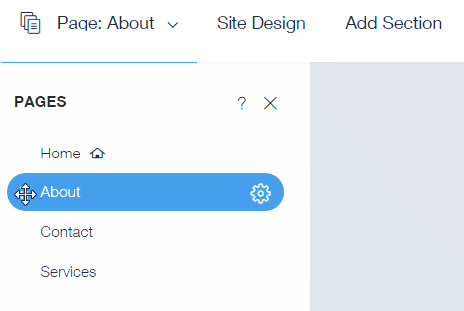

rearrange
to change the position, time or order of something

Slide 13
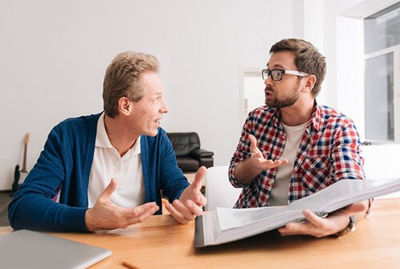
colleague
a person with whom one works especially in profession or business

Slide 14

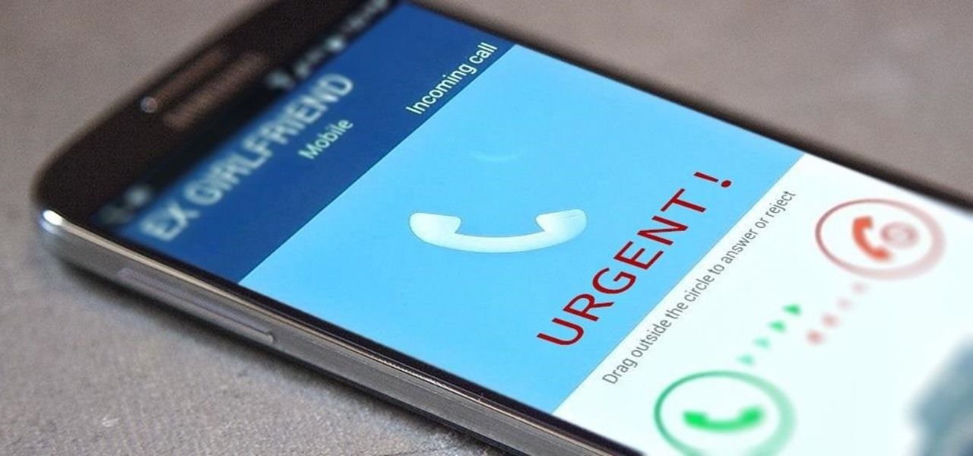
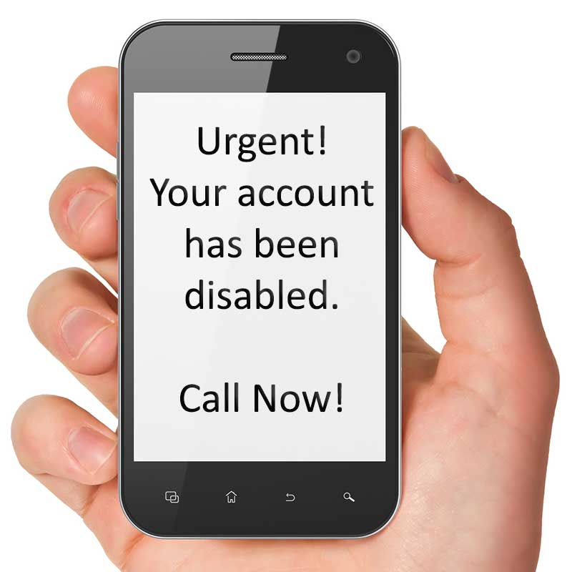
People can send urgent messages when they are in big trouble or when they face
a serious problem.

Slide 15


urgent
requiring immediate action or attention

Slide 16
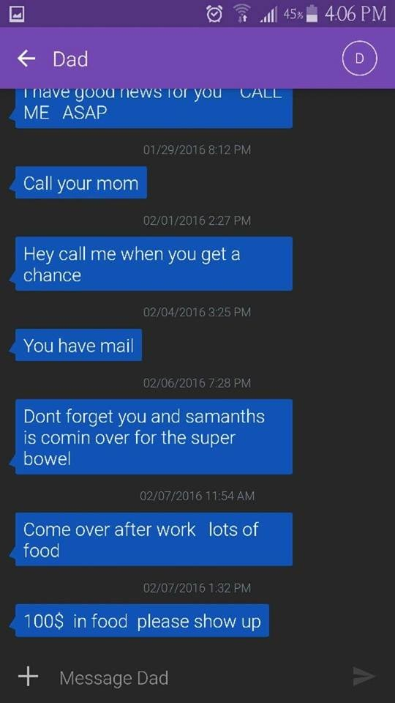


People write shortcut language and abbreviations in text messages such as asp which means as soon as possible.

Slide 17
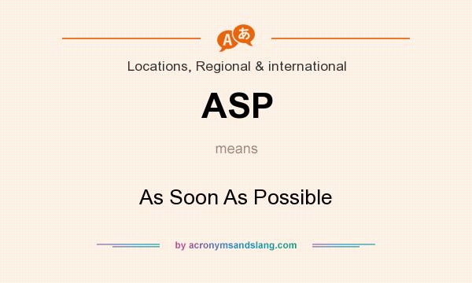
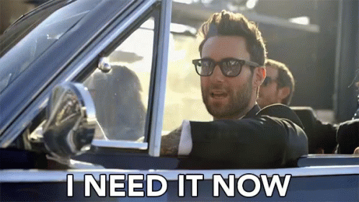
asp
as soon as possible

Slide 18
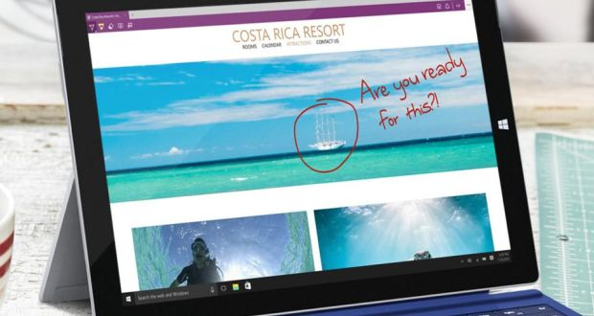
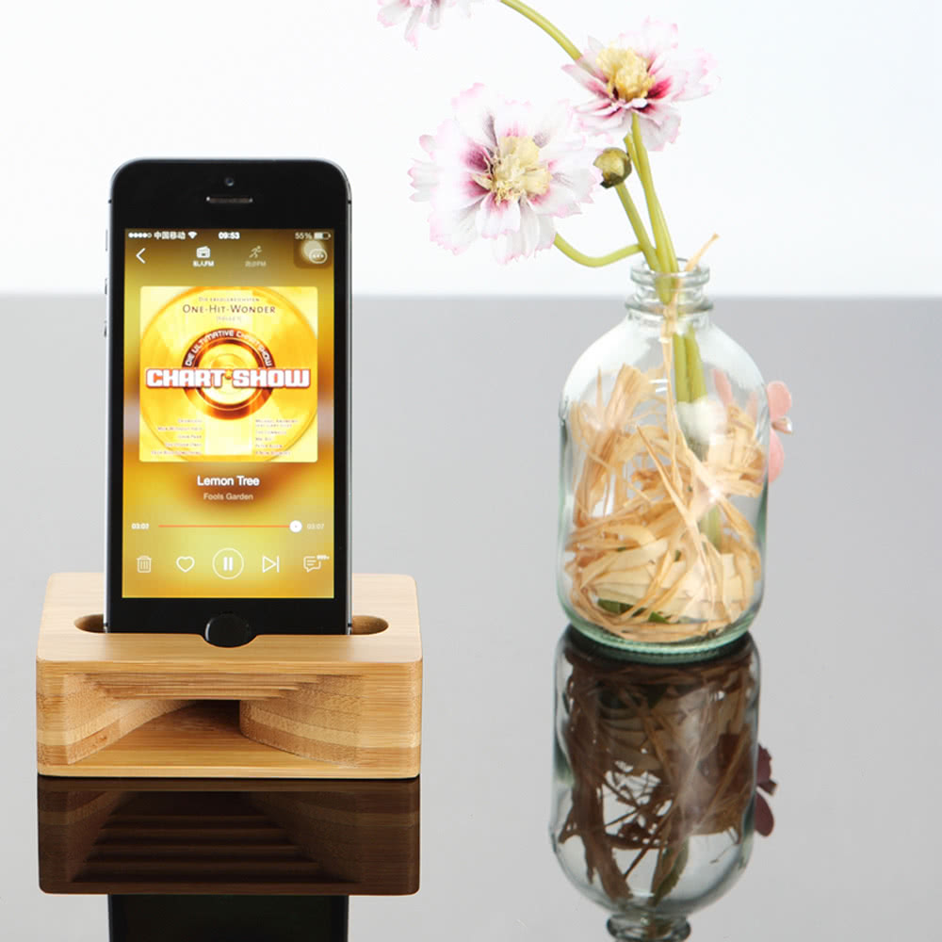


Slide 19
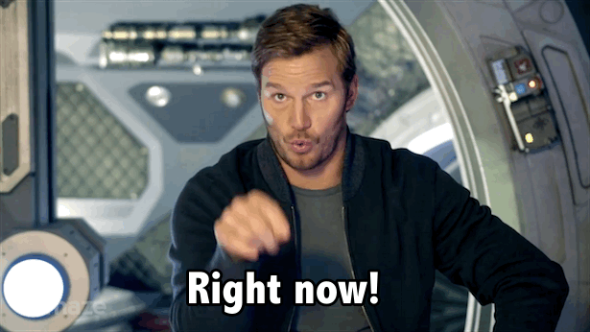
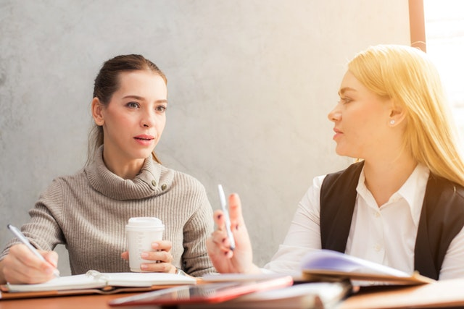
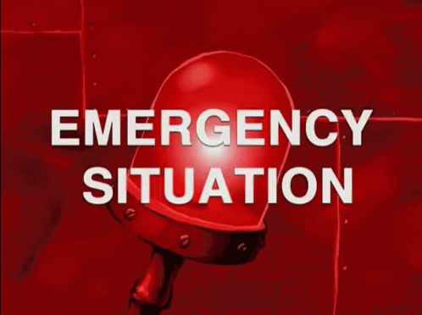
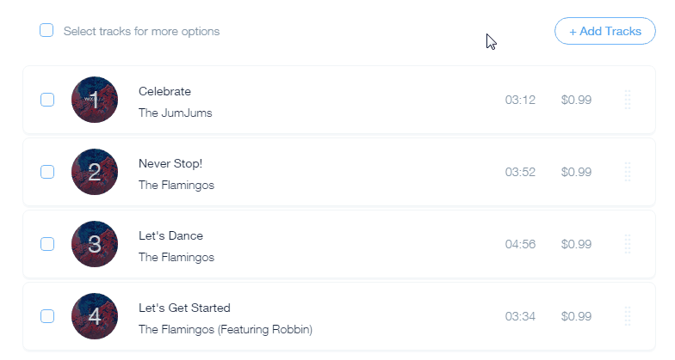
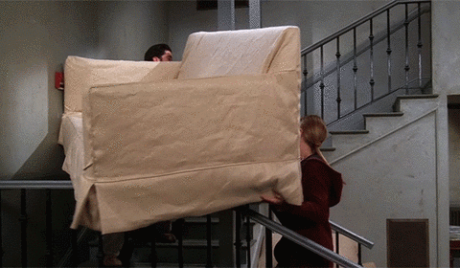
asap (exp.)
colleague (n.)
rearrange (v.)
urgent (adj.)

Slide 20

Student’s Book
Page 84

Slide 21
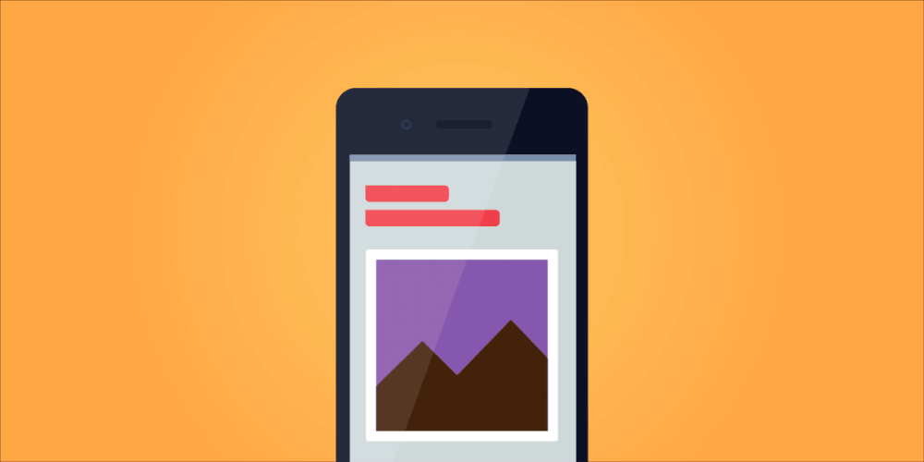


Slide 22
Look at the pictures and say what kind of messages they are.

Slide 23
They are text message, e-mail, post-it note and message in a bottle.

Slide 24
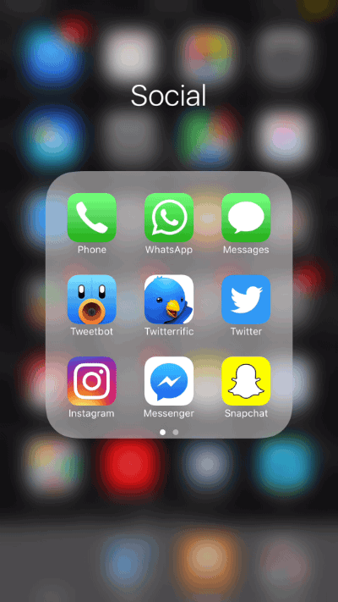



Slide 25


Slide 26
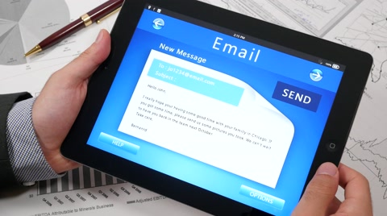
Read your answers.

Slide 27
a. Where could you find each message?
1. a mobile phone
2. a computer
3. next to any telephone
4. on a beach

Slide 28
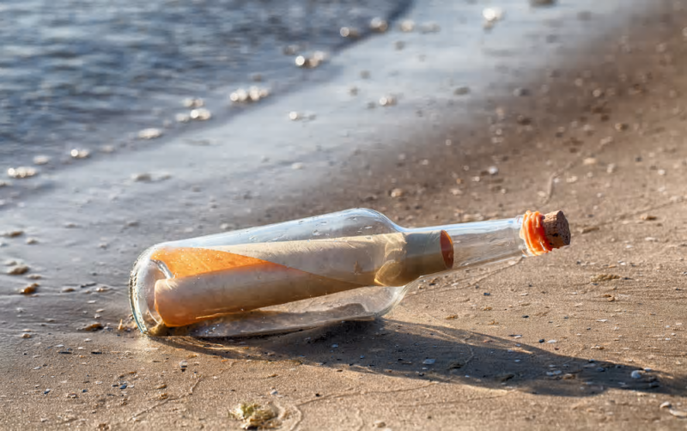
b. Who do you think wrote them and why?
1. A young person wrote a text message to tell his friend that he will get back soon.
2. A businessman wrote an e-mail to another one to rearrange a meeting in his office.
3. Dalia wrote a post-it note to tell Nadia to get back.
4. A passenger on a ship wrote an urgent message.

Slide 29

c. Who were they written to?
1. A young person wrote it to a friend.
2. The e-mail was written to a businessman.
3. The post-it note was written to a friend or a family member.
4. A passenger wrote the message to anyone at all.

Slide 30
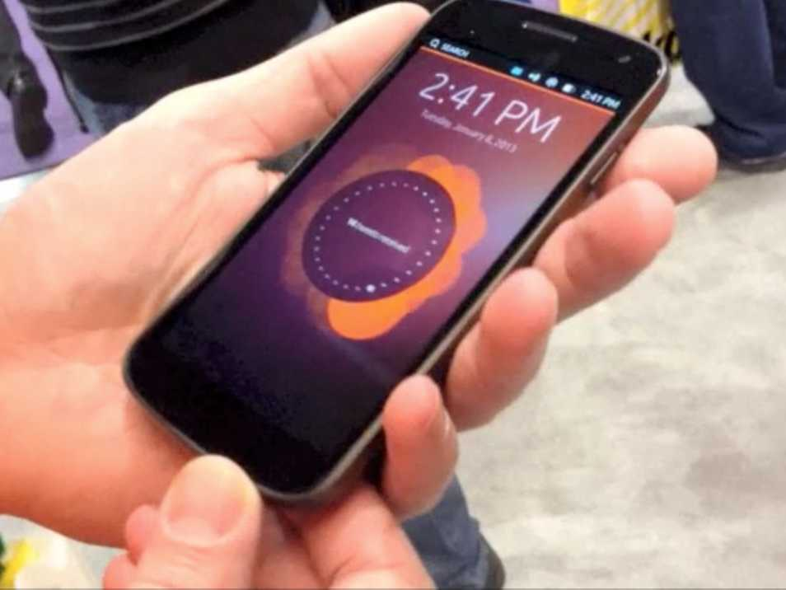
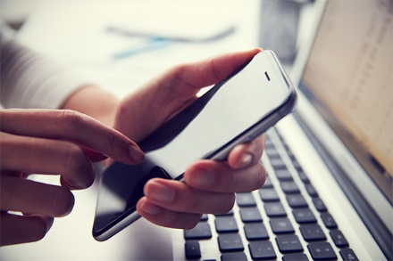
d. Who do you send messages to?
Who do you receive messages from?

Slide 31



Slide 32

Thanks for texting
me my mate (friend), I will get back to you soon.

Slide 33

Hussein
Thanks for letting me know in advance. I actually have the same problem as you, and was just about to contact you. Let’s rearrange things then. How about 27th March? My schedule is pretty free that day so I will be able to travel to your office instead.
Ahmed

Slide 34
Original message
Dear Ahmed,
I’m afraid I can’t make our meeting tomorrow afternoon. A colleague is out of the office and I have to take his place. If we could reschedule asap I would really appreciate it, as there are many things to discuss about our forthcoming project.
Hussein

Slide 35


Nadia
Reem phoned. Can you get back to her as soon as possible – it’s urgent. She’ll be at home until 4.30.
Dalia

Slide 36


I am sending this message out to sea to see if anyone will find it. If you are reading this message, wherever you are in the world
... please send it back to me at ...

Slide 37



Slide 38
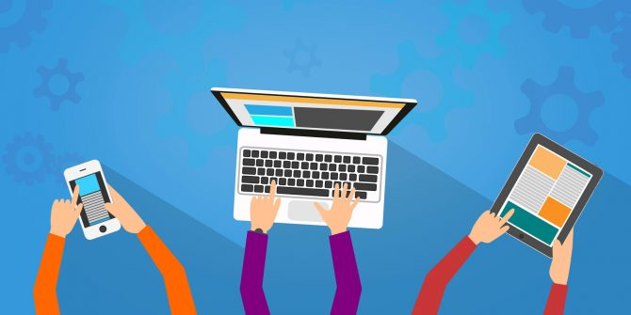
What other ways do you use to send messages?

Slide 39

Closure

Slide 40
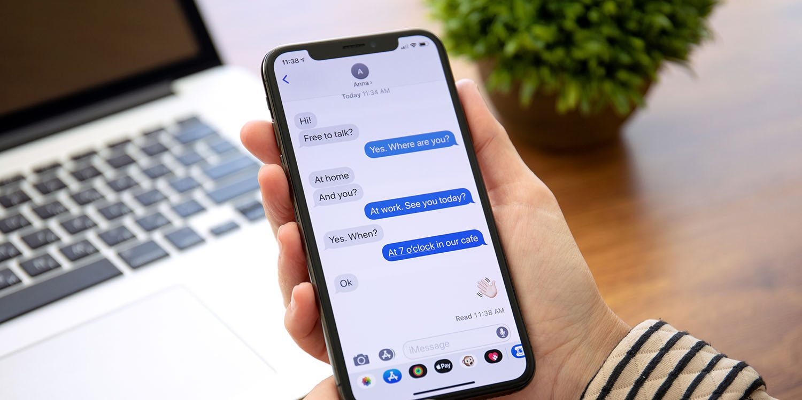
Which type of sending messages is your favourite? Why?

Slide 41


