Slide 1


SB P56
Power - the alternatives

Slide 2
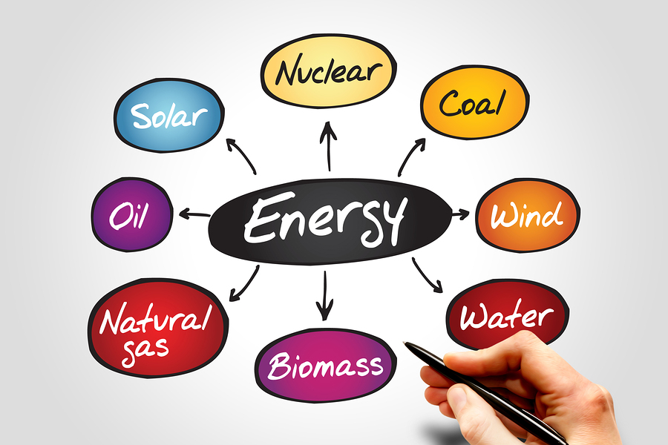
The sources of energy.

Slide 3
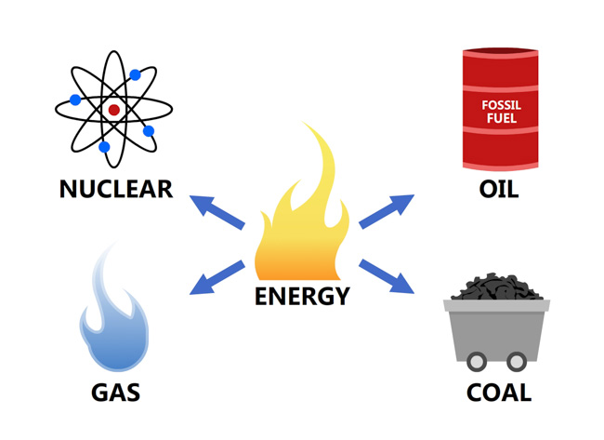
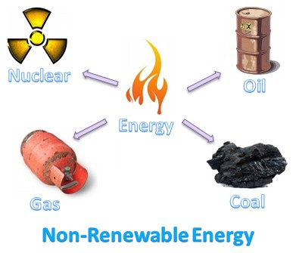
The non-renewable sources of energy.

Slide 4

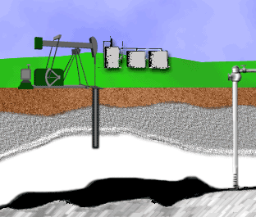
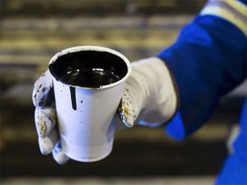

crude oil
oil from the underground in its natural state before it has been processed or refined

Slide 5
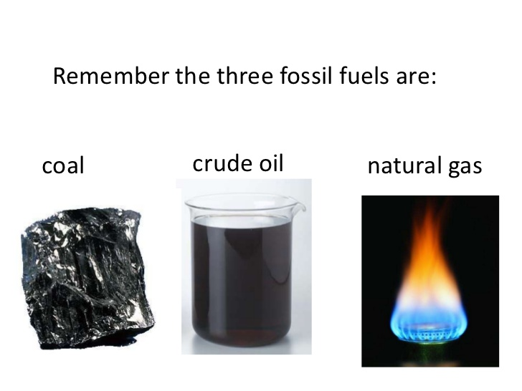
fossil fuel
a natural fuel such as coal or gas , formed from the remains of living organisms

Slide 6





Slide 7



having limits or bounds

Slide 8

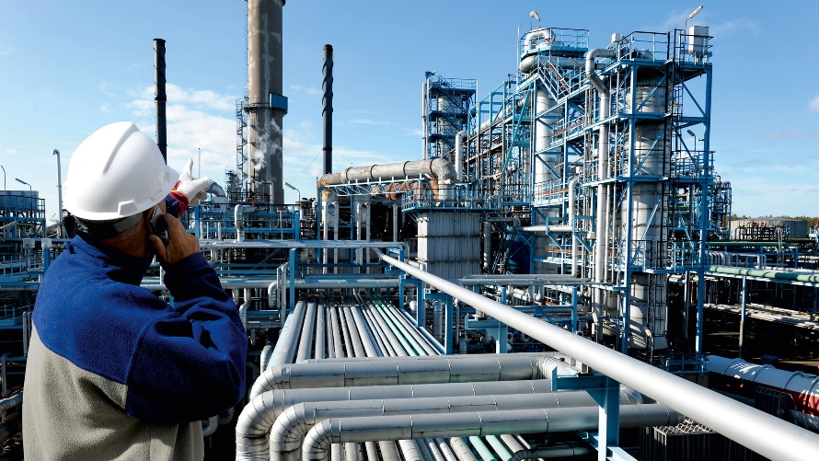
the removal of impurities or unwanted elements from a substance.

Slide 9
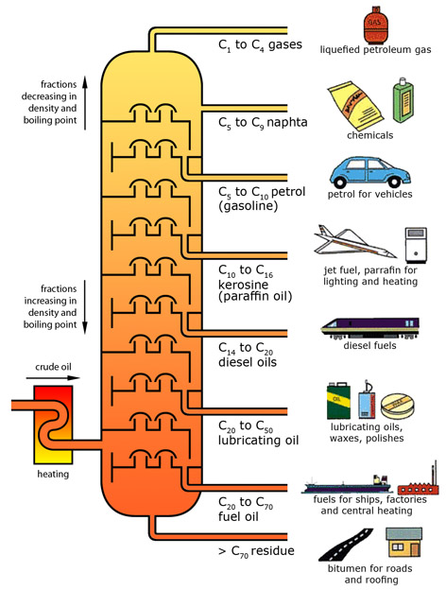
fractional distillation
separation of a liquid mixture into fractions by boiling at different temperatures

Slide 10
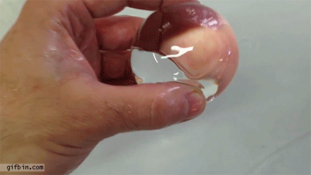
polymer
a substance used in making plastic

Slide 11
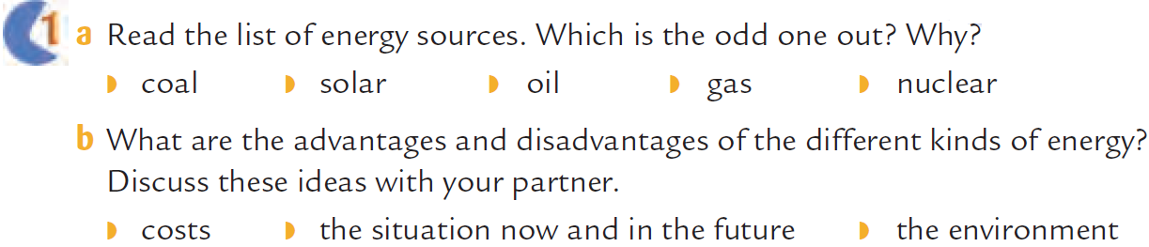

Solar is a renewable energy while coal, oil, gas and nuclear are non-renewable sources of energy.

Slide 13
2. Why is it necessary to develop new ways to provide energy?
Because fossil fuels are finite.
They damage the environment and cause pollution.
They contribute to global warming.
Drilling for oil can destroy animal habitat.
How can we protect the world’s energy sources?
We must stop depending on oil as the main source.
We can use the alternative sources of energy.

Slide 14
Sources of Energy
Non- renewable sources
(Fossil fuels)
Oil
coal
Natural gas
Renewable sources
(Alternative energy sources)
Sun
(solar power)
water
wind
Advantages
generating electricity - making petrol for cars- operating machines – heating - making diesel for buses
Advantages
clean - green - renewable- free- not polluted
Disadvantages
- finite - causes pollution - harms the environment - destroys animals' natural habitat

Slide 15


Nasser Al-Saeed Sec. School For Boys
Hawalli Educational District
English Department
Under the auspices of :
HOD Mr. Hesham Al- Sakhawi

