Slide 1
Grade five
Unit eleven
Famous people

Slide 2
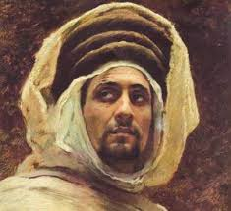
Lesson one page ….. Special people
Ahmed bin Majid
Ahmad ibn Mājid was an Arabian navigator. He was born in 1421 in Ras Al Khaima .At the age of 17 he was able to navigate ships. He was so famous that he was known as the first Arab seaman.

Slide 3
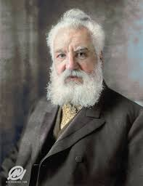
Alexander graham Bell
Alexander
Alexander Graham Bell was a Scottish-born scientist and inventor best known for inventing the first working telephone in 1876 and founding the Bell Telephone Company in 1877

Slide 4
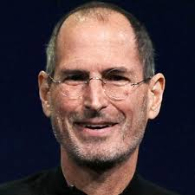
Steve Jobs
Steve
Steven Paul Jobs was an American inventor and designer who was the co-founder of Apple Computer. Apple's products, which include the iPod, iPhone and iPad, are now seen as dictating the evolution of modern technology.

Slide 5
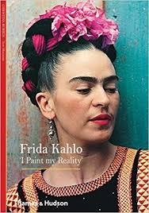
Frida Kahlo
Frida
Artist Frida Kahlo was one of Mexico's greatest artists who began painting mostly self-portraits .She exhibited her paintings in Paris and Mexico before her death in 1954.

Slide 6
Who do you admire most in the four famous people? why?

Slide 7
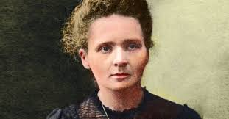
Marie Curi
Marie
Marie Curie was the first woman to win a Nobel Prize, in Physics. She became the first person to claim Nobel honors twice.

Slide 8
Key Vocabulary
An artist
An explorer
A scientist
An inventor
A business person
Writer
Film director
Mountain climber

Slide 9
Adjectives
Brave
Kind
Caring
Intelligent
Fun
Creative
Famous

Slide 10
Key vocabulary
Name
From
Hometown
Nationality
Place of birth
Birth date
Job

Slide 11
Lesson three famous people and their work
HH Hamdan bin Mohammed bin Rashid is the crown prince of Dubai.
Every one call him Fazza.
He is a famous poet.
He loves horses,camels,cars,and travelling.
He studied in Dubai and the united kingdom.
He learned that good friends and hard work are important.

Slide 12
Lesson four Jane Goodall
What does Fazza write?
How many brothers and sisters does he have?
Where did he study?
Why did he have an Emirati flag on the top of Burj Khalifa?
What does he like?
When was he born?

Slide 13
Lesson four
Jane Goodall was very famous for her work with chimpanzees in Africa. She watched their actions and discovered many things about them.
She was born in 1934 .She lived in London .When she was young ,she liked watching animals and birds in her garden.
When she was older , her dream came true and she worked with animals in Africa.

Slide 14
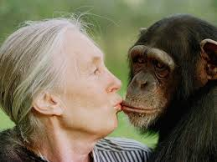
Answer the following Questions
When was Jane Goodwall born?
Where did she live?
Which animal did she care for?
What did she like when she was young?
What was her dream when she became older?

Slide 15
Lesson four A presentation about a famous person
Who do you admire and why?
I am going to talk about ……………………….
She was born in…………………………………….
When he was young , she liked…………….
Jane became famous because she worked with……………………..

Slide 16
Question Tag
He is a teacher, isn’t he?
She is a nurse, isn’t she?
They are teachers, aren’t they?
They are not actors, are they?

Slide 17
Let’s Practice
wasn’t it
Lunch was delicious, _____?
Spring break is next week, __________?
Class finished quickly, ____________?
isn’t it
didn’t it

Slide 18
1. You don't have to work today, ___ _?
2. She won't get here on time, __?
3. Your dog hasn't had puppies, ____?
4. That wasn't a very good movie, _ __?
5. The computer isn't on, ____?

Slide 19
Lesson five Page 167 Making a good presentation
Look at this information about Sheikh Mohammed Bin Rashed and try to make a good presentation about him.
Name | HH Sheikh Hamdan bin M. bin Rashdid
Born | The uae ,1982
family | Son of Sheikh Mohammed
Character | Hard-working
What does he do? | President of Hamdan

Slide 20
Feel free to use in your classroom
Dore by:Abdulazim Ibrahim
A terminated English teacher

