Slide 1
English Booklet
Grade 5
Semester 3
My Name:……..…….....…..
Grade 5 /…..

Slide 2
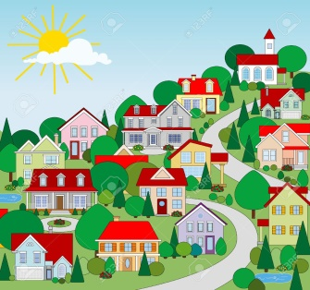
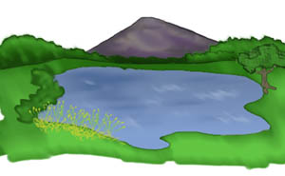
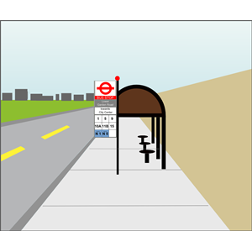
Where we live Lesson 1
Read and match
road
office building
village
path
pavement
lake
forest
mountain
field

Slide 3
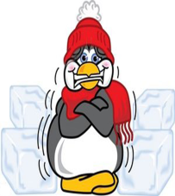
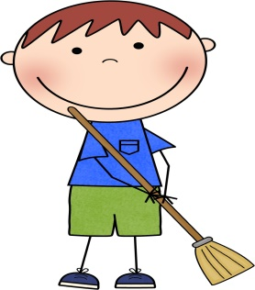
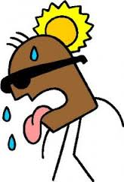
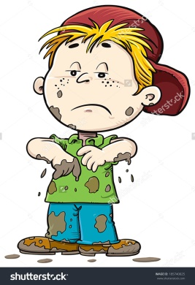
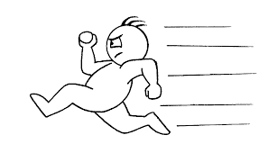
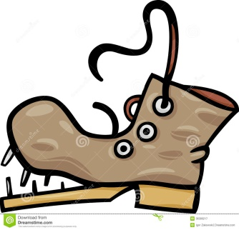
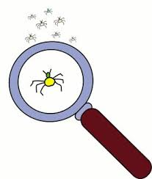
Where we live Lesson 1+2
Comparative
عند المقارنة بين شخصين أو شيئين نضيف ( er) إلى الصفة الموجودة تم نتبعها بكلمة (than) مثال:
Moza is taller than Reem
Write the adjective under the correct picture
clean – pretty – hot – noisy-good-cheap-dirty – fast- big& large- cold - old- small

Slide 4
Where we live Lesson 2
Complete the chart:
Comparative “er” | Words
 | clean
 | pretty
 | hot
 | noisy
 | good
 | cheap
 | dirty
 | fast
 | big
 | large
 | cold
 | old
 | small

Slide 5
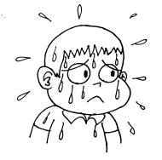
Where we live Lesson 2
Write the adjective under the correct picture
peaceful – colorful – amazing – popular – modern – ancient – humid - beautiful
Complete the chart:
Words | Comparative “more”
peaceful
colorful
amazing
popular
modern
ancient
humid
beautiful

Slide 6
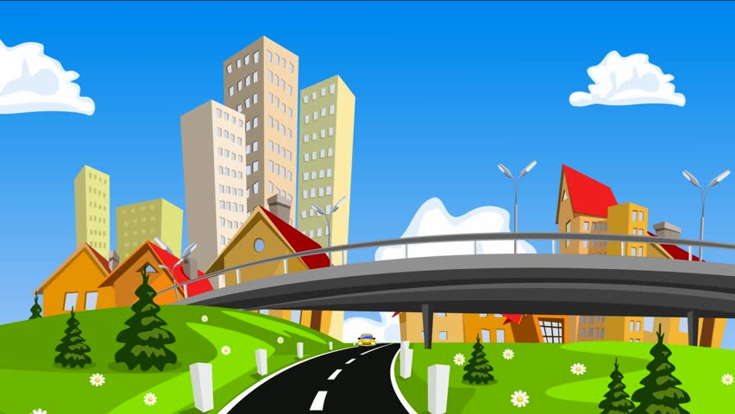
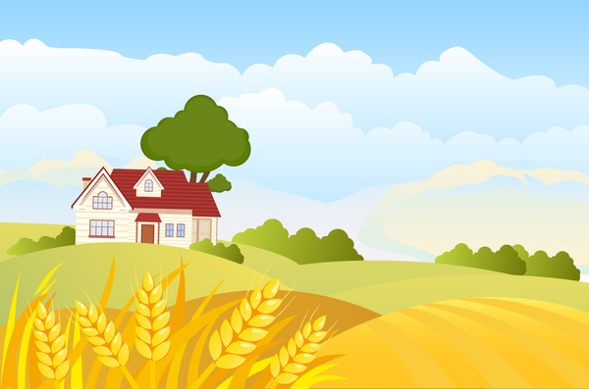
Where we live Lesson 2
compare between city and country
City
Country
------------------------------------------------------------------------------------------------------------
------------------------------------------------------------------------------------------------------------
The country is cleaner than the city .
The country is _______________than the city.
The city is ___________________than the country.
__________________________________________________________________________________________________________________________________________________________________

Slide 7
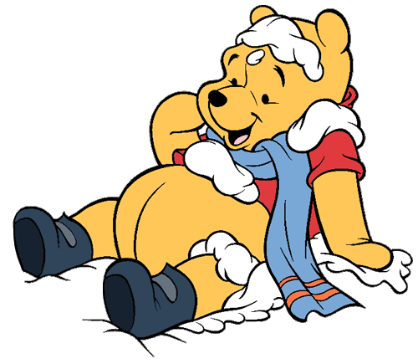
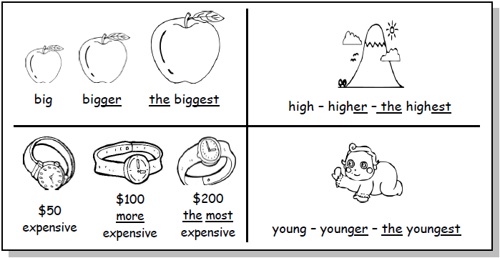
Where we live Lesson 4
Superlative
عند المقارنة بين مجموعة نضيف (est) إلى الصفة الموجودة مثال:
Omar is the shortest in the class
Complete the chart:
Words | Comparative add “er or more” | Superlative add ‘’est or most ‘’
long
high
old
humid
beautiful

Slide 8
Where we live Lesson 4
Superlative add ‘’est or most ‘’ | Comparative add “er or more” | Words
 |  | old
 |  | colorful
 |  | amazing
 |  | fast
 |  | modern
 |  | ancient
 |  | hot
 |  | beautiful
 |  | clean
 |  | pretty
 |  | humid
 |  | noisy
 |  | good
 |  | cheap
 |  | dirty
 |  | popular
 |  | big
 |  | large
 |  | cold
 |  | peaceful
 |  | small

Slide 9
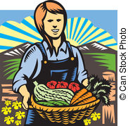
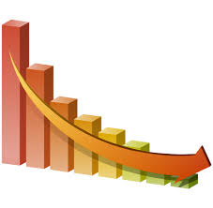
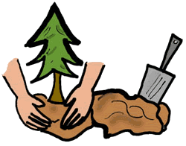
Where we live Lesson 4
Read and match
produce
oxygen
reduce
carbon dioxide
plant
release
environment
forest

Slide 10
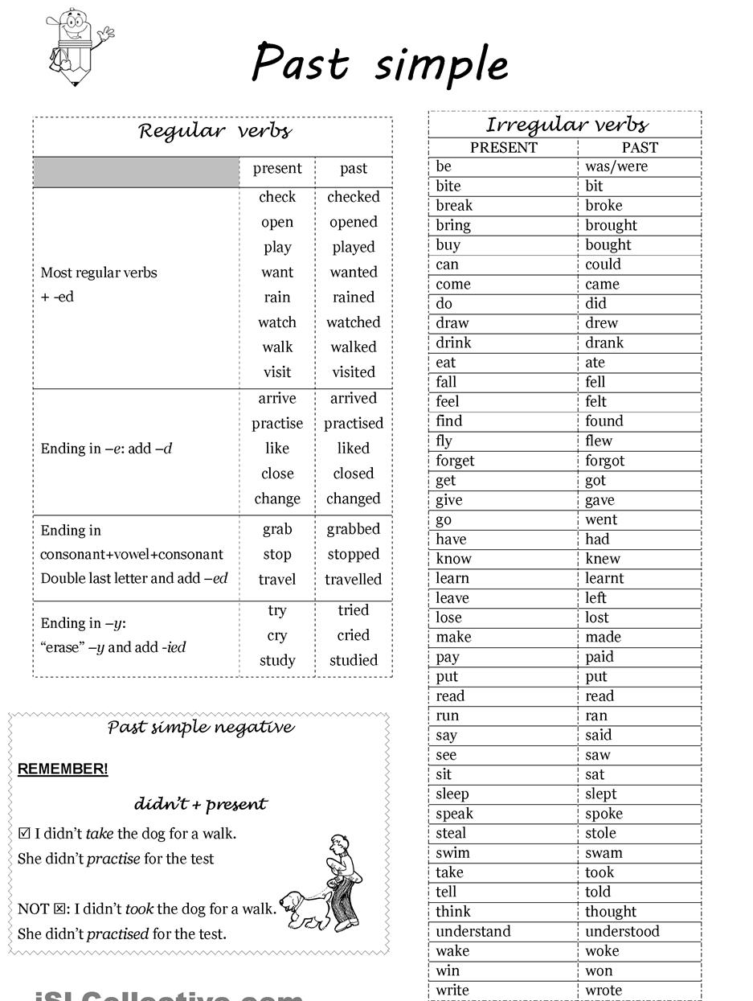
Where we live Lesson 6

Slide 11
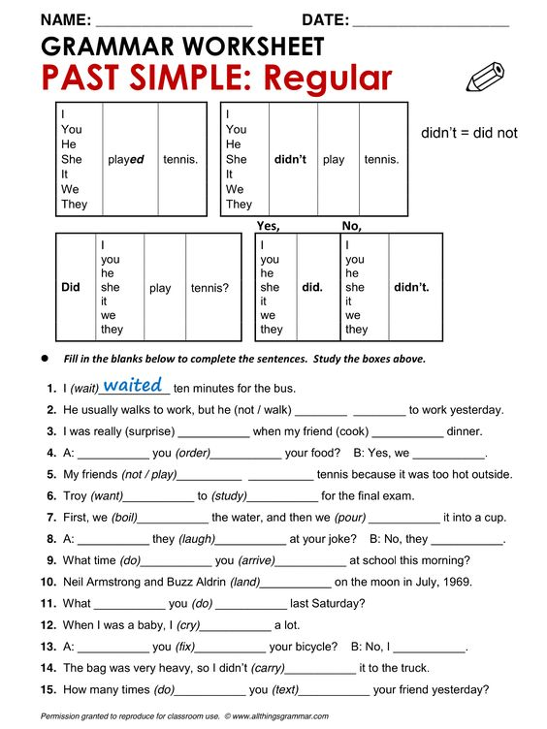
Where we live Lesson 6

Slide 12
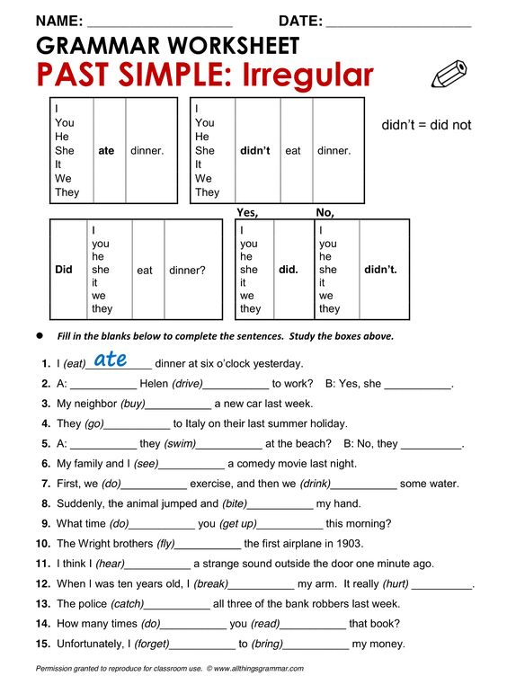
Where we live Lesson 6

Slide 13
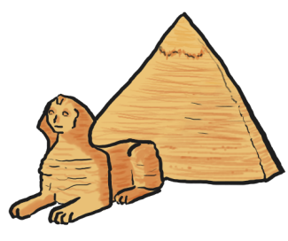
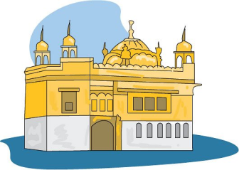
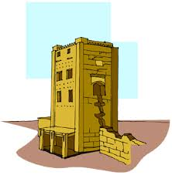
Where we live Lesson 8
What is your favorite place?
Wahiba sand
Burj Khalifa
albadyyah mosque
pyramid
________________
________________
old
ancient
huge
strange
mysterious
colorful
exciting
exotic
modern
__________
My favorite place is
because……
------------------------------------------------------------------------------------------------------------------------------------------------------------------------------------------------------------------------------------------------------------------------------------------------------------------------------------------------------------------------------------------------------------------------------------------------------------------------------------------------------------------------------------------------------------------

Slide 14
Where we live Lesson 9
Read and answer
Match these headings to paragraphs (1–3):
a Description
b Opinion
c Location
Read and complete the sentences
The castle is on a _________, green island.
Surrounding by water and ___________ mountains.
The area is _______________ for its beautiful scenery.
Some of the local animals are very ____________.
There are _____________deer on the hills and a lots of ____________birds.
I think it would be very ____________.

Slide 15
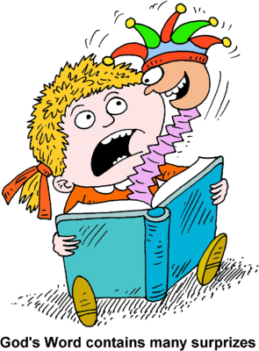
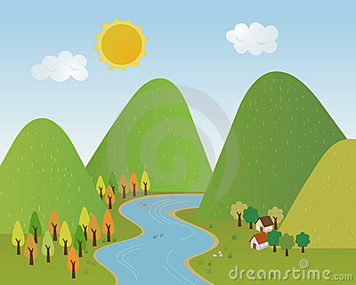
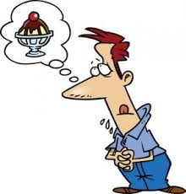
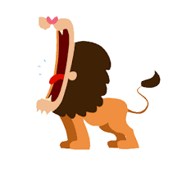
Where we live Lesson 10
Read and write the words under the correct pictures
valley – wonderful – surprise – dates – hungry – roar – roof - step

Slide 16
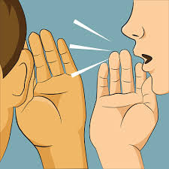
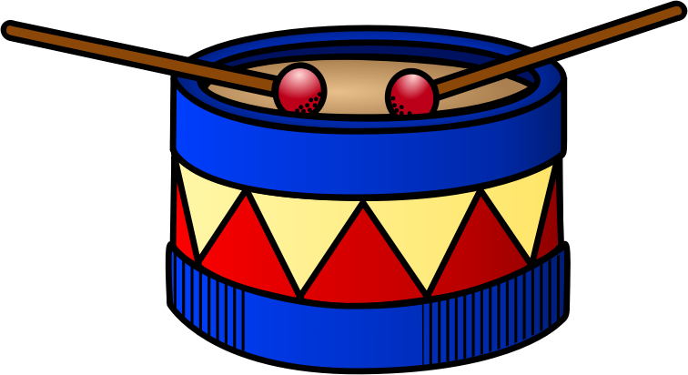
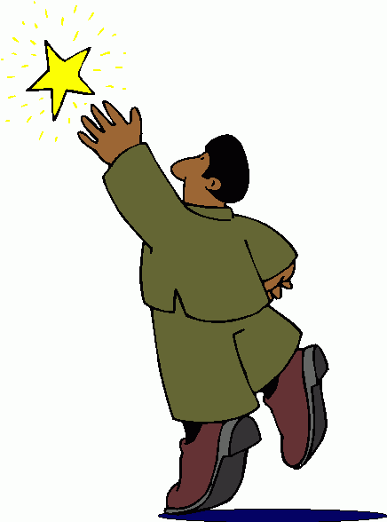
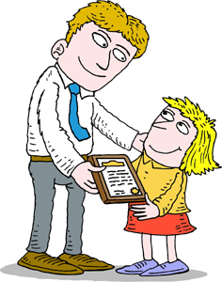
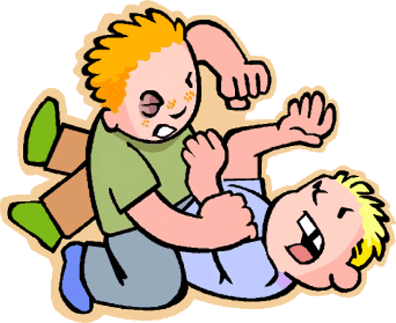
Where we live Lesson 11
read and match
drum
gold
reach
chirp
whisper
reward
hit
silver

Slide 17
Unit 10
All about science

Slide 18
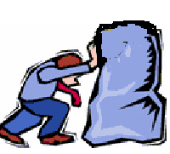
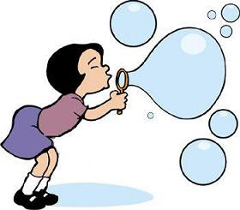
All about science Lesson 2
Write:
straw - scissors - cut - push - blow
………………………….
………………………….
………………………….
………………………… …………………………
Use the permission, offer and request: Can I/you
…………………… squash the straw?
…………………… cut the paper?
……………………… read the book?
…………………… push the box?

Slide 19
All about science Lesson 4
Circle a,b:
1. I play with my friend …………… lives near us.
who
which
2. He put my food in the fridge ……………… is very big.
which
who
3. Boys read the book …………… he buy from Dubai.
who
which
4. They invent many machines …………… is very useful.
which
who
5. The book …………… Ali read is very funny.
that
who
We use who when we talk about people.
We use which + that when we talk about thing.

Slide 20
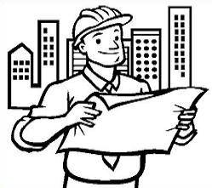
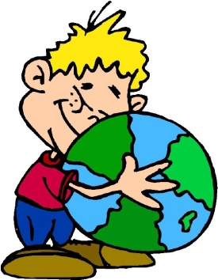
All about science Lesson 5
Match:
engineer plant scientist microscope earth scientist
Where → place
Who → people
When → time
Why → reason
What → action or object
Answer using the words int the box:
……………………………… do you live?
……………………………… is your best friend?
……………………………… you will go to Dubai Mall?
……………………………… they invent the car?
……………………………… is your favorite invention?

Slide 21
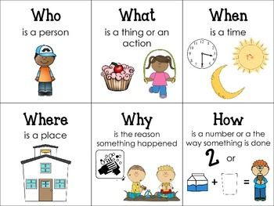
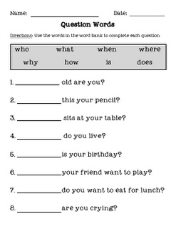
All about science Lesson 5
Write:

Slide 22
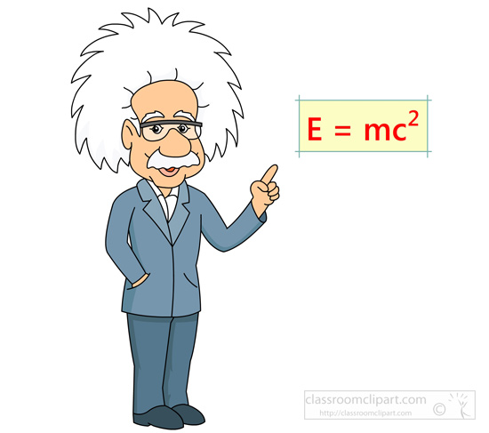
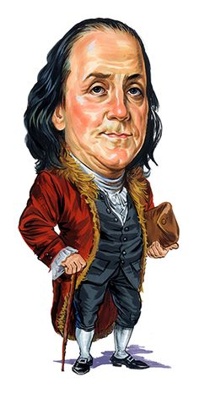
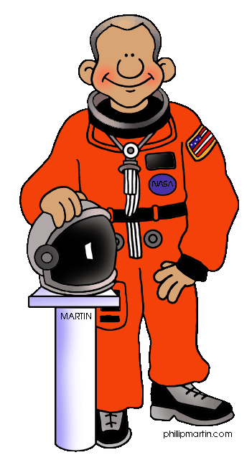
Unit 11
Famous People

Slide 23
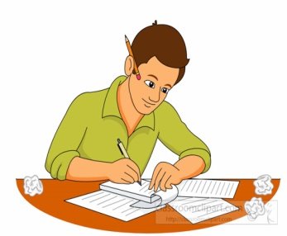
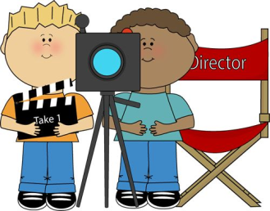
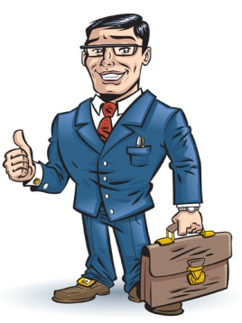
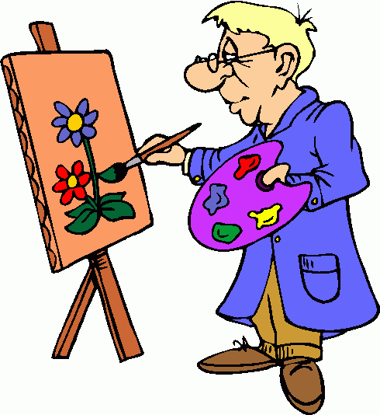
Famous People Lesson 1
Read and Complete the sentences
artist - writer - film director - mountain climber - explorer - scientist - inventor - business person -
He is a astronaut.
He is a ______________________
_______________________
He is a ______________________
_______________________
____________________
_____________________
_______________________
_______________________

Slide 24
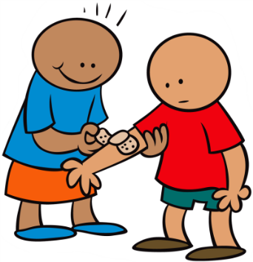
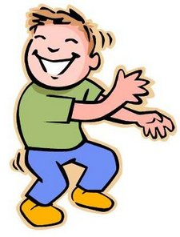
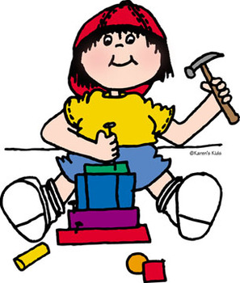
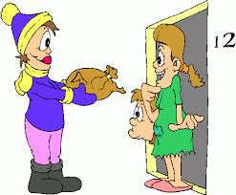
Famous People Lesson 2
Read and match
caring
intelligent & clever
fun
beautiful
exciting & interesting
creative
brave
kind
generous

Slide 25
Famous People Lesson 2
Modal verbs
inf s ing | past | Present
 | could (n’t) | can (n’t)
 | might (n’t) | may (n’t)
 | should (n’t) | shall (n’t)
 | would (n’t) | will (n’t)
 | ought to (n’t) | must (n’t)
Read and circle
She ( can’t - must )be a writer.
He ( might - must ) be a doctor.
She ( must – can’t ) be a astronaut.
She ( could – must ) be a teacher .

Slide 26
Famous People Lesson 3
Read and answer the questions
Match the headings below with paragraph 1 to 4
a – about Sheikh Hamdan
b- Good thing he has done
c- School life
d- Family life
Complete these notes :
Name :__________________________________
From:____________________________________
birth date: _______________________________
Job:______________________________________

Slide 27
Famous People Lesson 5

Slide 28
Famous People Lesson 5

Slide 29
Famous People Lesson 2
Write the words in correct place
country – when – generous – rules – desert - kind – amazing – animals
Read and match
desert
amazing
rules
country

Slide 30
Famous People Lesson 10

Slide 31
Unit 12
Story time

Slide 32
Story time Lesson 1

Slide 33
Story time Lesson 2
Add the prefixes (dis – un) to the words:
The doctor was ……………… to his patient.
kind
Omar seems ……………… he always fights with his bother.
friendly
She is ………………………… because she raise her voice upon her mother.
respect
We haven’t be ………………… when we tell the truth.
honest
He was ……………… because his father had an accident.
happy

Slide 34
Story time Lesson 3
Write:
camping – scorpion –desert – noise – scared - sand

Slide 35
Story time Lesson 4
Write a story:
First,…………………………………………………………………………………………………….
Next,…………………………………………………………………………………………………….
After,…………………………………………………………………………………………………….
Finally,………………………………………………………………………………………………….

Slide 36
Story time Lesson 5
I was reading.
She/He/It was reading.
They/We were reading.

Slide 37
Story time Lesson 6

