Slide 1
GeoGebra

Slide 2
Parallel lines and proportional parts
Objectives:
Use proportion to find side lengths
Find missing measures using similar triangles

Slide 3
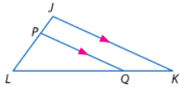
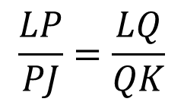
Parallel lines and proportional parts
Triangle Proportionality Theorem
If a line is parallel to one side of a triangle and intersects two other sides
then it divides the sides into segments of proportional lengths
$\overline{ST}||\overline{QR}$
$$\frac{LP}{PJ}=\frac{LQ}{QK}$$

Slide 4
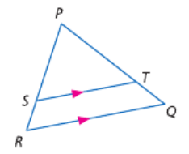
Parallel lines and proportional parts
In △PQR $\overline{ST}||\overline{QR}.$
If PT = 7.5, TQ = 3, and SR = 2.5, find PS

Slide 5
Your turn on Nearpod!
In △PQR $\overline{ST}||\overline{QR}.$
If PS = 12.5, SR = 5, and PT = 15, find TQ

Slide 6
Kahoot!

Slide 7
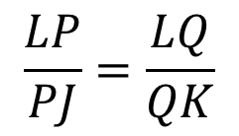
Parallel lines and proportional parts
Converse of Triangle Proportionality Theorem
Can we turn it around?
If a line intersects two sides of a triange, and divides the sides into segments of proportional lengths
then the line is parallel to the third side of the triangle.
$$\frac{LP}{PJ}=\frac{LQ}{QK}$$
$\overline{ST}||\overline{QR}$

Slide 8
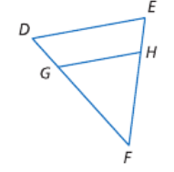
Parallel lines and proportional parts
In △DEF EH=3, HF=9, and DG is one third the length of GF. Is $\overline{DE}||\overline{HG}?$

Slide 9
Parallel lines and proportional parts
Midsegment of triangles
Midsegment: connects midpoint of the sides
GeoGebra activity

Slide 10
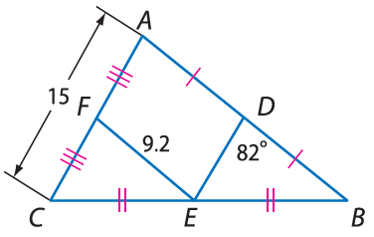
Parallel lines and proportional parts
Find each measure.
DE
DB
m∠FED

Slide 11
Parallel lines and proportional parts
Objectives:
Use proportion to find side lengths
Find missing measures using similar triangles

Slide 12
Parallel lines and proportional parts
Proportional Parts of Parallel Lines

Slide 13
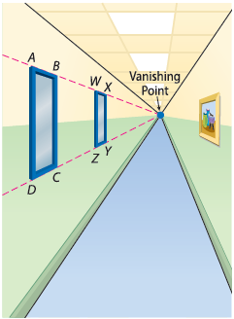
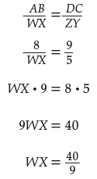
Parallel lines and proportional parts
Shaikha is drawing a hallway in one-point perspective. She uses the guidelines shown to draw two windows on the left wall. If segments $\overline{AD}$, $\overline{BD}$, $\overline{WZ}$, and $\overline{XY}$ are all parallel, AB = 8 cm, DC = 9 cm, and ZY = 5 cm, find WX.
About 4.4 cm

Slide 14
Parallel lines and proportional parts
Congruent Parts of Parallel Lines

Slide 15
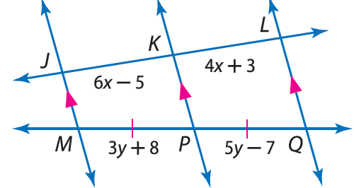
Parallel lines and proportional parts
Find x and y

Slide 16
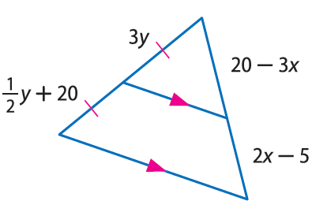
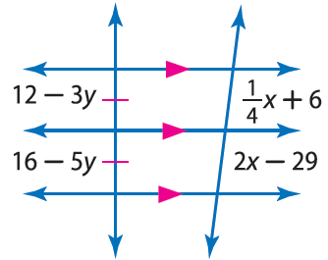
Your turn on Nearpod!
Find x and y

Slide 17
Parallel lines and proportional parts
Objectives:
Use proportion to find side lengths
Find missing measures using similar triangles

