Slide 2
A and B are in Egypt / C and D are in Rome
A
C
D

Slide 3
C
B
A
D
A
B
C
D

Slide 9
about 120
over 4500 years
more than 2 millions
clothes, food, games, gold

Slide 10
add ed or d
made
put
thought
went
ate
began
brought
drew
came

Slide 11
4
put
2
built
built
1
drew
3
cut

Slide 12
Now we live in ---------------, but in the past we lived in ----------------
Now we eat ---------------, but in the past we ate ----------------
Now we wear -------------, but in the past we wore ----------------
Now we play ------- for fun, but in the past we played ------ for fun.

Slide 13
chariot
bread
Sandals
Tunic
baths

Slide 14
4
2
3
5
C
B
D
A

Slide 16
Notebook
about life in the ancient Rome.
describe the houses in ancient Rome.
Roman clothes.
talk about jobs.
food.
what the Roman did for fun.

Slide 17
4
3
5
6
2
mummy
sphinx
aqueducts
colosseum
numerals

Slide 20
did
Howard Carter
find
the tomb?
did
the pharaoh?
Tutankhamun
become
did
Howard Carter
find
the tomb?
did
the archeologists
find
in the tomb?

Slide 21
F
F
O
F
a headline
a quotation
an opinion
a fact

Slide 26
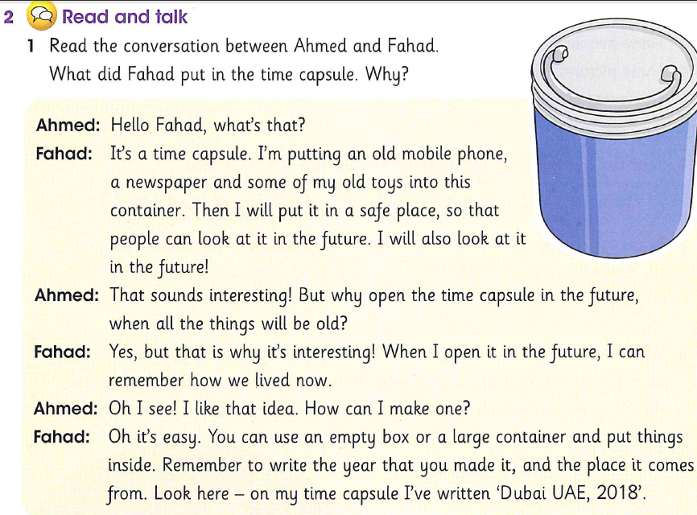

Slide 28
Cancelled

Slide 29
The end of unit 12
Thanks for watching

