Slide 1


Slide 2
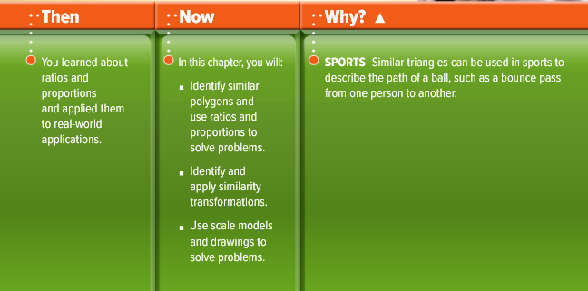

Slide 3
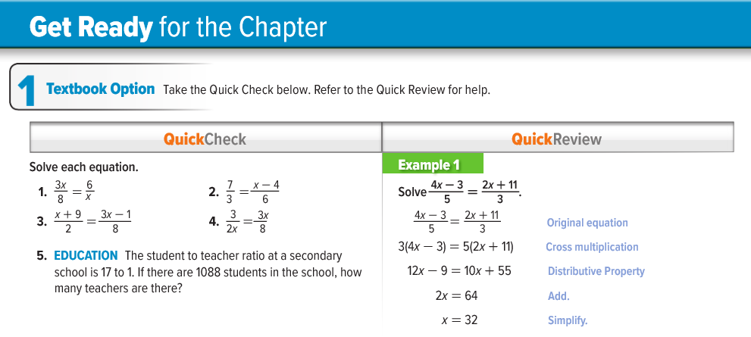

Slide 4
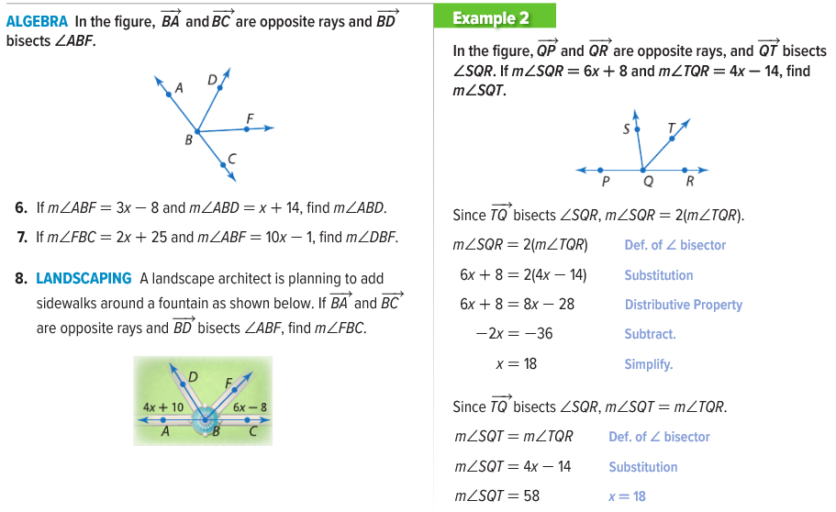

Slide 5
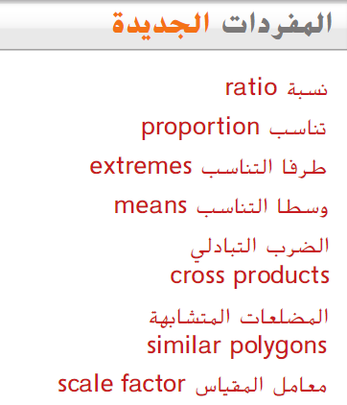

Slide 6
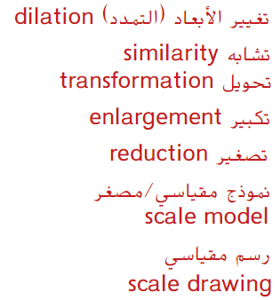

Slide 7
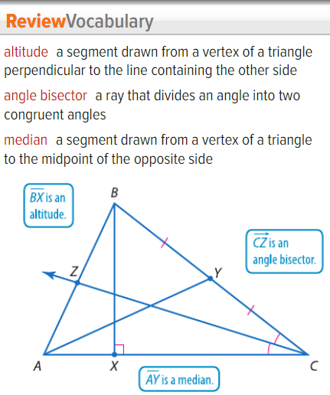
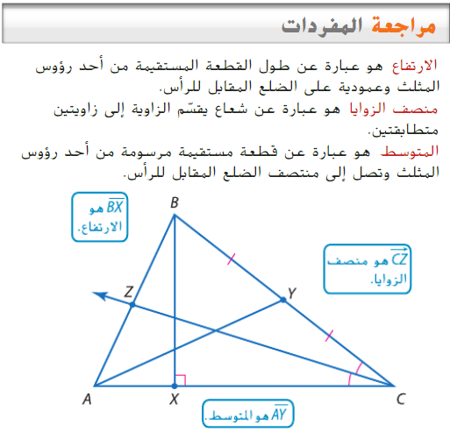

Slide 8
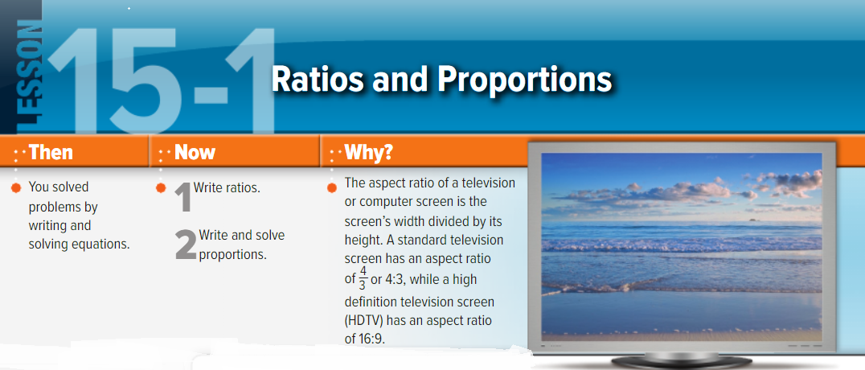

Slide 9

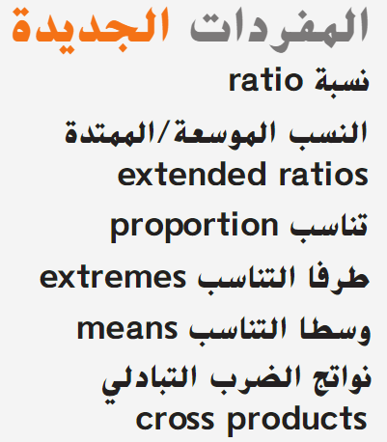

Slide 10
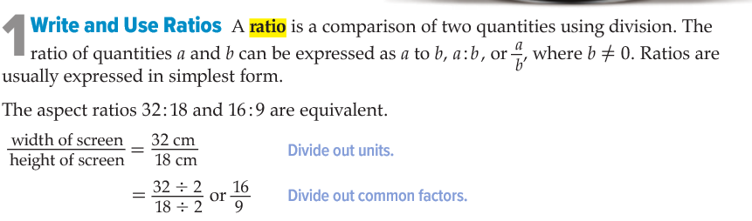

Slide 11
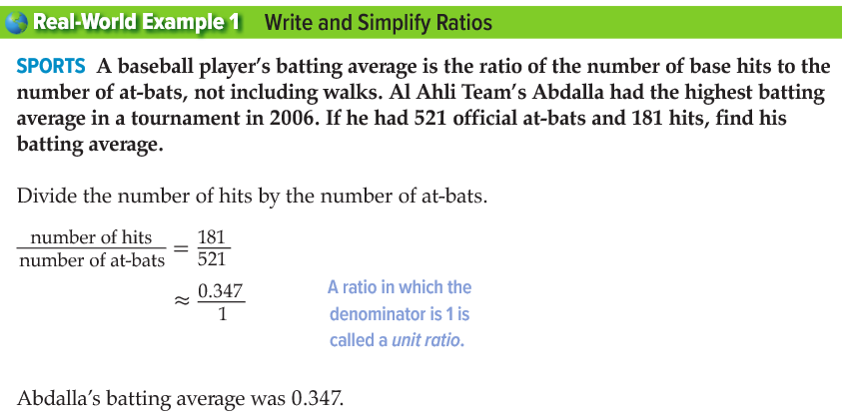

Slide 12
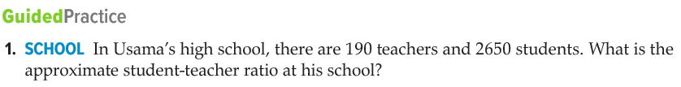


Slide 13


Slide 14
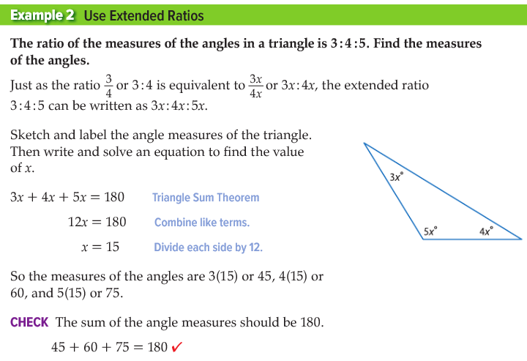

Slide 15



Slide 16
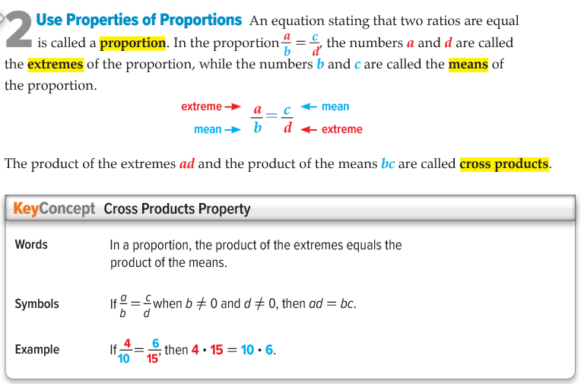
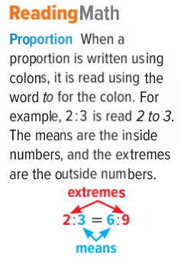

Slide 17
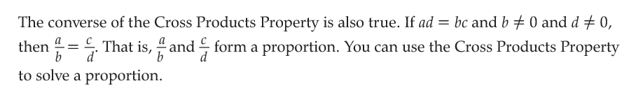

Slide 18
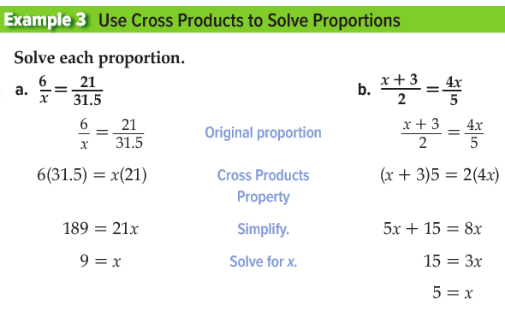
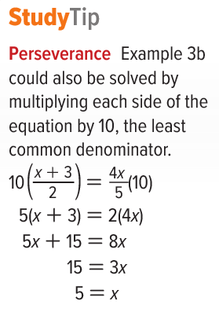

Slide 19

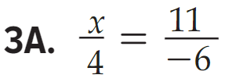
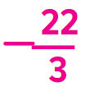

Slide 20
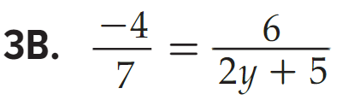
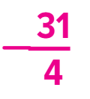

Slide 21
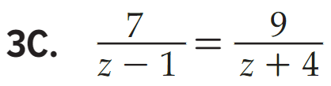


Slide 22
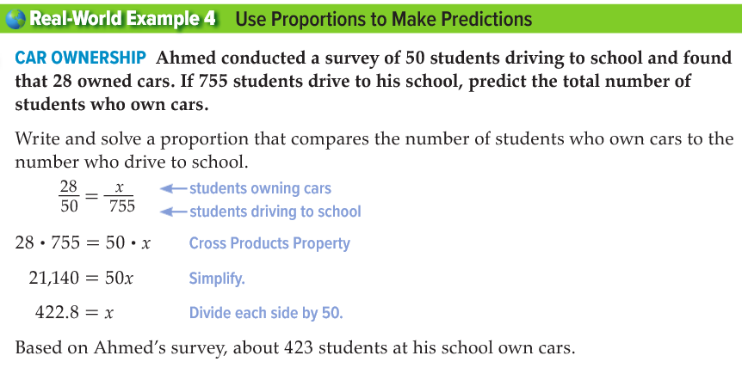

Slide 23
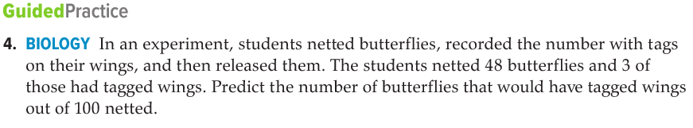


Slide 24
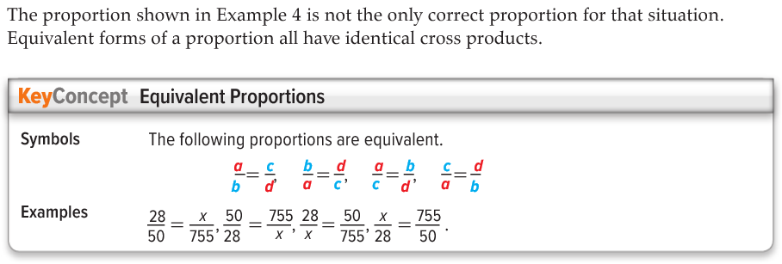

Slide 25
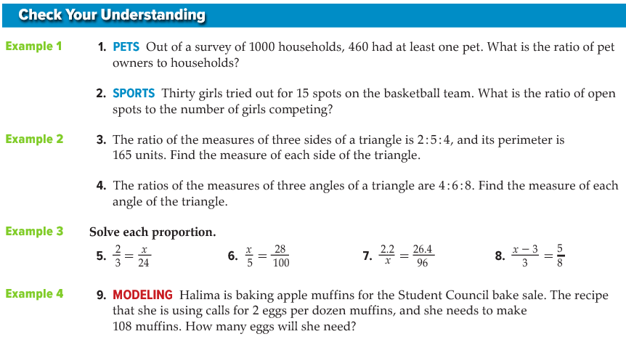

Slide 26
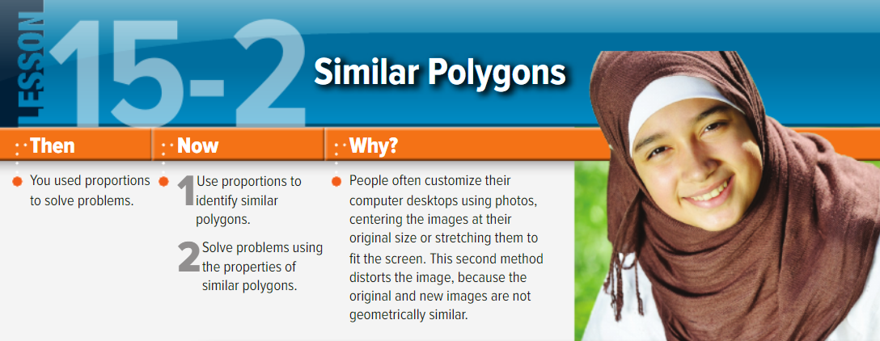

Slide 27
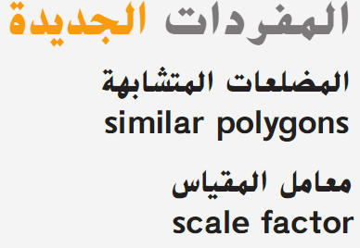

Slide 28
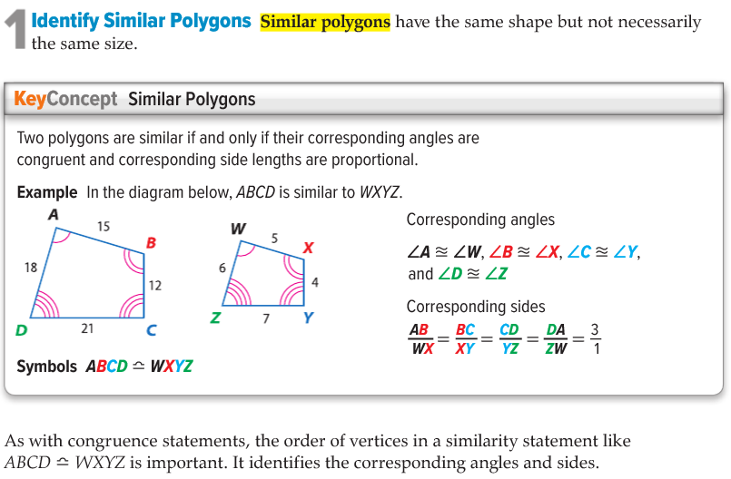

Slide 29
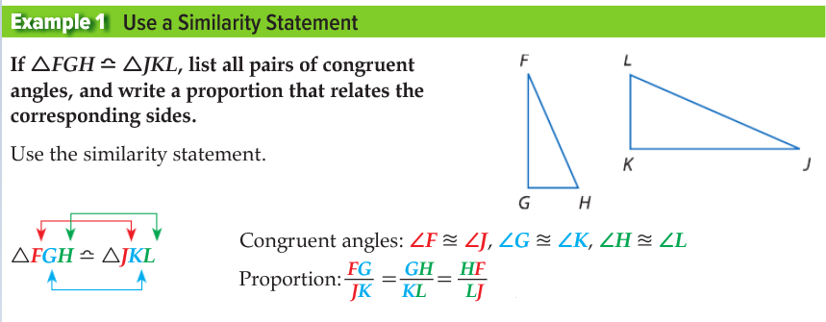

Slide 30
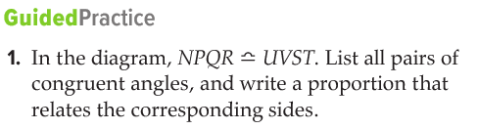
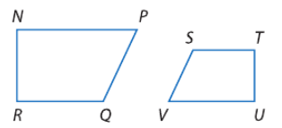
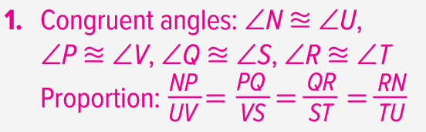

Slide 31
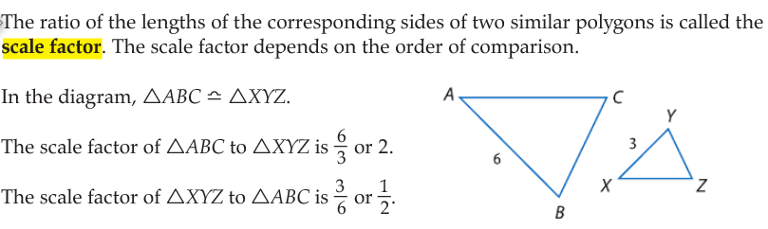
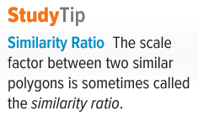

Slide 32
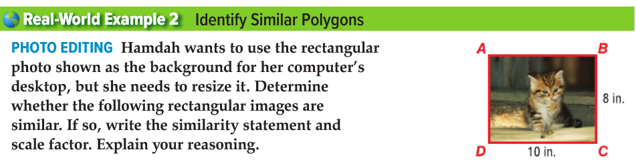
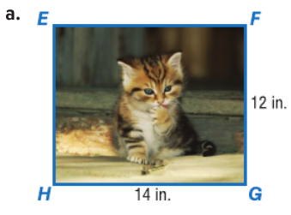
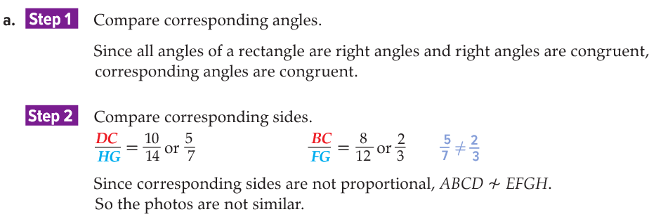

Slide 33
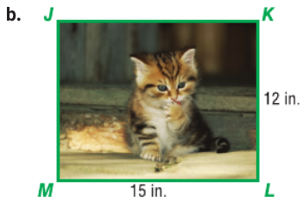
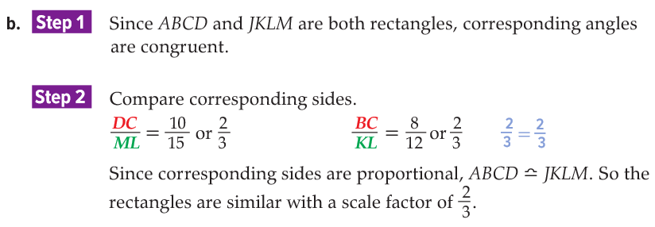

Slide 34
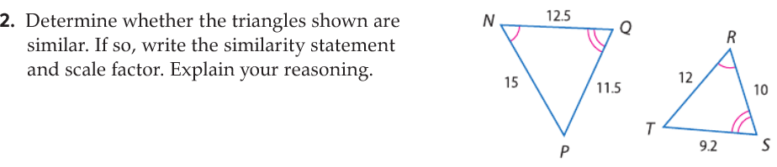
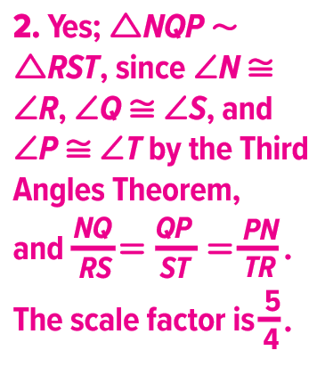

Slide 35
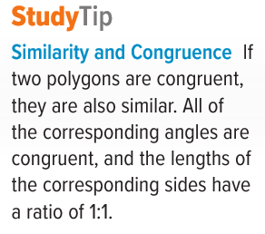

Slide 36
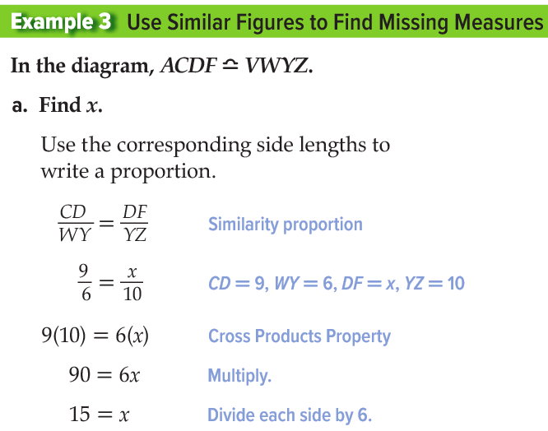
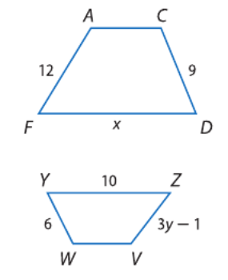

Slide 37
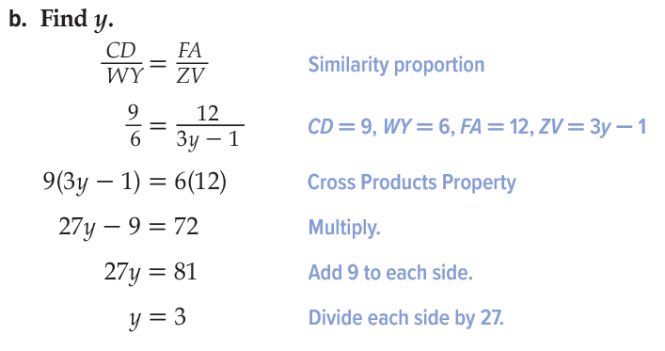

Slide 38
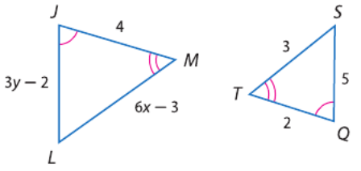
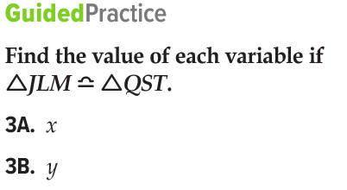



Slide 39
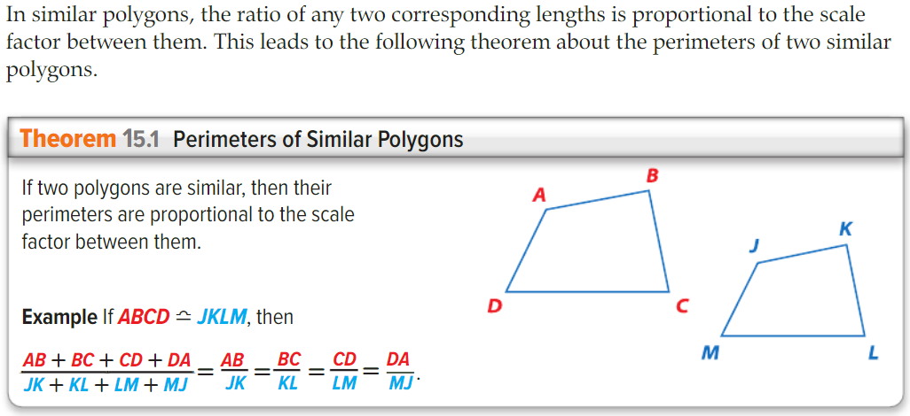

Slide 40



Slide 41



Slide 42


Slide 43


Slide 44


Slide 45


Slide 46


Slide 47




Slide 48


Slide 49


Slide 50


Slide 51


Slide 52





Slide 53


Slide 54


Slide 55


Slide 56


$$√$$

Slide 57


Slide 58



Slide 59



Slide 60



Slide 61


Slide 62


Slide 63




Slide 64


Slide 65


Slide 66


Slide 67


Slide 68


Slide 69


Slide 70


Slide 71


Slide 72




Slide 73


Slide 74


Slide 75




Slide 76



Slide 77


Slide 78


Slide 79





Slide 80



Slide 81


Slide 82



Slide 83


Slide 84


Slide 85




Slide 86



Slide 87


Slide 88


Slide 89


Slide 90


Slide 91


Slide 92


Slide 93


Slide 94


Slide 95




Slide 96


Slide 97


Slide 98


Slide 99




Slide 100



Slide 101


Slide 102




Slide 103


Slide 104


Slide 105


Slide 106


Slide 107


Slide 108


Slide 109


Slide 110


$B is larger than A, so the dilation is an enlargement$
$$The distance between the vertices \left(4,0\right)and \left(4,4\right) for A$$
$is 4 and between the vertices at (5,0) and (5,5) is 5.$
$So, the scale factor is \frac{5}{4}$

Slide 111


$B is smaller than A, so the dilation is an reduction.$ $The distance between the vertices \left(3,3\right)and \left(3,−3\right) for A$
$is 6 and between the vertices at (1,1) and (1,−1) is 2.$
$So, the scale factor is \frac{2}{6} or \frac{1}{3}$

Slide 112


Slide 113


$$2. The scale factor of the dilation=\frac{1.5cm}{5cm}=0.3$$
$Percent of scale factor=0.3×100=30\%$

Slide 114



Slide 115


Slide 116


Slide 117


Slide 118



Slide 119



Slide 120


Slide 121


Slide 122


Slide 123


Slide 124



Slide 125


Slide 126


1. $Use ruler to find the distance between Nashville and Chattanooga.$
$The distance between Nashville and Chattanooga is 2.2 centimeters.$
$Let x represents the actual distance between Nashville and Chattanooga$.
$$\frac{Map}{Actual}:\frac{1}{64.4}=\frac{2.2}{x}$$
$$x=64.4×2.2$$
$$x=141.68kms$$

Slide 127


Slide 128



Slide 129



$$A. Scale of the model:\frac{Model height}{Actual height}=\frac{0.9m}{10.2m}=\frac{1}{11.33}$$
B. $The actual building is 11.33 times taller than the model.$
$The model is \frac{1}{11.33} times taller than the actual building.$

Slide 130



Slide 131


$3. Maximum length=14 feet$
$So, 11 inch=14 feet$
$1 inch= \frac{14}{11}=1.27\frac{feet}{inch}≈1.5 feet per inch$
$so, 1 inch=1.5feet\left(This is the scale\right)$
$Actual length=a ; Model length=m$; $Model width=w$
$a=1.5 m$
$$Length:14=1.5m Width:12=1.5w$$
$$\frac{14}{1.5}=m \frac{12}{1.5}=w$$
$$m=9.33 w=8$$
$$So, the dimensions of paper are 9.33 inches by 8 inches$$

Slide 132


Slide 133


Slide 134


Slide 135


Slide 136


