Slide 1
15-5 Parts of Similar Triangles

Slide 2
15-5 Parts of Similar Triangles
You learned that corresponding sides of similar polygons are proportional.
Recognize and use proportional relationships of corresponding angle bisectors, altitudes, and medians of similar triangles.
Use the Triangle Bisector Theorem.

Slide 3
Special Segments of Similar Triangles
Section 15.2 showed that corresponding side lengths of similar polygons are proportional.
In this section, special segments in triangles that are also proportional are:
Altitudes
Angle bisectors
Medians

Slide 4
What is…?
An Altitude?
An angle bisector?
A median?
B
A
C

Slide 7
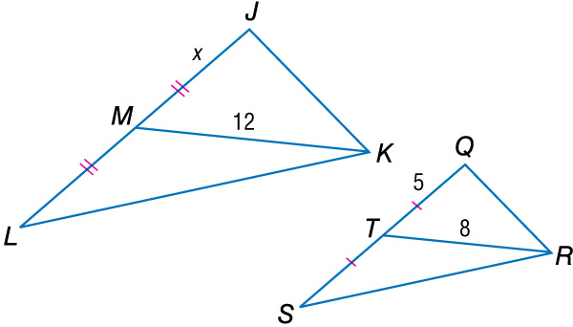
In the figure, ΔLJK ~ ΔSQR. Find the value of x.
MK and TR are corresponding medians and LJ and SQ are corresponding sides. JL = 2x and QS = 2(5) or 10.
~Δ have corr. medians proportional to the corr. sides.
Substitution
12 ● 10 = 8 ● 2x Cross Products Property 120 = 16x Simplify. 7.5 = x Divide each side by 16.
Answer: x = 7.5

Slide 8
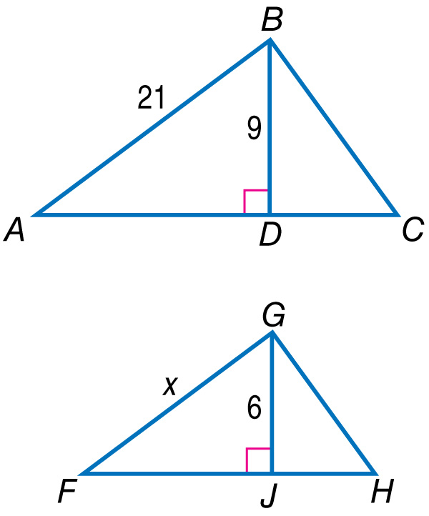
In the figure, ΔABC ~ ΔFGH. Find the value of x.
A. 7
B. 14
C. 18
D. 31.5

Slide 9
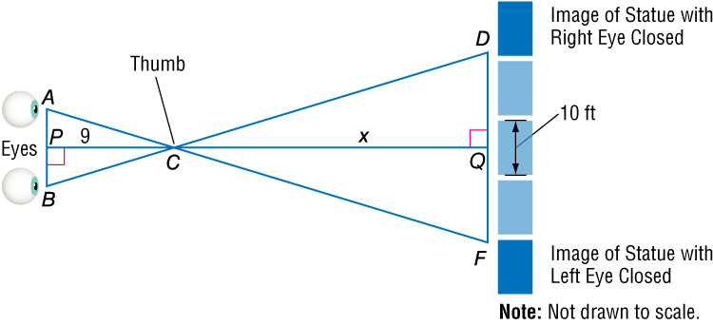
ESTIMATING DISTANCE Sanjay’s arm is about 9 times longer than the distance between his eyes. He sights a statue across the park that is 10 feet wide. If the statue appears to move 4 widths when he switches eyes, estimate the distance from Sanjay’s thumb to the statue.
Understand Make a diagram of the situation labeling the given distance you need to find as x. Also, label the vertices of the triangles formed.

Slide 10
We assume if Sanjay’s thumb is straight out in front of him, then PC is an altitude of ΔABC. Likewise, QC is the corresponding altitude. We assume that AB || DF.
Plan Since AB || DF, ∠BAC ∠DFC and ∠CBA ∠CDF by the Alternate Interior Angles Theorem. Therefore, ΔABC ~ ΔFDC by AA Similarity. Write a proportion and solve for x.

Slide 11
Solve
Theorem 15.8
Substitution
Simplify.
9 ● 40 = x ● 1 Cross Products Property
360 = x Simplify.
Answer: So, the estimated distance to the statue is 360 feet.

Slide 12
The side opposite the bisected angle is now in the same proportion as the sides of the angle.

Slide 13
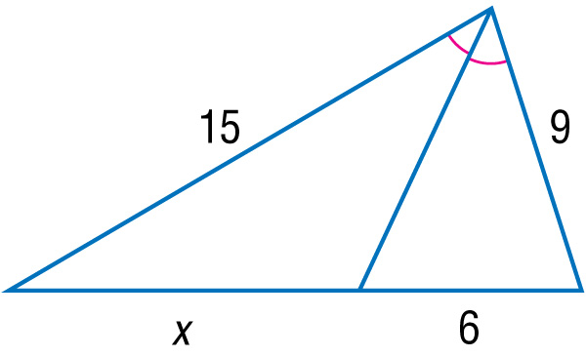
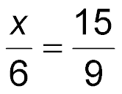
Find x.
Since the segment is an angle bisector of the triangle, the Angle Bisector Theorem can be used to write a proportion.
Triangle Angle Bisector Theorem
9x = (15)(6) Cross Products Property
9x = 90 Simplify.
x = 10 Divide each side by 9.
Answer: x = 10

Slide 14
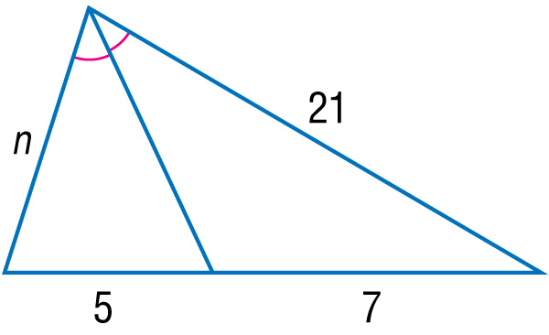
Find n.
A. 10
B. 15
C. 20
D. 25

