Slide 1
Welcome back
by Magdalena Mrowka

Slide 2
Revise writing exam rules.
2. Do some writing activities.
Lesson Objectives

Slide 3
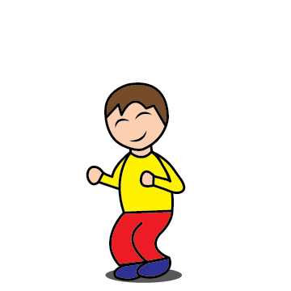
1.
We should use a reliable (not a phone), fully charged device.
T / F
2.
The exam is 30 min long.
T / F
3.
We can answer with just one word.
T / F
4.
We can copy from our friends or the Internet.
T / F
5.
We should care about punctuation (capital letters and full stops).
T / F
6.
We should try to finish quickly without reading our answers again.
T / F

Slide 4
i spoke to my english teacher yesterday. she asked about my Homework
2. ismail matar plays For manchester united.
3. i didn`t do my home work
4. he has a head ache
5. To get to my school, you must go straight turn right then turn left.
Punctuation practice:
Can you spot the mistakes?
1. I spoke to my English teacher yesterday. She asked about my homework.
2. Ismail Matar plays for Manchester United.
3. I didn`t do my homework.
4. He has a headache.
5. To get to my school, you must go straight, turn right, then turn left.

Slide 5
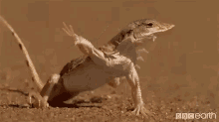
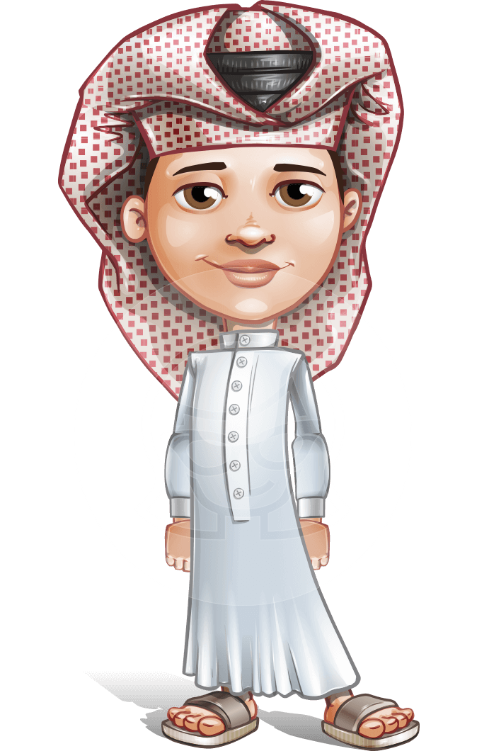
Look at the pictures and answers.
What`s the weather like in the desert?
Hot.
Is it a good answer?
No, it isn`t. You must give a full answer, if instructions tell you so.
It`s hot in the desert.

Slide 6
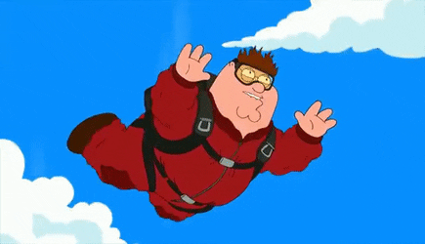
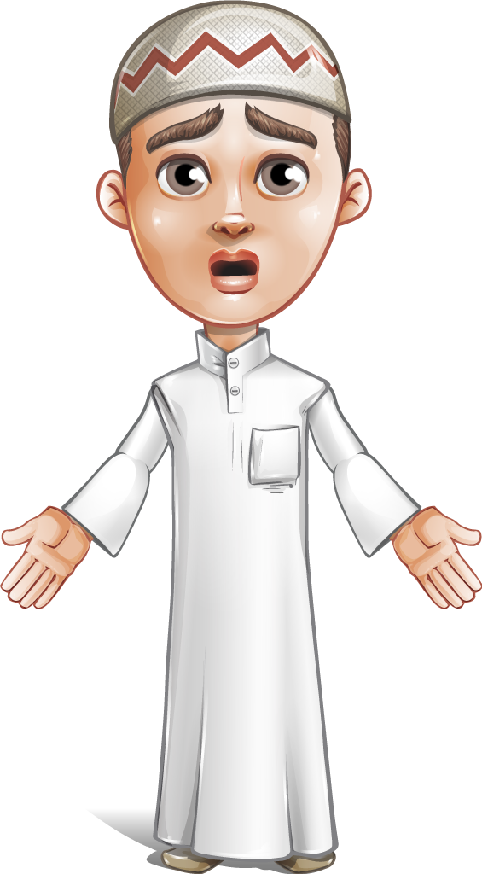
Would you like to try sky diving?
Yes.
Yes, because it`s exciting.
Don`t use words like nice, funny, beautiful when you talk about activities.

Slide 7
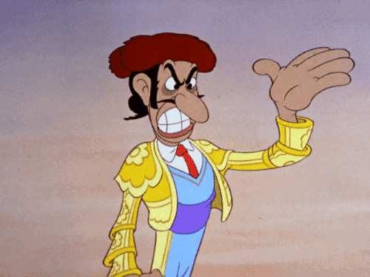
Where would you like to go on holiday?
Hiszpania.
Spain, because it`s a country of good football teams.
Always write in English. If you don`t know the English word, write about something you know in English.

Slide 8
In the exam, it`s very important to use appropriate grammar.
Where did you go last weekend?
I went to Al AIain with my parents.
You see the infinitive here
The question was in Past Simple, so must be the answer.

Slide 9
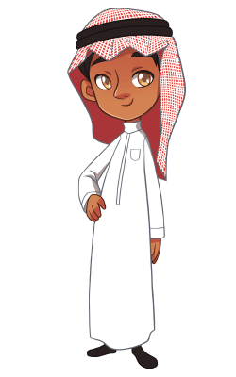
Decide if those sentences are correct.
My brother is the shortest boy in the family.
My brother is the shorter boy in the family.
x
This weekend I`m going to help my mum paint the kitchen.
This weekend I going to help my mum paint the kitchen.
x
There is some water in the glass, but there isn`t much milk.
v
I like camping in the desert, because we sleep in tents.
I like camp in the desert, because we sleep in tents.
x

Slide 10
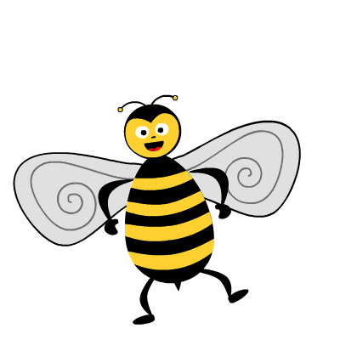
Spelling is also very important.
Look at those popular mistakes.
football
scientist
foot ball
sientist
because
becose
beautiful
Be quiet, please.
beautifull
Be quite, plese.
I have no money.
I have no many.
toothbrush
tooth brush
I go with friends.
Me go with frinds.

Slide 11
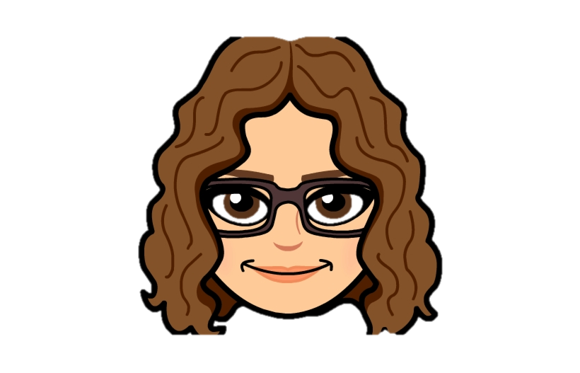
You will do some practice activities in the next lesson.
That’s all for today!
Have a great afternoon!

