Slide 1
15-3 Similar Triangles

Slide 2
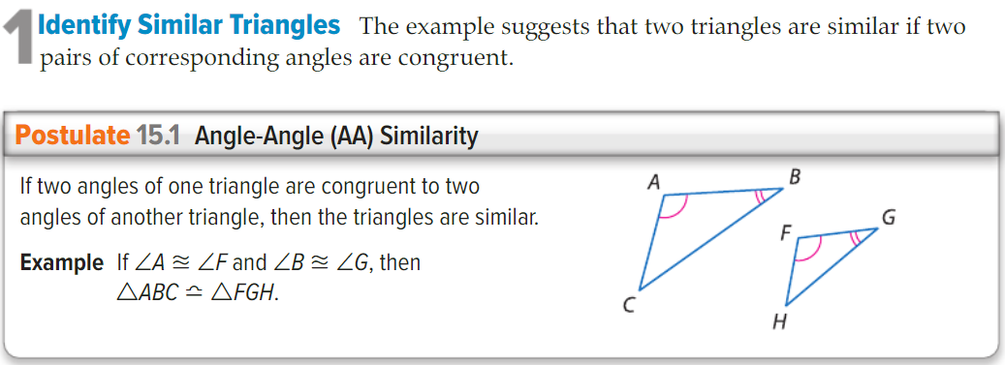
Concept

Slide 3
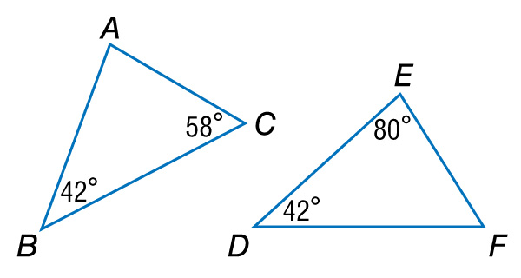
Example 1
Use the AA Similarity Postulate
A. Determine whether the triangles are similar. If so, write a similarity statement. Explain your reasoning.

Slide 4
Example 1
Use the AA Similarity Postulate
Since m∠B = m∠D, ∠B ∠D.
By the Triangle Sum Theorem, 42 + 58 + m∠A = 180, so m∠A = 80.
Since m∠E = 80, ∠A ∠E.
Answer: So, ΔABC ~ ΔEDF by the AA Similarity.

Slide 5
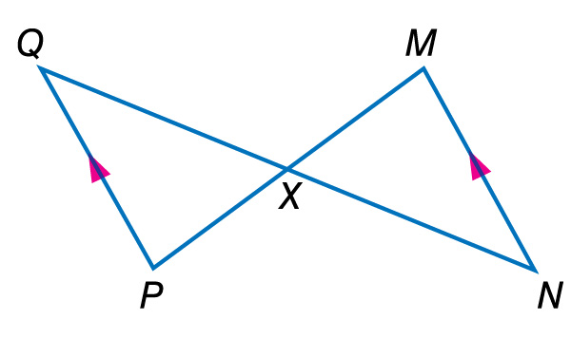
Example 1
Use the AA Similarity Postulate
B. Determine whether the triangles are similar. If so, write a similarity statement. Explain your reasoning.

Slide 6
Example 1
Use the AA Similarity Postulate
∠QXP ∠NXM by the Vertical Angles Theorem.
Since QP || MN, ∠Q ∠N.
Answer: So, ΔQXP ~ ΔNXM by AA Similarity.

Slide 7
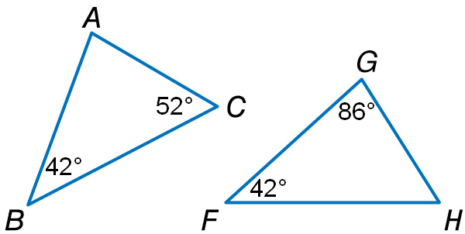
Example 1
A. Determine whether the triangles are similar. If so, write a similarity statement.
A. Yes; ΔABC ~ ΔFGH
B. Yes; ΔABC ~ ΔGFH
C. Yes; ΔABC ~ ΔHFG
D. No; the triangles are not similar.

Slide 8
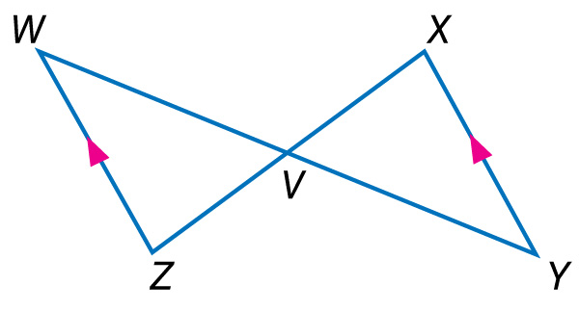
Example 1
B. Determine whether the triangles are similar. If so, write a similarity statement.
A. Yes; ΔWVZ ~ ΔYVX
B. Yes; ΔWVZ ~ ΔXVY
C. Yes; ΔWVZ ~ ΔXYV
D. No; the triangles are not similar.

Slide 9
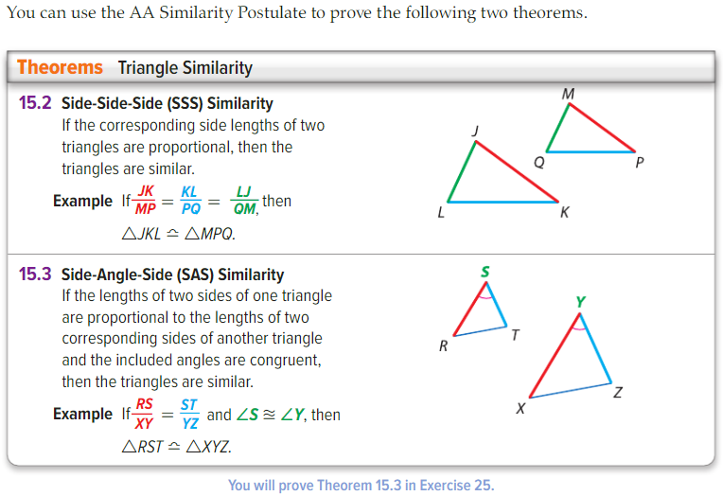
Concept

Slide 10
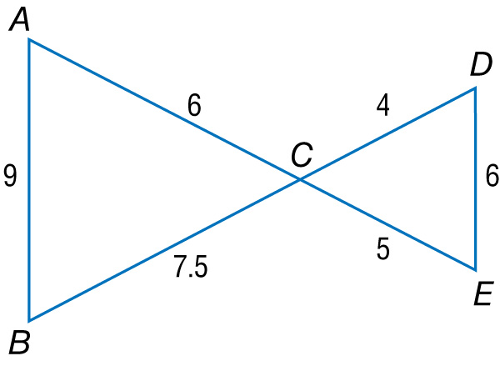
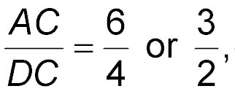
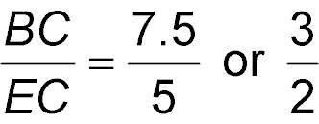
Example 2
Use the SSS and SAS Similarity Theorems
A. Determine whether the triangles are similar. If so, write a similarity statement. Explain your reasoning.
Answer: So, ΔABC ~ ΔDEC by the SSS Similarity Theorem.

Slide 11
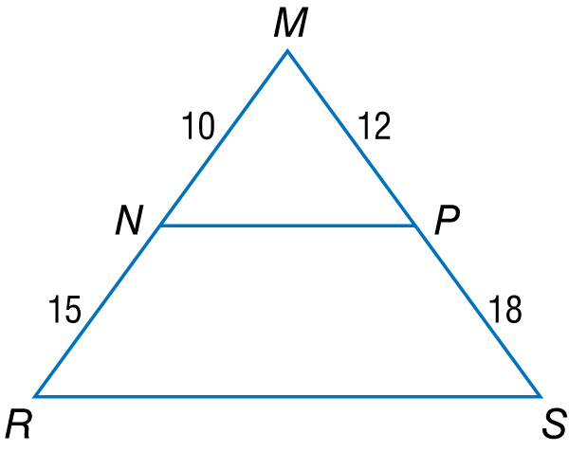
Example 2
Use the SSS and SAS Similarity Theorems
B. Determine whether the triangles are similar. If so, write a similarity statement. Explain your reasoning.
By the Reflexive Property, ∠M ≅ ∠M.
Answer: Since the lengths of the sides that include ∠M are proportional, ΔMNP ~ ΔMRS by the SAS Similarity Theorem.

Slide 12
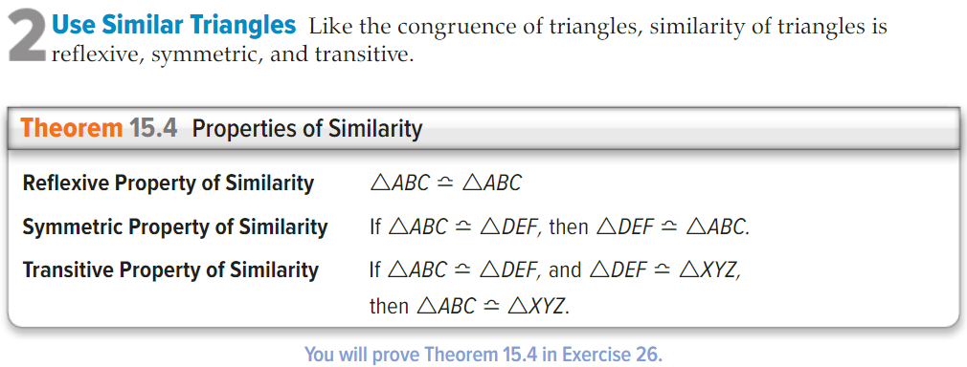
Concept

Slide 13
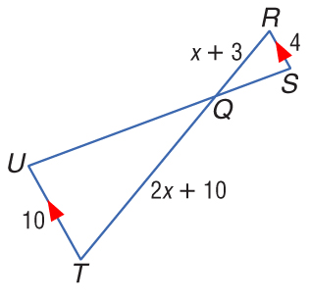
Example 4
Parts of Similar Triangles
ALGEBRA Given , RS = 4, RQ = x + 3, QT = 2x + 10, UT = 10, find RQ and QT.

Slide 14
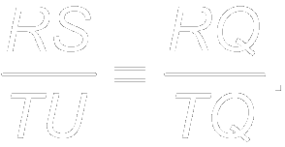
Example 4
Parts of Similar Triangles
Since because they are alternate interior angles. By AA Similarity, ΔRSQ ~ ΔTUQ. Using the definition of similar polygons,
Substitution
Cross Products Property

Slide 15
Example 4
Parts of Similar Triangles
Distributive Property
Subtract 8x and 30 from each side.
Divide each side by 2.
Now find RQ and QT.
Answer: RQ = 8; QT = 20

Slide 16
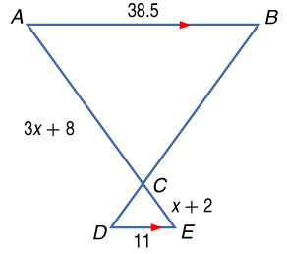
Example 4
ALGEBRA Given AB = 38.5, DE = 11, AC = 3x + 8, and CE = x + 2, find AC.
A. 2
B. 4
C. 12
D. 14

Slide 17
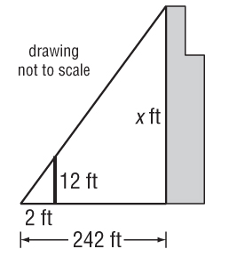
Example 5
Indirect Measurement
SKYSCRAPERS Josh wanted to measure the height of the Sears Tower in Chicago. He used a 12-foot light pole and measured its shadow at 1 p.m. The length of the shadow was 2 feet. Then he measured the length of Sears Tower’s shadow and it was 242 feet at the same time. What is the height of the Sears Tower?
Understand Make a sketch of the situation.

Slide 18
Example 5
Indirect Measurement
Plan In shadow problems, you can assume that the angles formed by the Sun’s rays with any two objects are congruent and that the two objects form the sides of two right triangles. Since two pairs of angles are congruent, the right triangles are similar by the AA Similarity Postulate.
So the following proportion can be written.

Slide 19
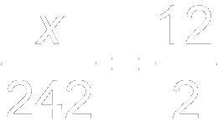
Example 5
Indirect Measurement
Solve Substitute the known values and let x be the height of the Sears Tower.
Substitution
Cross Products Property
Simplify.
Divide each side by 2.

Slide 20
Example 5
Indirect Measurement
Answer: The Sears Tower is 1452 feet tall.
242
Check The shadow length of the Sears Tower is or 121 times the shadow length of the light pole. Check to see that the height of the Sears Tower is 121 times the height of the light pole. = 121 
______
2
1452
______
12

Slide 21
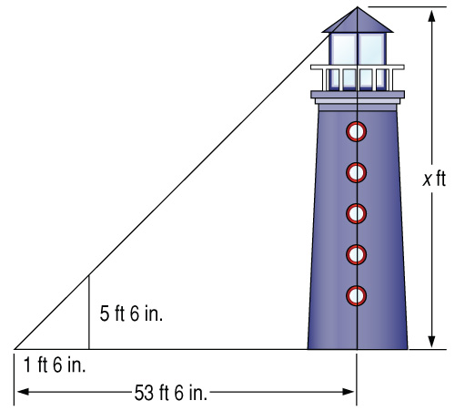
Example 5
LIGHTHOUSES On her trip along the East coast, Jennie stops to look at the tallest lighthouse in the U.S. located at Cape Hatteras, North Carolina. At that particular time of day, Jennie measures her shadow to be 1 foot 6 inches in length and the length of the shadow of the lighthouse to be 53 feet 6 inches. Jennie knows that her height is 5 feet 6 inches. What is the height of the Cape Hatteras lighthouse to the nearest foot?
A. 196 ft B. 39 ft
C. 441 ft D. 89 ft

Slide 22
Concept

