Slide 1
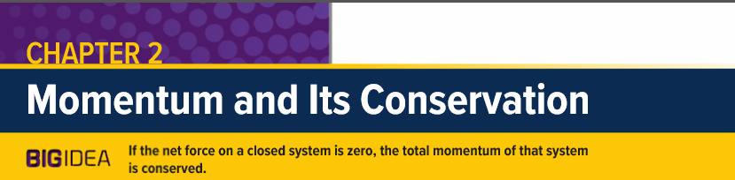
10
Notes:
Introductory slide displaying titles and objectives.

Slide 2
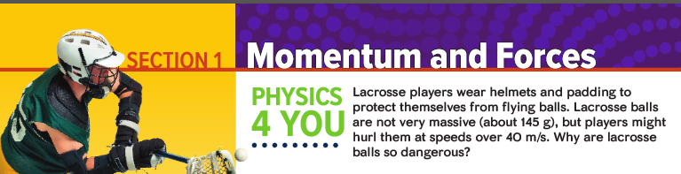

Slide 3

Starter Activity
What is momentum?

Slide 4
Learning objectives
Define and calculate impulse
Estimate the impulse from a force vs time graph.
Define and calculate momentum
Define impulse-momentum theorem and relate it to Newton’s second law of motion.
Use the impulse-momentum theorem to solve problems.
Apply the impulse- momentum theorem to explain its effective use in some real-word physics

Slide 5
Impulse momentum theorem
It can be exciting to watch a baseball player hit a home run. The pitcher hurls the baseball toward the plate. The batter swings, and the ball recoils from the impact.
Before the collision, the baseball moves toward the bat.
During the collision, the ball is squashed against the bat.
After the collision, the ball moves at a high velocity away from the bat, and the bat continues along its path but at a slower velocity.

Slide 6
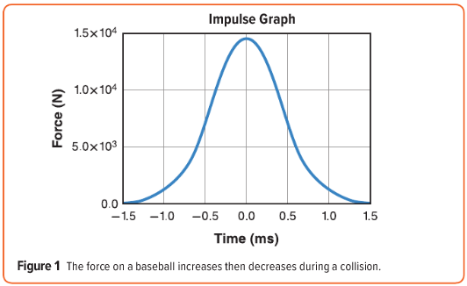
Impulse momentum theorem
According to Newton’s second law of motion, the force from the bat changed the ball’s velocity.
This force changes over time, as shown in Figure 1
This whole event takes place within about 3.0ms
How can you calculate the change in velocity of the baseball?

Slide 7
Impulse momentum theorem
Impulse
Newton’s second law of motion (F = ma) can be rewritten in terms of the change in velocity divided by the time for that change.
Multiplying both sides by the time interval (Δt) results in this equation.
FΔt = mΔv = m(v_{f} - v_{i})
The left side of the equation (FΔt) is defined as the impulse.
impulse on an object is the product of the average force on an object and the time interval over which it acts.
Unit: Newton-seconds (N s) it is a vector
the magnitude of the impulse equals the area under the curve of a force-time graph, as in Figure 1.

Slide 8
Impulse momentum theorem
Momentum
FΔt = mΔv = m(v_{f} - v_{i}) in this equation, mΔv = m(v_{f} - v_{i})
The product of the object’s mass (m) and the object’s velocity (v) is defined as the momentum of the object.
Unit: kg m/s. it is a vector
also known as linear momentum, is represented by following equation

Slide 9
Impulse momentum theorem
Impulse momentum theorem
FΔt = mΔv = m(v_{f} - v_{i}) = m v_{f} – m v_{i} in this equation,
use momentum P = mv
FΔt = P_{f} – P_{i}
the impulse on an object is equal to the change in its momentum, which is called the impulse-momentum theorem

Slide 10
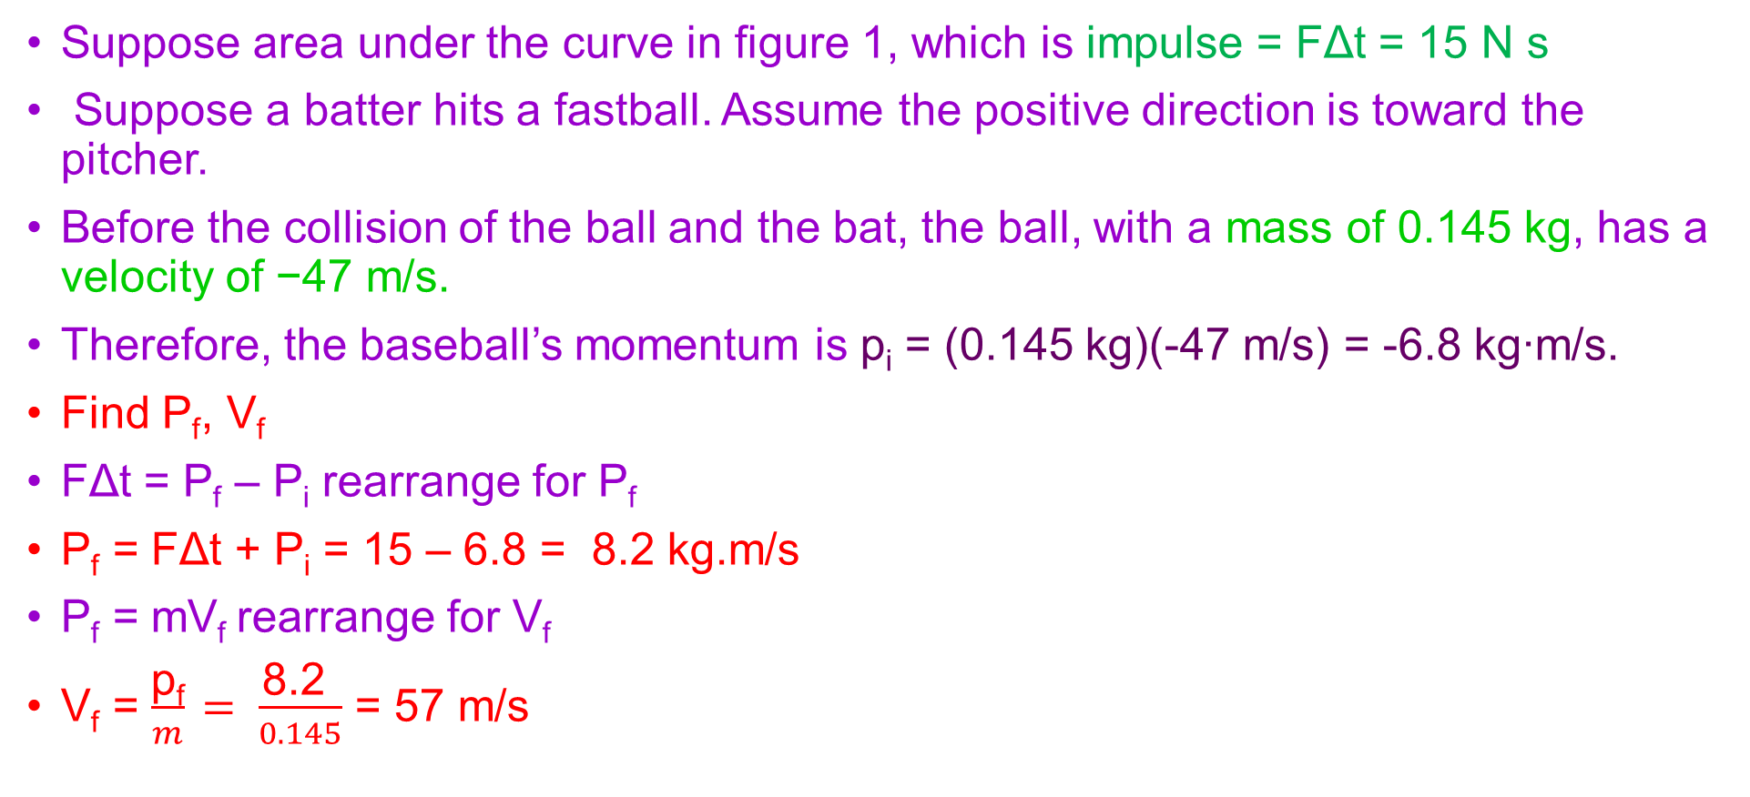
Impulse momentum theorem
Using Impulse momentum theorem
Suppose area under the curve in figure 1, which is impulse = FΔt = 15 N s
Suppose a batter hits a fastball. Assume the positive direction is toward the pitcher.
Before the collision of the ball and the bat, the ball, with a mass of 0.145 kg, has a velocity of −47 m/s.
Therefore, the baseball’s momentum is p_{i} = (0.145 kg)(-47 m/s) = -6.8 kg∙m/s.
Find P_{f}, V_{f}
FΔt = P_{f} – P_{i} rearrange for P_{f}
P_{f} = FΔt + P_{i} = 15 – 6.8 = 8.2 kg.m/s
P_{f} = mV_{f} rearrange for V_{f}
V_{f} = $\frac{\text{p}\text{f}}{m}$ $= \frac{\text{8.2 }}{0.145}$ = 57 m/s
https://www.youtube.com/watch?v=1WIECGg71WY

Slide 12
Use impulse momentum theorem

Slide 13
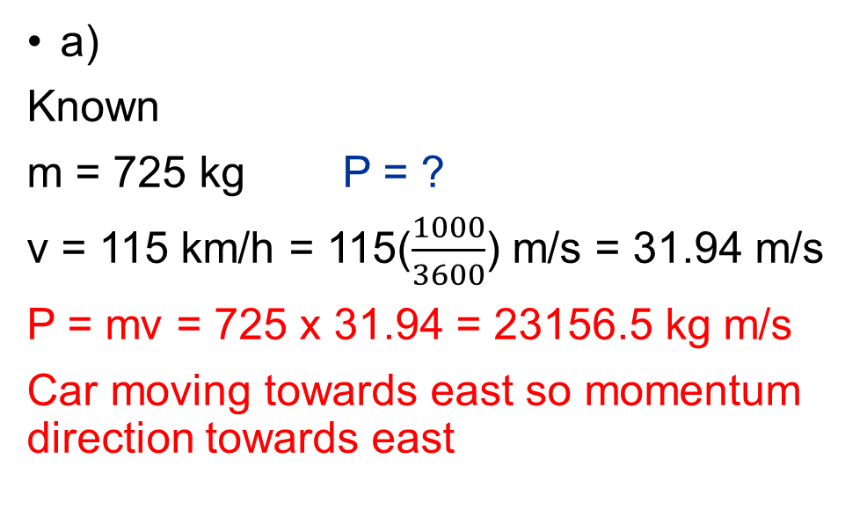
Plenary Activity
a)
Known
m = 725 kg P = ?
v = 115 km/h = 115($\frac{1000}{3600}$) m/s = 31.94 m/s
P = mv = 725 x 31.94 = 23156.5 kg m/s
Car moving towards east so momentum direction towards east
b)
Known
m = 2175 kg
P = 23156.5 kg m/s v = ?
P = mv rearrange for v,
v = P/m = 23156.5/ 2175 = 10.65 m/s

Slide 14
Plenary Activity
a)
Known
Δt = 2 s f = 5000 N ΔP = P_{f} - P_{i}?
Impulse momentum theorem
f Δt = ΔP = P_{f} - P_{i}
ΔP = P_{f} - P_{i} = f Δt = 5000 x 2 = 10000 N s
Direction of impulse opposite to car’s velocity
b)
Known
m = 725 kg P_{f} = ? V_{f} = ?
P_{i} = 23156.5 kg m/s, f Δt = 10000 N s
f Δt = ΔP = P_{f} - P_{i}
P_{f} = f Δt + P_{i} = 10000 + 23156.5 = 33156.5

Slide 15
SL Activity
Page 273: section 1: review 10 to 14

Slide 16
Using Impulse momentum theorem to save lives

