Slide 1
15-7 Scale Drawings and Models

Slide 2
Lesson Menu
Five-Minute Check (over Lesson 15–6)
Then/Now
New Vocabulary
Example 1: Use a Scale Drawing
Example 2: Find the Scale
Example 3: Real-World Example: Construct a Scale Model

Slide 3
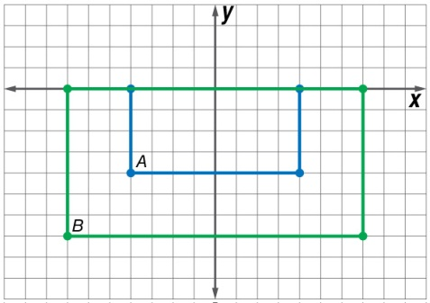
5-Minute Check 1
Determine whether the dilation from Figure A to Figure B is an enlargement or a reduction. Then find the scale factor of the dilation.
7
__
A. enlargement;
B. enlargement;
C. reduction;
D. reduction;
4
4
__
7
7
__
4
4
__
7

Slide 4
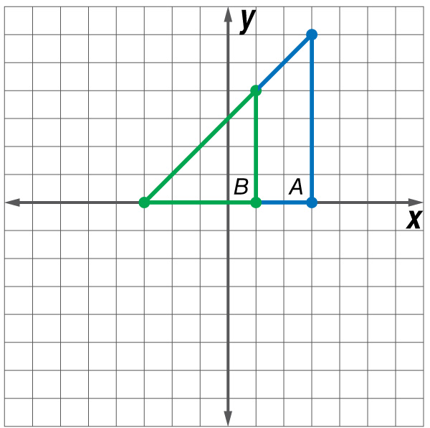
5-Minute Check 2
Determine whether the dilation from Figure A to Figure B is an enlargement or a reduction. Then find the scale factor of the dilation.
3
__
A. enlargement;
B. enlargement;
C. reduction;
D. reduction;
2
2
__
3
3
__
2
2
__
3

Slide 5
5-Minute Check 3
The coordinates of the vertices of two triangles are listed in the table. What is the scale factor of the dilation from ΔABC to ΔXYZ?
7
A.
B.
C. 2
D. 3
__
4
1
__
2

Slide 6
Then/Now
You used scale factors to solve problems with similar polygons.
Interpret scale models.
Use scale factors to solve problems.

Slide 7
Vocabulary
scale model
scale drawing
scale

Slide 8
Example 1
Use a Scale Drawing
MAPS The distance between Boston and Chicago on a map is 9 inches. If the scale of the map is 1 inch : 95 miles, what is the actual distance from Boston to Chicago?
Method 1 Write and solve a proportion.
Let x represent the distance between Boston and Chicago.

Slide 9
Example 1
Use a Scale Drawing
1 ● x = 95 ● 9 Cross Products Property
x = 855 miles Simplify.
Method 2 Write and solve an equation.
Let a = actual distance in miles between Boston and Chicago and m = map distance in inches. Write the scale as , which is 95 miles per inch. So for every inch on the map, the actual distance is 95 miles.

Slide 10
Example 1
Use a Scale Drawing
a = 95 ● m Write an equation.
= 95 ● 9 m = 9
= 855 Solve.
Answer: The distance between Boston and Chicago is 855 miles.
Check Use dimensional analysis.
✓

Slide 11
Example 1
MAPS The distance between Cheyenne, WY, and Tulsa, OK, on a map is 8 inches. If the scale of the map is 1 inch : 90 miles, what is the actual distance from Cheyenne to Tulsa?
A. 800 miles
B. 900 miles
C. 630 miles
D. 720 miles

Slide 12
Example 2
Find the Scale
A. SCALE MODEL A miniature replica of a fighter jet is 4 inches long. The actual length of the jet is 12.8 yards. What is the scale of the model?
To find the scale, write the ratio of a replica length to an actual length.
Answer: The scale of the model is 1 in. : 3.2 yd.

Slide 13
Example 2
Find the Scale
B. SCALE MODEL A miniature replica of a fighter jet is 4 inches long. The actual length of the jet is 12.8 yards. How many times as long as the actual is the model jet?
To answer this question, find the scale factor of the model. Multiply by a conversion factor that relates inches to yards to obtain a unitless ratio.
Answer: The scale factor is 115.2 : 1. That is, the actual jet is 115.2 times as long as the model.

Slide 14
Example 2
A. SCALE MODEL A miniature replica of a fire engine is 9 inches long. The actual length of the fire engine is 13.5 yards. What is the scale of the replica?
A. 2 in. : 3 yd
B. 1 in. : 3 yd
C. 2 in. : 5 yd
D. 3 in. : 4 yd

Slide 15
Example 2
B. SCALE MODEL A miniature replica of a fire engine is 9 inches long. The actual length of the fire engine is 13.5 yards. How many times as long as the model is the actual fire engine?
A. 48
B. 54
C. 60
D. 63

Slide 16
Example 3
Construct a Scale Model
SCALE DRAWING Gerrard is making a scale model of his classroom on an 11-by-17 inch sheet of paper. If the classroom is 20 feet by 32 feet, choose an appropriate scale for the drawing and determine the drawing’s dimensions.
The actual classroom is 20 feet wide.
20 feet ÷ 11 inches = 1.8 feet per inch
The actual classroom is 32 feet long.
32 feet ÷ 17 inches = 1.8 feet per inch

Slide 17
Example 3
Construct a Scale Model
A scale of 1 inch = 2 feet would be appropriate. So, for every inch on the paper p, let the actual measure a be 2 feet. Write this as an equation.
width:
a = 2 ● p Write an equation.
20 = 2 ● p a = 20
10 = p Divide each side by 2.

Slide 18
Example 3
Construct a Scale Model
length:
a = 2 ● p Write an equation.
32 = 2 ● p a = 32
16 = p Divide each side by 2.
Answer: 1 in. : 2 ft; 10 in. wide, 16 in. long

Slide 19
Example 3
ARCHITECTURE Alaina is an architect making a scale model of a house in a 15-by-26 inch display. If the house is 84 feet by 144 feet, what would be the dimensions of the model using a scale of 1 in. : 6 ft?
A. 14 in. × 24 in.
B. 14 in. × 25 in.
C. 15 in. × 25 in.
D. 15 in. × 26 in.

