Slide 1
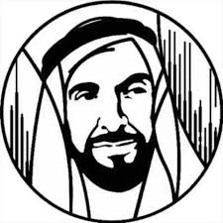
Maths exam revision
You must have a pen and paper ready for revision
Do the question without looking at the multiple-choice options.
Time yourself – 2 minutes and 30 seconds per question.
The extra 30 seconds can be used to check your answer
(or to guess if you are running out of time!)
Good luck and enjoy the revision!!!

Slide 2
Maths exam

Slide 3
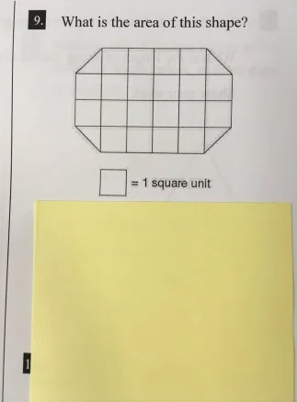
Maths revision

Slide 4
Question 1
What is data display?
A graph
For example: line graph, box plot, histogram, dot plot

Slide 5
Question 1

Slide 6
Question 2
What key words?
- mean, median, mode, Q1, Q3, IQR, range, mean absolute deviation

Slide 7
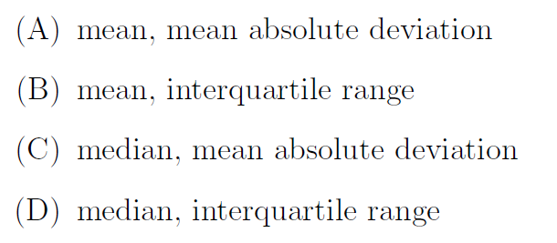
Question 2

Slide 8
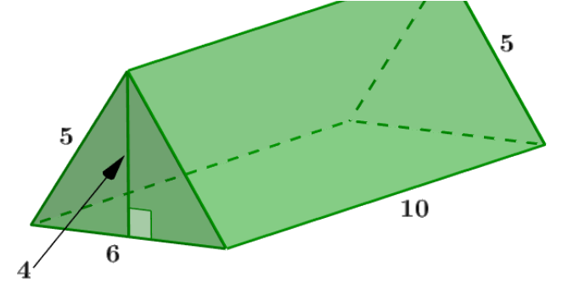
Question 3
Triangular prism:
2. Area of triangle x 2 = ½ b h
½ x 6 x 4 x 2 =
12 x 2 (because of 2 triangles) =24.
3. lw = 10 x 5 = 50
lw = 10 x 6 = 60
lw = 10 x 5 = 50
Add all up
24 + 50 + 60 + 50
= 184
b = 6
h = 4
l = 10

Slide 9
Question 3

Slide 10
Question 4
Lowest = 0
Highest = 6
Median = 3
Q1 = 1
Q3 = 5
IQR = Q3 – Q1 = 4

Slide 11
Question 4

Slide 12
Question 5
Surface Area of Pyramid
Triangles x 4
Area of a triangle = ½ b h
½ x 4 x 3.5 = 7
Triangles x 4 = 4 x 7 = 28
b = 4
h = 3.5

Slide 13
Question 5

Slide 14
Question 6
Mean = add all the numbers and divide by the total sum of numbers
Median = put numbers in order – smallest to biggest and then find the middle number
Mode = repeated the most in the data

Slide 15
Question 6

Slide 16
Question 7
First find the mean of 5 and 7 = 6
Mean increase by 1 = 6 + 1 = 7
Now you do 7 x 3 = 21
21 – 5 – 7 = 9

Slide 17
Question 7

Slide 18
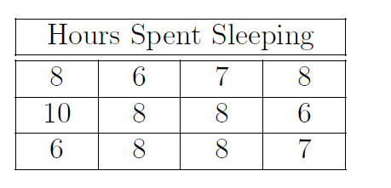
Question 8

Slide 19
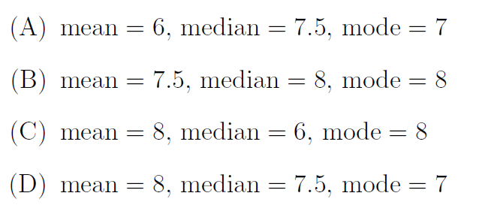
Question 8

Slide 20
Question 9

Slide 21
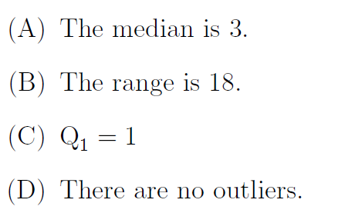
Question 9

Slide 22
Question 10

Slide 23
Question 10

Slide 24
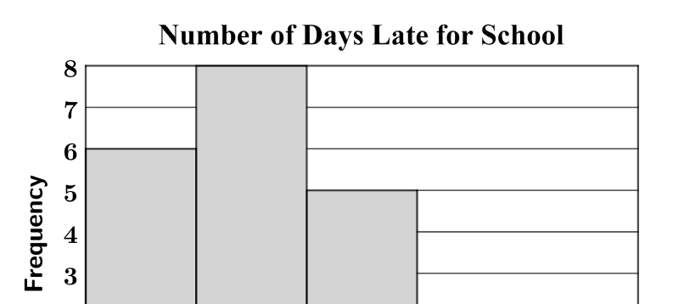
Question 11
Look at graph
At least means 6 and more
6 to 8 = 5
9 to 11 = 2
12 to 14 = 1
5+ 2+ 1 =8

Slide 25
Question 11

Slide 26
Question 12
With outlier
Mean: 11.4
Mode: 1
Median: 2
Without outlier (50)
Mean: 1.75
Mode: 1
Median: 1.5

Slide 27
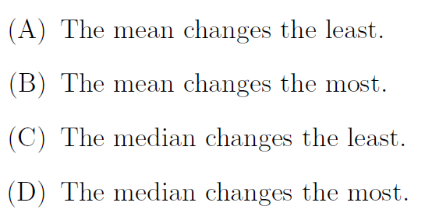
Question 12
With outlier
Mean: 11.4
Mode: 1
Median: 2
Without outlier (50)
Mean: 1.75
Mode: 1
Median: 1.5

Slide 28
Question 13
1. Median = middle value
2. Put them in order
3, 3, 4, 4, 5, 5, 7, 7, 7, 9
So middle value is 5

Slide 29
Question 13

Slide 30
Question 14
Symmetrical means mirror image/same on one side and other
Outlier: a far value

Slide 31
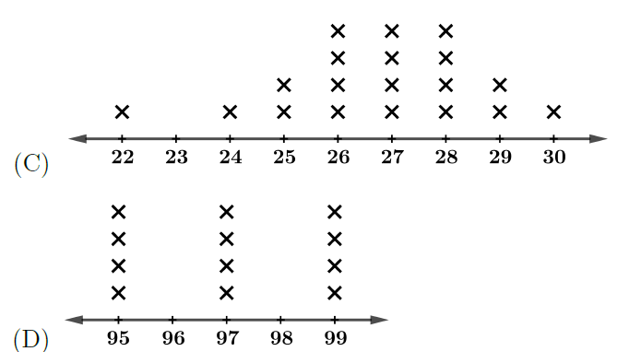
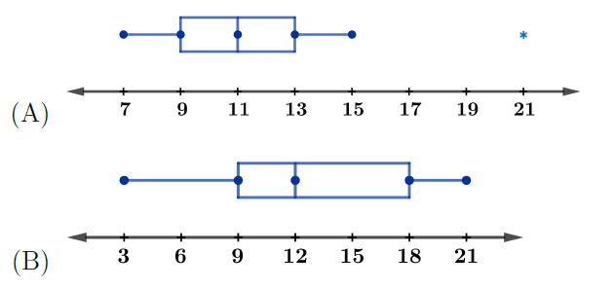
Question 14

Slide 32
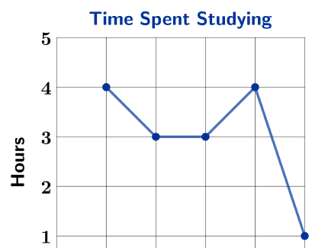
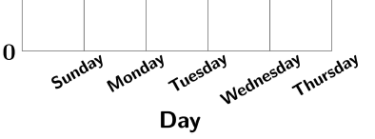
Question 15
Sunday: 4
Monday: 3
Tuesday: 3
Wednesday: 5
Thursday: 1

Slide 33
Question 15

