Slide 1
Writing

Slide 2
Pushing Boundaries
Writing 1
The Truth About Multitasking
Lesson 1
Term 1 - 2021/2022
Federal Entity | هيئة اتحادية

Slide 3
Objectives
1- Reading:
- Identifying the main idea of a text
- Completing missing parts of a text
2- Language focus:
-Expressing opinions and supporting them with evidence

Slide 4
Breakout Teams: 5 minutes (someone take notes) get into your groups and discuss the following questions. We will share ideas as a class when you’re done.

Slide 5
Strategy
Skim the text
Read the sentences
Go back to the text and read around the missing parts
Ascertain the main idea of that section and find the sentence which fits the best
Make sure you read the completed text when you are done to check it makes sense.

Slide 6
C
B
A

Slide 9
Expressing opinions Add one of the following words to the opinion phrases below to give them more power humble, truly, honestly
I think
I believe
In my opinion
I honestly think
I truly believe
In my humble opinion
There are numerous ways to express your opinion in English, make impressive and varied choices!

Slide 11
Free Writing
……………………………………………………………………………………………………………………………………………………………………………………………………………………………………………………………………………………………………………………………………………………………………………….. ………………………………………………………………………………………………………………………………………………………………………………………………………………………………………………………………………………………………………………………………………………………………………………..
………………………………………………………………………………………………………………………………………………………………………………………………………………………………………………………………………………………………………………………………………………………………………………..
………………………………………………………………………………………………………………………………………………………………………………………………………………………………………………………………………………………………………………………………………………………………………………..
………………………………………………………………………………………………………………………………………………………………………………………………………………………………………………………………………………………………………………………………………………………………………………..
………………………………………………………………………………………………………………………………………………………………………………………………………………………………………………………………………………………………………………………………………………………………………………..
………………………………………………………………………………………………………………………………………………………………………………………………………………………………………………………………………………………………………………………………………………………………………………..
………………………………………………………………………………………………………………………………………………………………………………………………………………………………………………………………………………………………………………………………………………………………………………..

Slide 12
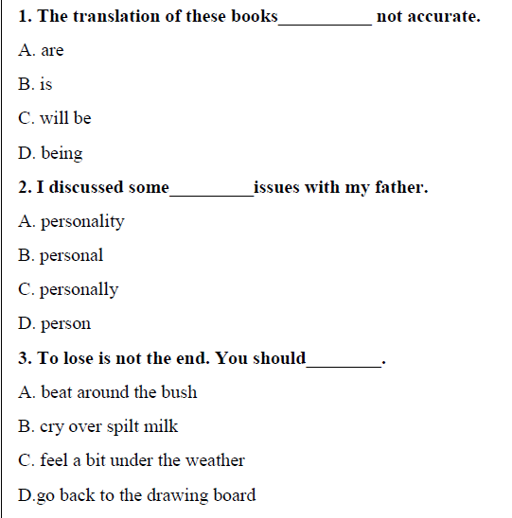
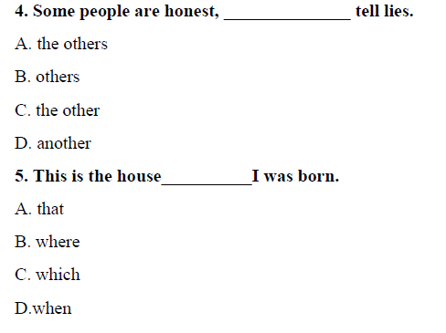

Slide 13
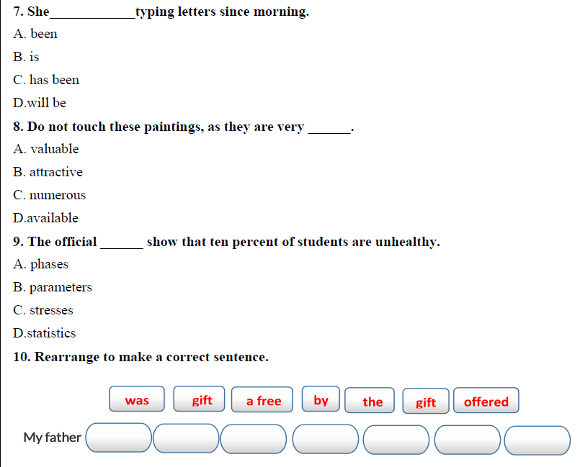
was
offered
A free
gift
by
the
gift

Slide 14
PLENARY

Slide 15
https://forms.office.com/r/XF6Mq92Dzt
https://wordwall.net/resource/21736602
Wordwall - Create better lessons quicker (https://wordwall.net/resource/21736602)
Multitasking : Writing practice
Unjumble - Drag and drop words to rearrange each sentence into its correct order.

Slide 16
Pushing Boundaries
Writing 1 – The Truth About Multitasking Lesson 2
Term 1 2021/2022
What is a blog? Write what you know in the chat box!
Federal Entity | هيئة اتحادية

Slide 17
Learning objectives
Listening:
Listening to and getting ideas from an extended audio on the topic
Writing:
Preparing for and writing a blog post
Language focus:
Expressing opinions and supporting them with evidence
Skills focus:
Collaborating – peer reviewing each other’s writing and providing constructive feedback

Slide 18
Blog titles In today’s lesson, we are preparing to write a blog. Choose one of these titles and start thinking about what you will include in your blog.
The Joys of Multitasking
The Dangers of Multitasking

Slide 20
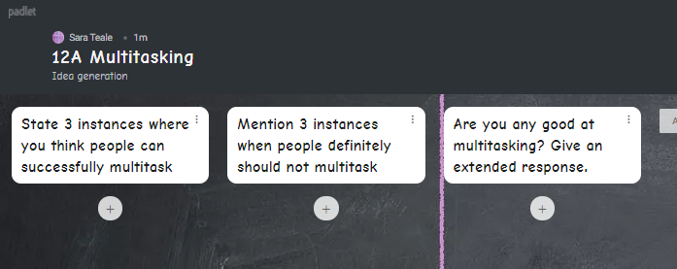
Planning
https://padlet.com/danielle6039/zczl0cfdz5w0q9k
Starter
Write 3 instances where you believe people can successfully multitask
Write 3 instances where you believe people definitely shouldn’t be multitasking
Just list your ideas, we will come back to these ideas later
5 Minutes

Slide 21
Listening – watch the video to review the ideas we discussed yesterday and get more information on the topic. You may need these ideas later!

Slide 23
Planning - Padlet
https://padlet.com/danielle6039/zczl0cfdz5w0q9k
Let’s go back to our planning Padlet and expand our ideas. Add reasons and examples to each of the instances you wrote earlier. You can also now respond to the final question, ‘are you any good at multitasking?’. Give an extended response to this.
10 Minutes

Slide 24
Blog Writing: First draft

Slide 25
Blog Writing
Blog writing is normally:
Formal or informal
In the 1st or 3rd person
Engaging and exciting or
serious and technical
Things to consider…

Slide 26
PLENARY
We have spent the last two lessons generating ideas and opinions. Now it is time to put all of these together and start writing our blog posts.
You have 10 minutes of class time to start writing.
Open a new Microsoft Word document in your personal folder on Teams and name it either “The joys of multitasking” or “The dangers of multitasking”, depending on which of the titles you chose earlier.
Your blog should have at least three sections. Each sections
should be between 50 – 80 words.
Don’t forget: we are training for EmSAT where you will need to think and write quickly and under pressure, so get working!

Slide 27
Blog Writing: Peer review

Slide 28
Peer review: two heads are better than one!
Work with a partner to give constructive feedback. You will open each other’s files on Teams to do this (be very careful to not delete or edit anything without your partner knowing). Here are the things you need to think about when evaluating your partner’s work:
Content and effect
Is the writer’s opinion presented in an interesting way?
Is it supported by reasons, arguments, facts, and examples.
Can you visualize what is being described in examples?
Should more supporting details be added?
Are there too many redundant details?
Can facts, opinions, and feelings be presented differently (more directly or indirectly?)
Are there sections or sentences that need to be rewritten?
Form
Punctuation, capitalization, other quotation marks
Spelling
Grammar
Vocabulary
Variety of sentences
Transition (connecting words)
You can either give your partner feedback verbally or by writing notes on their first draft.

Slide 29
Final writing: Homework

Slide 30
Homework You should now be ready to go ahead and write your final blog posts. Make sure you have listened to and taken onboard the suggestions from your partner before you write.
The Joys of Multitasking
The Dangers of Multitasking
Upload your final work to your personal folder in Teams. You have one week to complete this task, so give it your best shot! You can submit this as a PowerPoint with pictures to make it look more authentic.

Slide 31
Plenary

Slide 32
Exit Ticket
Tell me what you learned today! Leave me a message in the chat box.
Don’t forget: You have 1 week to complete your blogs. Upload your work to your folder in Teams, clearly labelled with the title of your blog post

