Slide 1
Unit 1 flashcards

Slide 2
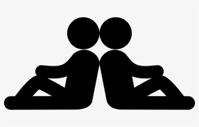
back-to-back
two people facing in opposite directions with their backs touching.

Slide 3
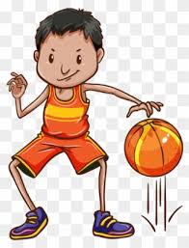
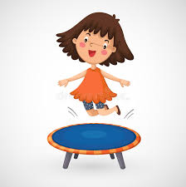
bounce
to hit a
surface and then move
quickly away.

Slide 4
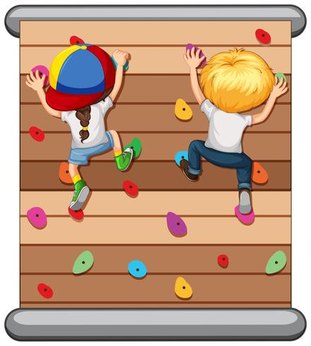
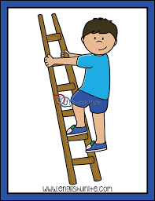
climb
to go up something.

Slide 5
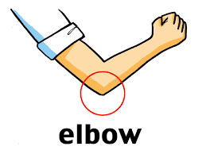
elbow
the part in the middle of
your arm
where it bends.

Slide 6

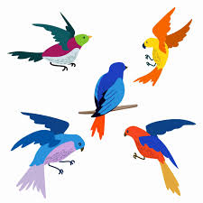
Feather
one of the soft, light
things that cover a bird’s skin.

Slide 7
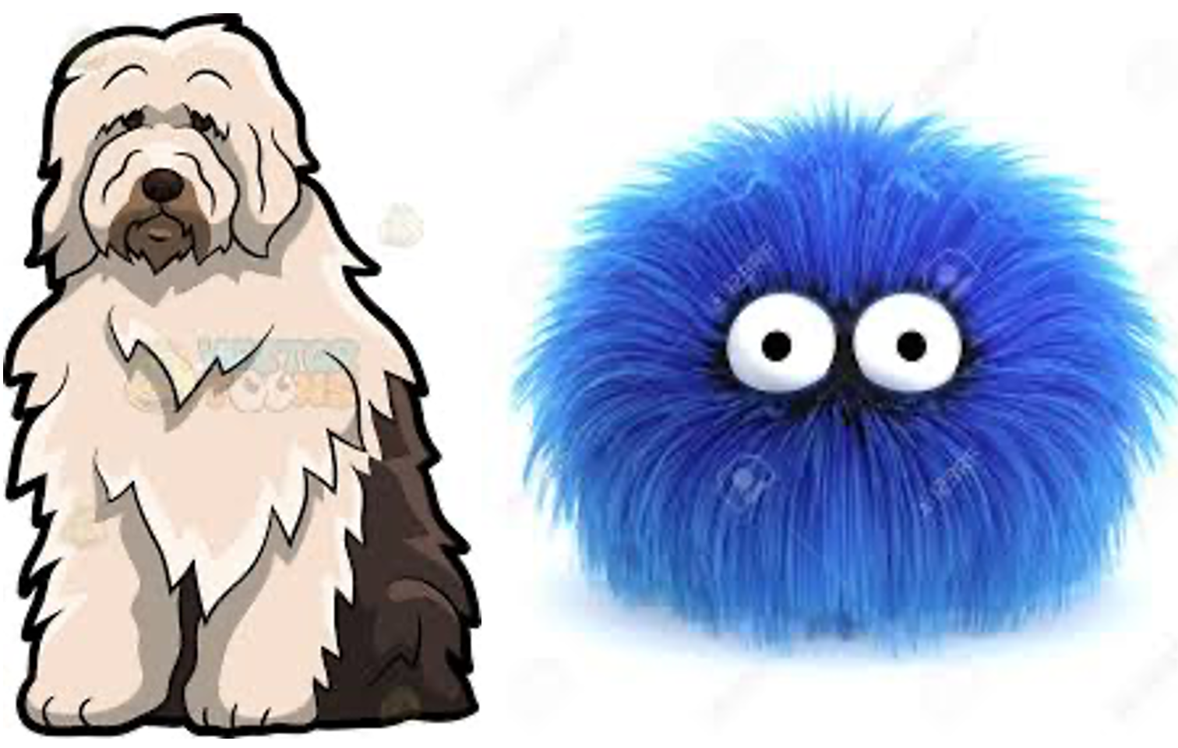

Fur
the thick hair
that covers the
bodies of some animals like dogs and rabbits.

Slide 8
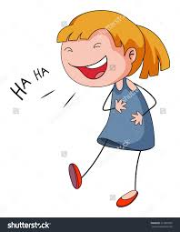
giggle
to laugh in an excited way.

Slide 9
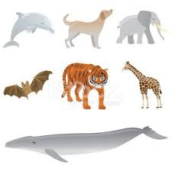
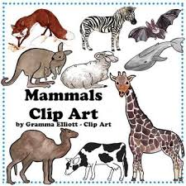
mammals
animals that give
birth to their kids. They feed their babies milk.

Slide 10
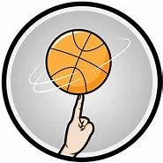
spin
to turn round and round quickly.

Slide 11
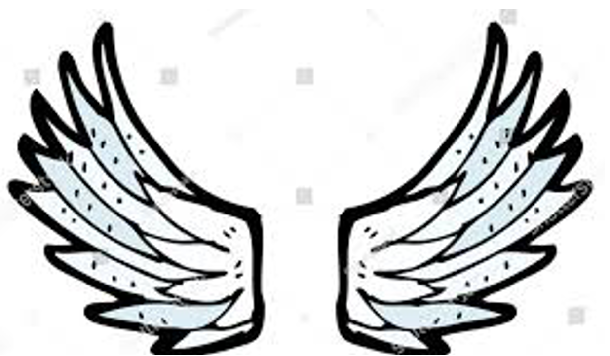
wing
the flat part of the body that a bird, insect, or bat uses for flying.

Slide 12
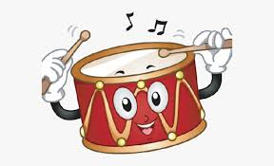
drum
a musical
instrument
played by hitting with the hand or a stick.

Slide 13

celebrate
To share in
(a happy day or event) with a social gathering or enjoyable activity.

Slide 14
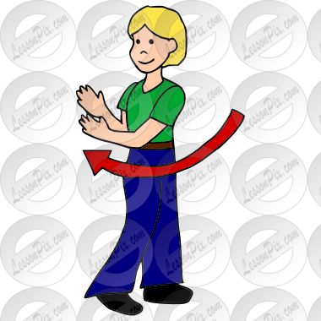
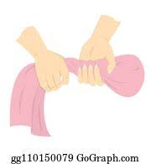
twist
To turn a part of your
body or a thing

Slide 15
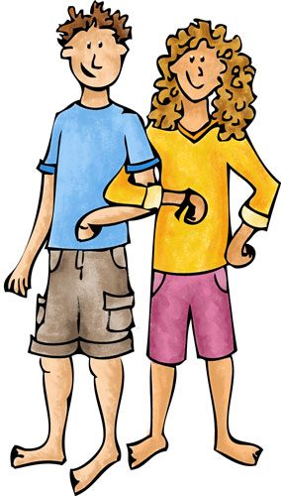
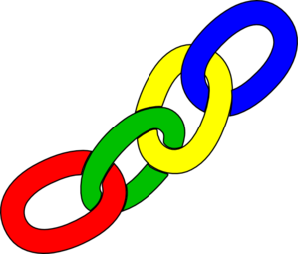
Link
a connection between two people
or things.

Slide 16
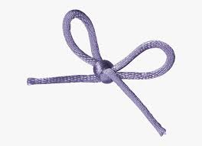
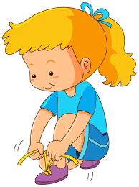
tie
to hold
together two ends of
string.

Slide 17
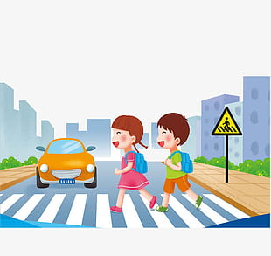
cross
to go across
from one side to the other.

Slide 18
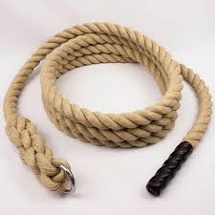
rope
Very thick string

Slide 19
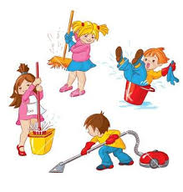
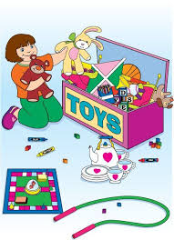
tidy up
make things cleaner

Slide 20
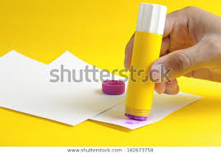
to stick
to hold to something firmly.

Slide 21
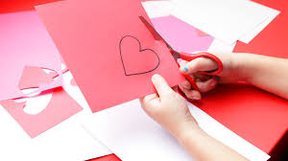
cut out
to remove
something from a larger piece
by cutting.

Slide 22
The end
Good luck

