Slide 1
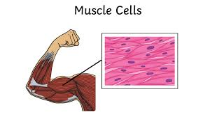
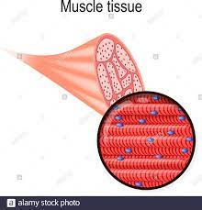
6/9/2021
Chapter 2: Life - Structure and Function
Section 1: Exploring Life
6A2
Page 15
Cell and its Organization
For this lesson you will need your…
Science notebook
Pencil case
Textbook
Wifi MOESTAFF
password-MOESt@ff2020

Slide 2
Learning Objectives:
Students are expected to:
define cells and explain what they are made of
Tissue, organ, organ system
Keywords

Slide 3
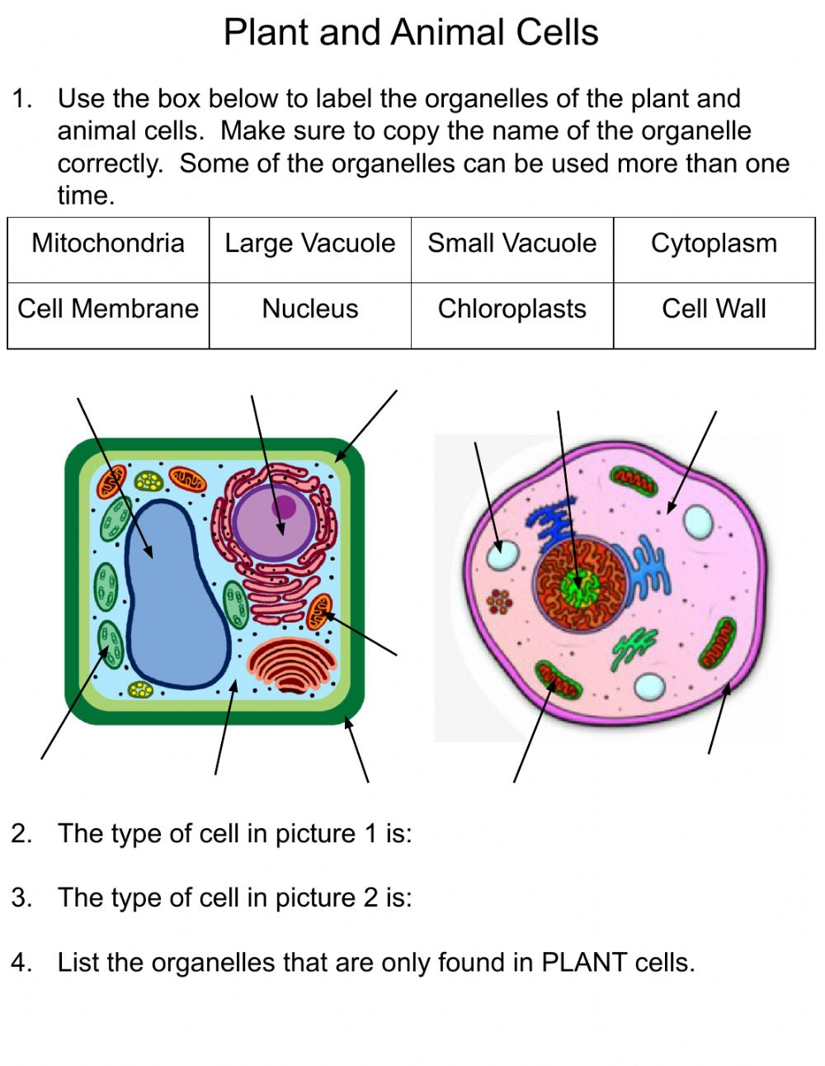
Lesson Starter
https://www.liveworksheets.com/c?a=s&t=on35kk2jy2&sr=n&ms=uz&l=zr&i=uctttnc&r=hn&db=0&f=dzduznzx&cd=pjl08cc5qi5lgsxkzzzlkwl2ngnxglgmxg
Write your answer in chat box.

Slide 5
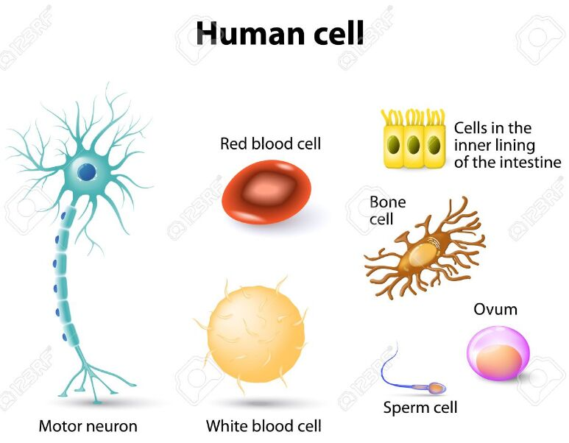

Slide 9
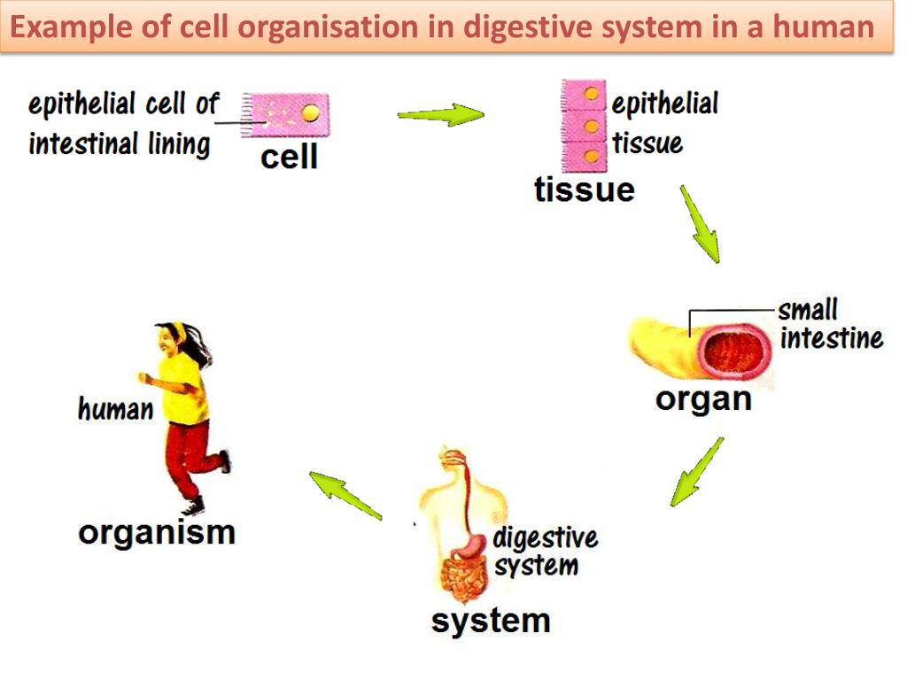
Cells produce tissues.
Tissues produce organs.
Organs produce organ systems.
Organs systems produce organisms
https://www.edumedia-sciences.com/en/media/931-from-the-cell-to-the-organism

Slide 10
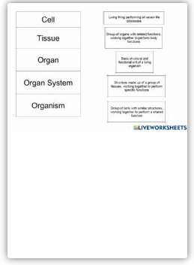
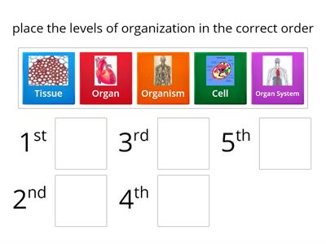
define cells and explain what they are made of
Quick check
EVALUATE
https://www.liveworksheets.com/c?a=s&t=on35kk2jy2&sr=n&ms=uz&l=lz&i=uouofxs&r=fj&db=0&f=dzduznzx&cd=pjl08cc5qi5lagxjxjempeq2ngnxglgmxg
https://wordwall.net/play/8502/229/788

Slide 14
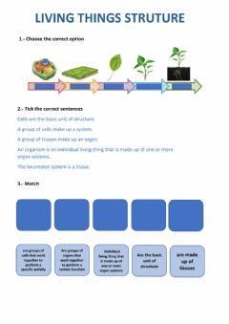
define cells and explain what they are made of
Quick check
EVALUATE
https://www.liveworksheets.com/c?a=s&t=on35kk2jy2&sr=n&ms=uz&l=pt&i=ufzdncn&r=ys&db=0&f=dzduznzx&cd=pjl08cc5qi5lhzxegnlklip2ngnxglgmxg
https://wordwall.net/play/8533/775/2782

Slide 16
https://wordwall.net/play/5106/189/205

Slide 17
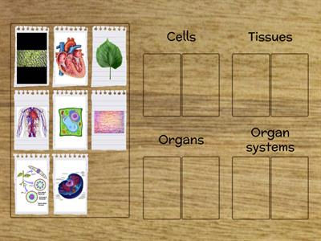
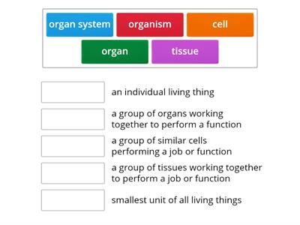
define cells and explain what they are made of
Quick check
EVALUATE
https://wordwall.net/play/6784/171/8506
https://wordwall.net/play/5595/504/1706

Slide 18
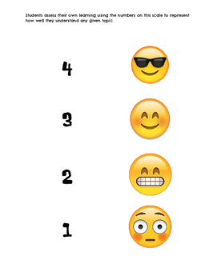
Plenary/ Exit ticket
Self assessment Type your name and self-assessment in the chat box.
I totally understand! - 9 or 10/10 or 5/5
I get it! – 7 or 8 /10
or 4/5
I’m nearly there! - 5 or 6 / 10
or 3/5
I need more help please! – 4 or less
or 2/5 or less
https://www.liveworksheets.com/c?a=s&t=on35kk2jy2&sr=n&ms=uz&l=xb&i=utuudnc&r=sr&db=0&f=dzduznzx&cd=pjl08cc5qi5lmfxzxxnlkps2ngnxglgmxg

