Slide 2
Unit 4 Lesson2
Part 2 Pg No.28

Slide 3
Circle the correct answer
What does An-Nas mean?
Mankind or people B) Jinn and Angels
2.What are the 3 qualities of Allah mentioned in Surat An-Nas?
Hearer, Answerer and Knower B) Lord, King and God of people
3. What is the meaning of ‘seeking refuge’?
A) Ask for protection or shelter B) Search for a good house

Slide 4
WALT: explain the overall meaning of verses 4 to 6 of surat an-nas
We can infer the creature from whom we should seek refuge.
1
We can identify the Surahs that are named Al-Muawwizatain.
2
We can list the occasions when we should seek refuge in Allah.
3

Slide 5
https://www.youtube.com/watch?v=9KuwgqT2nEg

Slide 6
Whom do we seek refuge or protection from?
We seek protection from the evil whisperer who whispers into the hearts of people.
The evil whisperer is Shaytan. Shaytan is the biggest enemy of humans. He wants us all to go the hell-fire along with him.
Shaytan has many helpers and partners from among the jinn and humans.
Jinn are another creation of Allah who are created from fire. They are invisible, so we cannot see them.
Another creation of Allah who cannot be seen are the angels. The angels are created from light.

Slide 7
Circle the correct answer
1. Who is the evil whisperer who whispers into the hearts of people?
A) Angels B) Shaytan
2. Who are the helpers of Shaytan?
A) Jinn and Humans B) Animals and Birds
3. What are Jinn made of?
A) Fire B) Water
4. Which creature of Allah are made of light?
A) Angels B) Human Beings

Slide 8
Drag the smiley to the success criteria that we have achieved
We can infer the creature from whom we should seek refuge.
1
We can identify the Surahs that are named Al-Muawwizatain.
2
We can list the occasions when we should seek refuge in Allah.
3

Slide 9
Al-muawwizatain
Al-Muawwizatain which means ‘the two (chapters) of Refuge’ refer to the last 2 Surahs of the Quran: Surat Al-Falaq and Surat An-Nas.
These 2 Surahs begin with the verse “Say, I seek refuge in….”
These 2 surahs were revealed together. They are so close to each other in meaning and the content that they are often recited together.
The Prophet (PBUH) said that the like of Al Falaq and An Nas has not been seen before and they are uncomparable.

Slide 10
Which two Surahs are known as Al-Muawwizatain?

Slide 11
Why are these two Surahs known as
Al-Muawwizatain?

Slide 12
Drag the smiley to the success criteria that we have achieved
We can infer the creature from whom we should seek refuge.
1
We can identify the Surahs that are named Al-Muawwizatain.
2
We can list the occasions when we should seek refuge in Allah.
3

Slide 13
Times when we should seek refuge
Before sleeping
Before using the washroom
At the beginning of the prayer
Before reading the Quran
5. Every morning and evening
6. When we are scared
7. When we are angry
8. When we are tempted to bad things

Slide 14
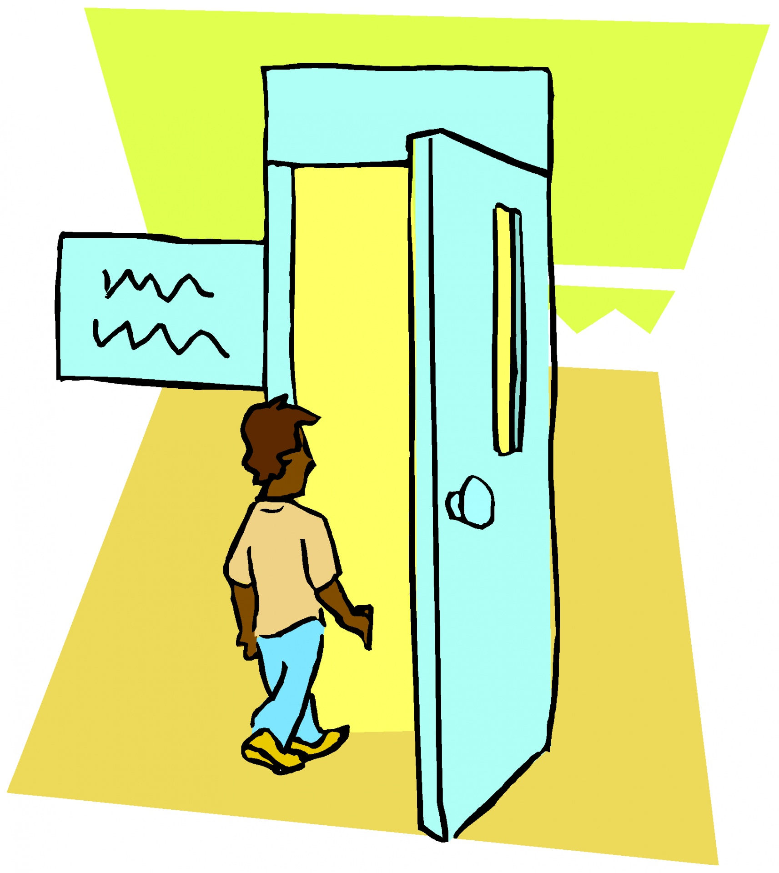
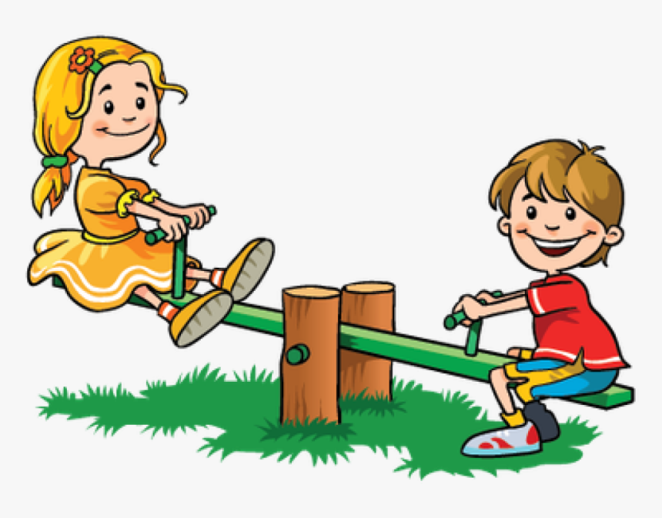
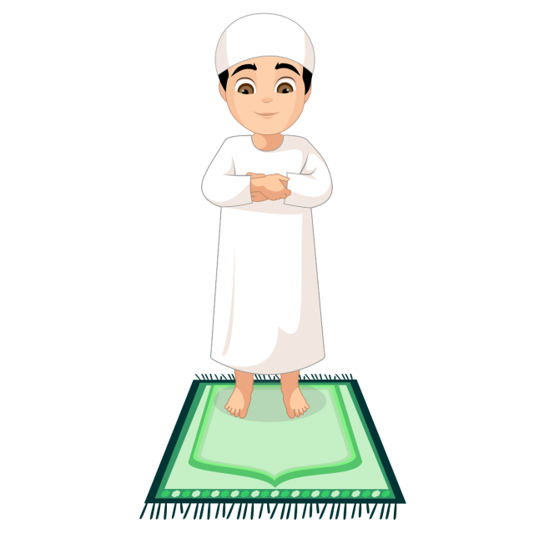
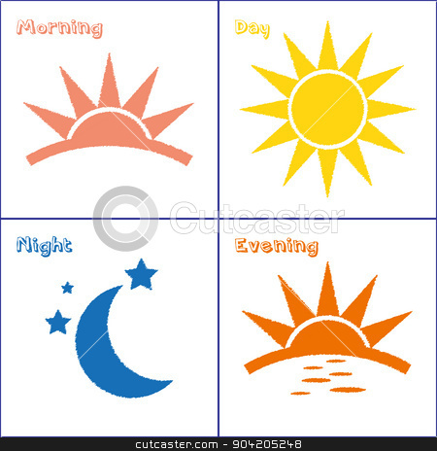
Circle the times when we should seek refuge
Washroom

Slide 15
Drag the smiley to the success criteria that we have achieved
We can mention some facts about Surat An-Nas.
1
We can list the qualities of Allah mentioned in these verses.
2
We can explain the meaning of seeking refuge.
3

Slide 16
Topic for the next class My Prayer Is The Light of My Life

