Slide 2
English Language
Reading and Writing task
Level – 1.1

Slide 3
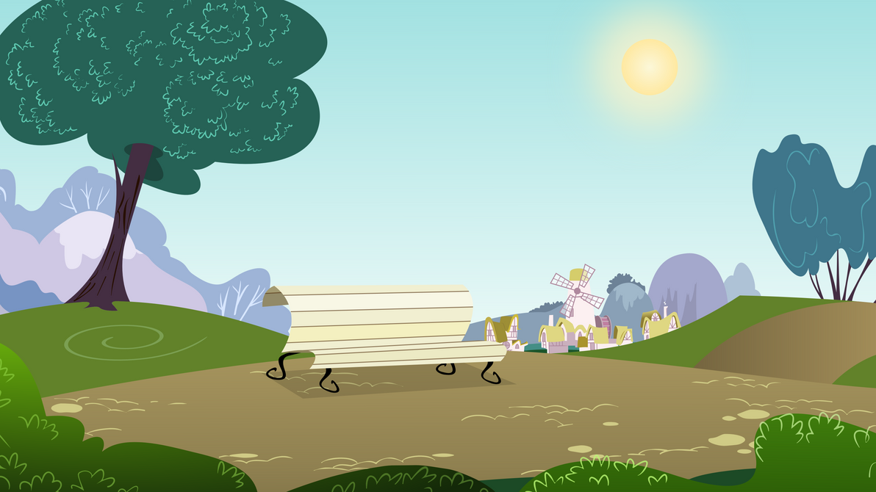
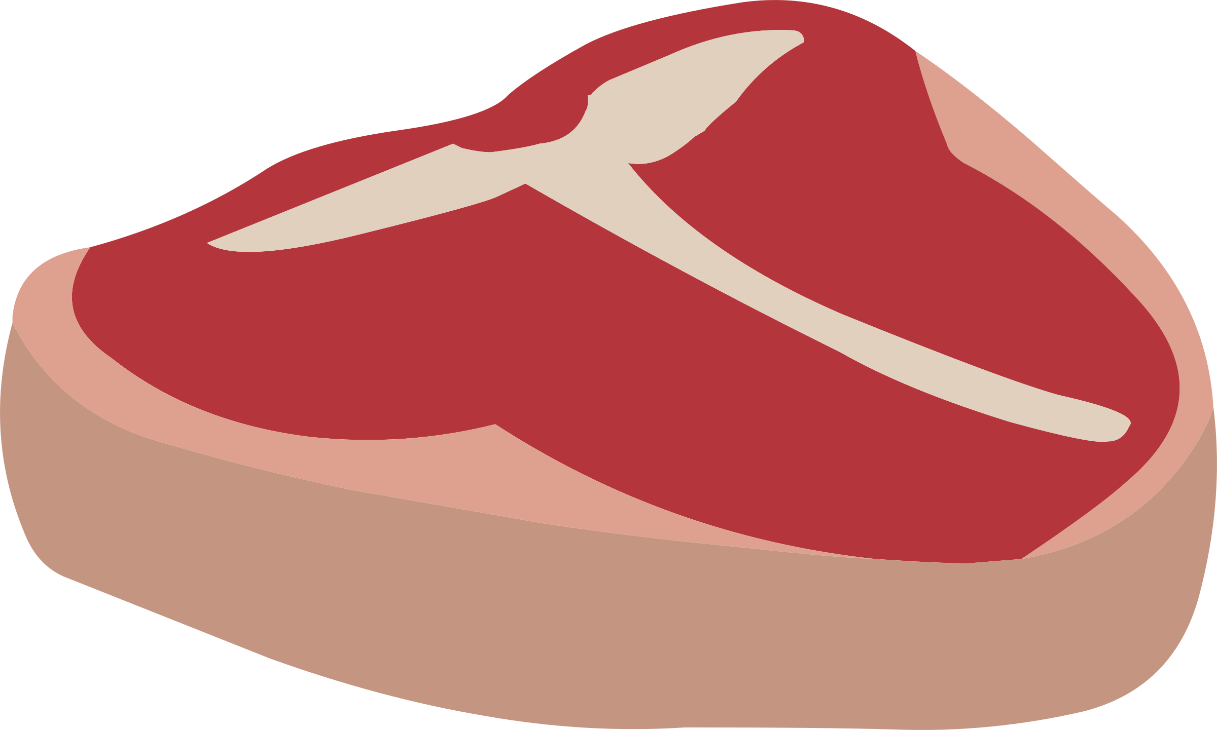
Project title: The Dog and the Shadow

Slide 4
Learning Objectives
Read and understand the story.
Understand words in the story.
Understand the meaning of the story.

Slide 5
Key Words
dog
shadow
water
plank
greedy

Slide 6
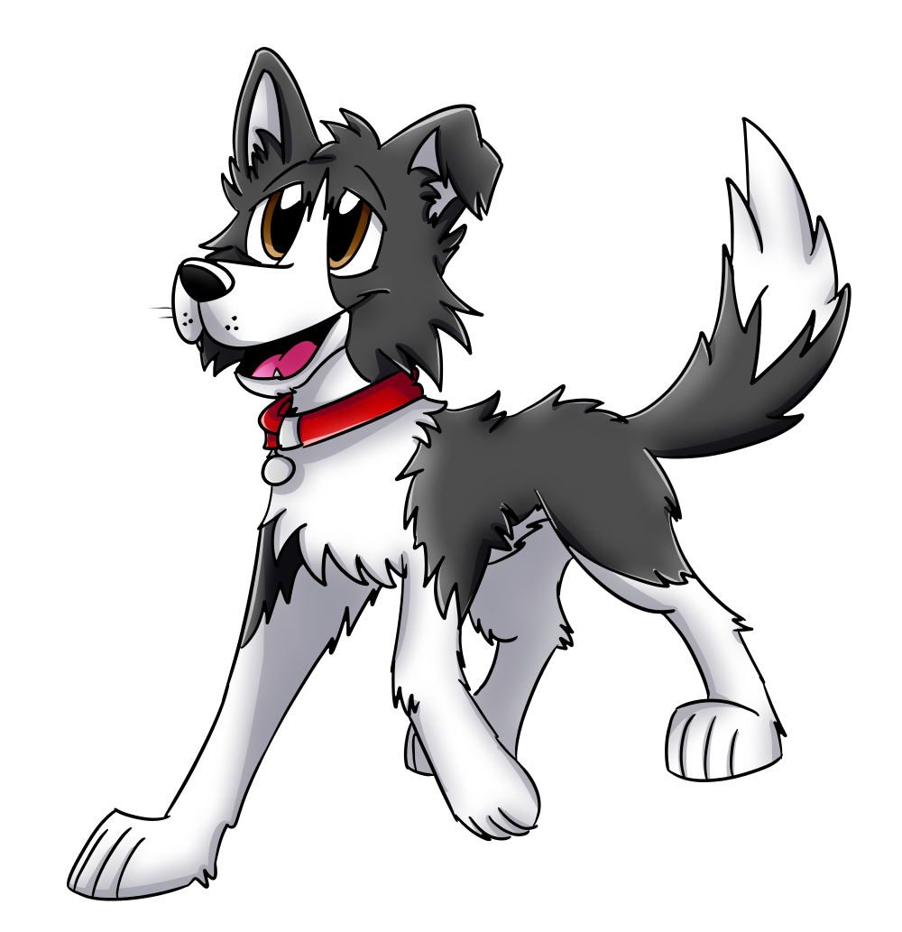
dog
a furry animal with four legs, a pointed nose, and a tail.

Slide 7
shadow
A shadow is the dark shape made when something blocks light

Slide 8
water
a clear liquid that has no taste or smell.

Slide 9
plank
a long, thin, flat piece of wood.

Slide 10
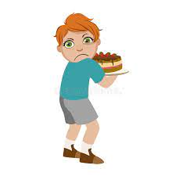
greedy
having a big desire or appetite for food.

Slide 11
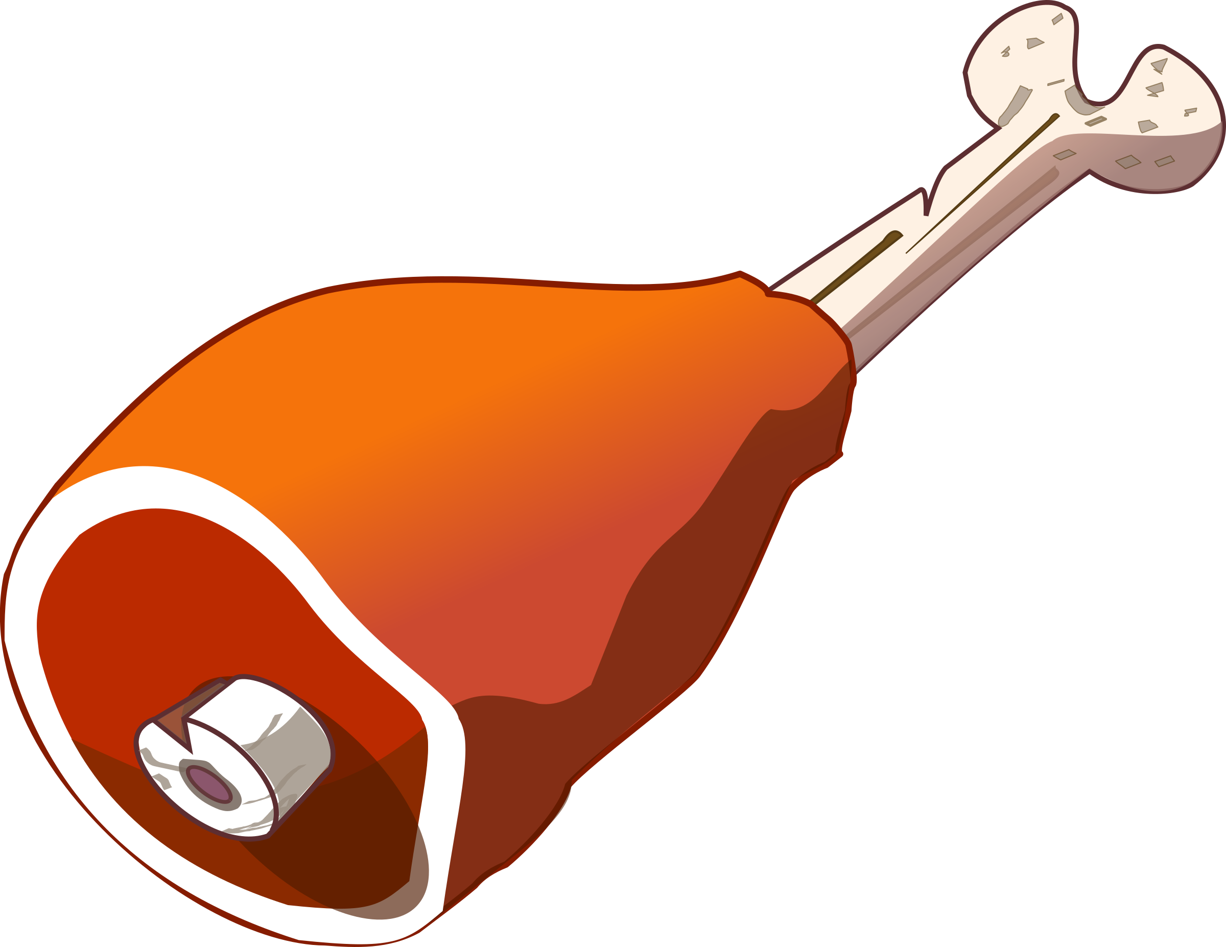
The dog carried the meat.

Slide 12
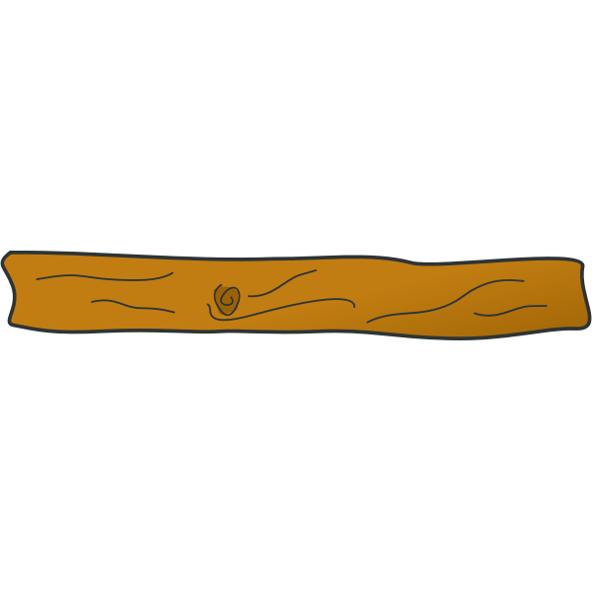
He crossed a plank.

Slide 13
He saw another dog.

Slide 14
He saw more meat.

Slide 15
He tried to eat more meat.

Slide 16
The meat fell into the water.

Slide 17
The other dog was a shadow.

Slide 18
The dog lost both meats.

Slide 19
Questions
Question 1:
What did you learn from the story?

Slide 20
Questions
Question 2:
What did the dog carry in his mouth?

Slide 21
Questions
Question 3:
What did the dog walk across?

Slide 22
Questions
Question 4:
How did the dog feel when he lost both meats?

Slide 23
Questions
Question 5:
Why did the dog lose both meats?

Slide 24
Questions
Question 6: Reflection
I think that question ______ was difficult because ______________.
I like question ______ because _____________________________.

Slide 25
Glossary
Shadow - A shadow is the dark shape made when something blocks light.
Plank - a long, thin, flat piece of wood.
Greedy - having a big desire or appetite for food.

