Slide 1
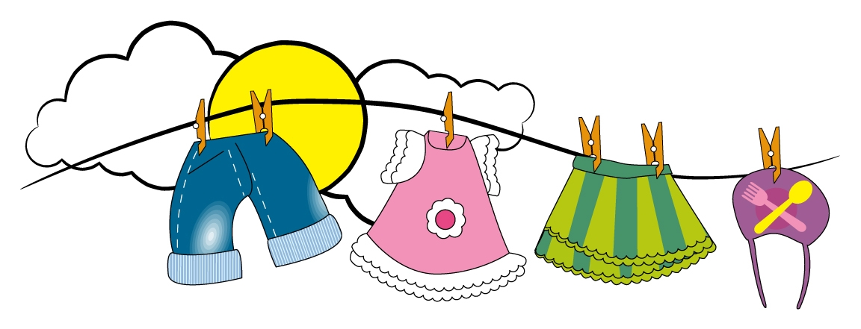
Unit 3 Clothing and accessories
Lessons 1-2
How important are clothes to you?

Slide 2
Lesson 1

Slide 3
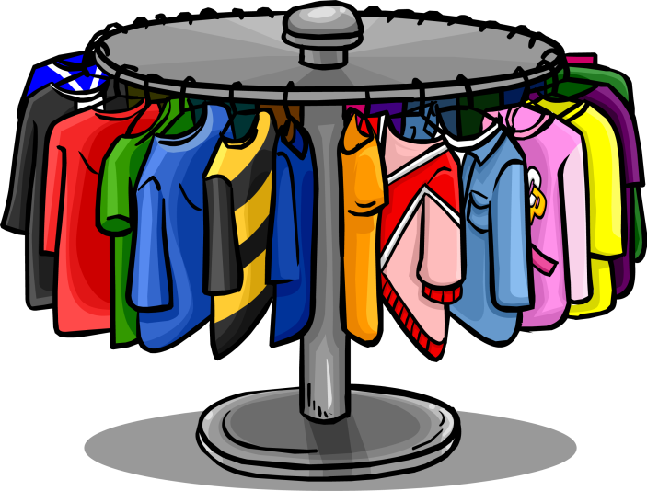
How many items of clothing can you name?

Slide 5
T-shirt is not described

Slide 6
Pyjamas
bandana
Zip
buttons
Collar
sleeves
Wrap
wear

Slide 7
sleeves
sombrero
buttons
bandana
zip
sari
kimono

Slide 8
C
E
b
a
f
d

Slide 9
Lesson 2

Slide 10
Learning objectives:
Speaking: To discuss shopping habits and clothes, using the present simple.
Reading: To read about two people’s views on clothes and fashion.
Speaking: To ask and answer questions about clothes and fashion.

Slide 12
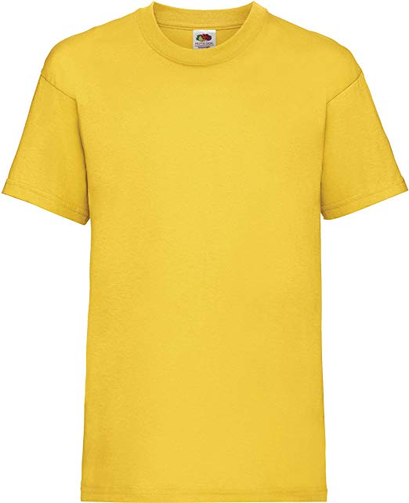
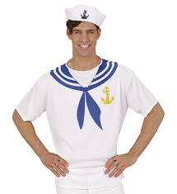
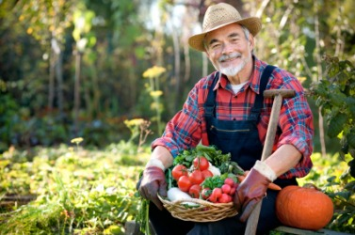
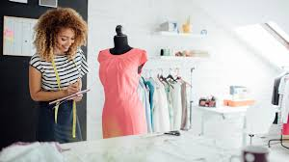
Key vocabulary:
T-shirt
uniform
designer
sailor
farmer
cotton

Slide 13
1 from the shape of the body
2 cotton
3 short
4 no

Slide 17
world
Uniforms
cotton
sleeves
shirt

Slide 19
1 What are you wearing today?
2 Do you like designer clothes?
3 Do you ever wear jeans?
4 Do you have a favourite item of clothing?
5 Do you wear traditional clothing from your country?
6 What do you wear as protection from the sun?

