Slide 1
9/9/2021
Chapter 2: Life - Structure and Function
Section 1: Exploring Life
6A1
Page 22
classify living things
For this lesson you will need your…
Science notebook
Pencil case
Textbook
Wifi MOESTAFF
password-MOESt@ff2020

Slide 2
Learning Objectives:
Students are expected to:
classify living things
Keywords
Domains, kingdom

Slide 3
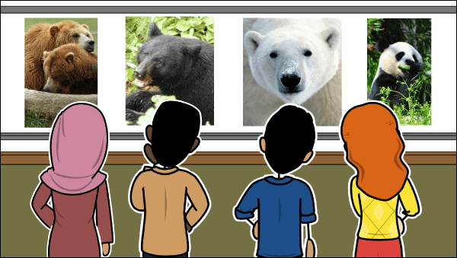
Lesson Starter
How can you classify the animals in the given picture . Write your answer in chat box.

Slide 4
classify living things
Classification
Organisms are classified according to their cell type, prokaryotic or eukaryotic as well as other characteristics.
All organisms are classified into one of the three domains- Bacteria, Archaea and eukarya.
And then into one of the six kingdoms

Slide 5
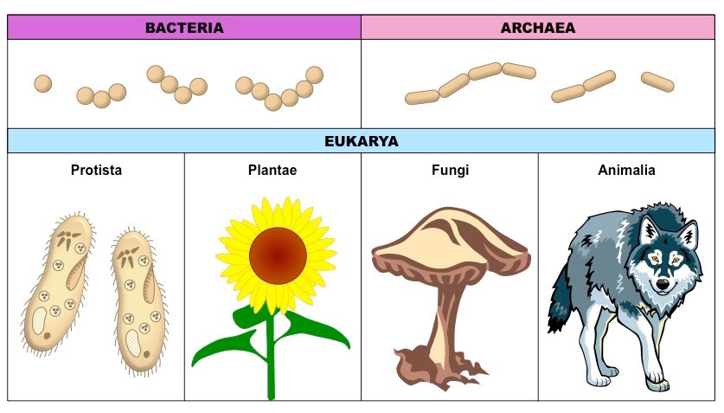
Organisms in the Bacteria and Archaea domains are unicellular prokaryotes, while organisms in the Eukarya domain are eukaryotes

Slide 6
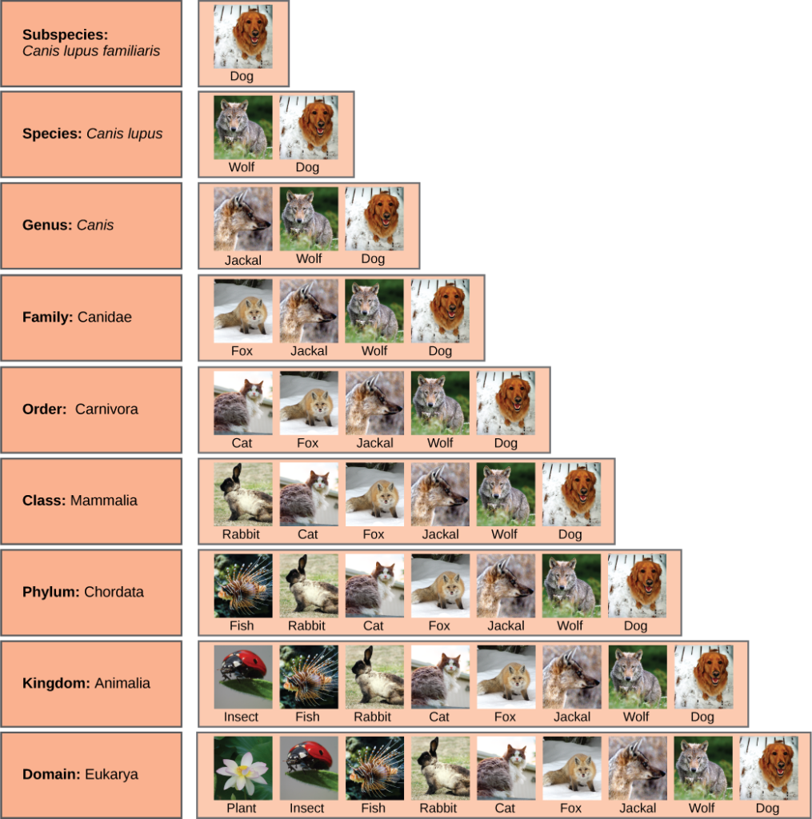
classify living things
Taxonomy
Using taxonomy, scientists divide all living things on Earth into three groups called domains.
Domains are divided into kingdoms, and then phyla ( singular, phylum), classes, orders, families, genera (singular, genus), and species.
A species is made of all organisms that can mate with one another and produce offspring that can reproduce.

Slide 7
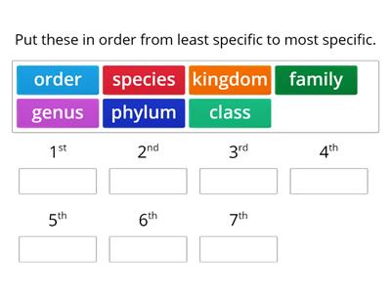
classify living things
Quick check
EVALUATE
https://wordwall.net/play/8229/121/628

Slide 8
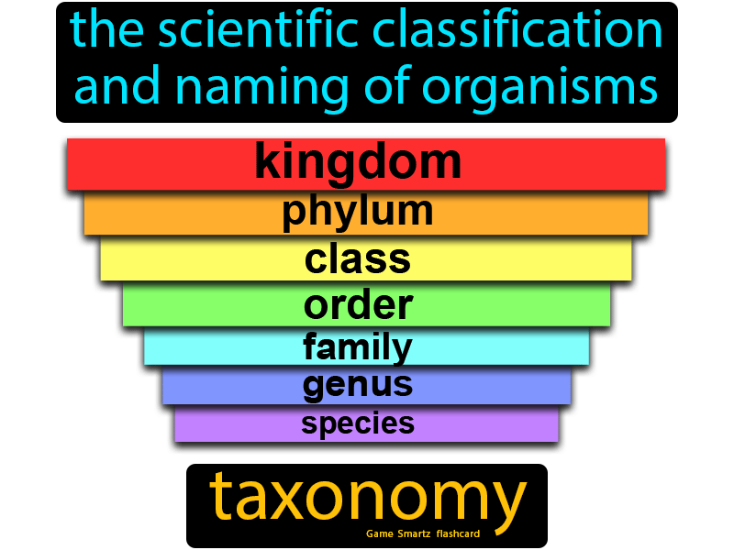
classify living things
Classification Systems
Linnaeus also classified organisms based on their behavior and appearance.
Today, the branch of science that classifies living things is called taxonomy.
A group of organisms is called a taxon (plural, taxa).
The current classification method uses organism’s cell type, habitat, the way it obtains food and energy.

Slide 9
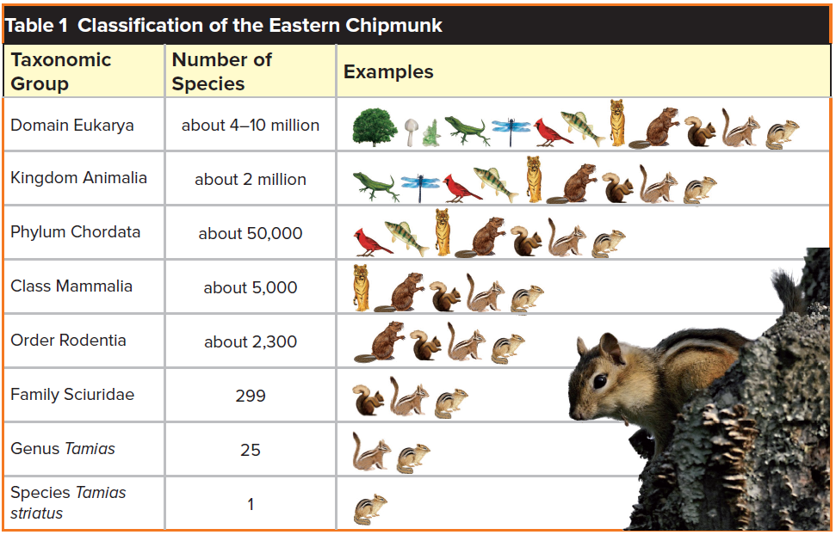
classify living things
How are living things classified?
Naming Living Things
Scientists name living things using a system called binomial nomenclature.
Binomial nomenclature is a naming system that gives each living thing a two-word scientific name.
More than 300 years ago a scientist named Carolus Linnaeus created the binomial nomenclature system.
All scientific names are in Latin. Homo sapiens is the scientific name for humans.
As shown in Table 1, the scientific name for an Eastern chipmunk is Tamias striatus

Slide 10
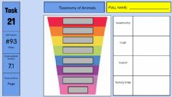
classify living things
Quick check
EVALUATE
https://www.liveworksheets.com/c?a=s&t=on35kk2jy2&sr=n&ms=uz&l=sj&i=uffdudc&r=ax&db=0&f=dzduznzo&cd=pjl08cc5qi5lpqxeenxnkdm2ngnxglgjxg

Slide 11
classify living things
Quick check
EVALUATE
1. A group of organisms is called a taxon
True
False
2. Linnaeus created a two-word naming system for organisms called ________________
3.Explain how binomial nomenclature helps scientists classify organisms

Slide 12
classify living things
Quick check
EVALUATE
1. A group of organisms is called a taxon
True
False
2. Linnaeus created a two-word naming system for organisms called Binomial nomenclature
3.Explain how binomial nomenclature helps scientists classify organisms.

Slide 13
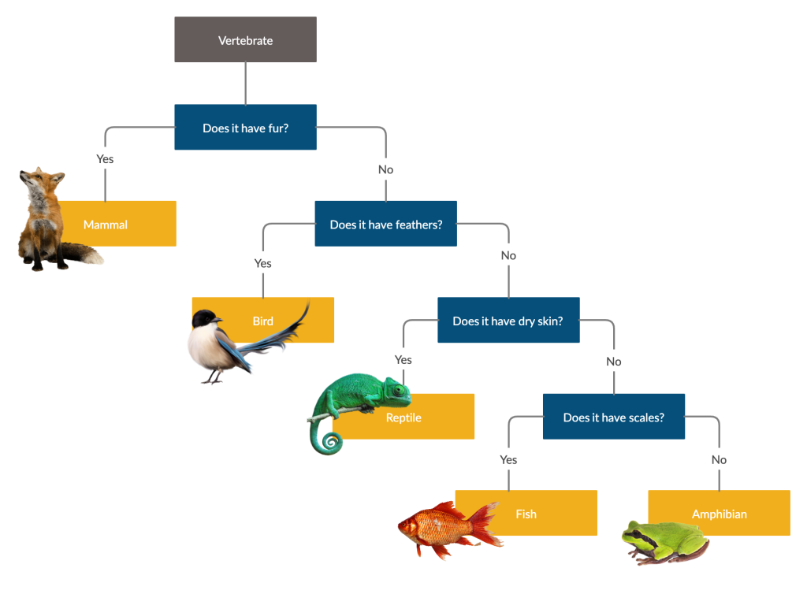
classify living things
Dichotomous keys are organized in steps.
Each step might ask a yes or a no question and have two answer choices. Which question is answered next depends on the answer to the previous question.
Based on the features, a choice is made that best describes the organism.
Dichotomous Keys
A dichotomous key is a tool used to identify an organism based on its characteristics.
Dichotomous keys contain descriptions of traits that are compared when classifying an organism.

Slide 14
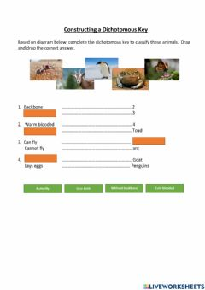
classify living things
Quick check
EVALUATE
https://www.liveworksheets.com/c?a=s&t=on35kk2jy2&sr=n&ms=uz&l=yt&i=uxutotc&r=xz&db=0&f=dzduznzo&cd=pjl08cc5qi5lizxmxzjzkmg2ngnxglgjxg

Slide 15
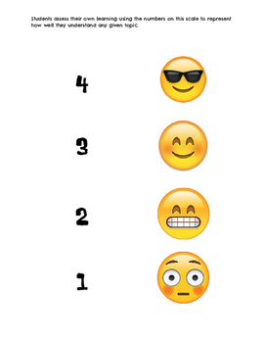
Plenary/ Exit ticket
Self assessment Type your name and self-assessment in the chat box.
I totally understand! - 9 or 10/10 or 5/5
I get it! – 7 or 8 /10
or 4/5
I’m nearly there! - 5 or 6 / 10
or 3/5
I need more help please! – 4 or less
or 2/5 or less

