Slide 1
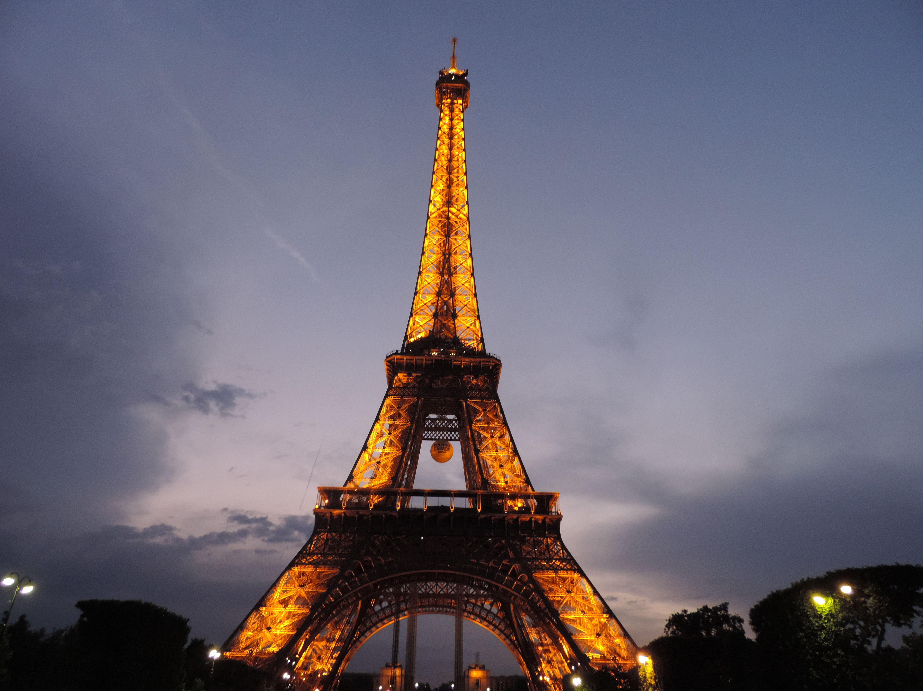
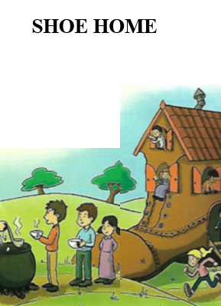
ENGLISH TRIMESTER 1 READING JOURNAL
Cycle 2 Term 1 (2021-2022) GRADE 6 GENERAL LEVEL 3.2

Slide 2
OBJECTIVES
READ AND IDENTIFY INFORMATION IN THE TEXT
DISCUSS THE OVERALL MEANING OF THE TEXT
SUMMARIZE THE MAIN POINTS OF THE TEXT

Slide 3
Complete the information
NAME:…………………………
GRADE: 6…………………..

Slide 4
Reading Goals
Read and identify information in a text
01
Discuss the overall meaning of the text with a partner.
02
Summarise the main points of the text in your own words.
03

Slide 5
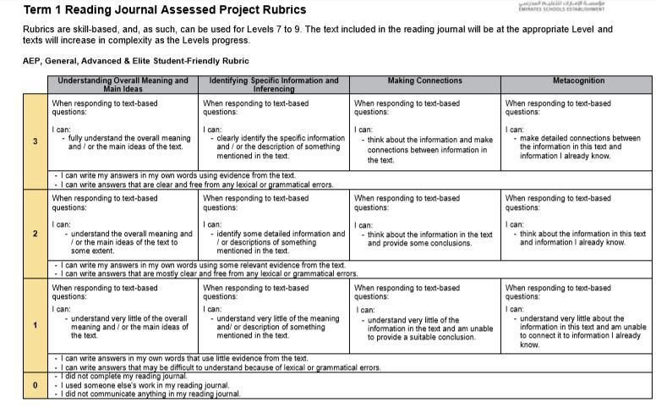
How will you be assessed?

Slide 6
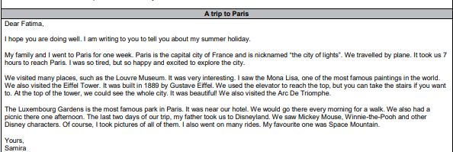
Let’s read a text:

Slide 7
Question 1:
What is the main point of this letter?

Slide 8
Question 2
How do you know Samira enjoyed Paris?
Which words helped you to answer the question?

Slide 9
Question 3
Who built the Eiffel Tower?
Which words helped you to answer the question?

Slide 10
QUESTION 4
Why did Samira say she was tired?
Which words helped you to answer the question?

Slide 11
QUESTION 5
Where did Samira and her family go to on their last two days of their trip?
Which words helped you to answer the question?

Slide 12
QUESTION 6
Why do you think Paris is called the “city of lights”?
Which words helped you to answer the question?

Slide 13
METACOGNITIVE THINKING: QUESTION 7
Think of another city Samira would like. Explain why she would like this city.
Explain why.

Slide 14
