Slide 1
2020-2021
Grade 2
UAE Phonics

Slide 2
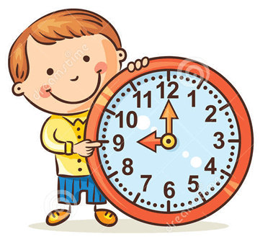
Classroom Rules
Rule 1: Join the class on time
Sunday
29th – March - 2020
Rule 2: keep your microphone muted
Our green earth
Rule 3: open your webcam
Rule 4: listen carefully and follow instructions

Slide 3
The date
Sunday
Today is …………………………
10th
of October,
2021

Slide 4
Weather
How is the weather today?
It is ………………

Slide 5
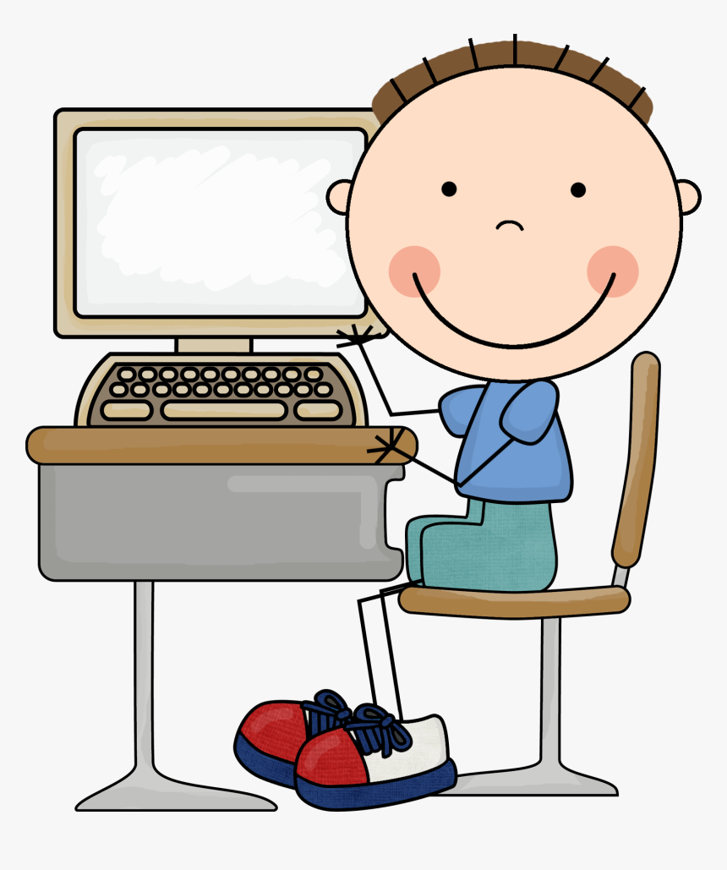
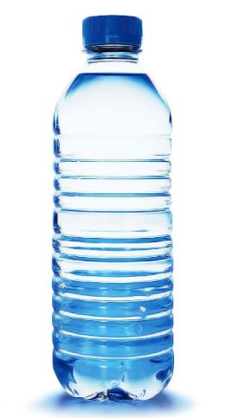
You will need:
Al Diwan​
https://elib.moe.gov.ae/App

Slide 6
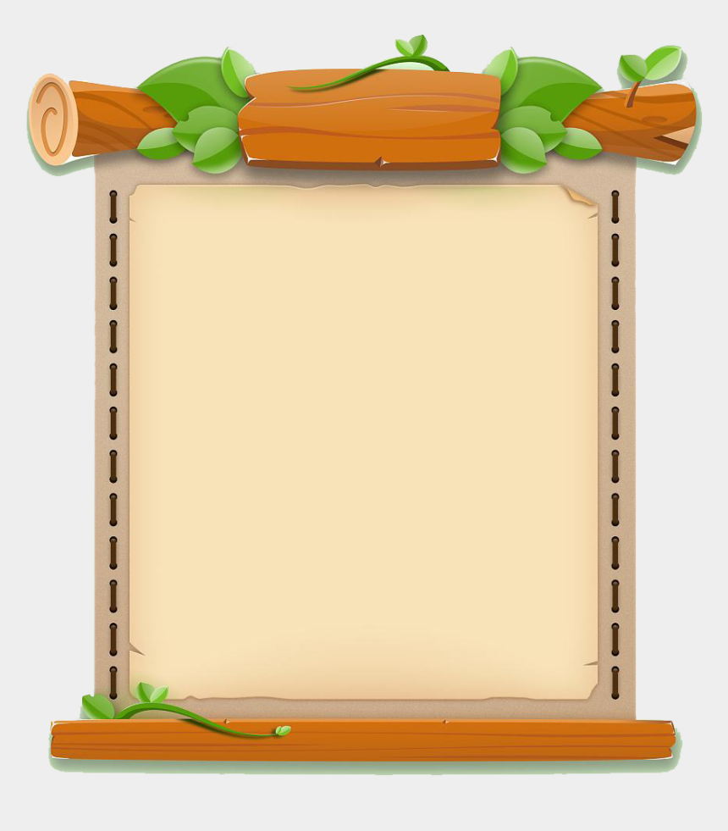
Objectives:
To be able to identify different kinds of pronouns.
2. To be able to use pronouns in sentences.

Slide 7
Warming Up
https://www.jigsawplanet.com/?rc=play&pid=2a77ebdf12ee

Slide 8
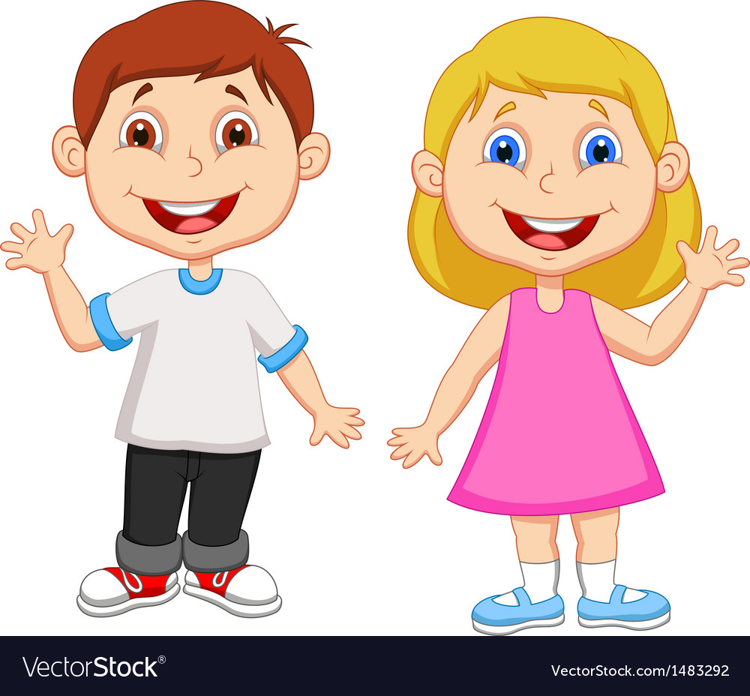
Pronouns

Slide 9
https://www.youtube.com/watch?v=ZY3U25QMxS8

Slide 12
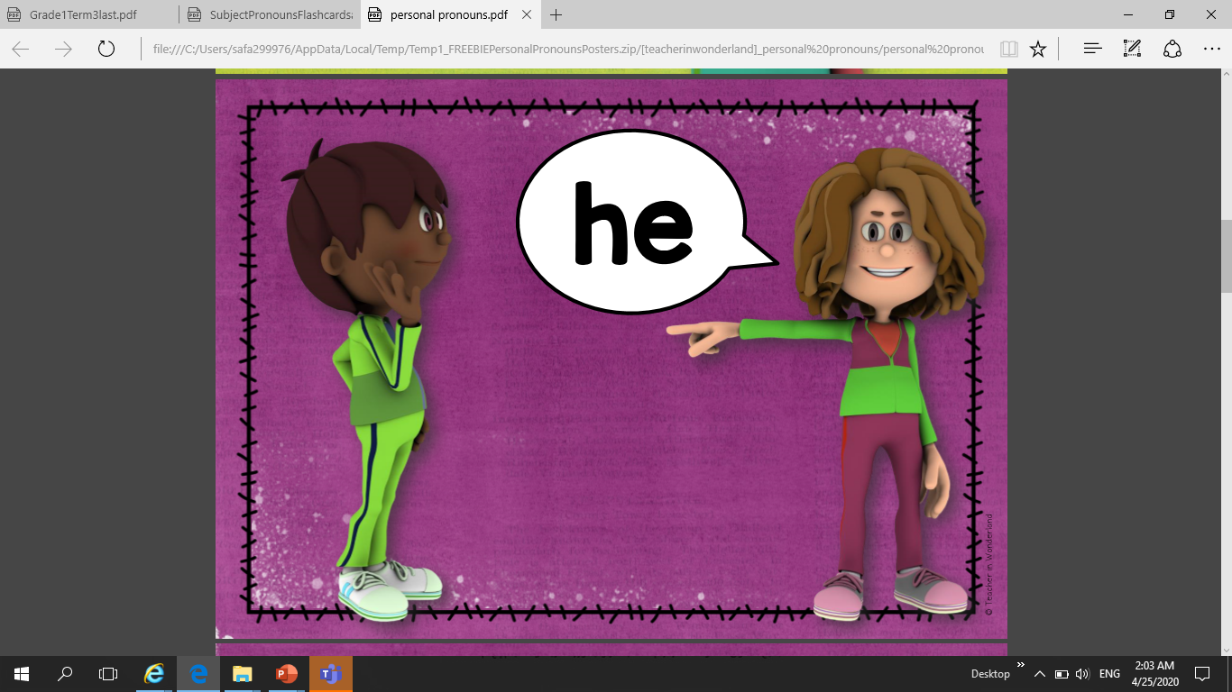

Slide 15
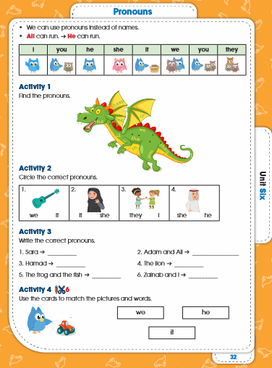
Page
32

Slide 16
32

Slide 17
# You have to know:
He
She
It
They
You
We
I
is
are
am
He is a boy.
You are happy.
I am Mona.

Slide 18
Let’s start!
Activity 1
Page 32

Slide 19
32

Slide 20
Let’s start!
Activity
2

Slide 21
32

Slide 22
Let’s start!
Activity 3
Page 32

Slide 23
she
they
he
it
they
we
32

Slide 24
Exit Ticket

Slide 25
Yellow
Green
Blue
Look and Choose:
Read and match:
Look and choose:
https://www.liveworksheets.com/id962427gt
https://www.liveworksheets.com/qk264294rr
https://wordwall.net/resource/311240/personal-pronoun

Slide 26
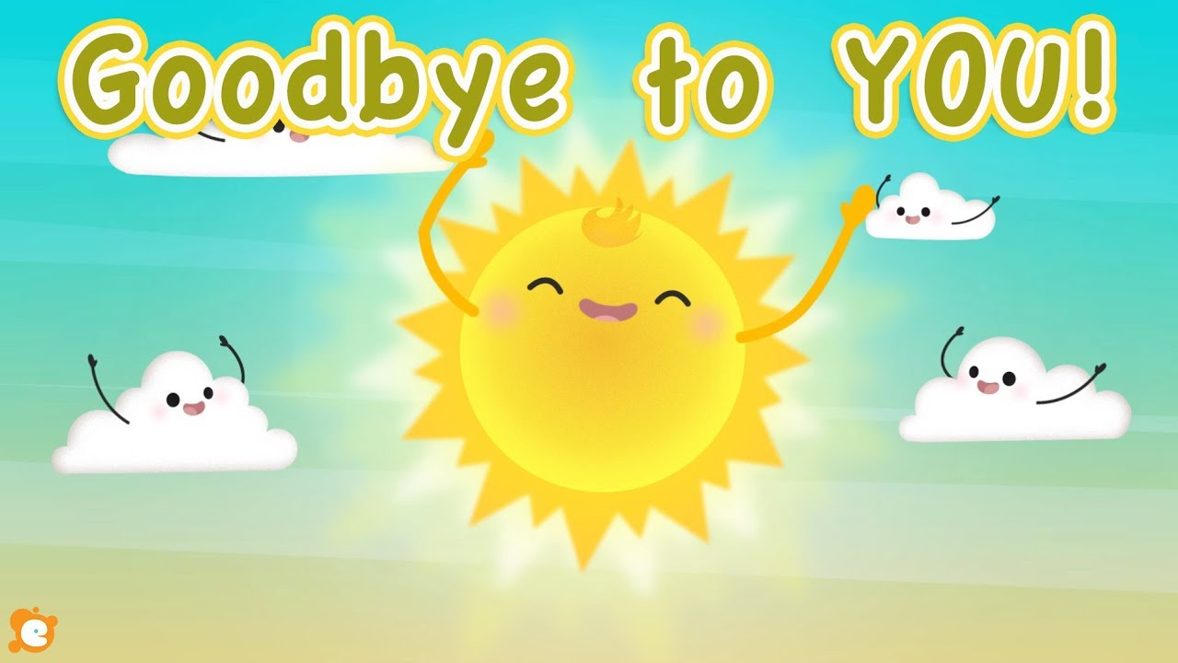
See you tomorrow. Have a nice day.

