Slide 1
Miss Genevieve
Science Teacher
Grade 4
Earth and its changing features
Earthquakes
SEN
Name: _____________________________
Grade: 4_____

Slide 2
Chapter 1 |  | Content | Dates
Earth and its changing features. Earthquakes | 1 | Map Earths Features
 | 2 | Evidence from rocks and fossils
 | 3 | Changes in Landscapes over time.
 | 4 | Map earthquakes
 | 5 | Model Earthquake movement
 | 6 | Reduce Earthquake damage

Slide 3
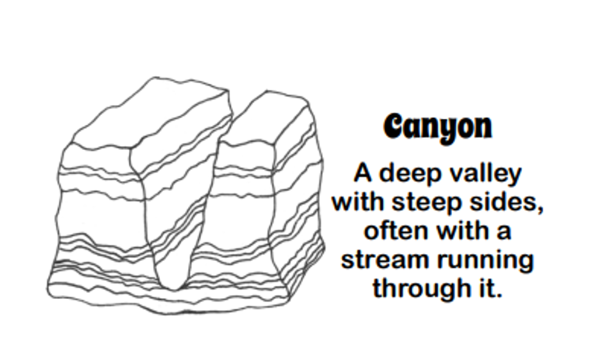
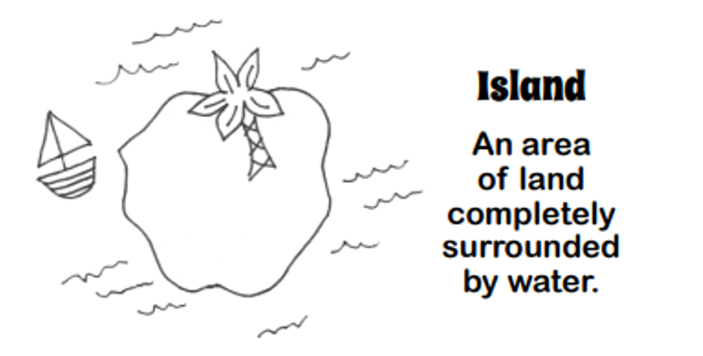
Lesson 1: Map earth’s features
Date:
Lesson 2.1.1- Tools of Technology

Slide 4
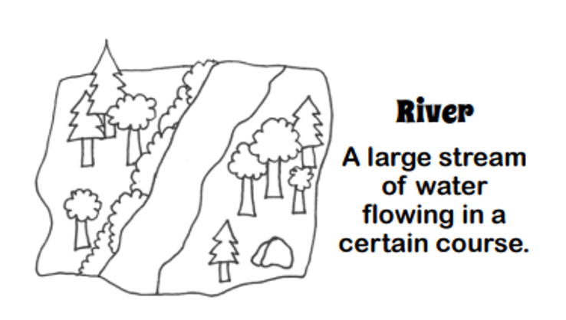
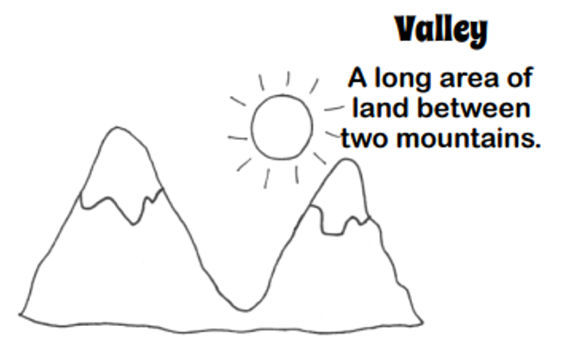

Slide 5
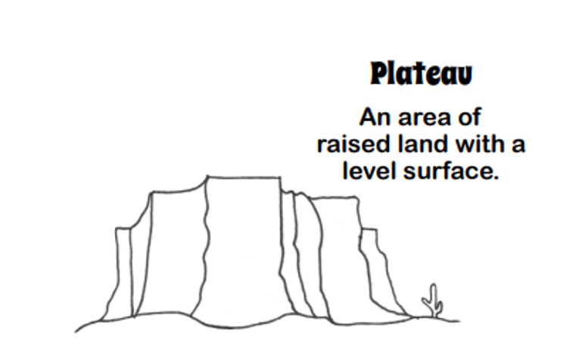
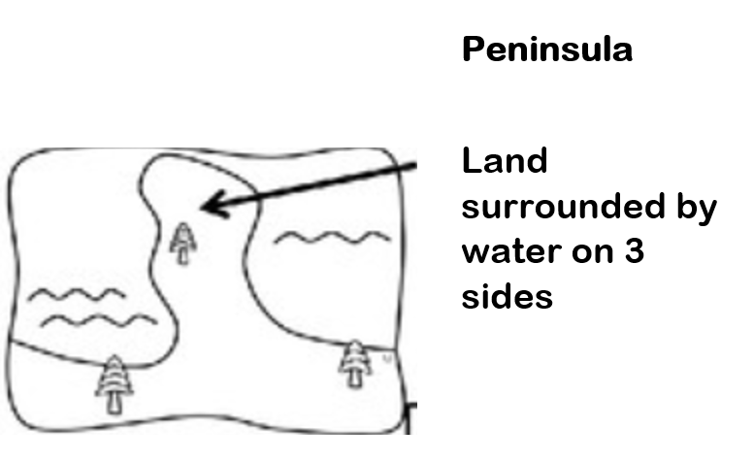

Slide 6
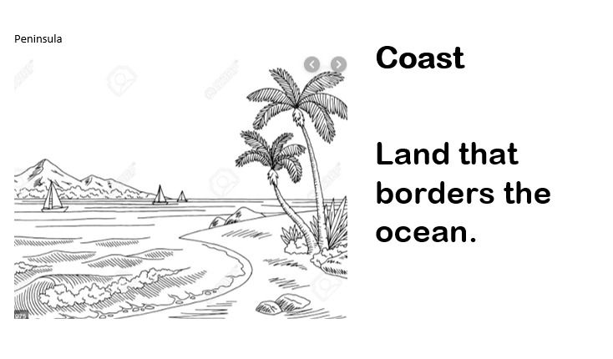
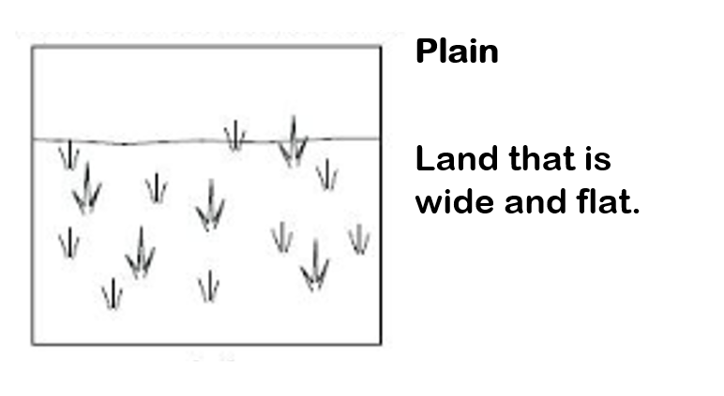

Slide 7
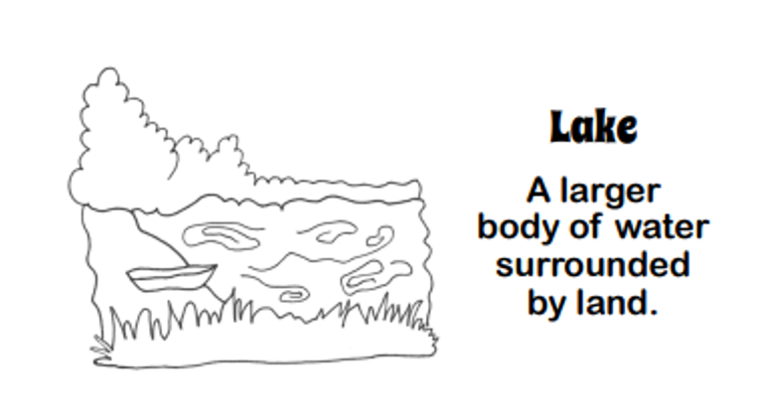
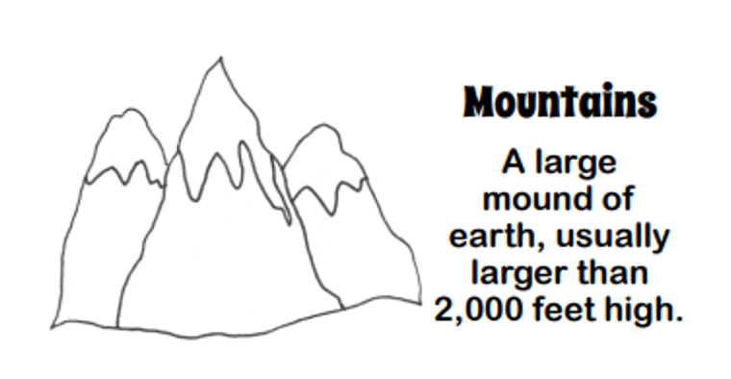

Slide 8
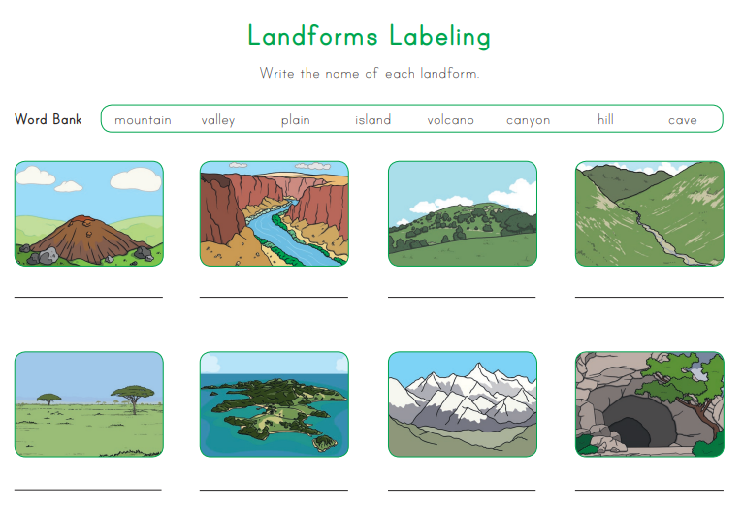
Teacher’s feedback
8

Slide 9
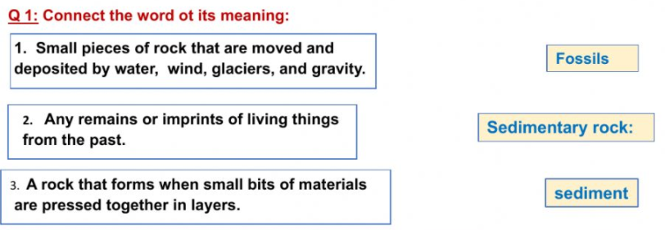
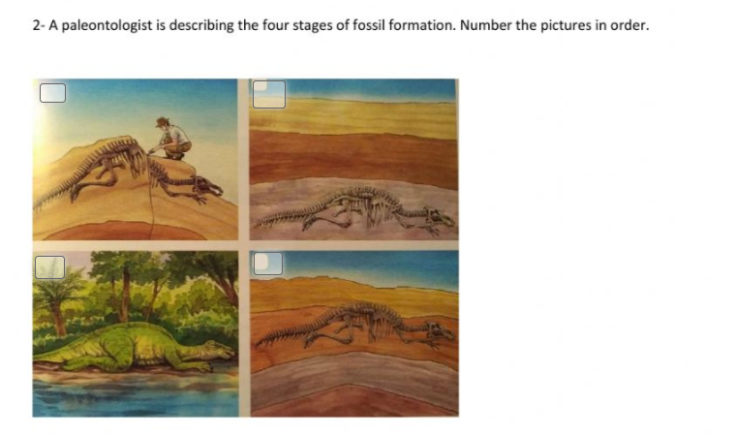
Lesson 2: Evidence from rocks and fossils.
Date:
Teacher’s feedback
10

Slide 10
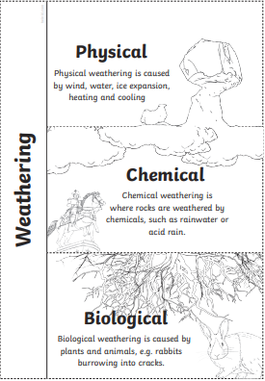
Lesson 3: Changes in Landscape over time
Date:

Slide 11
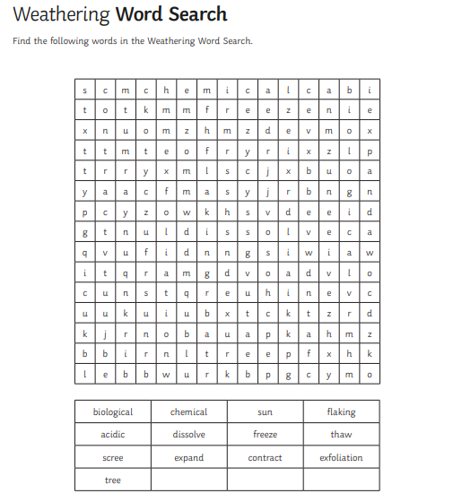
Lesson 3: Changes in Landscape over time
Date:
Teacher’s feedback
10

Slide 12
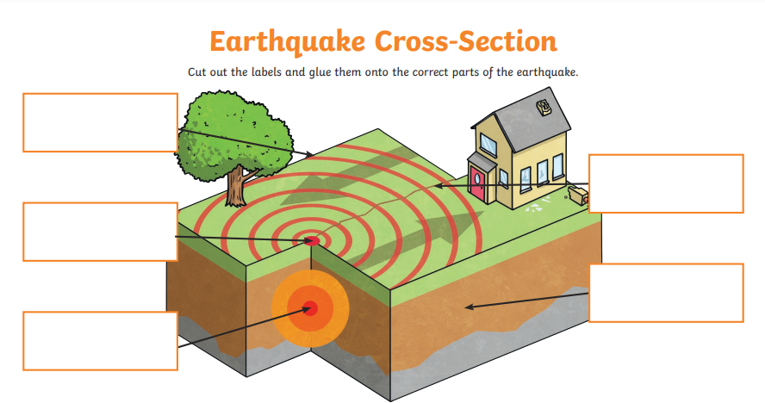
Lesson 4: Map earthquakes.
Date:
Teacher’s feedback
10

Slide 13
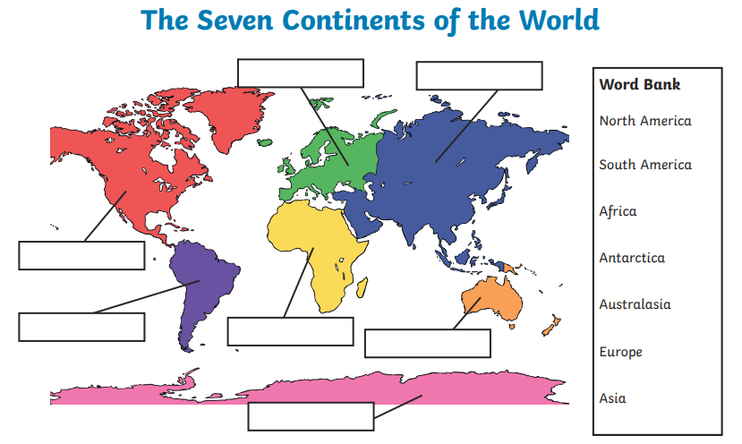
Lesson 4: Model earthquake movement.
Date:
Teacher’s feedback
7

Slide 14
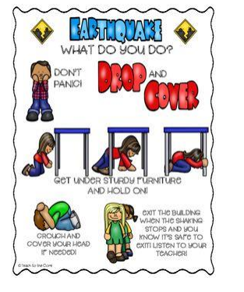
Lesson 4: Reduce Earthquake damage
Date:
Create a poster about how to stay safe in an earthquake

Slide 15
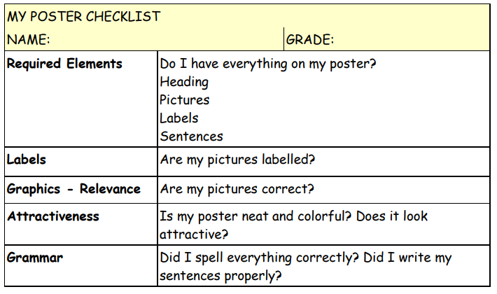
Lesson 4: Reduce Earthquake damage
Create a poster about how to stay safe in an earthquake
Date:
Teacher’s feedback
10

Slide 16
Inspire science Unit 3
Is my daughter/son notebook neat
هل دفتر تبنتي/ابني أنيق؟
Am I satisfied with my daughter’s/son progress
انا راضا عن تقدم مستوى ابنتي/ابني؟
Am I satisfied with my daughter/son homework
انا راضا عن واجبات ابنتي/ابني؟
Additional comments
Parent
teacher
SEN Coordinator

