Slide 1
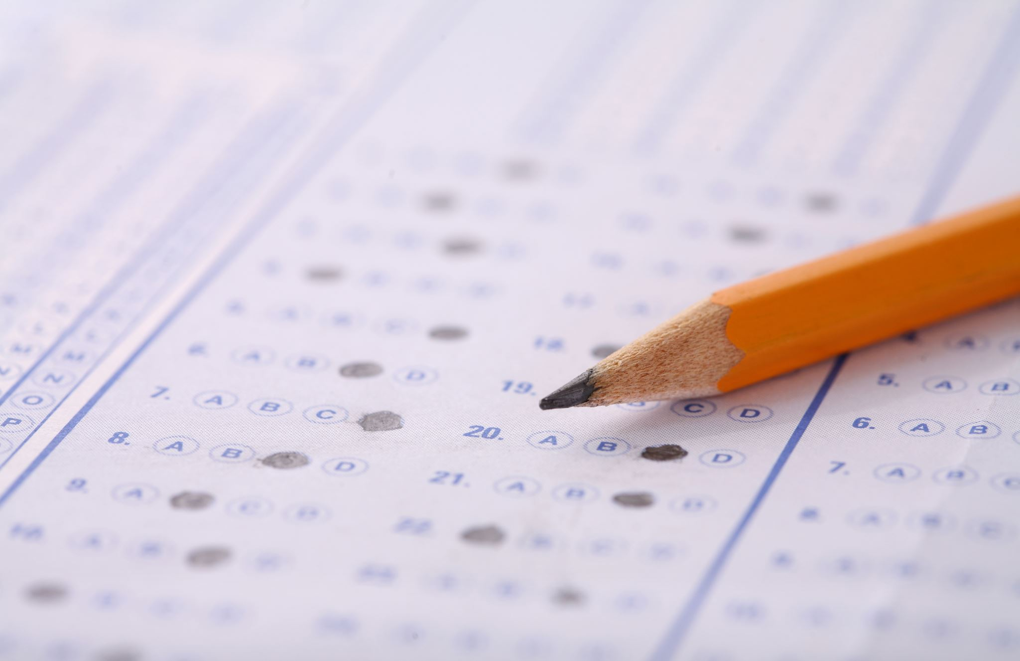
Exam revision
BTS

Slide 2
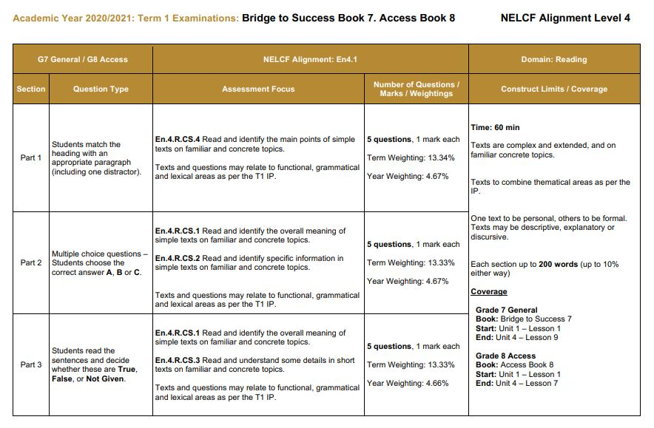
Part 1
Match heading with appropriate paragraph

Slide 3
Context clues
Illustration
Surrounding sentences
definition

Slide 5
LET’s Do an activity!

Slide 6
Part 2
Multiple choice Questions
Students Choose A, B, C

Slide 8
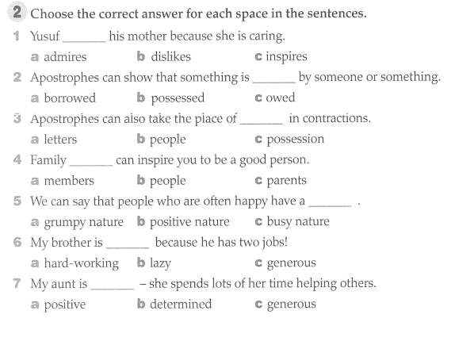
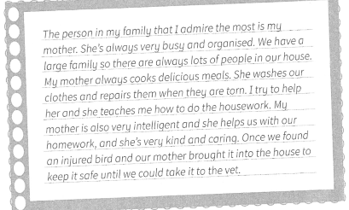

Slide 9
Part 3
Students read the sentence and decide whether it is true, false,
Not given

Slide 10
Grammar- BTS UNIT 1, page 11 ALEF LESSON 2 & 4

Slide 11
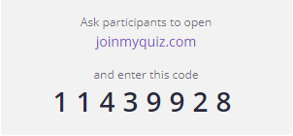
Let’s review modals.

Slide 12
Grammar- BTS Unit 1 Page 14

Slide 13
Let’s practice question tags
Click here!

Slide 14
isn’t it
possibly
isn’t it
shouldn’t I
possibly

Slide 15
Grammar- BTS Unit 2, page 26 Alef lesson 11

Slide 16
have had
have enjoyed
haven’t played
has been
Have seen

Slide 17
Grammar- Unit 2, page 28 Alef lesson 13

Slide 18
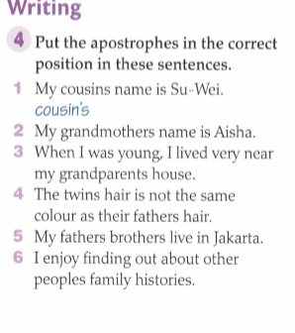
’
’
’
’
’
’

Slide 19
Let’s review Apostrophes
Click here!

Slide 20
Grammar- BTS Unit 2, page 33

Slide 21
Grammar- BTS Unit 2, page 37 Alef Lesson 19

Slide 22
have enjoyed
have read
have done
Do you have
have joined
haven’t had
have you played
have played
Has the headmaster spoken
Have you enjoyed
have made
have enjoyed

Slide 23
Grammar- BTS Unit 3, page 44 Alef Lesson 23

Slide 25
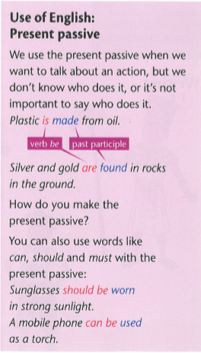
Grammar- BTS Unit 3 Page 48 Alef Lesson 26

Slide 26
is made
are formed
can be made
should not be worn
must not be used
is played

Slide 27
Grammar- BTS Unit 3, page 50 Alef lesson- 16 & 28

Slide 28
Grammar- BTS Unit 4, page 65 Alef lesson- 35

