Slide 1
Reading and Writing Task
Level 2.1
Term 1
2021-2022
Federal Entity | هيئة اتحادية

Slide 2
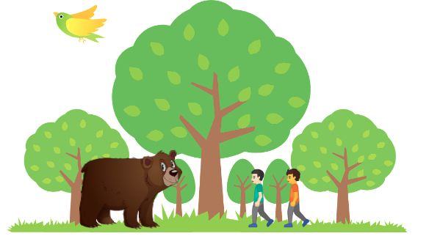
Key Words
forest
suddenly
towards
hurt
hide
ground
whisper

Slide 3
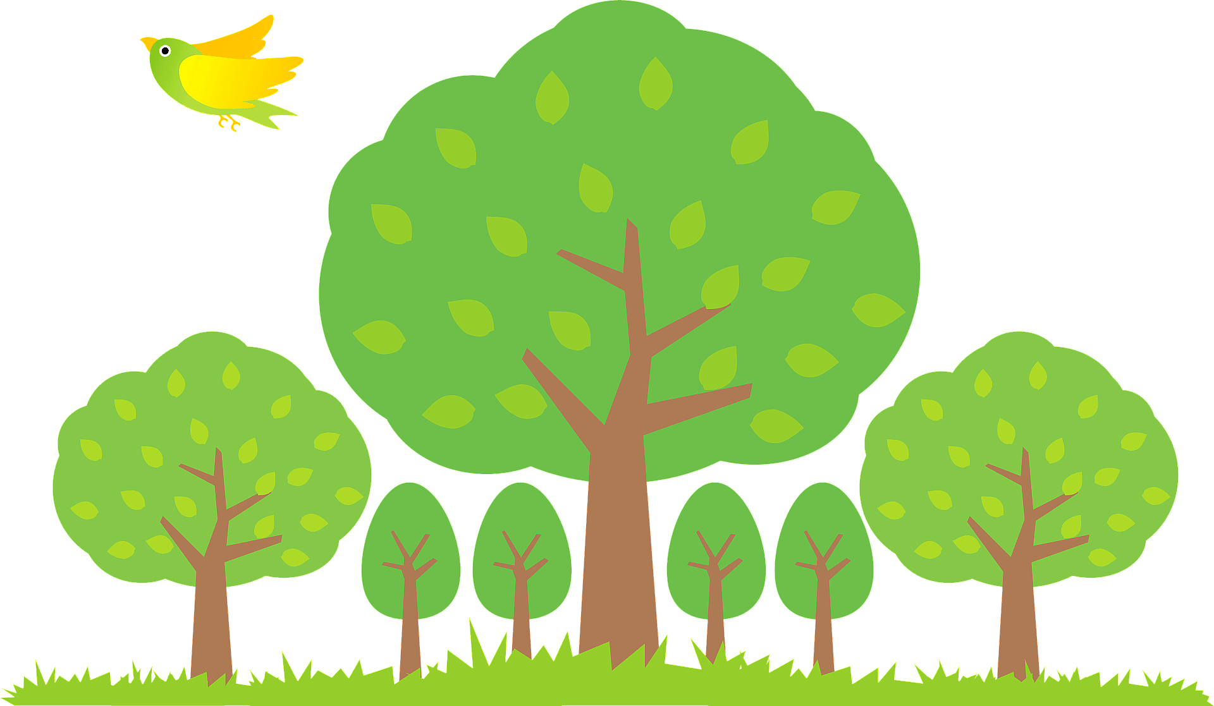
Forest
A place with trees.

Slide 4
Suddenly
Something that happened very fast.

Slide 5
Towards
Going to a specific location.

Slide 6
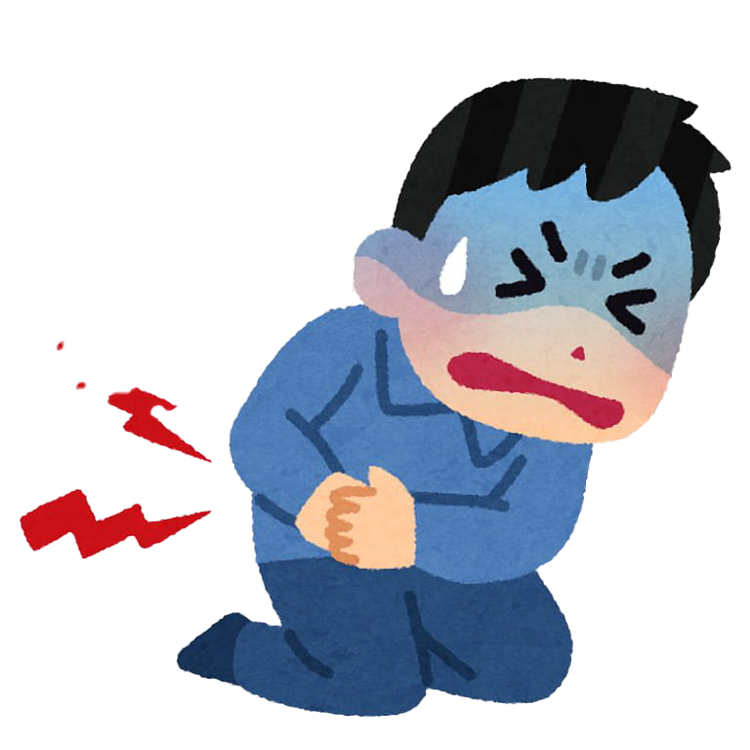
Hurt
To cause pain.

Slide 7
Hide
To keep away from being seen.

Slide 8
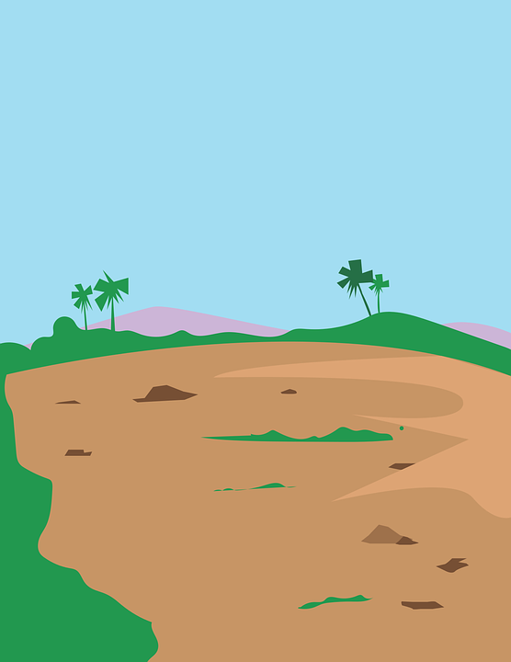
Ground
A piece of land.

Slide 9
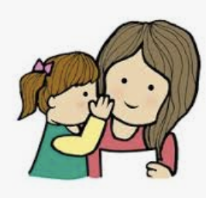
Whisper
To speak in a soft voice.

Slide 10
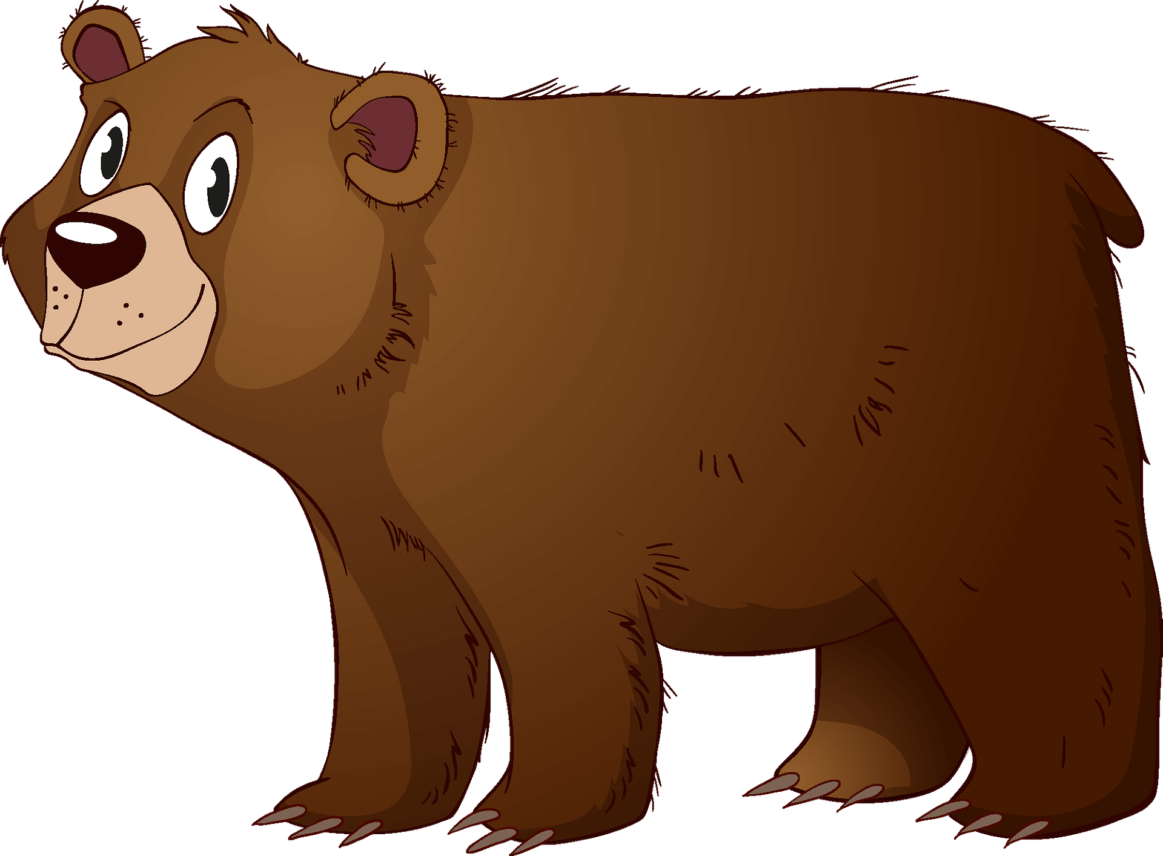
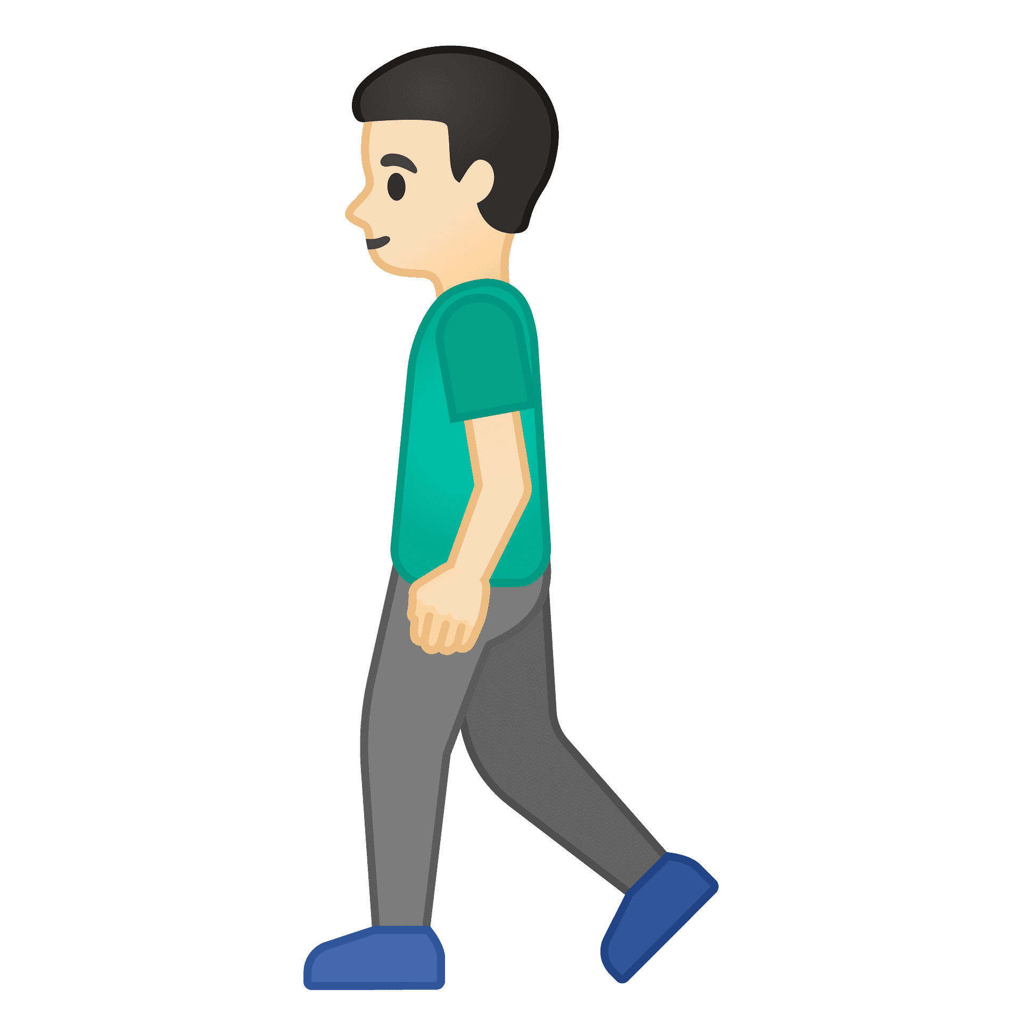
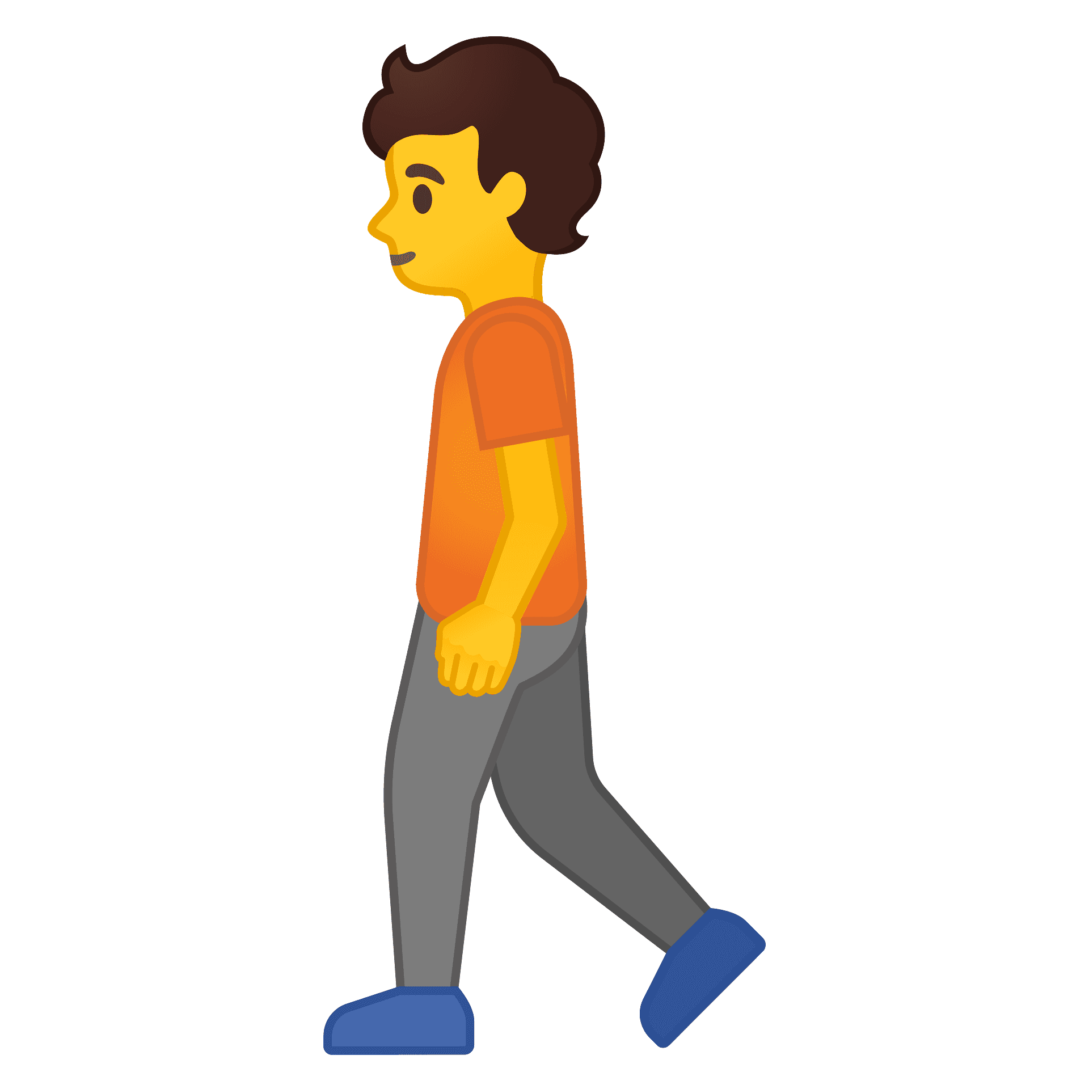
Watch a video about the story of the Two Friends and a Bear.
Have you heard this story before?

Slide 13
Two Friends and a Bear

Slide 14
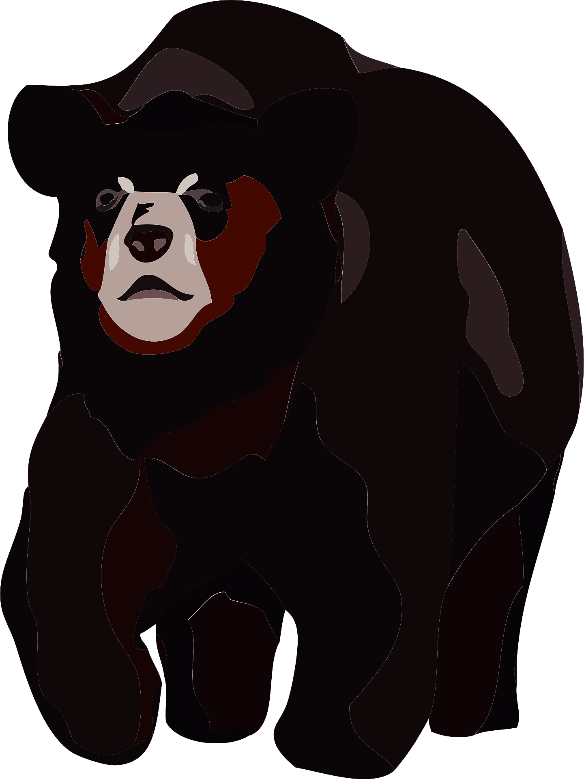
Sultan and Khalid were walking in the forest. Suddenly, a bear ran towards them.!

Slide 15
Khalid hid behind a tree, so the bear couldn’t see him.
Sultan thought that the bear would hurt him.
So, he lay on the ground and didn’t move.

Slide 16
The bear whispered into Sultan’s ear. “Don’t have a friend who hides when you need help.”

Slide 17
The End

Slide 19
Who are the main characters in the story?
The bear and the two friends. (Sultan and Khalid)
Where is the story set?
In the forest.

Slide 20
What happens in the beginning of the story?
Sultan and Khalid were walking in the forest. Suddenly, a bear ran towards them!

Slide 21
What happens in the middle of the story?
Khalid hid behind a tree, so the bear couldn’t see him.
Sultan thought that the bear would hurt him.
So, he lay on the ground and didn’t move.

Slide 22
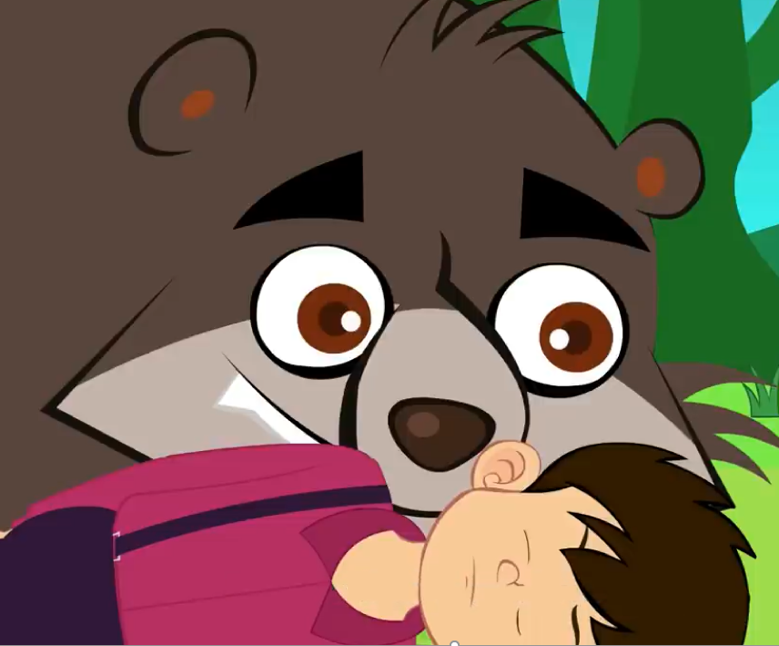
What happens at the end of the story?
The bear whispered into Sultan’s ear. “Don’t have a friend who hides when you need help.”

Slide 23
What lesson can we learn from this story?
Choose your friends wisely. Do not have fake friends.
A friend in need is a friend indeed.

Slide 24
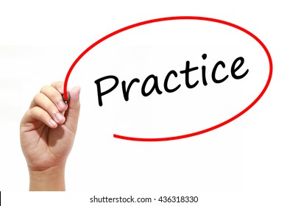

Slide 25
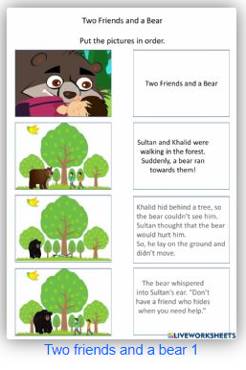
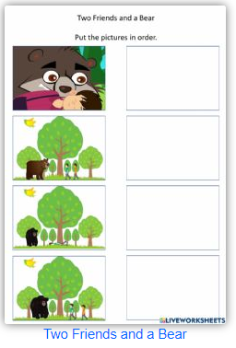
Check our understanding.
https://www.liveworksheets.com/1-ne2148732jr
https://www.liveworksheets.com/ha2469704ig
https://www.liveworksheets.com/ry2461288ig

Slide 26
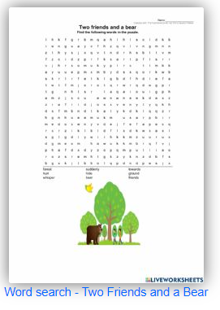
https://www.liveworksheets.com/1-gg2148775fr
https://quizizz.com/admin/quiz/615e91d5a5a90e001ea7794b

Slide 27
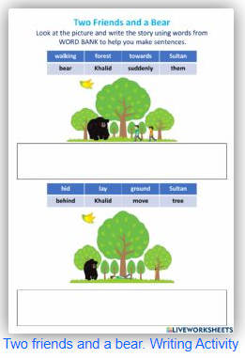
Class Writing Activity
Use words from the word bank
to make sentences.
https://www.liveworksheets.com/1-ut2148982ca

