Slide 1
Reading and Writing Task Level 1.2

Slide 2
Reading and Writing Task
Level 1.2
Term 1
2021-2022
Federal Entity | هيئة اتحادية

Slide 3
Objectives
I can read the text aloud.
I can answer the questions in my own words.
I can understand new words from the text.
I can say how the text makes me feel.

Slide 4
Key Words
lion | nap
mouse | run
king | swallow
jungle | catches
little | trapped

Slide 6
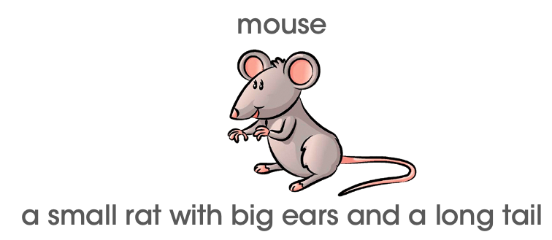

Slide 7
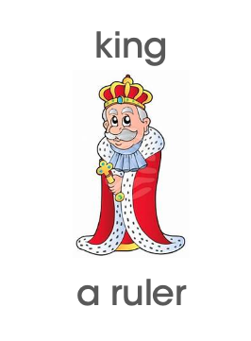

Slide 9
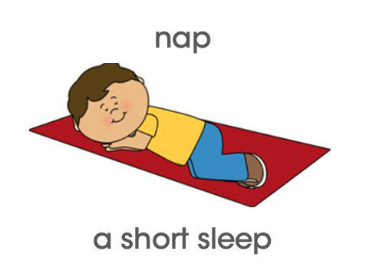

Slide 11
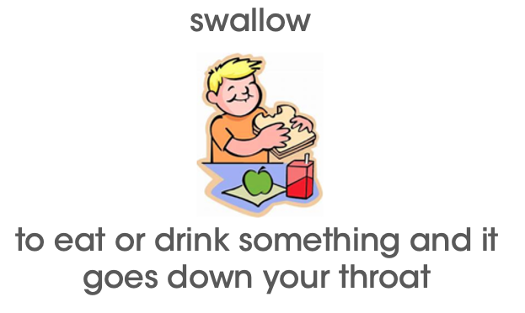

Slide 12
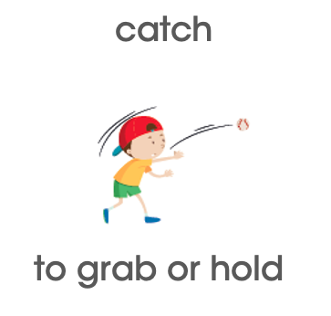

Slide 13
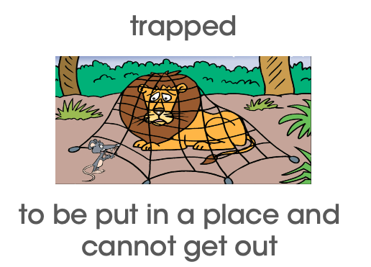

Slide 14
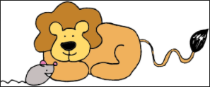
The Lion and The Mouse

Slide 15
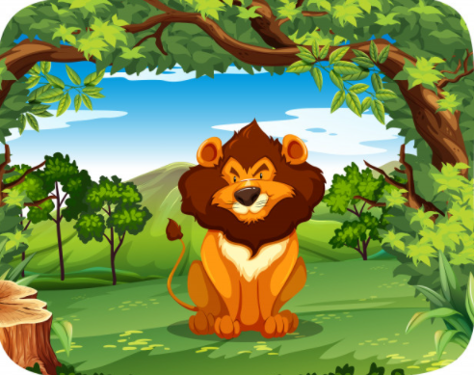
I’m the king of the jungle!

Slide 16
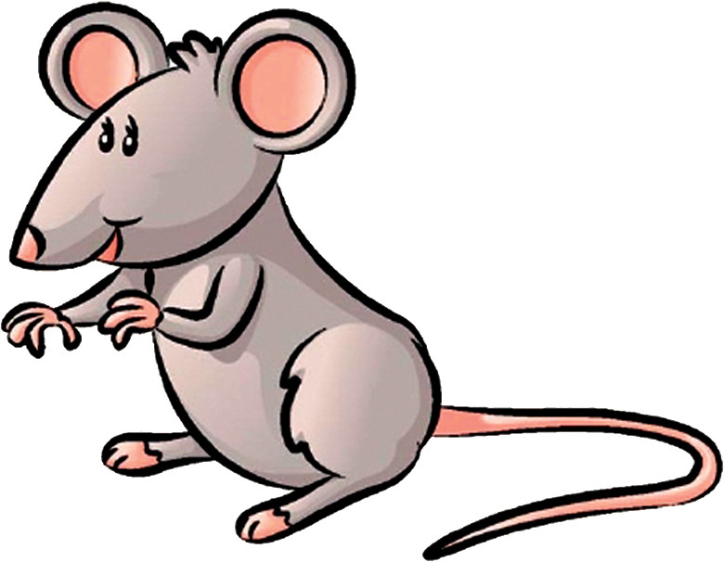
I am a little
mouse.

Slide 17
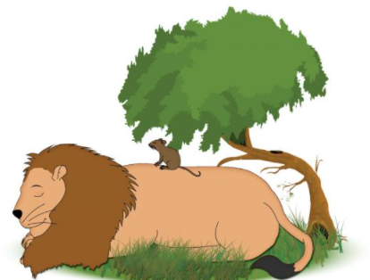
zzzz
Z Z Z
The lion takes a nap.

Slide 18
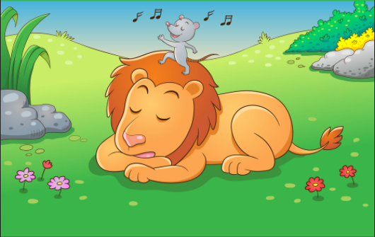
The mouse runs on the lion.

Slide 19
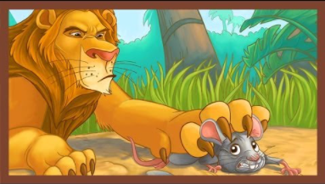
I’ll swallow you!
Lion catches mouse.

Slide 20
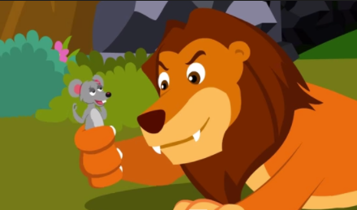
Don’t eat me!
I’ll help you.

Slide 21
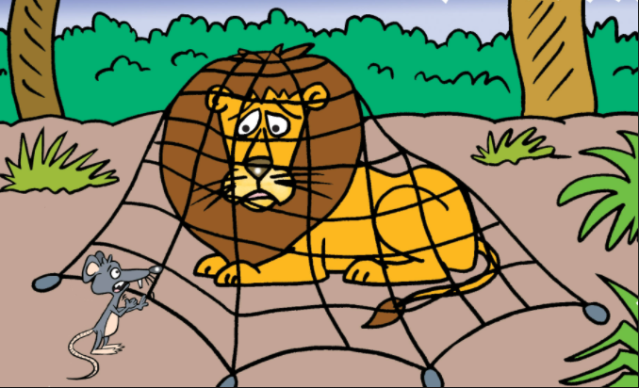
Lion was trapped in a net.

Slide 22
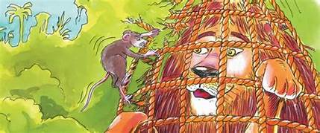
The mouse helped. They became friends.

Slide 23
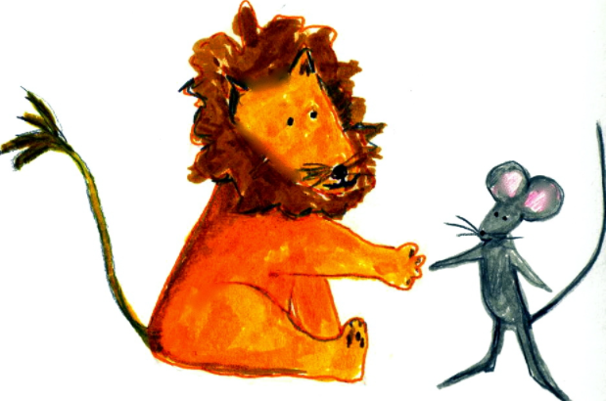
The End

Slide 24
Questions​
Question 1:
What can you learn from the story?
“I can learn__________.”

Slide 25
Questions​
Question 2:
Who is the story about?
“The story is about a _______ and a _______.”

Slide 26
Questions​
Question 3:
What was the lion trapped in?
“The ______ was trapped in a ______.”

Slide 27
Questions​
Question 4:
How would you feel if a lion opened his big jaws to swallow you?
“I would feel _________.”

Slide 28
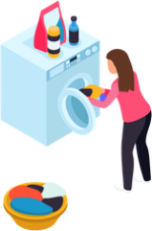
Questions​
Question 5:
How can you help someone?
“I can help someone by _______.”

Slide 29
​Reflection Question
Question 6: Reflection
I think that question ______ was difficult because ______________.
I like question ______ because _____________________________.

Slide 30
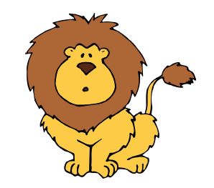
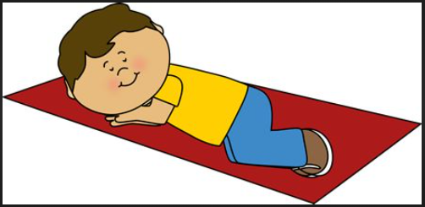
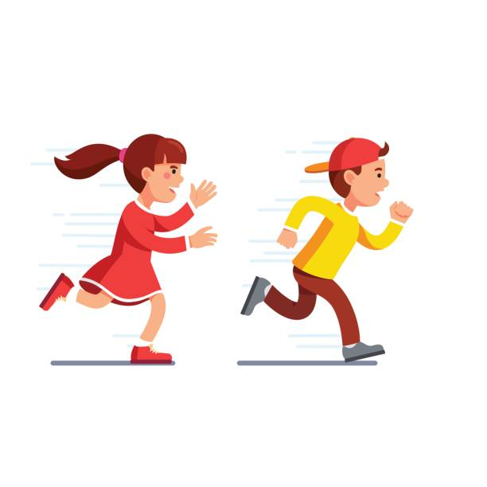
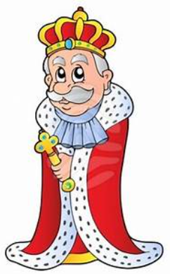
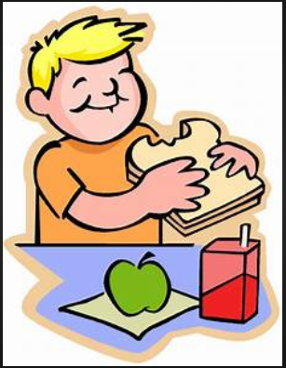
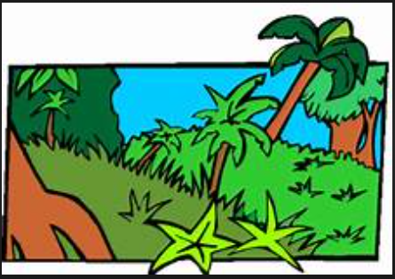
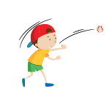
Glossary
lion (n)- a big cat |  | nap (n)- a short sleep
mouse (n)- a small rat with big ears and a long tail |  | run(s) (v)- to go quickly by moving legs and feet
king (n)- a ruler |  | swallow (v)- to put in mouth and chew
jungle (n)- land with trees and tall leaves |  | catch(es) (v)- to grab or hold
little (adj)- tiny or small |  | trapped (v)- to be put in a place and cannot get out

Slide 31
Follow us
ese.ae
Ese_ae

