Slide 1
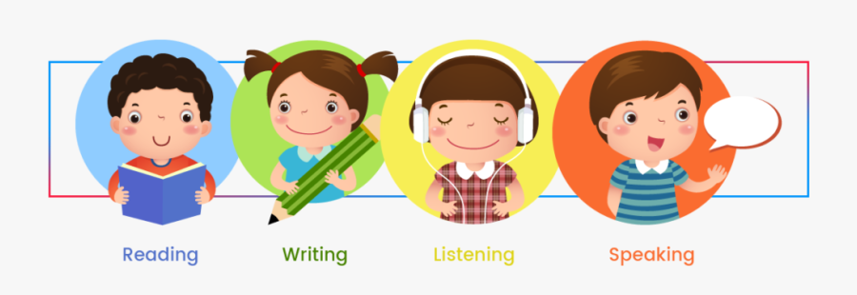
In this lesson you are going to :
Learning Outcomes:
1-To listen and understand a text.
2-To read for main idea and details.
3-To write simple sentences.

Slide 2
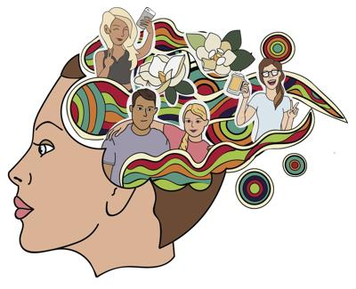
the ability to remember information, experiences, and people
Memories

Slide 3
What is memory?
It is something happened
in the past
and we still
remember it

Slide 4
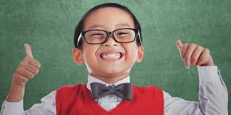
Types of memories
happy
sad
proud

Slide 5
Look and think :
Is this happy or sad memory?

Slide 6
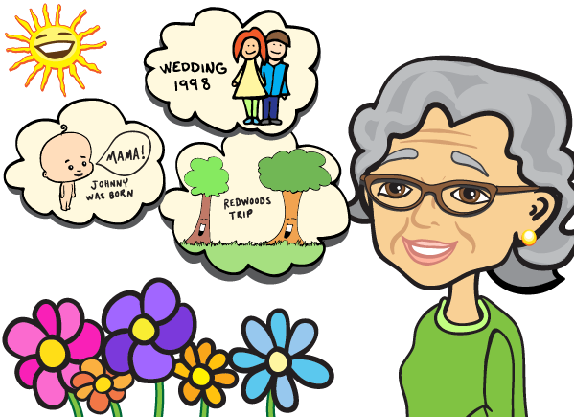
Look and think :
Is this happy or sad memory?

Slide 7
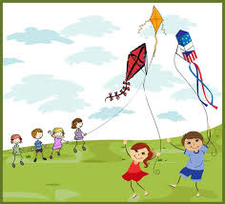
Look and think :
Is this happy or sad memory?

Slide 8
What can you
Remember about
last years?

Slide 9
Brainstorming
Is it a happy, sad, proud or funny memory?
Do you have a special memory from when you were very young?
How did you feel?

Slide 10
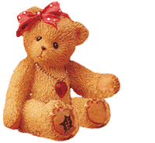
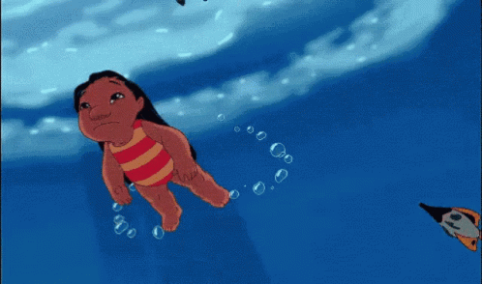
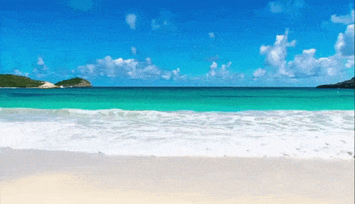
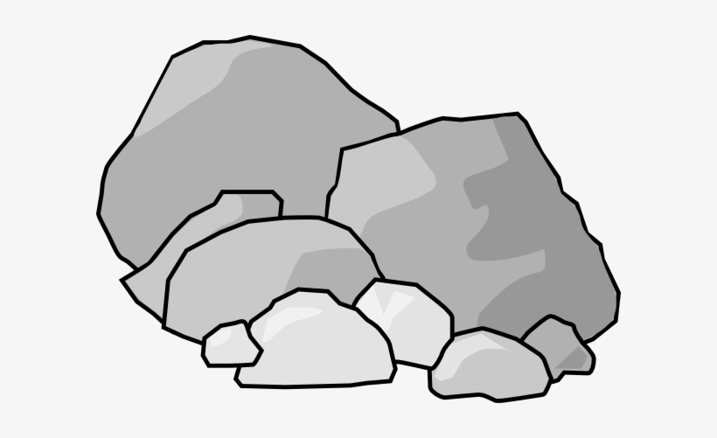
Guess The Word
Teddy bear
swam
beach
rock

Slide 11
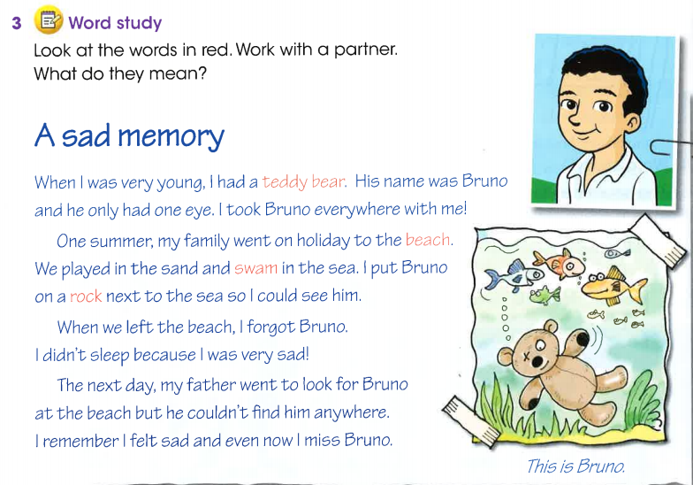
L.B Page : 22

Slide 12
Listen again and try to answer the questions.
It was a teddy bear.
They went to the beach.
He went to look for Bruno.

Slide 13
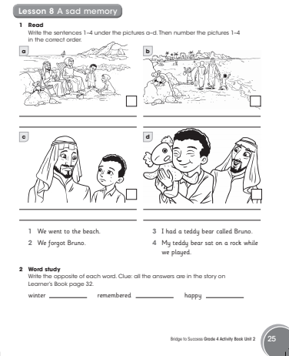
Activity Book / Page 17

Slide 14
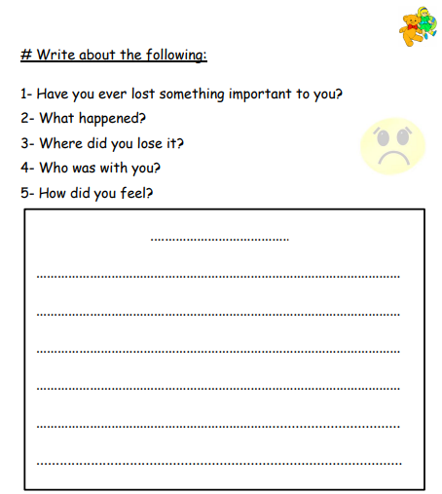
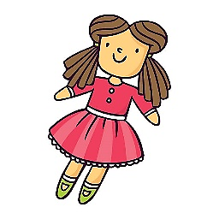
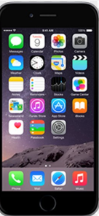
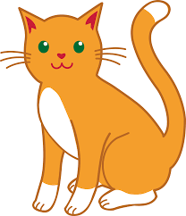

Slide 15
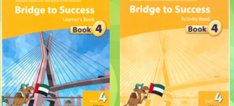
Learner’s Book pg.33/34 Activity Book pg. 26/27
Unit 2 - memories

Slide 16
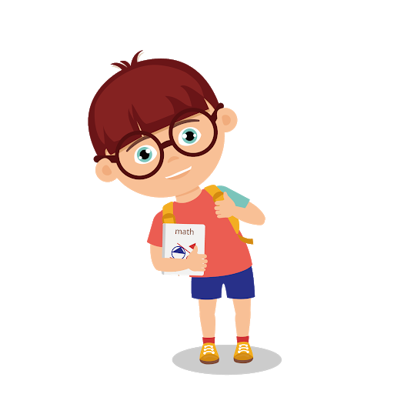
Define what makes a happy memory.
Discuss listening strategies and paying attention to details and answer questions
To write about proud and happy memory

Slide 17
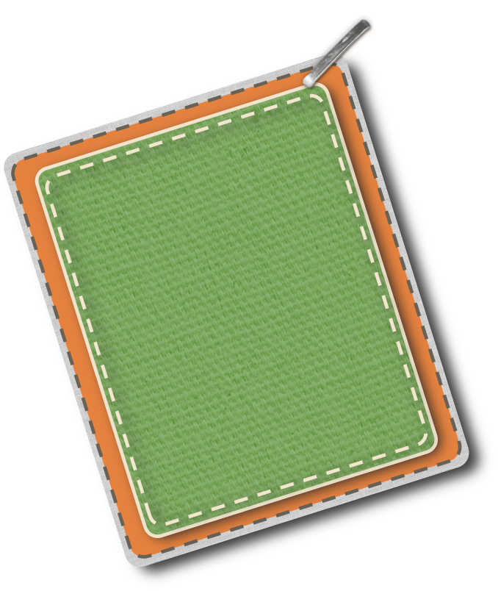
Let’s Learn
Proud
memory
LB P 23
AB 18

Slide 18
Listen to the story!
LB P 23

Slide 19
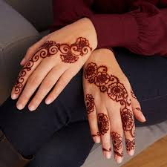
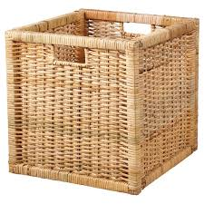
Vocabulary
henna
paint
proud
basket

Slide 20
Listen again and answer the questions!
What did the school celebrate?
What did they drink and eat?
Why was the girl proud?
Think!!!! - challenge
What does excited and proud mean?

Slide 21
Lets match – draw a line to the same meaning
Henna
Basket
Proud
Excited
Painted
Colored
Happy about something you did well
Very happy
A container for fruits or vegetables
Special paint for hands

Slide 22
What is this? When do you get this Why will you get this?
AB 26

Slide 23
https://wordwall.net/resource/5197504

