Slide 1

Magic e

Slide 2


Slide 3




Slide 4
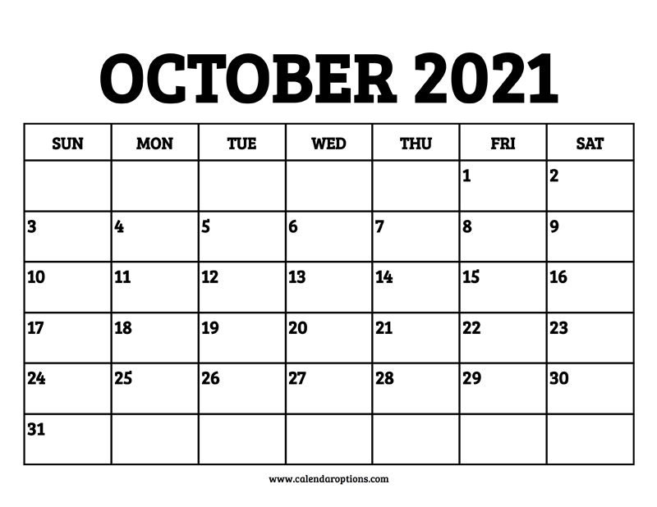

Slide 5
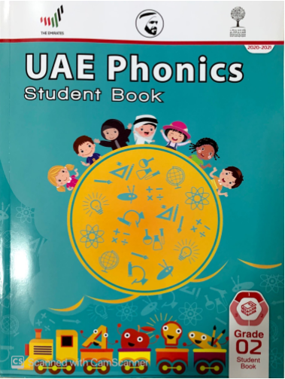

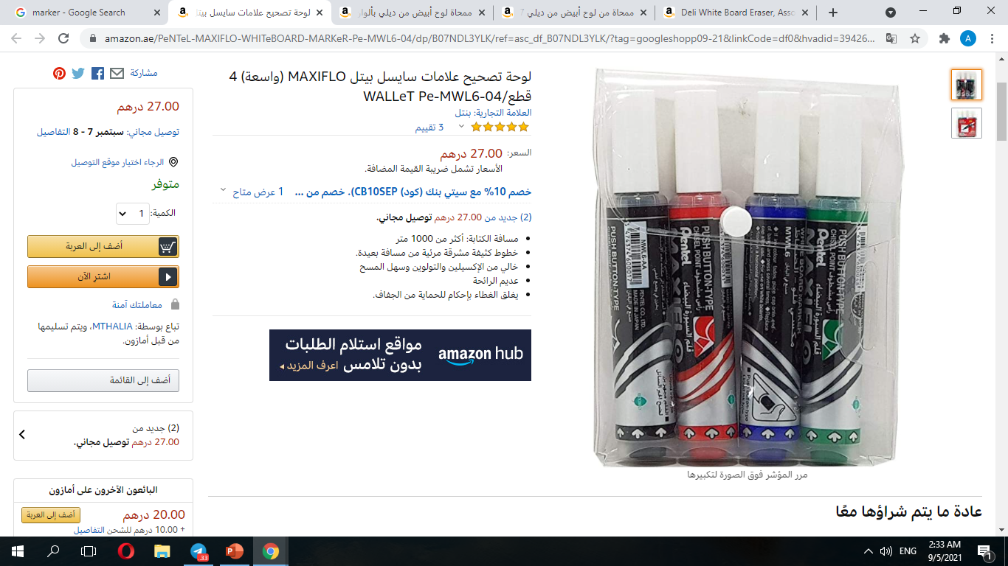



Slide 6

Our learning Outcomes
To be able to identify (magic e) in words.
2. To be able to read words with (magic e).

Slide 7


Slide 8
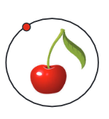


cherry
shoes
telephone
ring

Slide 9

white
shoes
shop
shark

Slide 10

cheese
sandwich
wheel
dolphin

Slide 11


wheel
shop
dolphin
ring

Slide 12
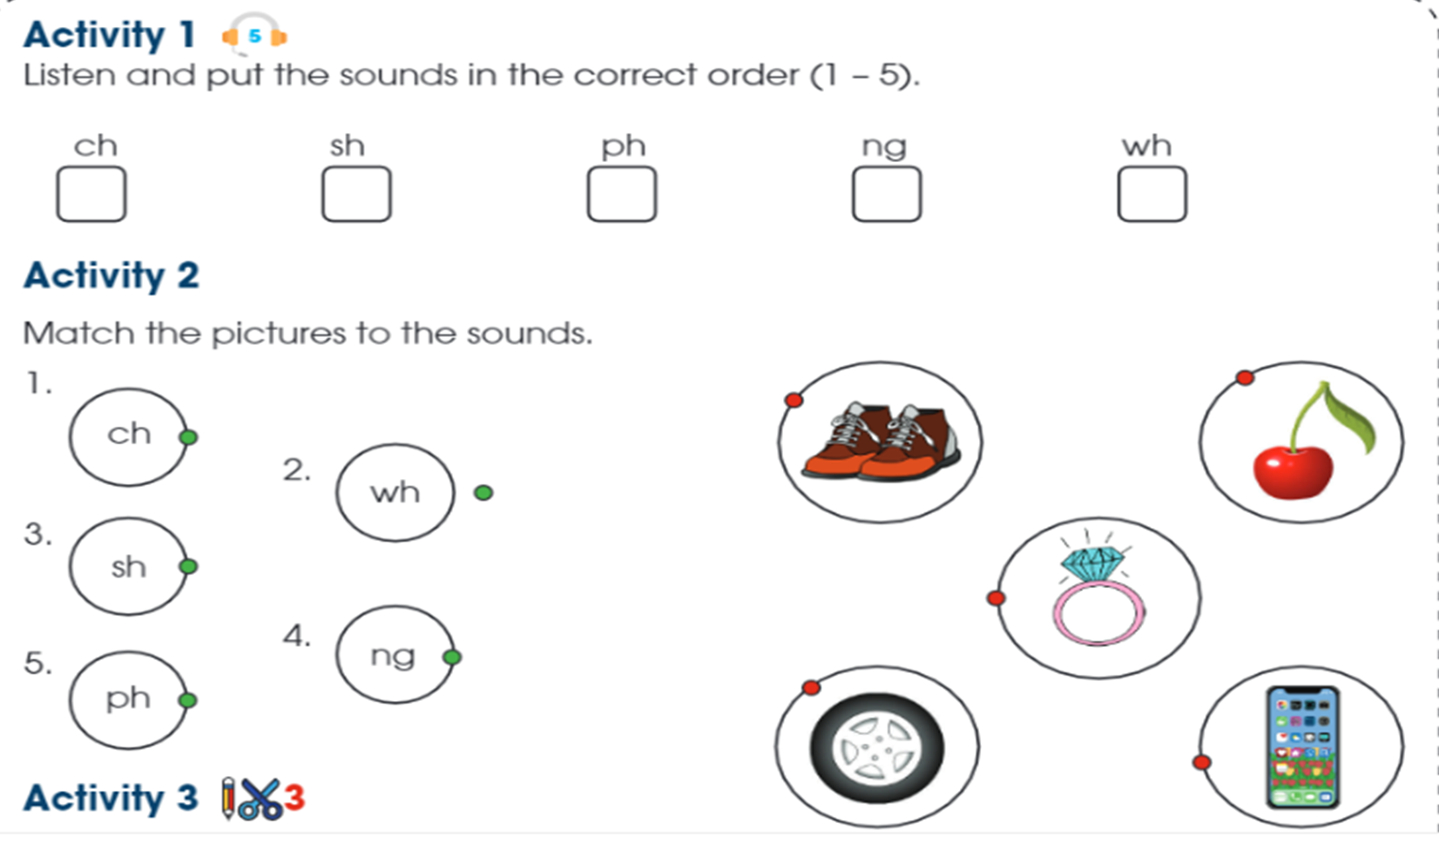
swing
cheese
wheel
telephone

Slide 13

Prepare your whiteboard

Slide 14


Slide 15
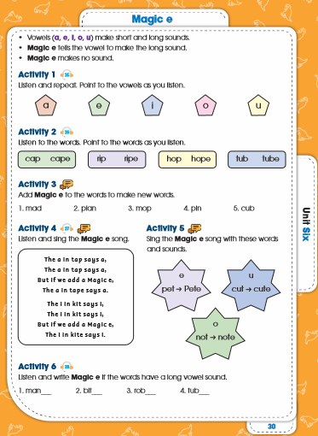
Page 30

Slide 16
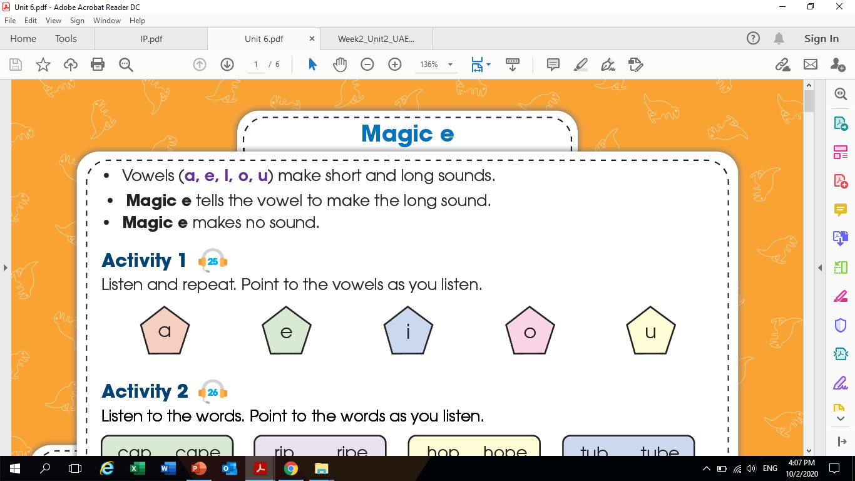

Slide 17

Let’s start!

Slide 18

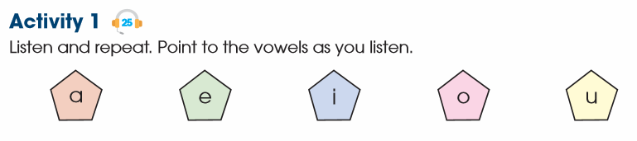

Slide 19
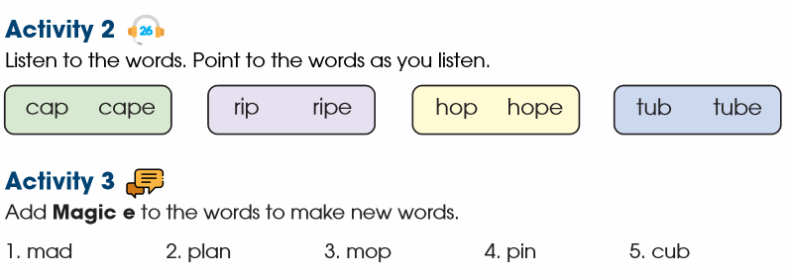
e
e
e
e
e

Slide 20
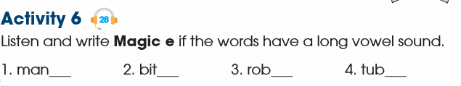
e
e

Slide 21
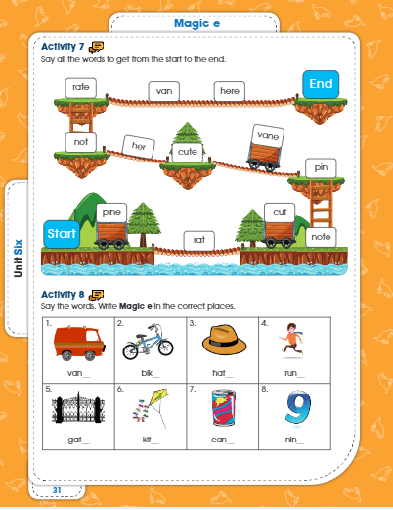
Page 31

Slide 22
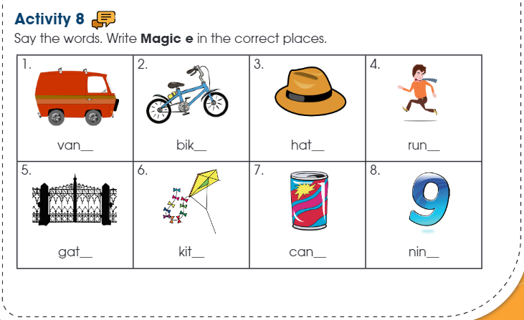
e
e
e
e

Slide 23



Let’s
Practice
https://www.liveworksheets.com/qa479259zo
https://www.liveworksheets.com/worksheets/en/Phonics/Long_vowels/Long_Vowel_Sounds_gl1236449cx
https://www.liveworksheets.com/dr438370oy

Slide 24
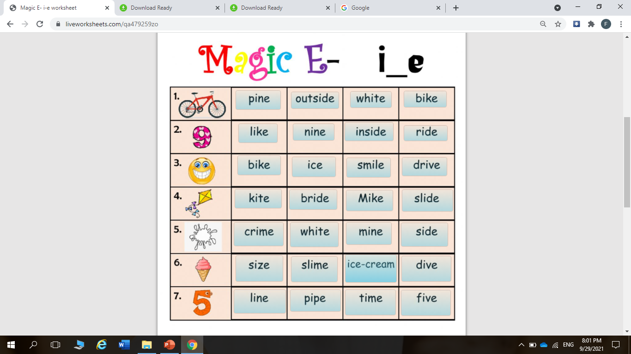
https://www.liveworksheets.com/qa479259zo

Slide 25
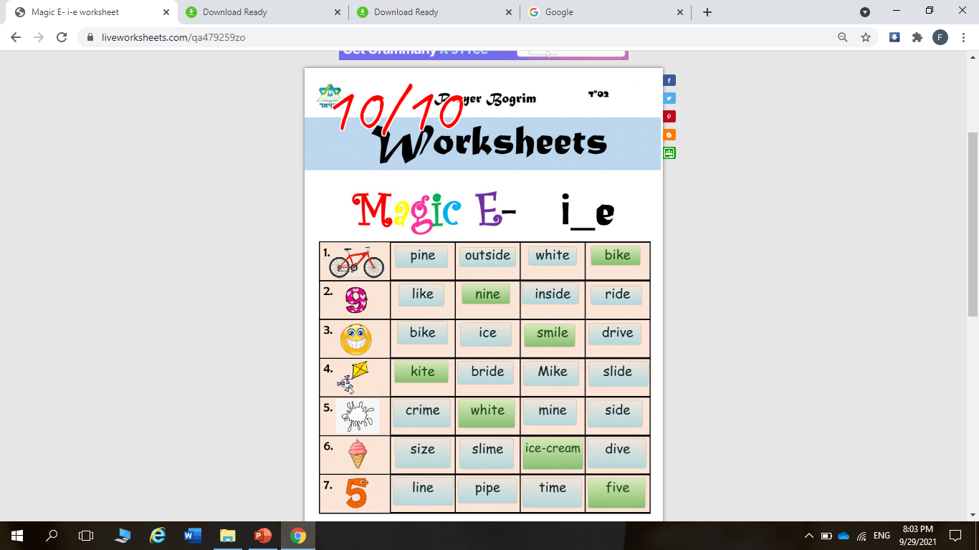

Slide 26
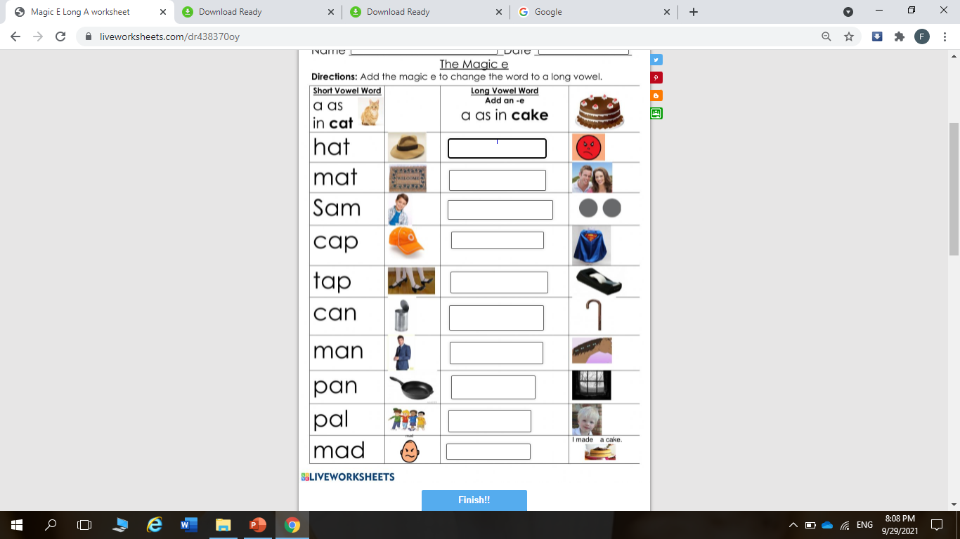

Slide 27
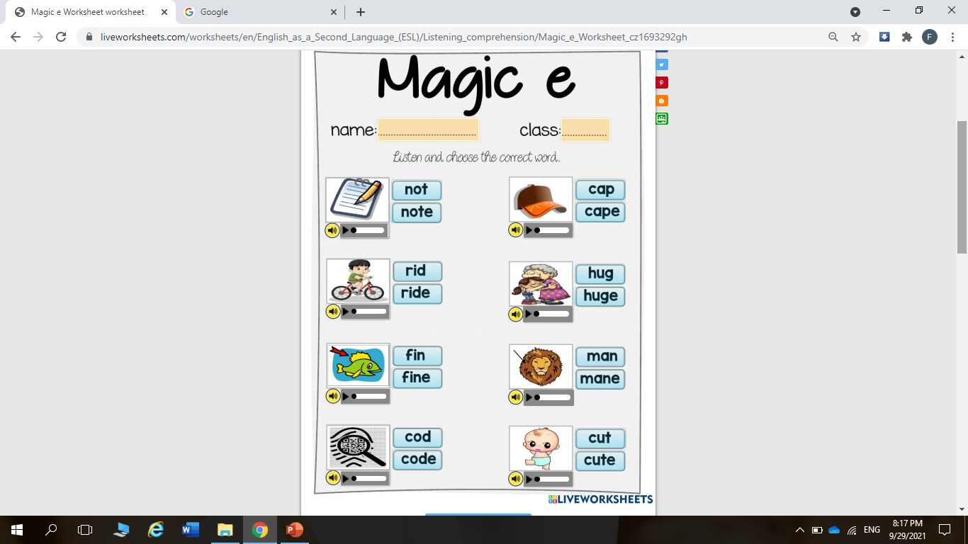
https://www.liveworksheets.com/worksheets/en/English_as_a_Second_Language_(ESL)/Listening_comprehension/Magic_e_Worksheet_cz1693292gh

Slide 28
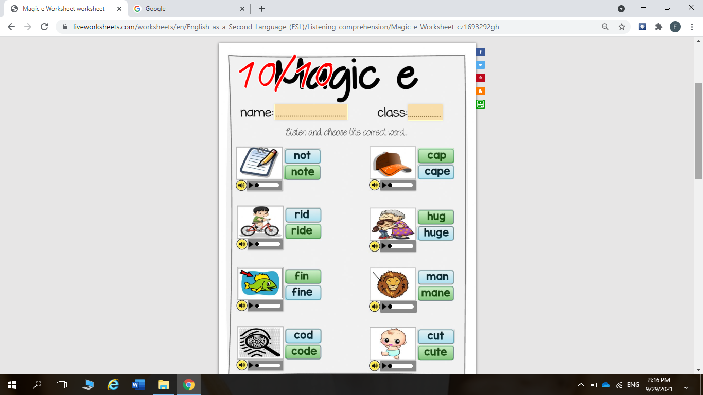

Slide 29





See you tomorrow!

