Slide 1
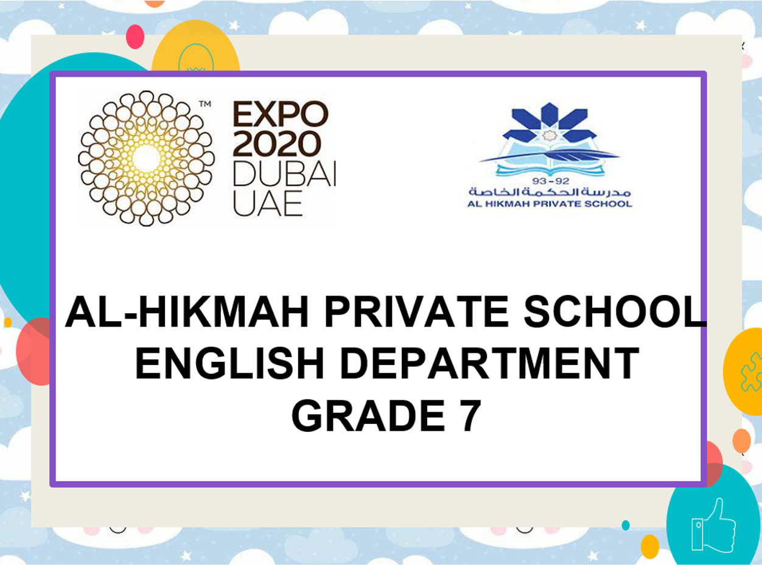
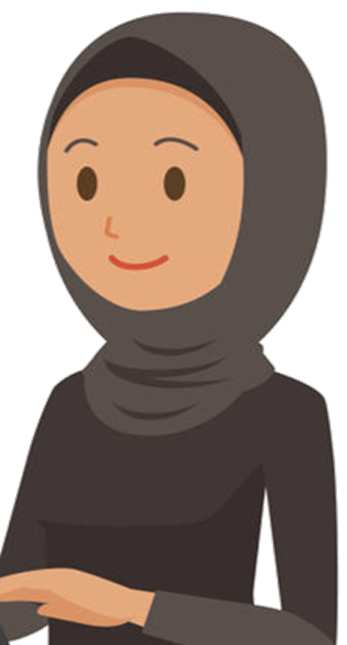
Good morning my dear students!
How are you?

Slide 2
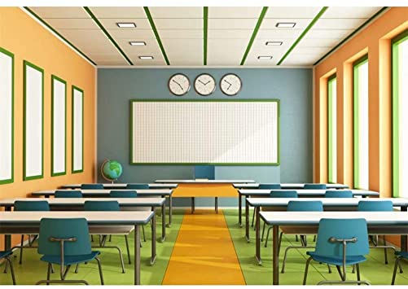
Good morning my dear students!
How are you?

Slide 3
Please keep quiet while your teacher is taking the attendance.

Slide 6
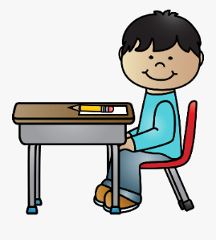
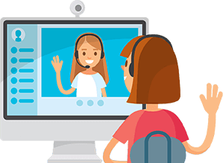
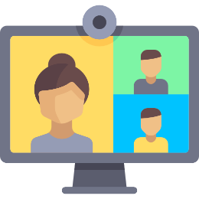
Class Rules
Be ready on time
Sit in a good position
Mute your microphone
Respect your friends

Slide 7
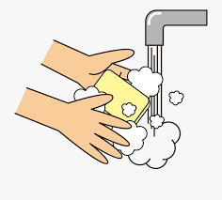
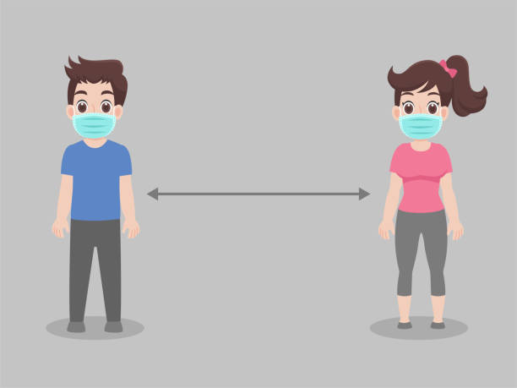
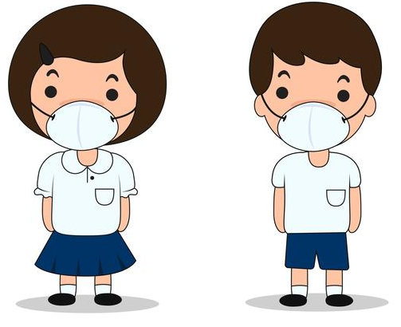
Read the message
Golden message
1
Stay at home
2
Wash your hands for 20 second
3
Wear a mask when you go out
4
Keep distance with others.
Stay at home For UAE and for your health.

Slide 8
Reading Review for Final Exam
Grade 7

Slide 9
Part 1
Reading
Part 1
Part 1 Read the paragraphs below. For questions 1-5, choose the best heading (A G) for each paragraph. There is one extra heading that you will not use. There is one EXAMPLE.

Slide 10
Example: A peninsula is a land that has water on three sides of it. We live on the Arabian Peninsula. We have the Red Sea, the Arabian Sea, and the Arabian Gulf around us.
G. The Arabian Pennisula

Slide 11
I love fresh air, quiet streets and the sound of animals. I could never live in the city. Living in the countryside makes me happy. Some people say it is boring but I love it!
If you are looking for a place to go shopping, we have the place for you. There are over 100 stores, 6 coffee shops, a supermarket and a place for children to play.
I love going to sit outside my uncle's bakery. They always have the best smells coming from the oven. Not only do they make really good bread, they also make sweets.
I am sure it was a lot of fun to live back then. Sitting around the campfire telling stories and taking care of the camels would be exciting. I would like traveling from oasis to oasis with my camels.
I think it is very important to offer people some coffee if they come to my home. I also offer them juice, water, tea, and something to eat like fruit or cake. I like to take care of my visitors.

Slide 13
b
a
d
f
c

Slide 14
Part 2
Read an email that Saif wrote to his grandmother about his school. For questions 6 10, circle the correct answer A, B or C. There is one EXAMPLE.
Page 2 of 6

Slide 15
Saif's Email
Dear Grandmother,
I hope you are doing well. I am emailing you to tell you about my new school in Fujairah. It is really nice. We have a lot of really good teachers and all of the students are very nice. I really like my new school and I want to tell you all about it.
I have a lot of great classes. My science teacher is Mr Ahmed. He is very funny. He likes to make us laugh while he is teaching us. We are learning a lot of really great things in science class.

Slide 16
My English teacher is Mr. Vince. He is such a good teacher. Sometimes his class is boring. He tries to make it fun by playing games. My English is getting better!
We also have a painting class. This is my favourite class. I am not great at painting but it helps me to be calm. My painting teacher is Mr. Farouq. He is a really good painter.
My Arabic teacher is named Mr. Abdullah. He is a really nice teacher. Sometimes the students are bad in his class and don't listen to him. Not me though. I am always good.
Well, I have to go to chess club now. See you soon grandma!
Love,
Saif

Slide 18
Saif's Email
Dear Grandmother,
I hope you are doing well. I am emailing you to tell you about my new school in Fujairah. It is really nice. We have a lot of really good teachers and all of the students are very nice. I really like my new school and I want to tell you all about it.
I have a lot of great classes. My science teacher is Mr Ahmed. He is very funny. He likes to make us laugh while he is teaching us. We are learning a lot of really great things in science class.
My English teacher is Mr Vince. He is such a good teacher. Sometimes his class is boring. He tries to make it fun by playing games. My English is getting better!
We also have a painting class. This is my favourite class. I am not great at painting but it helps me to be calm. My painting teacher is Mr Farouq. He is a really good painter.
My Arabic teacher is named Mr Abdullah. He is a really nice teacher. Sometimes the students are bad in his class and don't listen to him. Not me though. I am always good.
Well, I have to go to chess club now. See you soon grandma!
Love,
Saif

Slide 19
Part 3
Read about what life was like in the UAE in the past. For questions '1 1 15, circle the correct answer True, False, or Not Given. There is one EXAMPLE.

Slide 20
A Long Time Ago in the UAE
100 years ago, life was very different in the UAE. There were no big buildings, no fast cars, and no shopping malls. People had to work very hard to get food, water and clothes for their families.
Some people lived near the coast in cities like Khorfakkan. These people used the sea to live. They had jobs like pearl-diving or fishing. Being a pearl diver was a dangerous job. They would dive to the bottom of the sea and look for oysters. They would work form sunrise to sunset. It was very hard work.
Other people lived in the desert. There were many tribes or groups of people who lived together. Most of these tribes lived in tents. They lived in tents because they moved around a lot. They had to move from oasis to oasis to take care of their camels. Their camels were very important. The camels carried all of their things when they moved. They carried their tents, water, and anything else they needed. They would also drink camel milk and eat camel meat.
Life was hard back then but people still had some fun. One important tradition was to sit around a campfire in the evening and tell stories or share poetry. Life was very different back then.

Slide 21
A Long Time Ago in the UAE
100 years ago, life was very different in the UAE. There were no big buildings, no fast cars, and no shopping malls. People had to work very hard to get food, water and clothes for their families.
Some people lived near the coast in cities like Khorfakkan. These people used the sea to live. They had jobs like pearl-diving or fishing. Being a pearl diver was a dangerous job. They would dive to the bottom of the sea and look for oysters. They would work form sunrise to sunset. It was very hard work.

Slide 22
Other people lived in the desert. There were many tribes or groups of people who lived together. Most of these tribes lived in tents. They lived in tents because they moved around a lot. They had to move from oasis to oasis to take care of their camels. Their camels were very important. The camels carried all of their things when they moved. They carried their tents, water, and anything else they needed. They would also drink camel milk and eat camel meat.
Life was hard back then but people still had some fun. One important tradition was to sit around a campfire in the evening and tell stories or share poetry. Life was very different back then.

Slide 25
A Long Time Ago in the UAE
100 years ago, life was very different in the UAE. There were no big buildings, no fast cars, and no shopping malls. People had to work very hard to get food, water and clothes for their families.
Some people lived near the coast in cities like Khorfakkan. These people used the sea to live. They had jobs like pearl-diving or fishing. Being a pearl diver was a dangerous job. They would dive to the bottom of the sea and look for oysters. They would work form sunrise to sunset. It was very hard work.
Other people lived in the desert. There were many tribes or groups of people who lived together. Most of these tribes lived in tents. They lived in tents because they moved around a lot. They had to move from oasis to oasis to take care of their camels. Their camels were very important. The camels carried all of their things when they moved. They carried their tents, water, and anything else they needed. They would also drink camel milk and eat camel meat.
Life was hard back then but people still had some fun. One important tradition was to sit around a campfire in the evening and tell stories or share poetry. Life was very different back then.

Slide 26
How do you feel about the lesson today?
Did you learn something new?
1
I need more help! (Hard!)
2
I am getting there. (It was ok!)
3
I can do it! (Easy!)

Slide 27
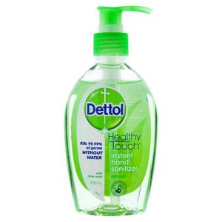
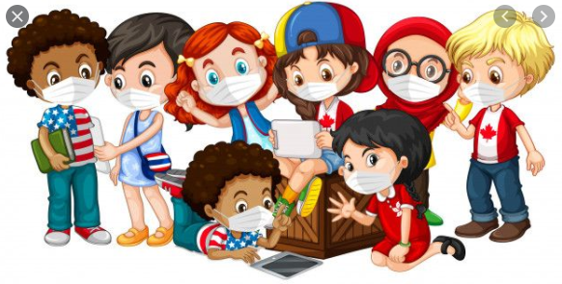
Golden message
Wash your hands every hour using water with soap for 20 seconds.
Wear your mask.

Slide 28
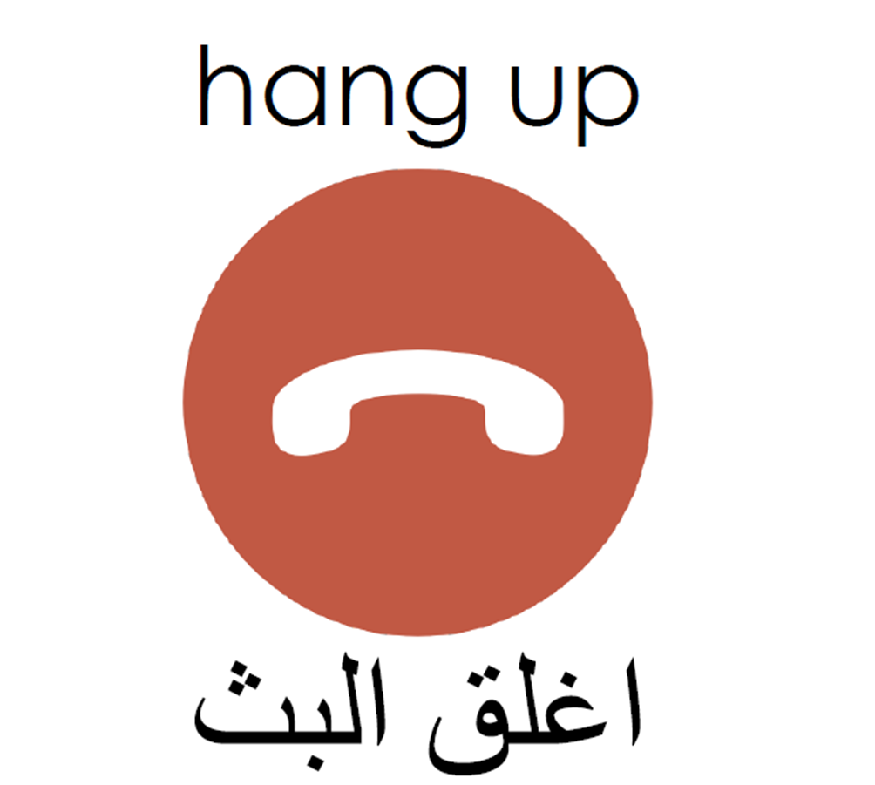
Our session has ended.
Bye – bye !

