Slide 1
Grade 5
Writing Programme
Task 1

Slide 2
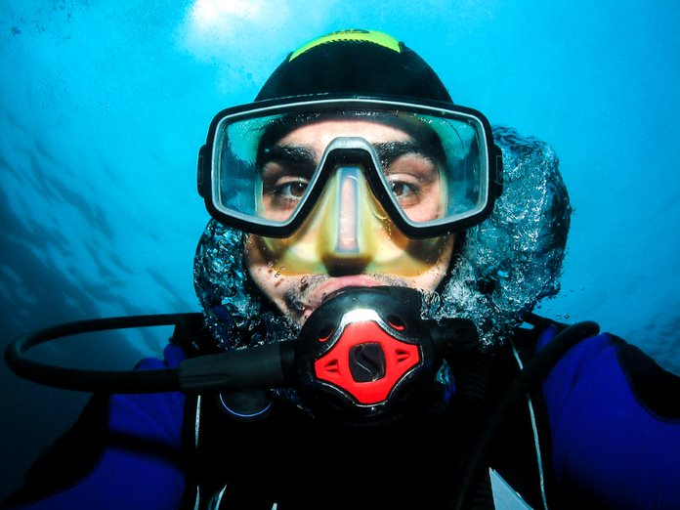
Activity 1 Answer the Questions
How do you think the person is feeling?
Where do you think he is?
What do you think is happening in the picture?

Slide 3
Activity 2 Imagine
Think about a scuba diver. Describe what you think a scuba diver is like as a person.
What is his/her personality like?
What is he/she good at?
What are his/her hobbies and interests?

Slide 4
Activity 3 Fix the Sentences
1. The scuba diver put off his equipment and went into the sea.
2. The scuba diver went deep over the water.
3. The scuba diver’s mask is made in glass.
4. He loves it because there are are lots of fish above the sea.

Slide 5
Activity 4 Finish the Story
The scuba diver is a scientist who studies the fish in the sea. He loves helping others and he is brave and kind.
One day, he took a boat far away from the coast. When he dived into the sea, he saw something strange…

