Slide 1
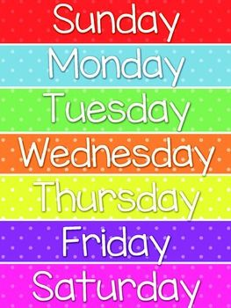
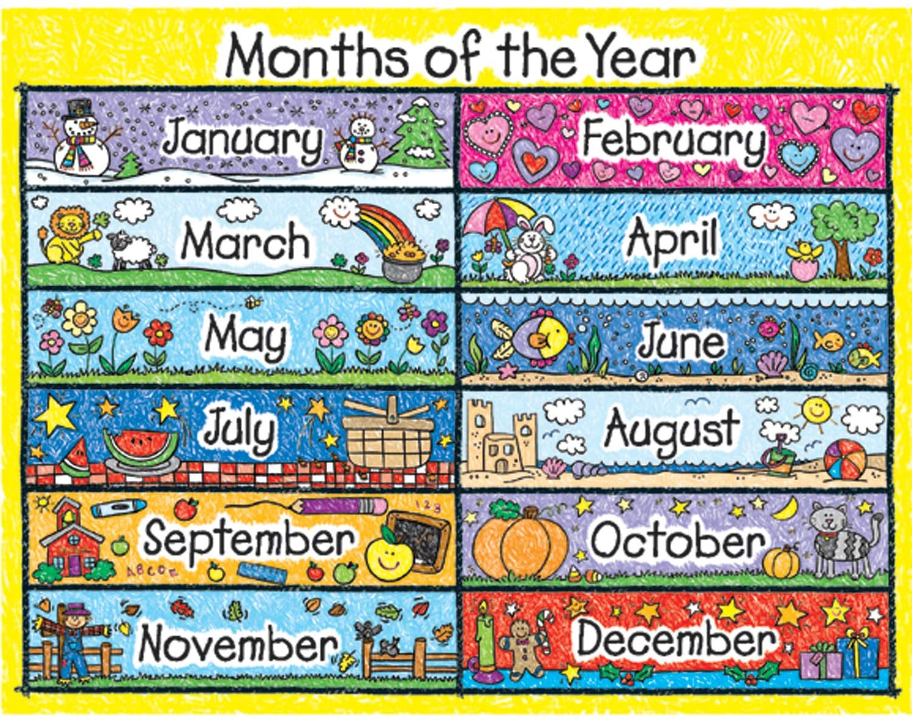
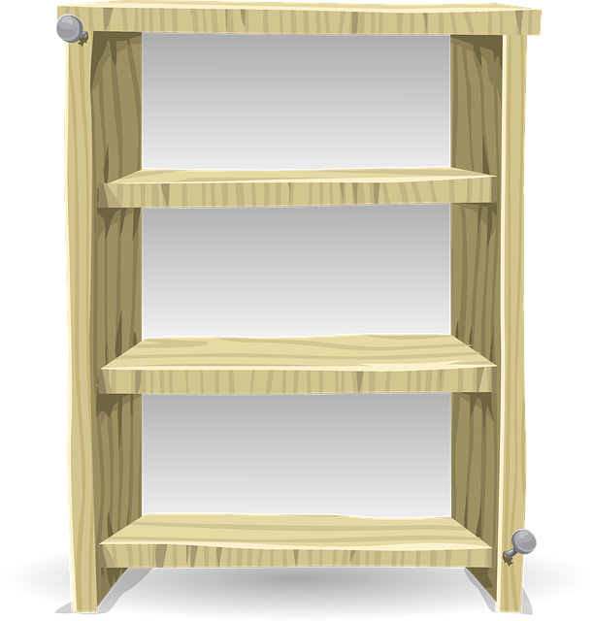
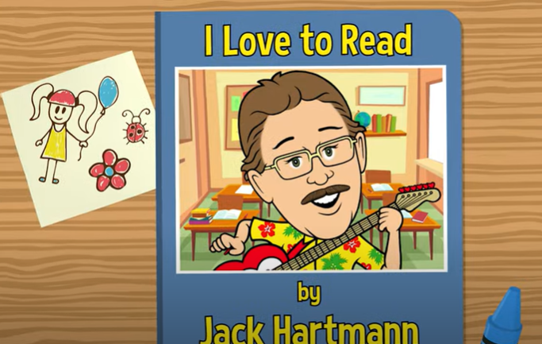
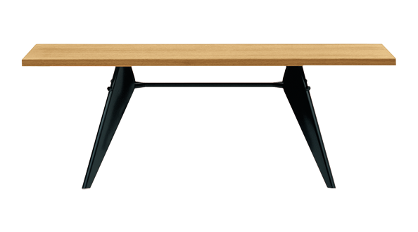
Good Morning Class
This Photo by Unknown Author is licensed under CC BY-NC
Notes:
Outline the 3 golden rules

Slide 2
National Anthem

Slide 3
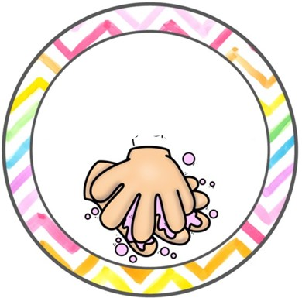
For your safety and the safety of others
Wash your hands
Keep distance
Wear a mask

Slide 4
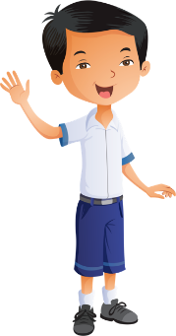
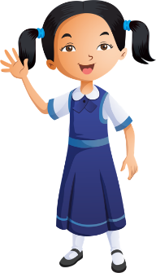
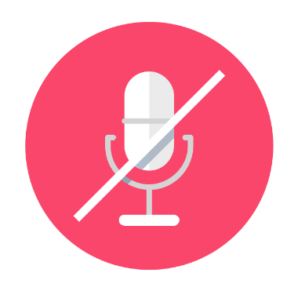
Distance learning and cybersecurity rules
Sit in a quiet place
Wear school uniform
Be ready
Stay on mute and wait for your turn

Slide 5
Lesson 2
Term 1 – Week 6
Listening Exam Practice

Slide 6
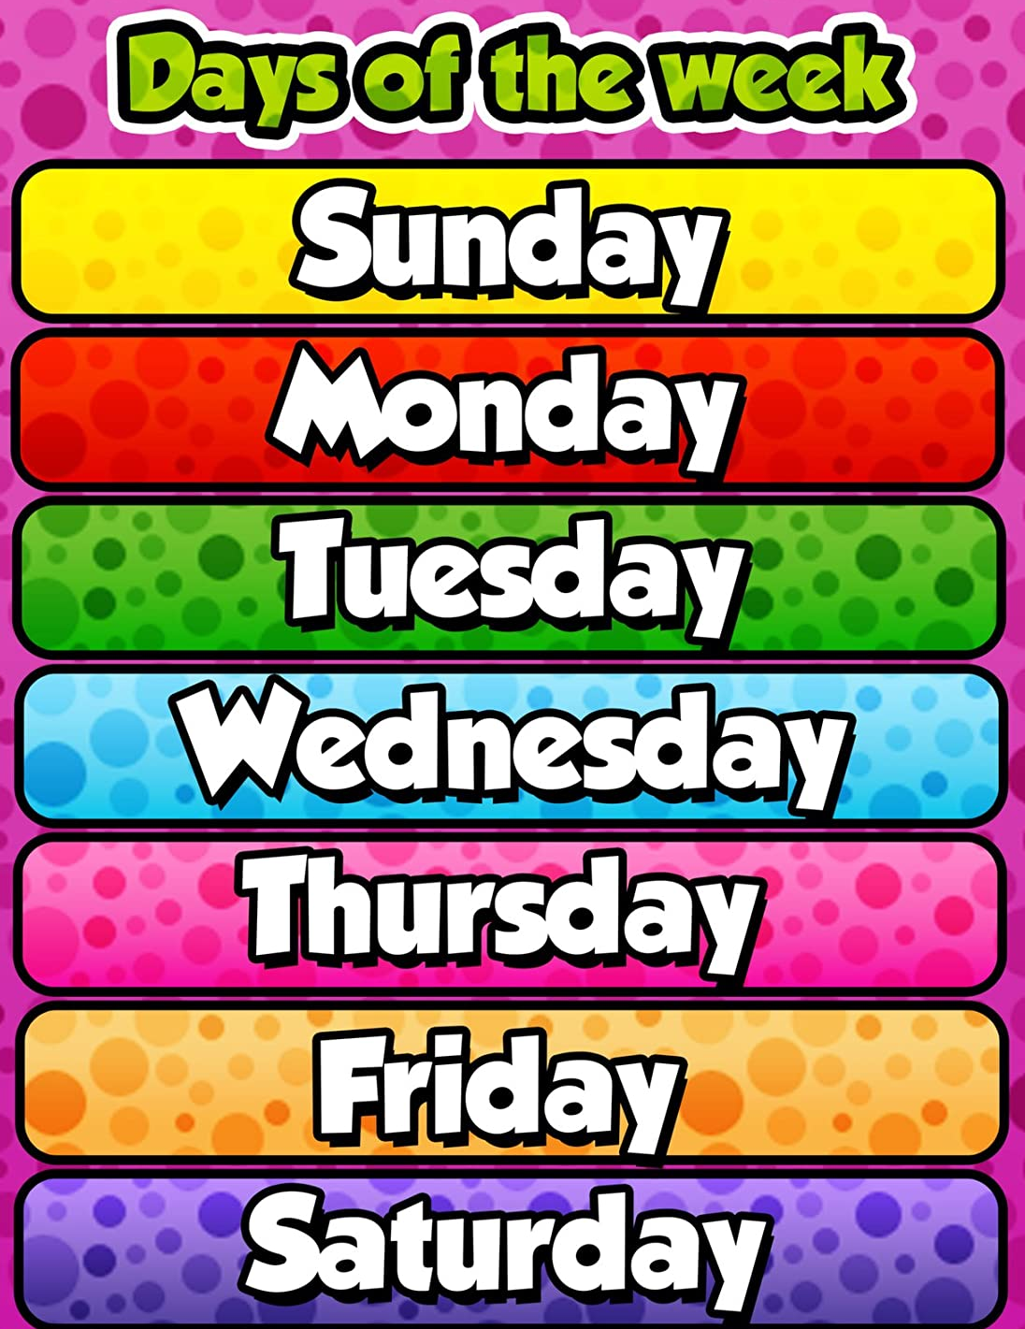
DAYS OF THE WEEK
What’s the day today?

Slide 7
PHONICS

Slide 8
SPELLINGS
​https://www.spellingtraining.com/index.html?&hyj&lyj&hzj&jyl&tjl&vej&lth&zjp
pen | net
ten | ant
pin | sun
tap | ink

Slide 9
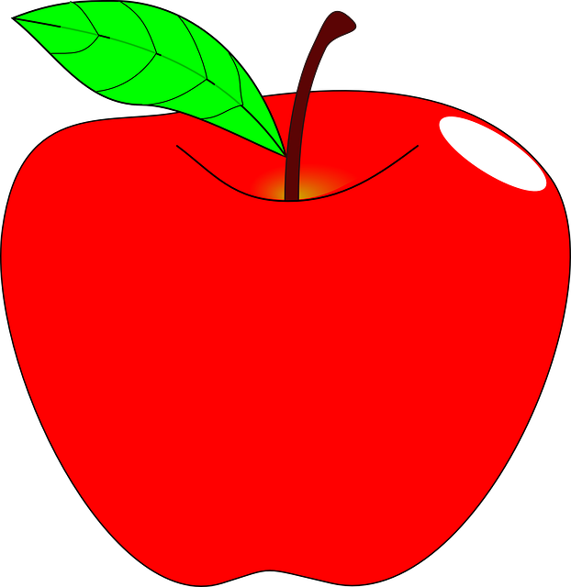
a
arrow
apple

Slide 10
n
nose
nine

Slide 11
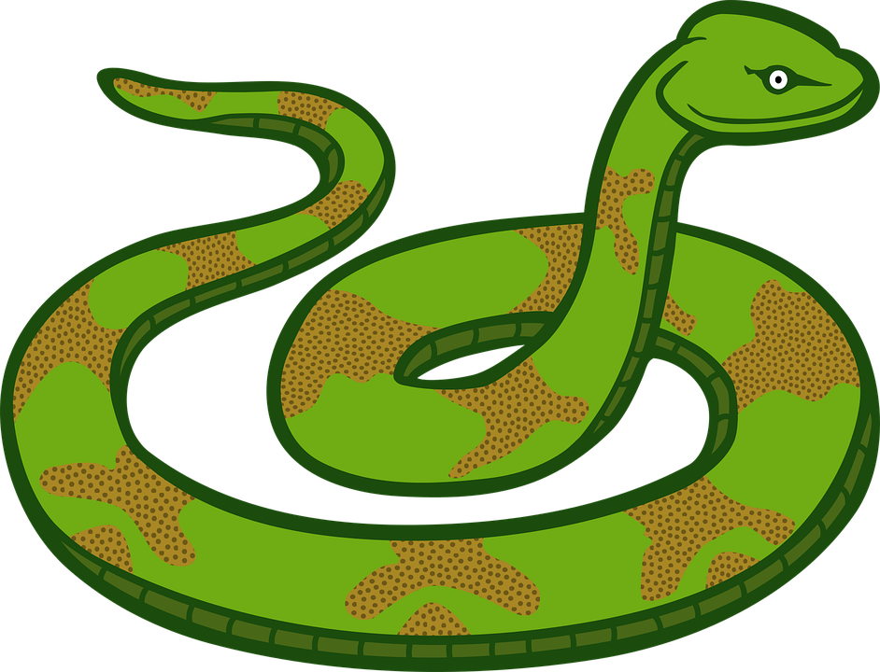
s
spoon
snake

Slide 12
p
pink
pen

Slide 13
i
igloo
ink

Slide 14
p
pin

Slide 15
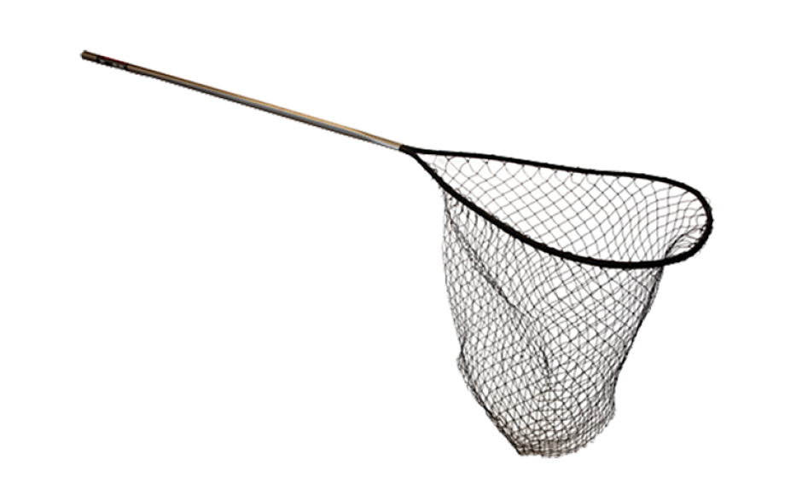
t
net

Slide 16
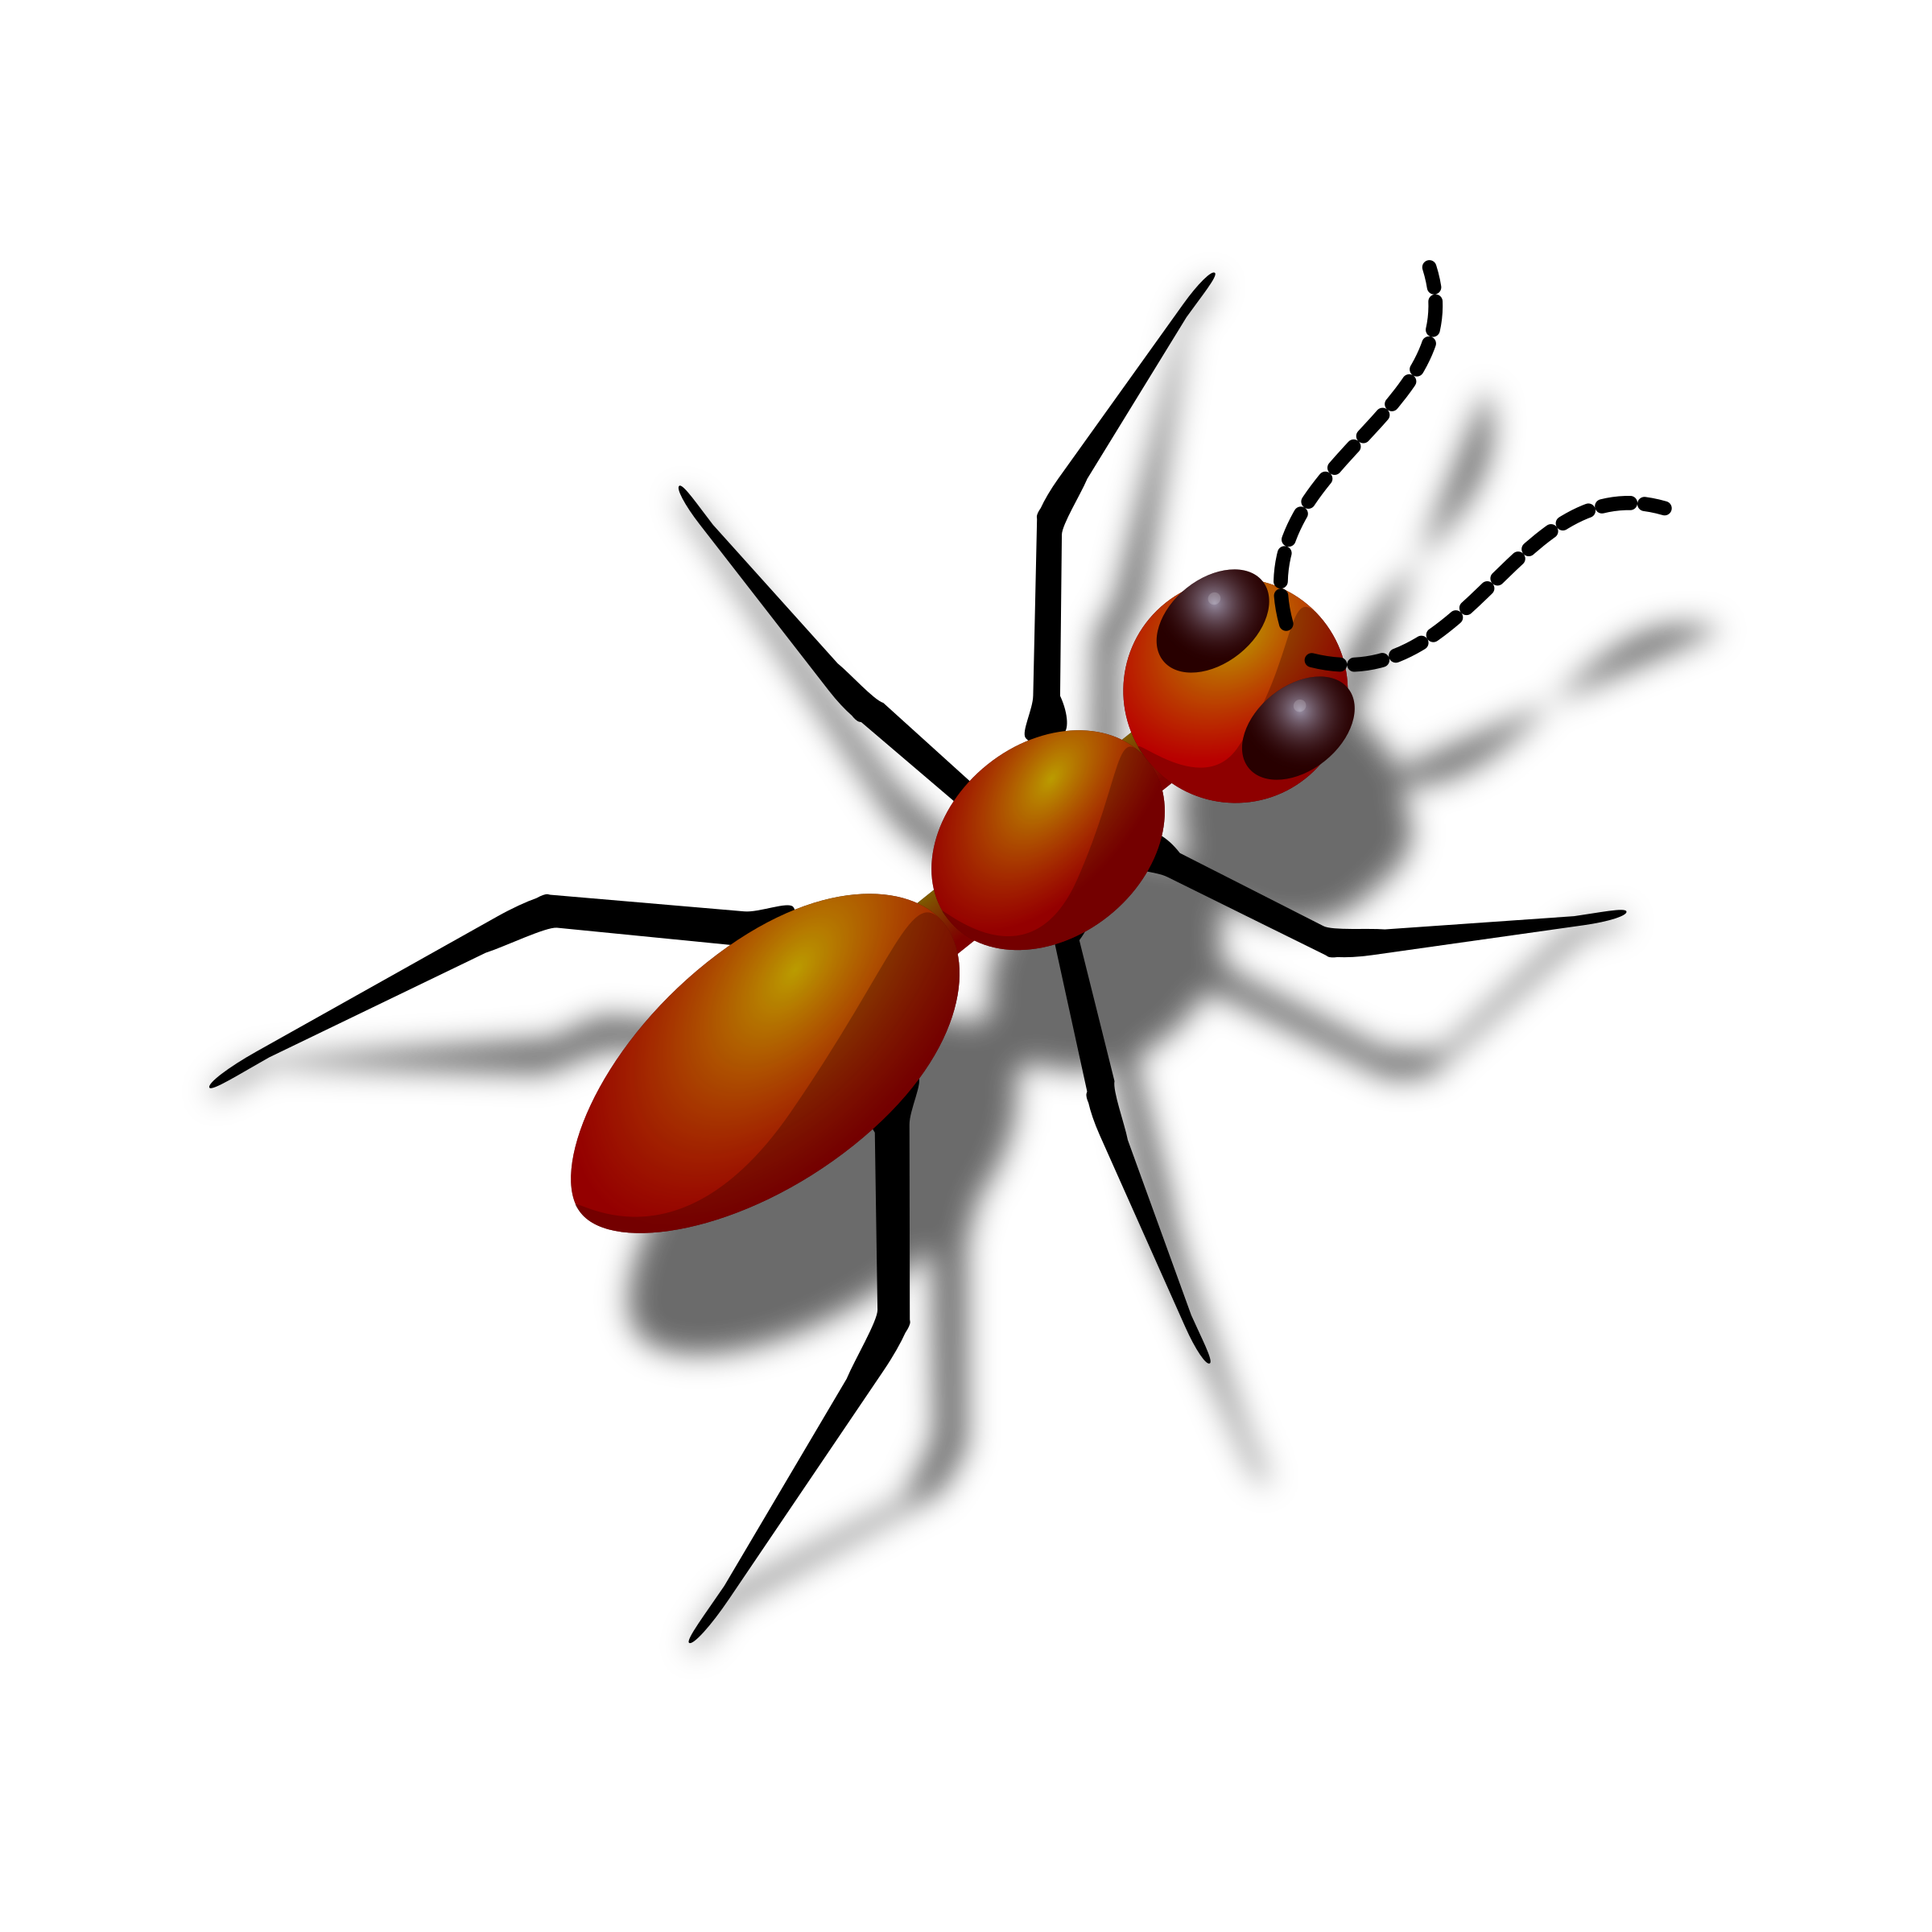
a
ant

Slide 17
s
sun

Slide 18
t
ten

Slide 19
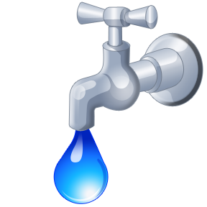
t
tap

Slide 20
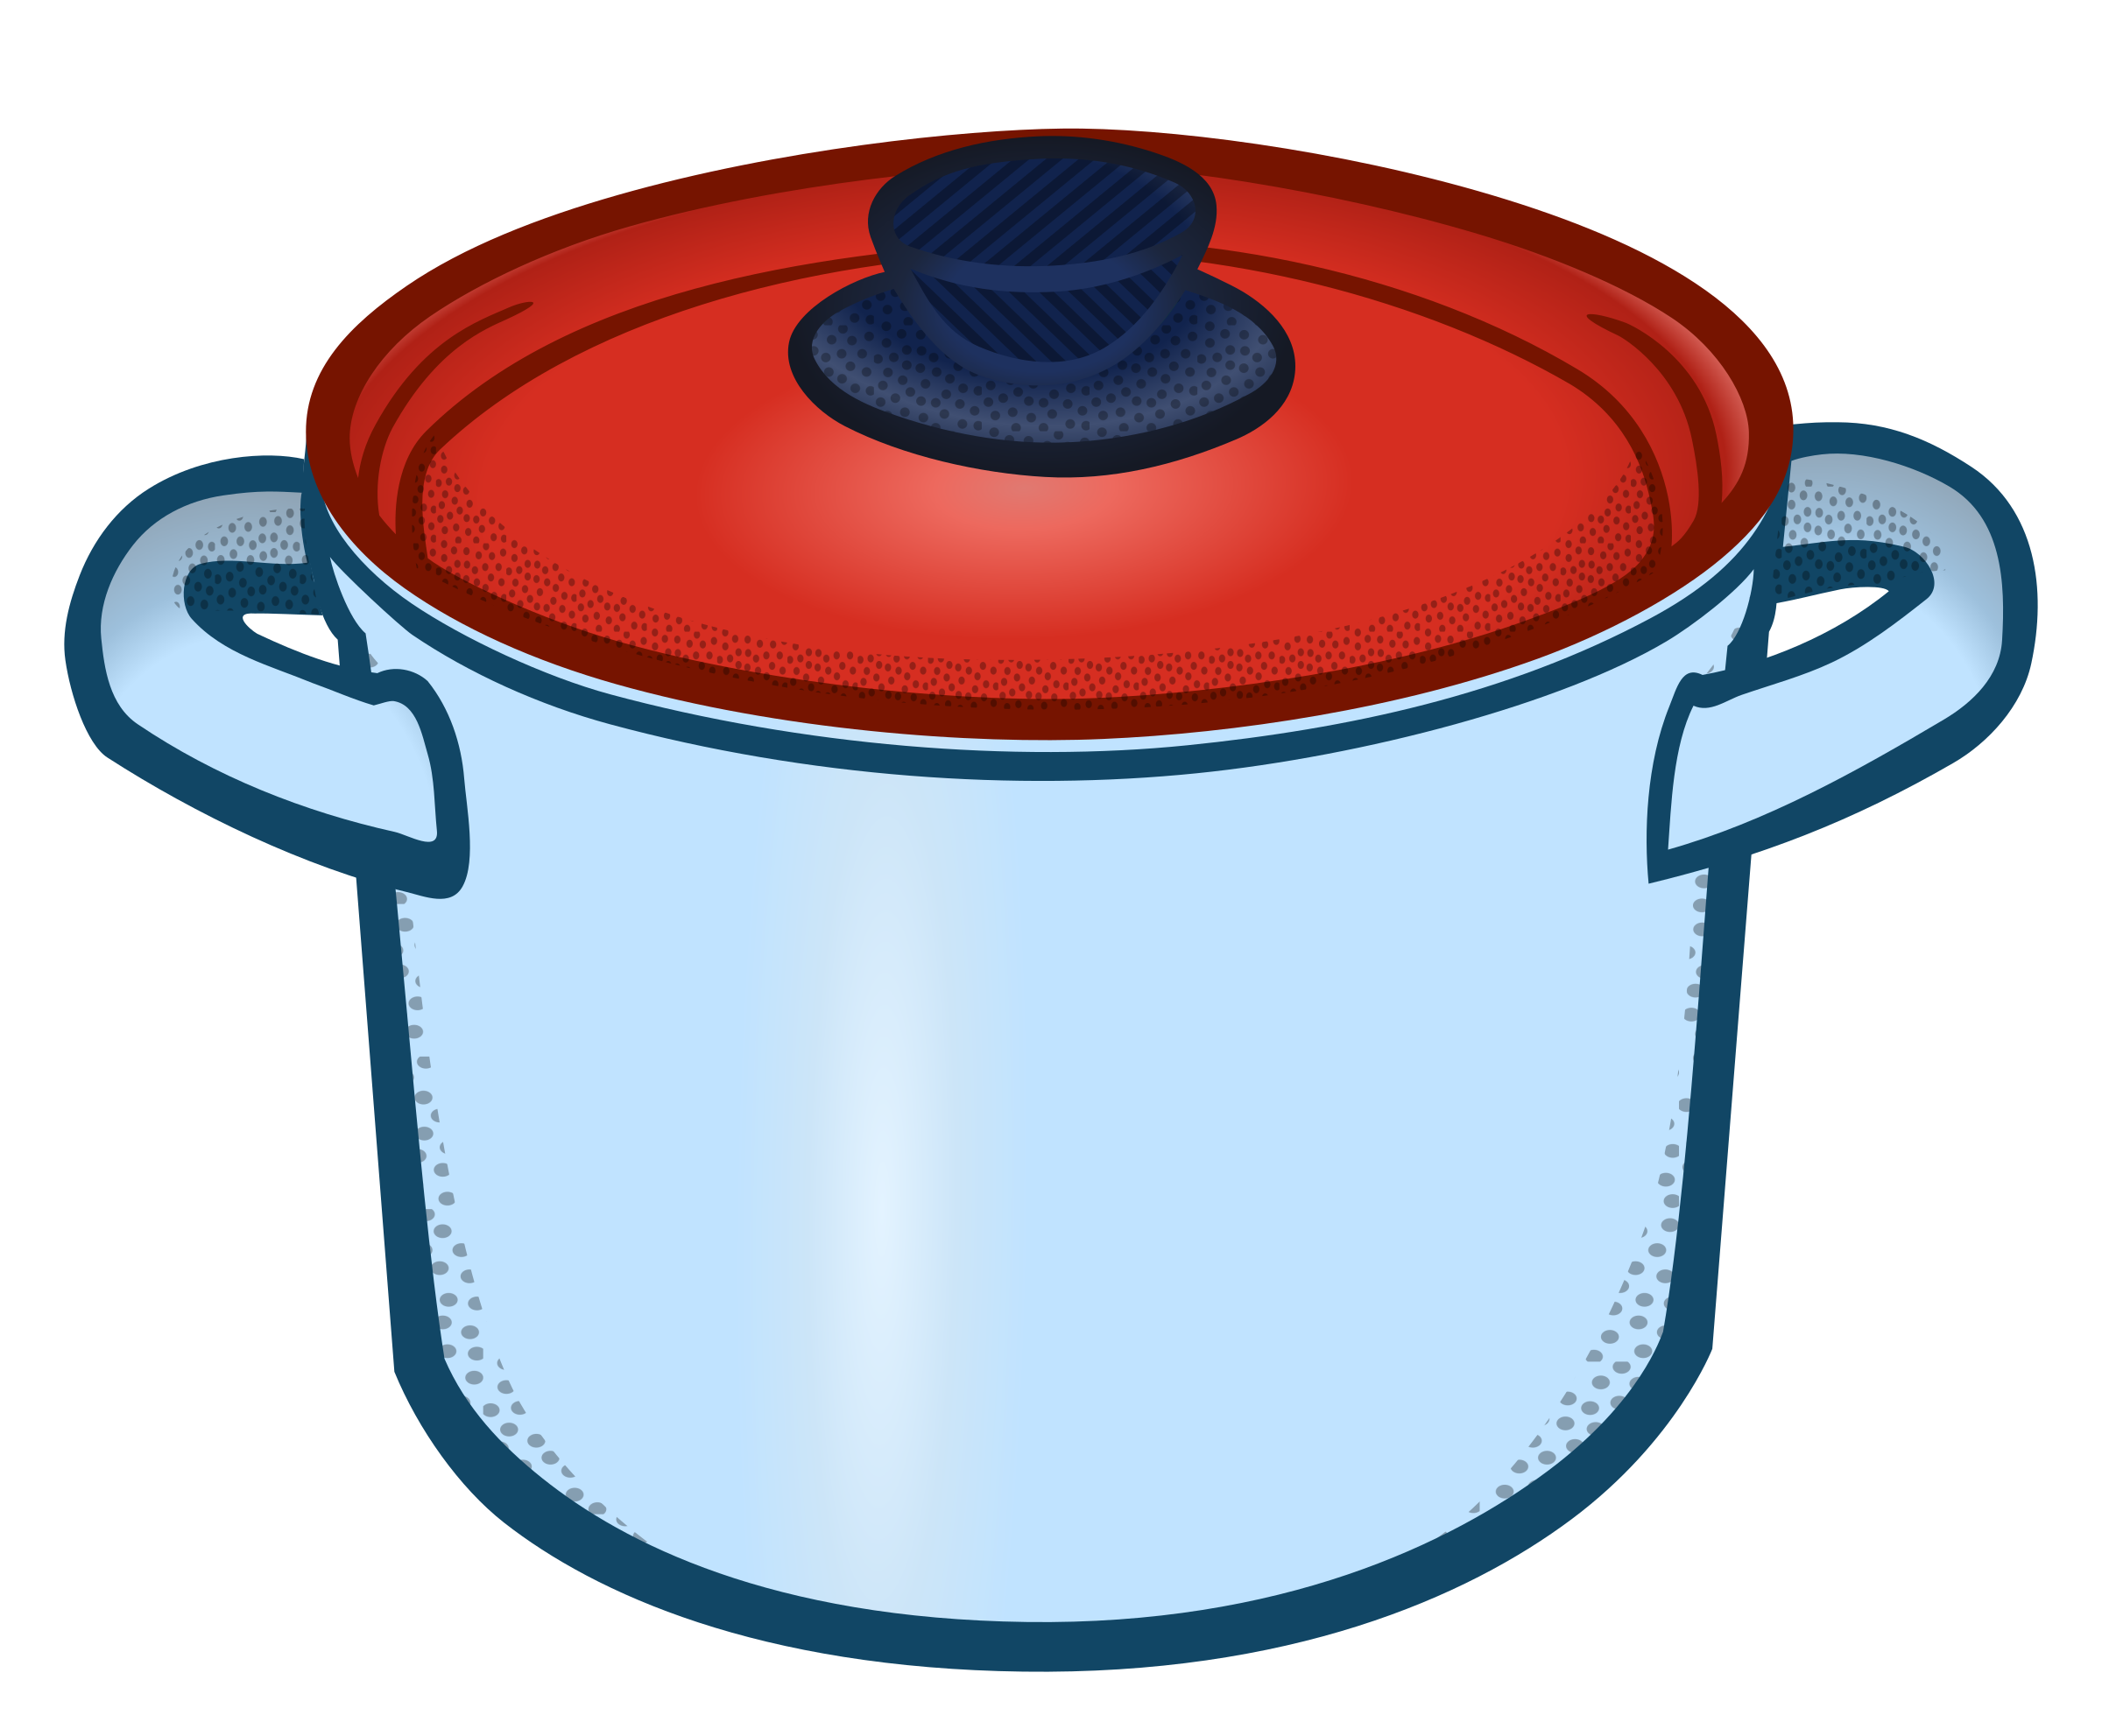
p
pot

Slide 21
n
nut

Slide 22
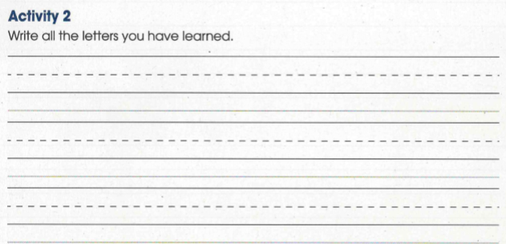
Shared Writing
Listen say and write
Dd
Ss
Ii
Pp
Aa
Nn
Tt

Slide 23
Listen and circle the correct words.
 | s | i
1 | t | p
2 | n | i
3 | s | p
4 | a | n
5 | s | a
Example

Slide 24
ANSWERS
Example
 | s | i
1 | t | p
2 | n | i
3 | s | p
4 | a | n
5 | s | a

Slide 25
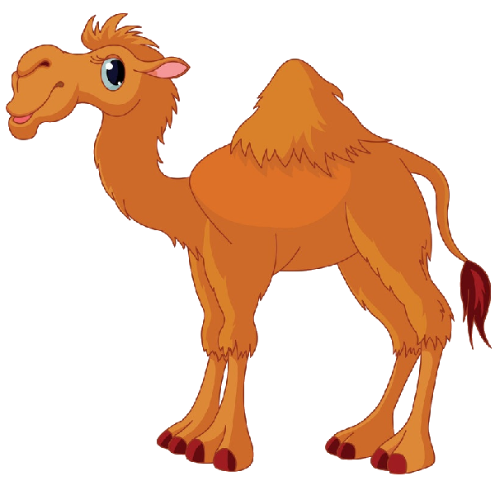
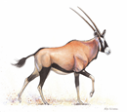
Differentiated Activities
Live worksheet | Link | Challenges
Wordwall | https://wordwall.net/play/5055/783/149 | Level 1
Wordwall | https://wordwall.net/play/21765/461/586 | Level 2
Wordwall | https://wordwall.net/play/12724/485/490 | Level 3

Slide 26
Self Assessment
I can read and write words with S A T P I N sound.
Yes, I can.
No, I can’t.

