Slide 1
Welcome
Grade
2

Slide 2
Please stand for the UAE Anthem.

Slide 5
Sunday
Monday
Tuesday
Wednesday
Thursday
Friday
Saturday

Slide 6
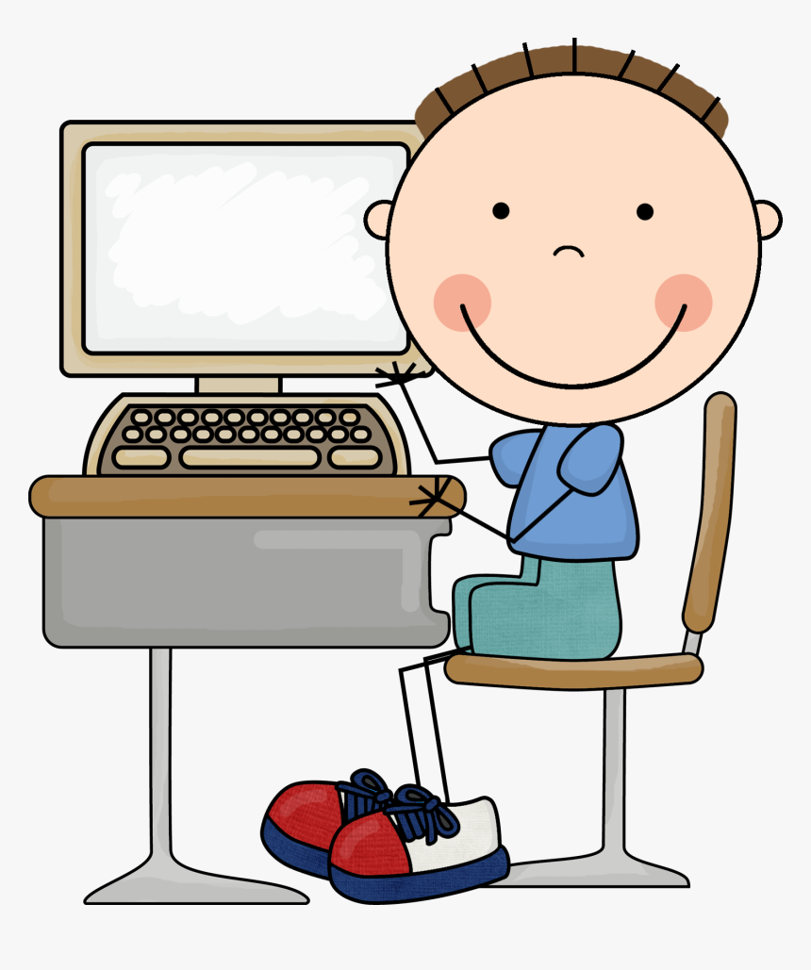
You will need:

Slide 7
Learning Objectives
To be able to read and identify familiar words and set phrases in very short, simple texts on familiar topics with the help of pictures.

Slide 8
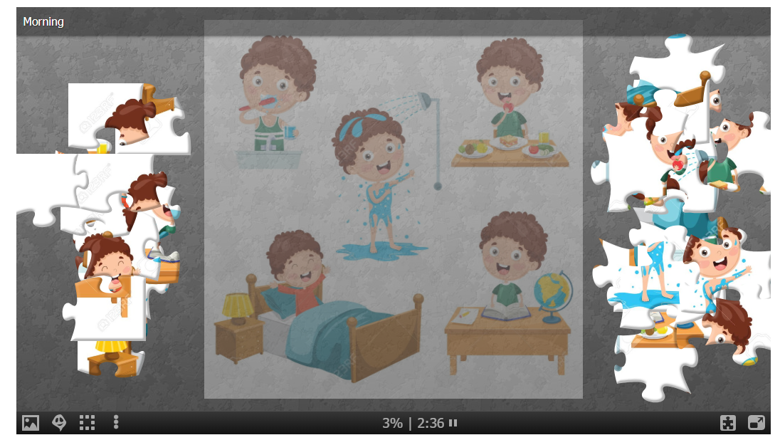
https://www.jigsawplanet.com/?rc=play&pid=3d4d60e1a57d

Slide 9
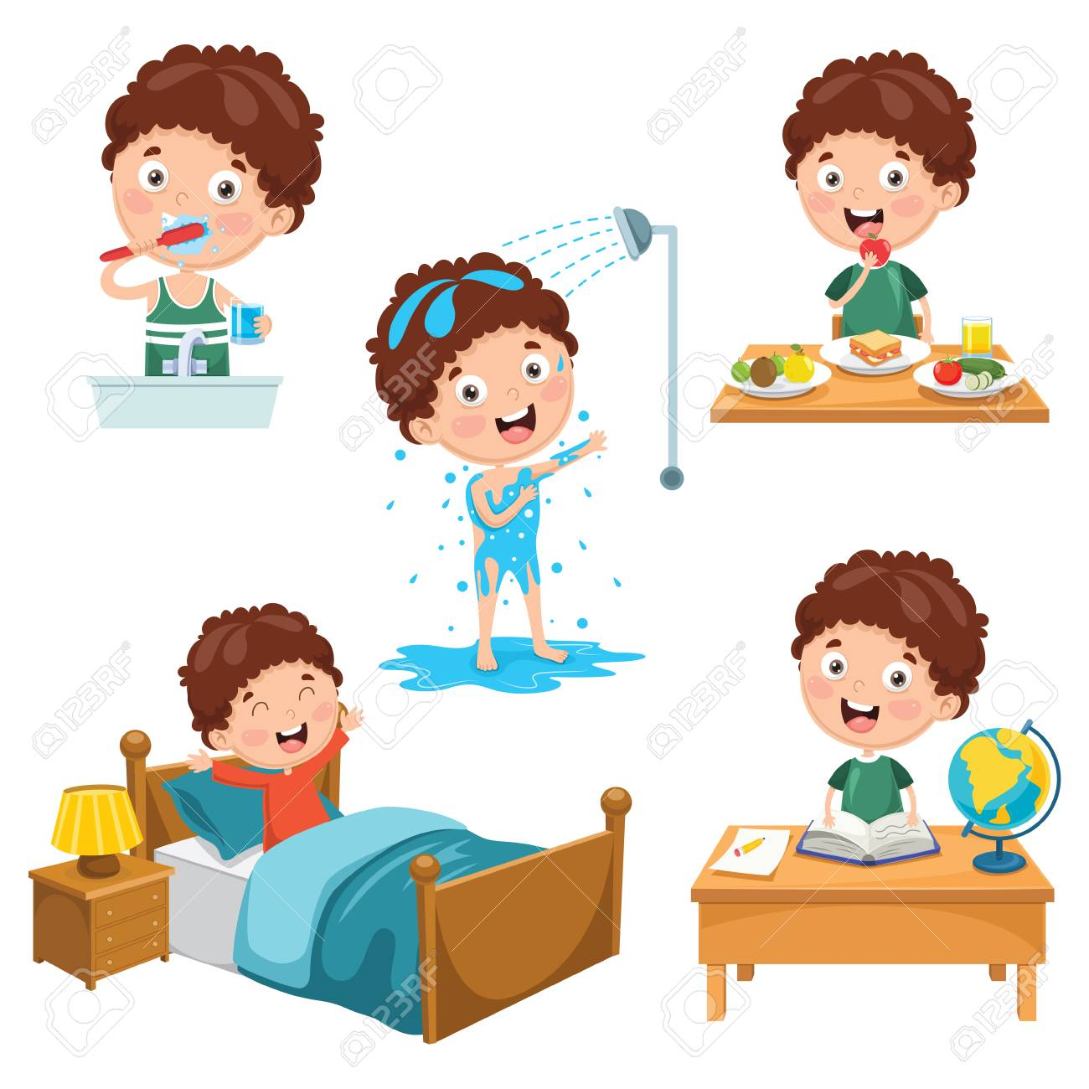

Slide 11
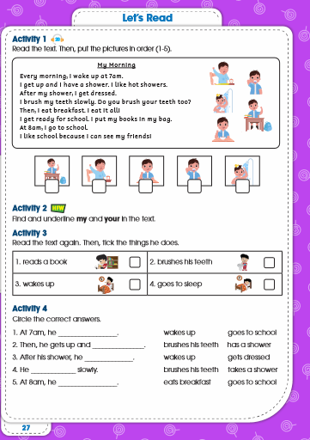
Open your book
Page 27

Slide 13
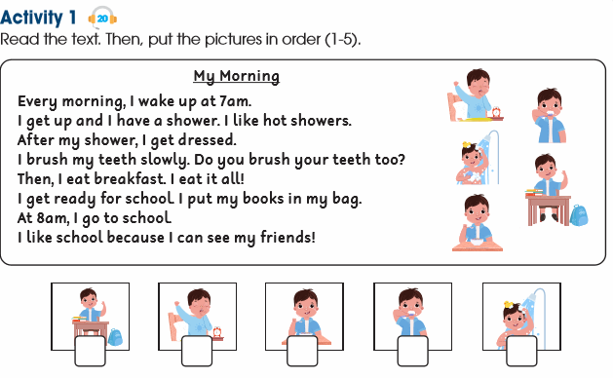
5
1
4
3
2

Slide 15
wakes up
has a shower.
gets dressed.
brushes his teeth
slowly.
goes to school.

Slide 16
https://www.liveworksheets.com/worksheets/en/English_as_a_Second_Language_(ESL)/Daily_routines/Morning_Routine_ve1150276km

Slide 17
https://www.liveworksheets.com/worksheets/en/English_as_a_Second_Language_(ESL)/Daily_routines/Daily_routine_py8698vv

Slide 20
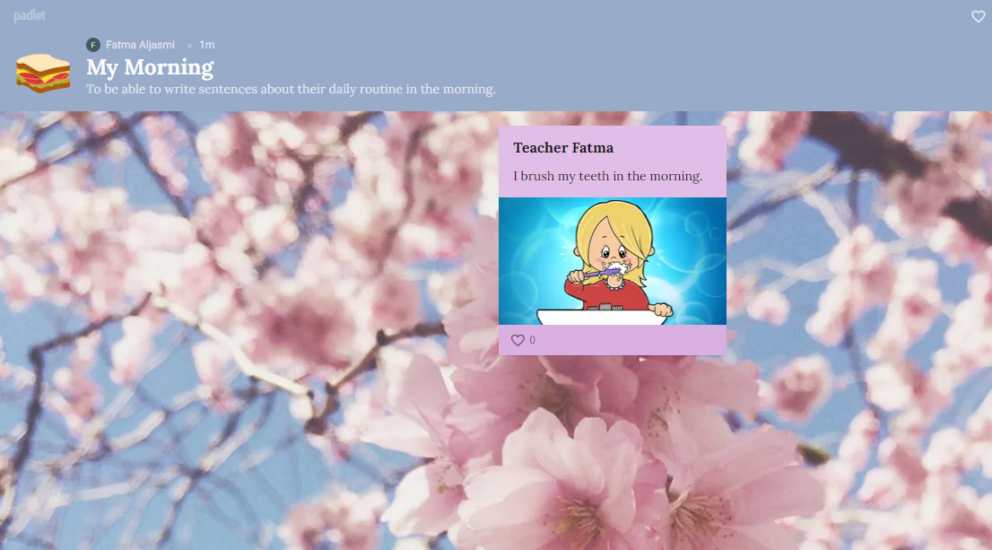
Exit ticket
https://padlet.com/fatmaaljasmi9/aqxe2akwp4eetrws

