Slide 1

Reading and Writing Task Review
Level 2.2
Term 1 2021/2022
Federal Entity | هيئة اتحادية

Slide 2
Key words
caught
set free
kind
rope
net
teeth

Slide 3
caught
the past form of “catch”, i.e. to capture somebody who would like to escape

Slide 4
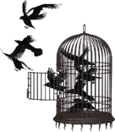
set free
to let somebody go, to let somebody be free

Slide 5

kind
nice and helping others

Slide 6
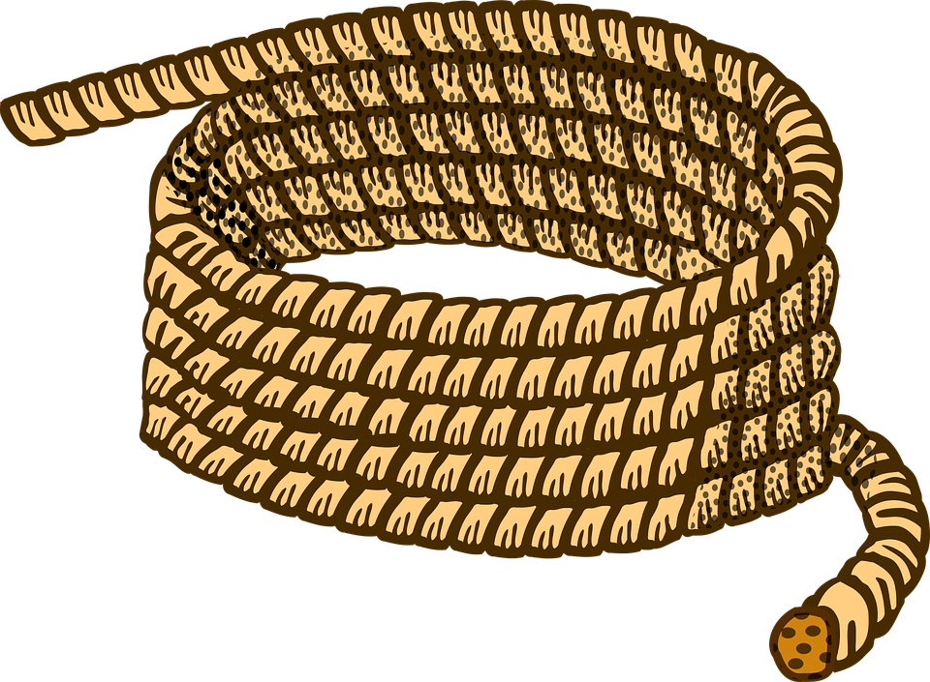
rope
a thing you use to tie things together

Slide 7

net
ropes tied together, sometimes used to catch animals

Slide 8

teeth
a part of your body in your mouth that helps you cut food into small pieces

Slide 9
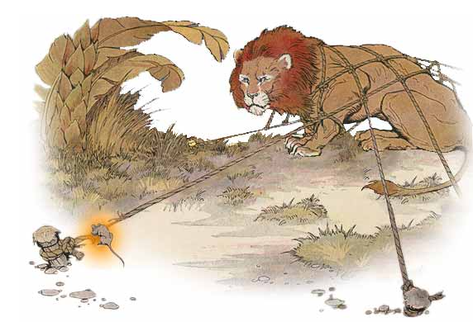
The Lion and the Mouse
Federal Entity | هيئة اتحادية

Slide 10

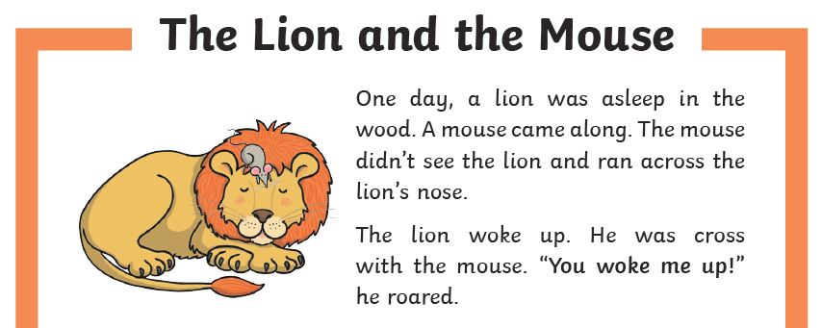

Slide 11
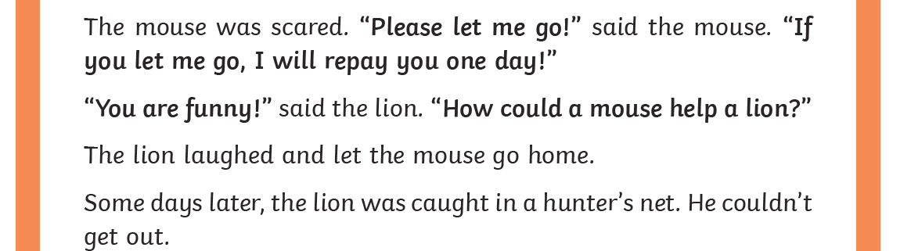

Slide 12
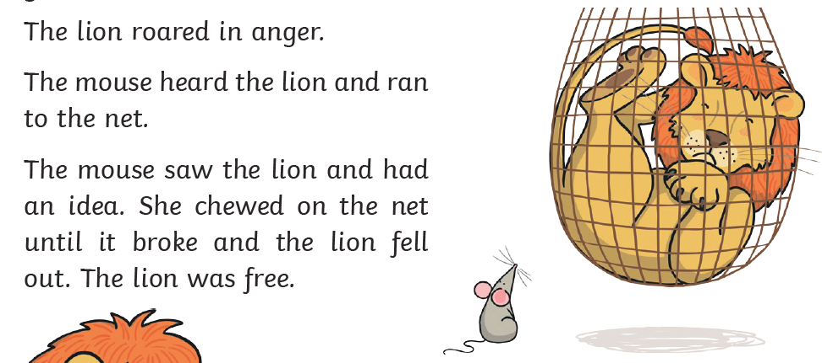

Slide 13
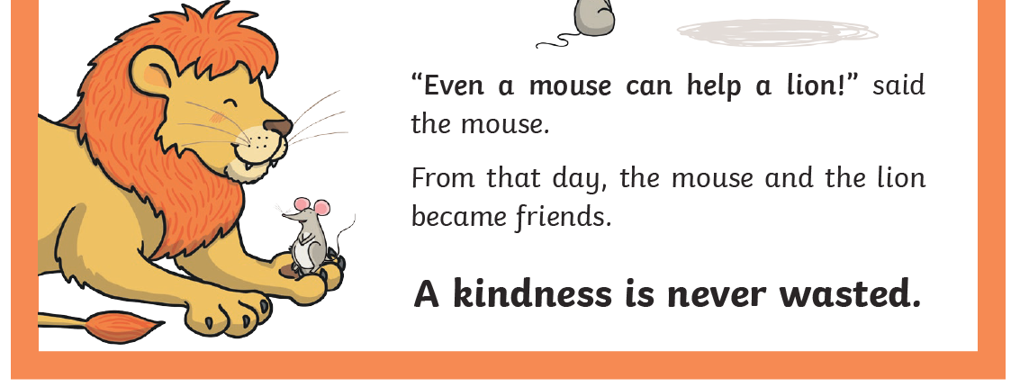

Slide 14

Questions

Slide 15

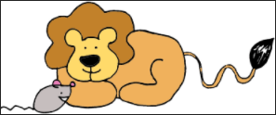
1. What can you learn from this story?
I can learn that______.

Slide 16
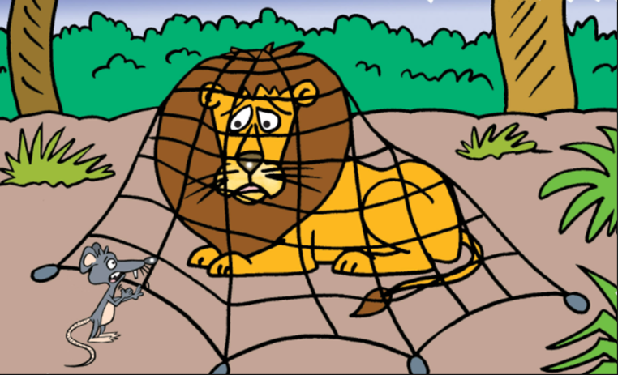
2. What was the lion caught in?
The lion was caught in a net.

Slide 17
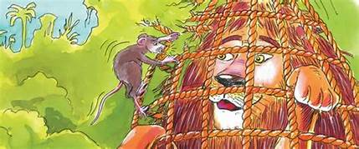
3. What did the mouse use to cut the ropes?
The mouse used its teeth to cut the ropes.

Slide 18
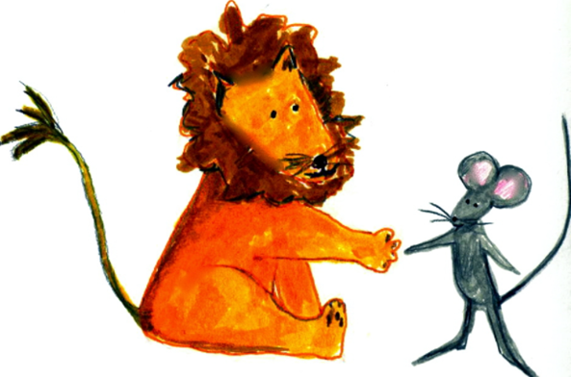
4. Why should we be kind to everybody?
We should be kind to everybody because ______.

Slide 19
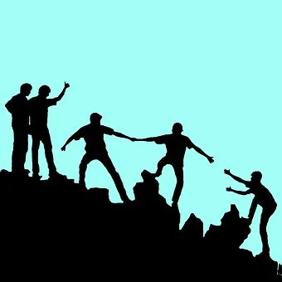
5. How can you help your friends?
I can ______.

Slide 20
6. Who are the characters in the story? Circle two.
a mouse
a badger
a fox
a lion

Slide 21
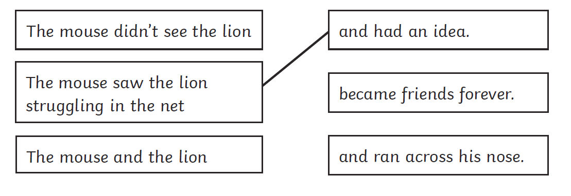
7. Complete the sentences. One has already been done for you.

Slide 22
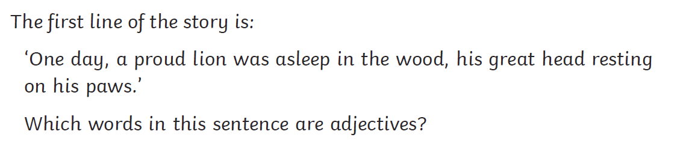
8. The first line of the story is:
Proud and great are both adjectives in this sentence.

Slide 23
9. Why did the lion want to kill the mouse? Circle 1
She had woken him from his nap.
He didn’t like mice.
He wasn’t a very nice lion.

Slide 24
10. Why did the mouse go to help the lion?
___________________________________________________________________________________________
___________________________________________________________________________________________
___________________________________________________________________________________________

Slide 25

Reflection

Slide 26


Reflective Questions
I think that question ______ was difficult because ______.
I like question ______ because ________________.

Slide 27

Glossary

Slide 28

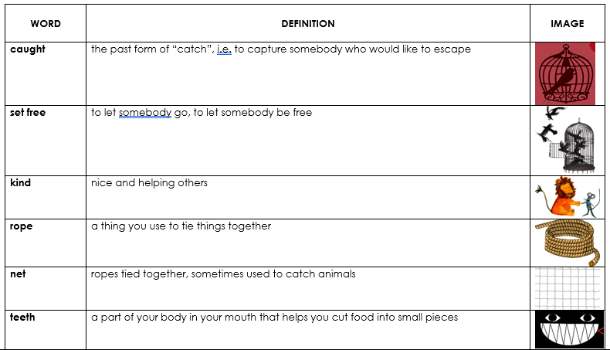
Glossary

Slide 29



Follow us
ese.ae
Ese_ae

