Slide 1
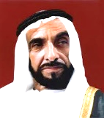
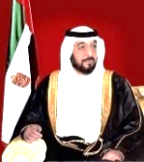
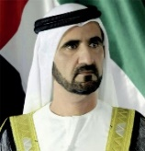
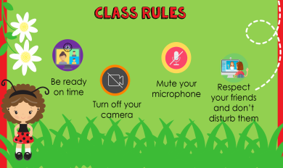
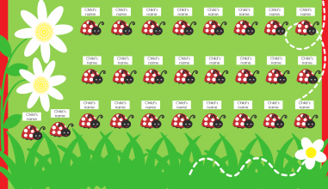
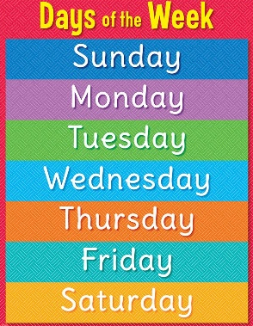
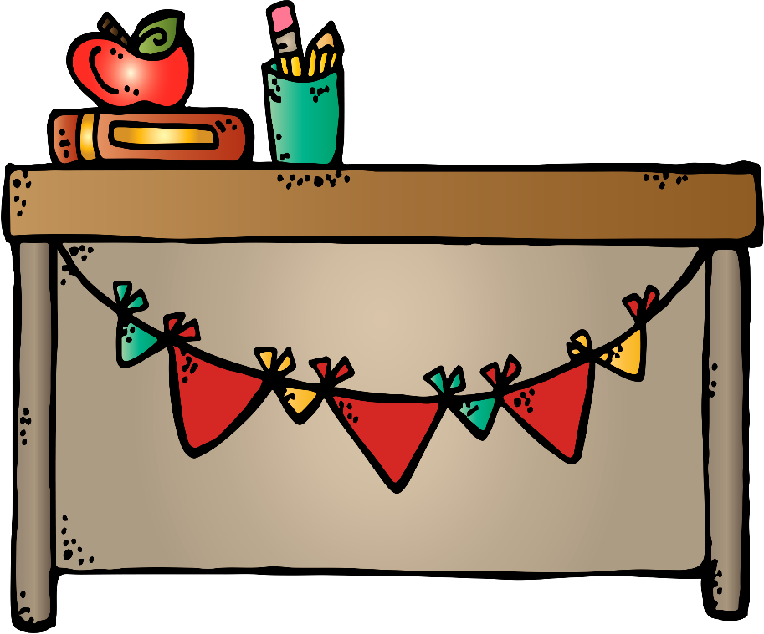
How is the
weather today?
Unit 5 , Lesson 3
Daily routine
Day:
Lesson 3
Title and Learning Outcomes:
Teacher Sameera AL Mathkoor
English Class/ Unit: 5 – Lesson: 3/ Daily Routines session with Ms. Sameera and grade 2 students

Slide 2
Attendance
Grade 2 - 1

Slide 3
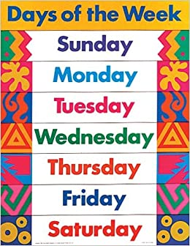
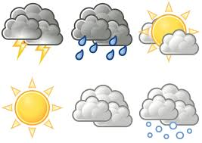
1) My name is ………………….
2) Today is ……………….
3) The date is ….. September 2021.
4) The weather is ………..

Slide 4
Class rules
Be ready on time
Mute your microphone
Respect your friends and don’t disturb them
Turn off your camera

Slide 5
Wash Your Hands
(with water and soap)

Slide 6
Lesson Map
1
Guessing the daily routine
2
Wh-question Strategy
Asking oral questions about daily routine
3
Practice Time & Self Evaluation

Slide 7
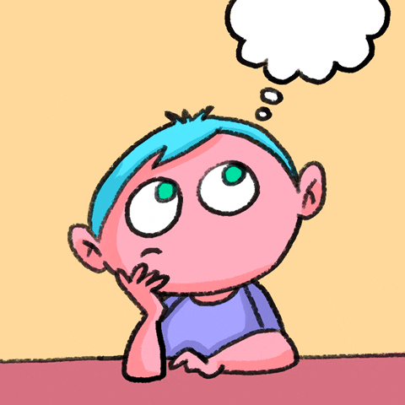
What’s inside my bag? - Strategy: Guessing
I think, there is a/ an ….. in your bag.

Slide 8
Let’s revise the
Daily routines

Slide 9
Watch the video and write the daily routines
Strategy: listening for purpose

Slide 10
Lesson Map
1
Guessing the daily routine
2
Wh-question Strategy
Asking oral questions about daily routine
3
Practice Time & Self Evaluation

Slide 11
Oral Questioning - Wh questions
Strategy: differentiation
What do you do in the morning everyday ?
What do you do in the afternoon ?
What do you do in the evening?
What do you do at the night ?
I ………………………. in the morning.

Slide 12
Learning Outcomes:
1. Identify the daily routines.
2. Read and write short sentences.

Slide 13
Reading Time

Slide 14
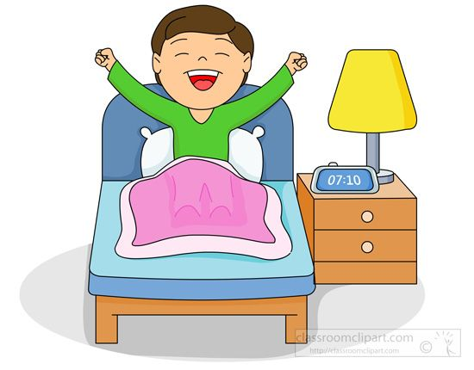
Wake
Reading Time - Strategy: differentiation
up

Slide 15
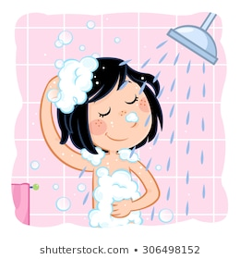
have
Reading Time - Strategy: differentiation
a
shower

Slide 16
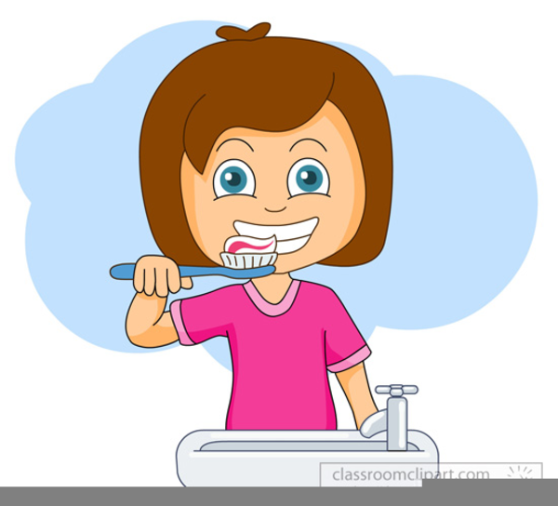
brush
Reading Time - Strategy: differentiation
my
teeth

Slide 17
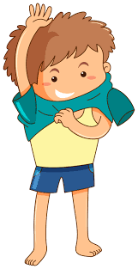
get
Reading Time - Strategy: differentiation
dressed

Slide 18
eat
Reading Time - Strategy: differentiation
breakfast

Slide 19
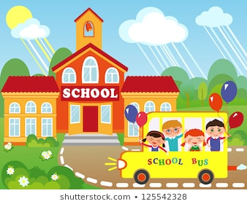
go
Reading Time - Strategy: differentiation
to
school

Slide 20
Eat breakfast
Get dressed
Have a shower
Brush my teeth
Go to school
Wake up

Slide 21
Lesson Map
1
Guessing the daily routine
2
Wh-question Strategy
Asking oral questions about daily routine
3
Practice Time & Self Evaluation

Slide 22
Open book
Page 26

Slide 23
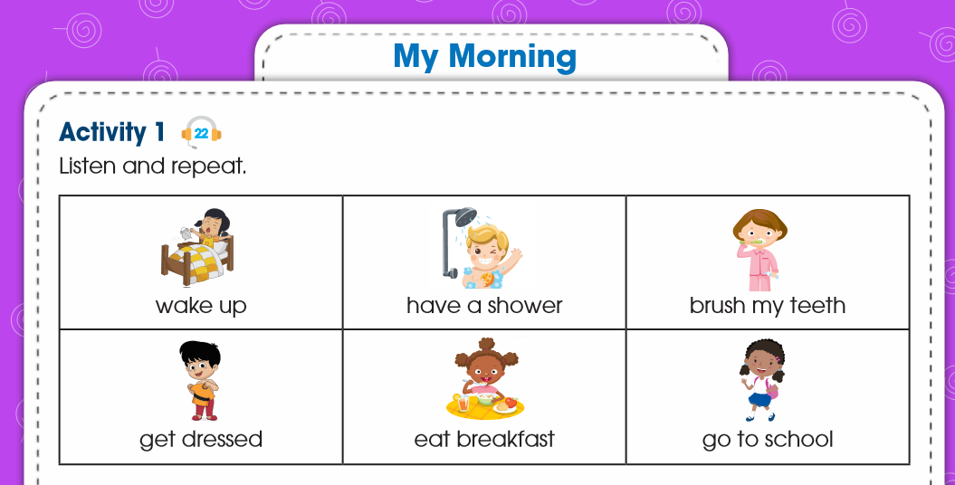
Slap the action- Strategy: Recognition
Page 26

Slide 24
Matching Game
Strategy: Reading for purpose

Slide 25
Feedback - Strategy: Self Evaluation
6

Slide 26
Fill in Gap Activity
Strategy: prediction
up
have
my
get
eat
go

Slide 27
Lesson Map
1
Guessing the daily routine
2
Wh-question Strategy
Asking oral questions about daily routine
3
Practice Time & Self Evaluation

Slide 29
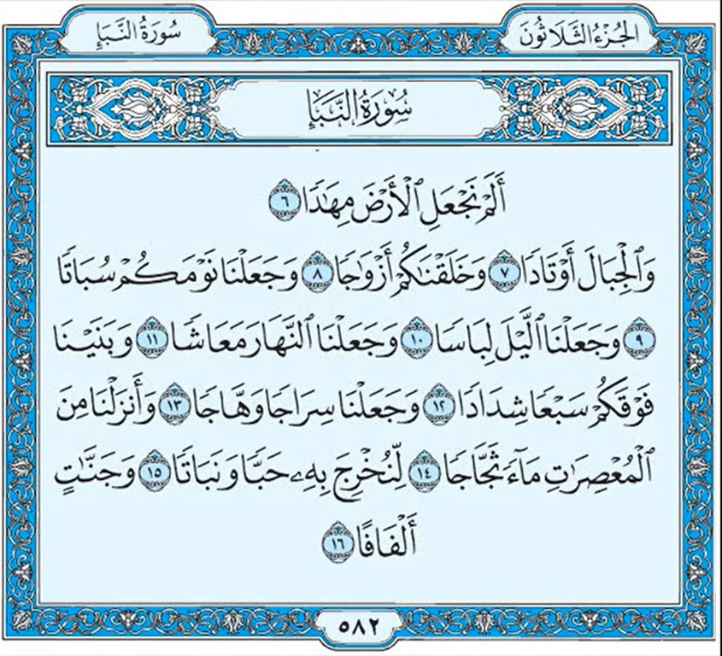
Exit Card - Strategy: Critical Thinking
Recite the Holy Quran.
When do you study and work? Why?

