Slide 1
8/9/2021
Chapter 2: Life - Structure and Function
Section 1: Exploring Life
6A2
Page 22
Prokaryotic Cells and Eukaryotic cells
For this lesson you will need your…
Science notebook
Pencil case
Textbook
Wifi MOESTAFF
password-MOESt@ff2020

Slide 2
Learning Objectives:
Students are expected to:
Differentiate the types of cells
Keywords
Prokaryote, Eukaryote

Slide 3
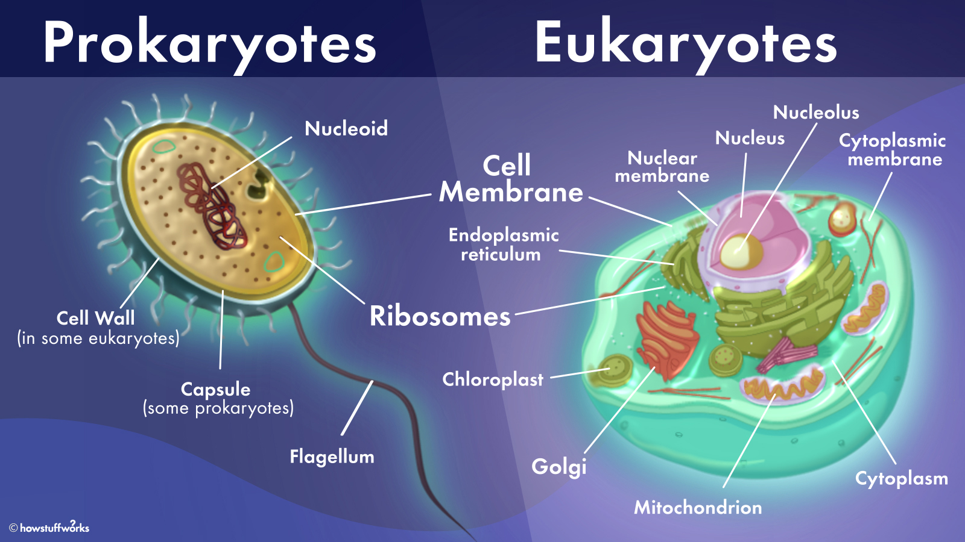
Lesson Starter
what is difference between prokaryotes and eukaryotes. Write your answer in chat box.

Slide 4
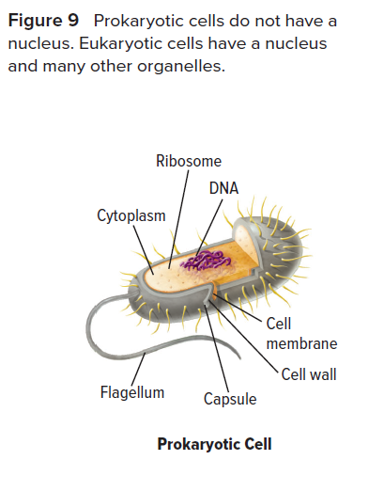
Differentiate the types of cells
Prokaryotic cells
Prokaryotic cells do not have a nucleus or other membrane-bound organelles.
Organelles are structures in cells that carry out specific functions.
The few organelles in prokaryotic cells are not sur-rounded by membranes.
Organisms with prokaryotic cells are called prokaryotes. Most prokaryotes are unicellular organisms, such as bacteria.
Which living organisms are prokaryotes?

Slide 5
Differentiate the types of cells

Slide 6
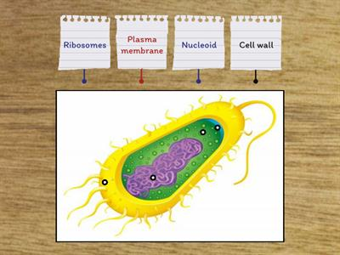
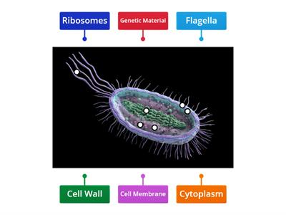
Differentiate the types of cells
Quick check
EVALUATE
https://www.wordwall.net/play/10559/437/738
https://www.wordwall.net/play/6788/509/743

Slide 7
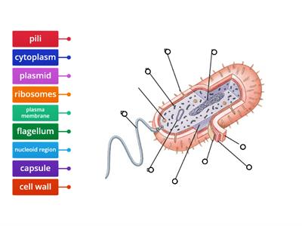
Differentiate the types of cells
Quick check
EVALUATE
https://www.wordwall.net/play/5347/240/371

Slide 8
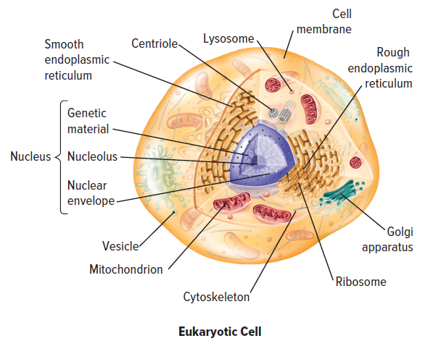
Differentiate the types of cells
Eukaryotic cells
Eukaryotic cells have a nucleus and other membrane-bound organelles.
Most multicellular organisms and some unicellular organisms are eukaryotes.
The eukaryotic cell shown in Figure 9 contains many structures that are not in a prokaryotic cell.
In eukaryotes, membranes surround most of the organelles, including the nucleus.
Which living organisms are eukaryotes?

Slide 9
Differentiate the types of cells
What structures are in both prokaryotic cells and eukaryotic cells?

Slide 10
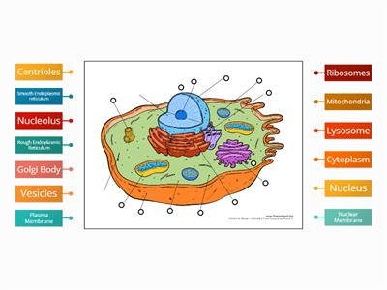
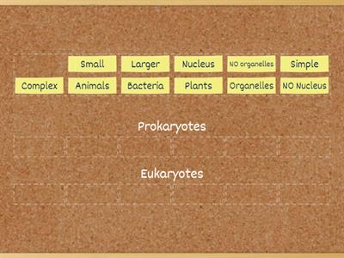
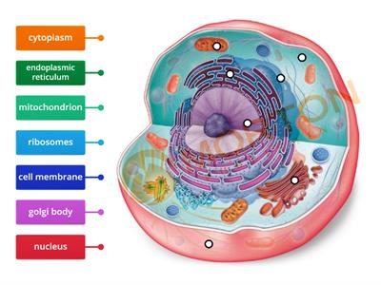
define cells and explain what they are made of
Quick check
EVALUATE
https://www.wordwall.net/play/179/746/7904
https://wordwall.net/play/778/198/443
https://www.wordwall.net/play/7666/429/342

Slide 11
Differentiate the types of cells
Quick check
EVALUATE
1. What is a cell made of?
Cell membrane
Nucleus
Cytoplasm
All of these
2. do not have a nucleus or other membrane-bound organelles
3. What structures are in both prokaryotic cells and eukaryotic cells?

Slide 12
Differentiate the types of cells
Quick check
EVALUATE
1. What is a cell made of?
Cell membrane
Nucleus
Cytoplasm
All of these
2. Prokaryotic cells do not have a nucleus or other membrane-bound organelles
3. What structures are present in both prokaryotic cells and eukaryotic cells?
DNA, Ribosome, cytoplasm, cell membrane

Slide 13
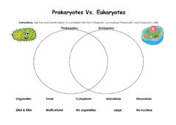
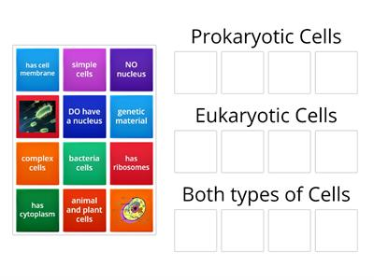
Differentiate the types of cells
Quick check
EVALUATE
https://www.liveworksheets.com/c?a=s&t=on35kk2jy2&sr=n&l=co&i=ufzxnns&r=aj&db=0
https://wordwall.net/play/13836/363/639

Slide 14
Learning outcome
Differentiate the types of cells

Slide 15
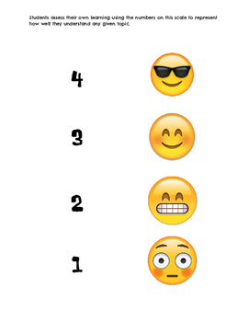
Plenary/ Exit ticket
Self assessment Type your name and self-assessment in the chat box.
I totally understand! - 9 or 10/10 or 5/5
I get it! – 7 or 8 /10
or 4/5
I’m nearly there! - 5 or 6 / 10
or 3/5
I need more help please! – 4 or less
or 2/5 or less

