Slide 1
5/9/2021
Chapter 2: Life - Structure and Function
Section 1: Exploring Life
6A2
Page 22
Unicellular and multicellular organisms
For this lesson you will need your…
Science notebook
Pencil case
Textbook
Wifi MOESTAFF
password-MOESt@ff2020

Slide 2
Learning Objectives:
Students are expected to:
Differentiate between unicellular and multicellular organisms
Keywords
Unicellular and multicellular

Slide 3
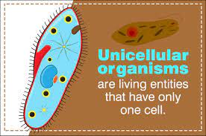
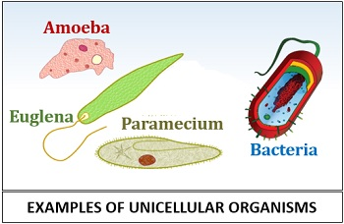
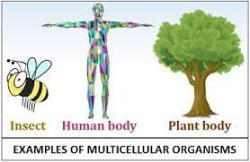
Lesson Starter
What is the difference between Unicellular and multicellular organisms. Write your answer in chat box.

Slide 4
Differentiate between unicellular and multicellular organisms

Slide 5
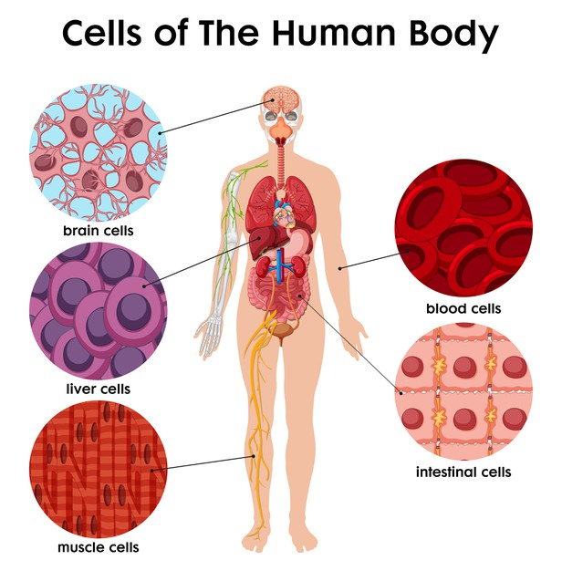
Differentiate between unicellular and multicellular organisms

Slide 6
Differentiate between unicellular and multicellular organisms
Living organisms are made of cells.
In all cells, macromolecules are organized into different structures that help cells function.
There are four macromolecules in cells—nucleic acids, lipids, proteins, and carbohydrates.
Nucleic acids, such as DNA, store information.

Slide 7
Differentiate between unicellular and multicellular organisms
Unicellular organisms have everything needed to obtain and use energy, reproduce, and grow inside one cell.
Some unicellular organisms are tiny and cannot be seen with-out a microscope.
Other unicellular organisms, such as the plasmodial slime mold
R

Slide 8
Differentiate between unicellular and multicellular organisms

Slide 9
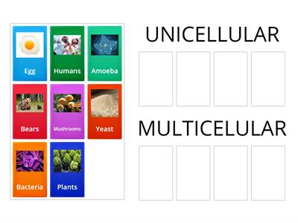
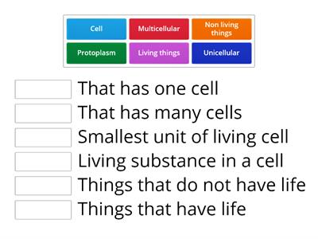
Differentiate between unicellular and multicellular organisms
Quick check
EVALUATE
https://wordwall.net/play/13584/296/214
https://wordwall.net/play/3454/151/947

Slide 10
Differentiate between unicellular and multicellular organisms
ENGAGE
Listening Activity – unicellular and multicellular organisms
write any 2 difference between unicellular and multicellular organisms?
Write down answers in chat box.

Slide 11
Differentiate between unicellular and multicellular organisms

Slide 12
Differentiate between unicellular and multicellular organisms

Slide 14
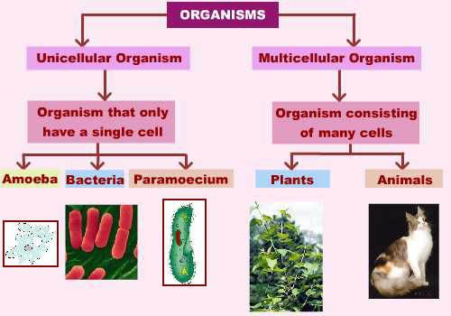
Differentiate between unicellular and multicellular organisms

Slide 15
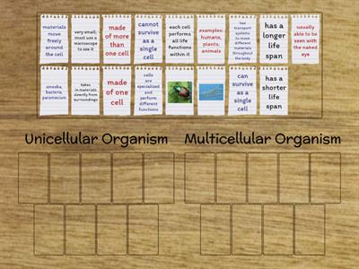
Differentiate between unicellular and multicellular organisms
Plenary
EVALUATE
https://wordwall.net/play/4893/355/9934
https://wordwall.net/play/492/845/8160

Slide 16
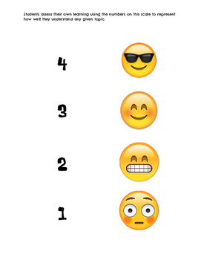
Plenary/ Exit ticket
Self assessment Type your name and self-assessment in the chat box.
I totally understand! - 9 or 10/10 or 5/5
I get it! – 7 or 8 /10
or 4/5
I’m nearly there! - 5 or 6 / 10
or 3/5
I need more help please! – 4 or less
or 2/5 or less

