Slide 2
السلام عليكم ورحمة الله وبركاته Islamic Studies (Non Arabs) Grade : 6 Date:25th to 29 Oct,2020

Slide 3
Qualities & rewards of believers Surat as- sajdah (13-22)
Unit 2: Lesson one

Slide 4
Guess the lesson title?
Starter
Classify the following qualities as you find here and then title them
Compliance with the command of Allah SWT - stubbornness - guidance – delusion or mistakes - night prayers - following the whims of oneself - disbelief - belief in Allah SWT - tolerance
..........................................Topic | ..........................................Topic

Slide 5
Types of Prostration
Prostration in Prayer
Prostration of Forgetfulness
Prostration of Recitation
LOGIC
To Obey Allah & get closer to Him
If you miss any Voluntary Act of Prayer
To be Thankful to Allah

Slide 6
We Are Learning To (WALT):
1-Recite the holy verses correctly.
2- Explain the meaning of Quranic vocabulary. (P1)
3-Explain the overall meaning of the verses.(P2)
4- Contrast the reward of the believer and the punishment of the disobedient.(P3)
5-Explain the justice of Allah SWT in terms of reward and punishment.
What I’m Looking For (WILF):
1.I can recite the holy verses correctly. (P1)
2. I can explain the overall meaning of the holy verses(P2)
3.I can conclude the main lesson from the holy verses. (P3)
LFQ: What are the qualities of believers?

Slide 7
وَلَوْ شِئْنَا لَآَتَيْنَا كُلَّ نَفْسٍ هُدَاهَا وَلَكِنْ حَقَّ الْقَوْلُ مِنِّي لَأَمْلَأَنَّ جَهَنَّمَ مِنَ الْجِنَّةِ وَالنَّاسِ أَجْمَعِينَ (13) فَذُوقُوا بِمَا نَسِيتُمْ لِقَاءَ يَوْمِكُمْ هَذَا إِنَّا نَسِينَاكُمْ وَذُوقُوا عَذَابَ الْخُلْدِ بِمَا كُنْتُمْ تَعْمَلُونَ (14) إِنَّمَا يُؤْمِنُ بِآَيَاتِنَا الَّذِينَ إِذَا ذُكِّرُوا بِهَا خَرُّوا سُجَّدًا وَسَبَّحُوا بِحَمْدِ رَبِّهِمْ وَهُمْ لَا يَسْتَكْبِرُونَ (15) تَتَجَافَى جُنُوبُهُمْ عَنِ الْمَضَاجِعِ يَدْعُونَ رَبَّهُمْ خَوْفًا وَطَمَعًا وَمِمَّا رَزَقْنَاهُمْ يُنْفِقُونَ (16) فَلَا تَعْلَمُ نَفْسٌ مَا أُخْفِيَ لَهُمْ مِنْ قُرَّةِ أَعْيُنٍ جَزَاءً بِمَا كَانُوا يَعْمَلُونَ (17) أَفَمَنْ كَانَ مُؤْمِنًا كَمَنْ كَانَ فَاسِقًا لَا يَسْتَوُونَ (18) أَمَّا الَّذِينَ آَمَنُوا وَعَمِلُوا الصَّالِحَاتِ فَلَهُمْ جَنَّاتُ الْمَأْوَى نُزُلًا بِمَا كَانُوا يَعْمَلُونَ (19) وَأَمَّا الَّذِينَ فَسَقُوا فَمَأْوَاهُمُ النَّارُ كُلَّمَا أَرَادُوا أَنْ يَخْرُجُوا مِنْهَا أُعِيدُوا فِيهَا وَقِيلَ لَهُمْ ذُوقُوا عَذَابَ النَّارِ الَّذِي كُنْتُمْ بِهِ تُكَذِّبُونَ (20) وَلَنُذِيقَنَّهُمْ مِنَ الْعَذَابِ الْأَدْنَى دُونَ الْعَذَابِ الْأَكْبَرِ لَعَلَّهُمْ يَرْجِعُونَ (21)

Slide 8
Link for surah Recitation:
https://www.youtube.com/watch?v=VVJrEkmB_iU

Slide 9
حق
القول
Words meanings
The divine decree is confirmed
Jinn
الجِنَّة
Mattresses or bed that recline
on or slept on
Arise
to worship
تتجافى
جنوبهم
عن
المضاجع

Slide 10
hospitality
and tender
من قرة
أعين
Reasons for
Pleasure and
Joy
Words meanings
نزلا
العذاب الأدنى
Punishment in this world
فاسقا
Disobedience of Allah SWT
العذاب الاكبر
Punishment in the hereafter

Slide 11
Pg. no. 85
The overall meaning of the verses

Slide 12
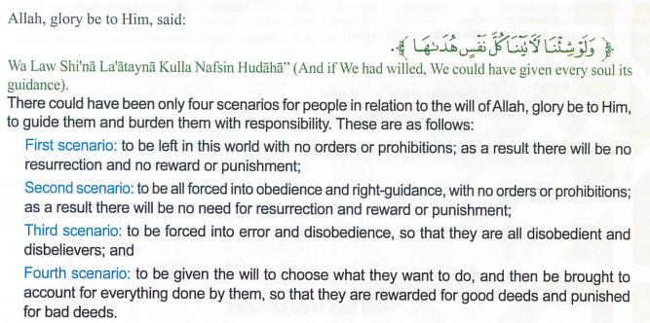
Pg. no. 86
Think and discuss
The fourth scenario
Allah has given us the choice to choose the Right Path

Slide 13
Pg. no. 86
Think ,compare & explain
(قال تعالى )
ولوشِئْنَا لَآَتَيْنَا كُلَّ نَفْسٍ هُدَاهَا وَلَكِنْ حَقَّ الْقَوْلُ مِنِّي لَأَمْلَأَنَّ جَهَنَّمَ مِنَ الْجِنَّةِ وَالنَّاسِ أَجْمَعِينَ
But the word from Me will come in to effect that,” I will surely fill Hell with Jinn and People all together
1- What are the similarities between people and jinn which make them share the same destiny in the Hereafter ?
People and jinn are given the choice to choose either the right path or the bad; they will be judged as per their deeds.

Slide 14
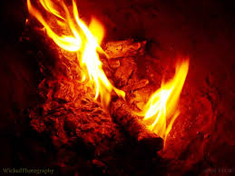
Pg. no.
Think critically:
1- What is the wisdom behind the existence of Jannah and Hell?
----------------------------------------------------------------------

Slide 15
I offer a solution
Problem Solving
A person who has not prayed or performed acts of worship for several years how can I ask him to perform his acts of worship?
----------------------------------------------------------------------------------------------------------------------------

Slide 16
P2
The Supplication of the Prostration of Recitation
Competencies (SCF)
Search using electronic devices

Slide 17
Pg. no. 88
Think and discover:
إِنَّمَا يُؤْمِنُ بِآَيَاتِنَا الَّذِينَ إِذَا ذُكِّرُوا بِهَا خَرُّوا سُجَّدًا وَسَبَّحُوا بِحَمْدِ رَبِّهِمْ وَهُمْ لَا يَسْتَكْبِرُونَ (15) تَتَجَافَى جُنُوبُهُمْ عَنِ الْمَضَاجِعِ يَدْعُونَ رَبَّهُمْ خَوْفًا وَطَمَعًا وَمِمَّا رَزَقْنَاهُمْ يُنْفِقُونَ (16) None believes in Our Signs except those who, when they are given good counsel through Our verses, fall down prostrate and celebrate the praise of their Lord and do not wax proud. Their sides forsake their beds, and they call upon their Lord in fear and hope,²⁷ and expend (in charity) out of the sustenance We have granted them
Characteristics of Believers:
1. Fall down in Prostration & Praise their Lord.
2. They spend from what Allah has given to them.
3. They are not ignorant.
4. Supplicate their Lord in fear.
5.They arise from their bed.

Slide 18
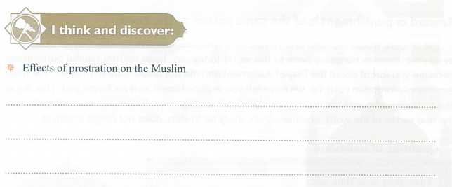
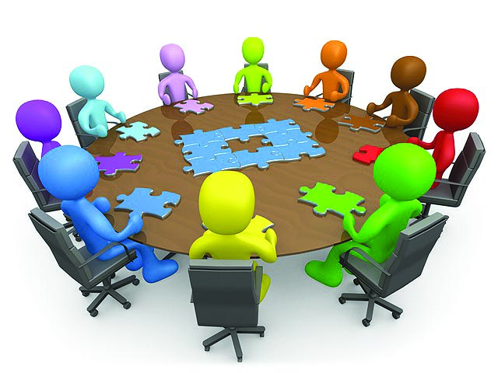
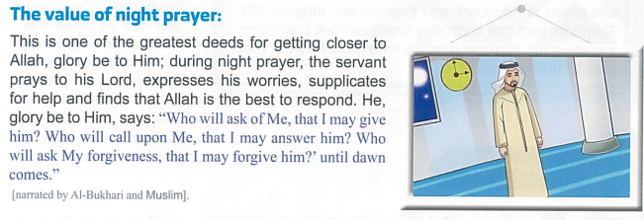
Pg. no. 88
Meditate and discover
He will get closer to Allah.
His prayers will be accepted.
He will get great rewards and his sins will be forgiven.

Slide 19
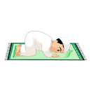
Pg. no. 89
Write the benefits of performing night prayer regularly on the individual?
(for help pg:88 or pervious hadith)
Think and write
Task:

Slide 20
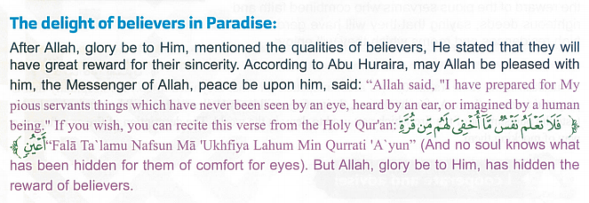
Pg. no. 89
Read ,think and explain:
P3:
89
Think critically
In your opinion, Why Allah SWT has hidden details of believers in Paradise ?
: Allah kept the reward secret only to surprise the Believers and to motivate them to work hard for becoming worthy of greatest rewards.

Slide 21
91
How to face distress or challenges?
We have to observe patience and put our complete trust in Allah and His plans.

Slide 22
Pg. no. 8
Who is the most unjust person in the light of your understanding of these above verses? Why?
-----------------------------------------------------

Slide 23
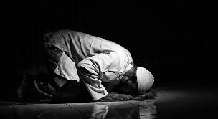
Pg. no. 8
Problem solving:
Present your classmate with a practical plan that will help him do the requirements for entering paradise on the day of Judgement.
By following the path chosen by Allah, one can be successful in the Hereafter.
Devotion to worship Allah Almighty
Performing acts of worship
Helping the needy
Good manners
Seeking knowledge
Mercy to animals
Tranquility and happiness
Livelihood
Blessings in age and health
Winning the satisfaction of Allah SWT and Jannah.
The ability to innovate and produce

Slide 24
Pg. no. 93
The way is chosen by Allah
Man has free choice to choose between right & wrong.

Slide 25
Pg. no. 93
Must task: Think and answer :
Allah, the Most generous, blesses us with His guidance, forgives our sins, loves us & provides the best to us.

Slide 26
Pg. no. 94
Extra Task: Think and complete:
Pain and distress
For a limited period

Slide 27
Home work:
Play the game ag home:
https://quizizz.com/admin/quiz/5d81f3e9523416001be55baf/surat-as-sajdah

Slide 28
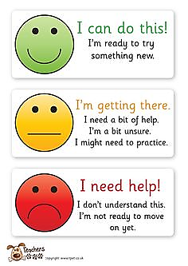
So, how do you find your learning today?

