Slide 1
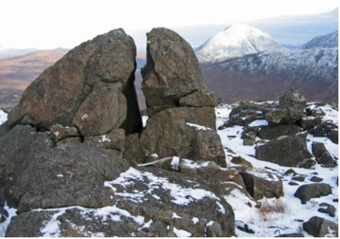
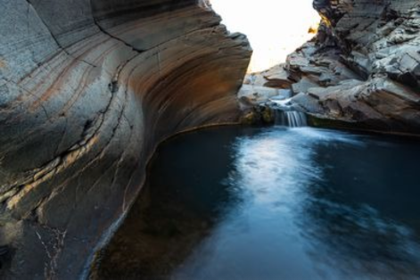
Grade 2
Science Quiz
Name: _____________
Date:______________
What is the process that breaks down landforms and rocks into smaller pieces?
Erosion
Weathering
Tornado
2. What do you call the different piece that make up soil?
Sediment
Pebbles
Rocks
What happened to this rock?
It was weathered by rain
It was weathered by wind
It was weathered by ice
4. What happened to this rock formation?
It was weather by wind
Nothing happened to it
It was weathered by water
5. The movement of sediment, or soil, from one place to another by some kind of force is
Erosion
Weathering
Sediment

Slide 2
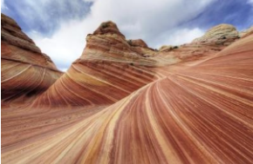
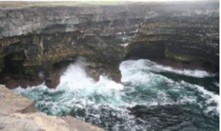
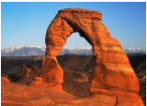
6. What do you think eroded this sand?
Wind
Water
Ice
7. What do you think caused this erosion?
Wind
Ice
Waves of water
8. Circle the picture which shows weathering
9. Most erosion is caused by water, wind or _________.
Ice
Rocks
Sun
10. Match the following
Weathering
Erosion
Deposition
/10
Sign:

