Slide 1
English Skills Check
Level 7.1
Term 1 2021-2022
Federal Entity | هيئة اتحادية

Slide 2
Contents:
Part 1: Preparation - vocabulary
Part 2: Preparation - grammar
Part 3: Mini - research task
Part 4: Top tips
Level 7.1
Term 1 Academic Year 2021-2022

Slide 3
Part 1: Preparation – Vocabulary.
Learn these words for the skills check.

Slide 4
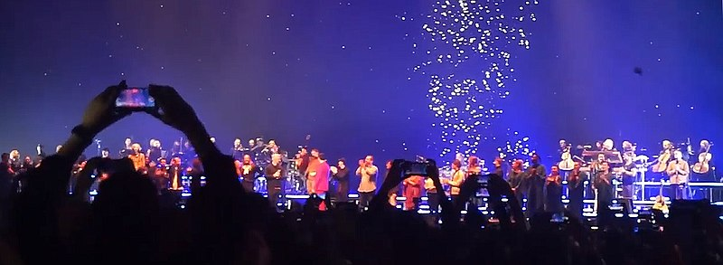
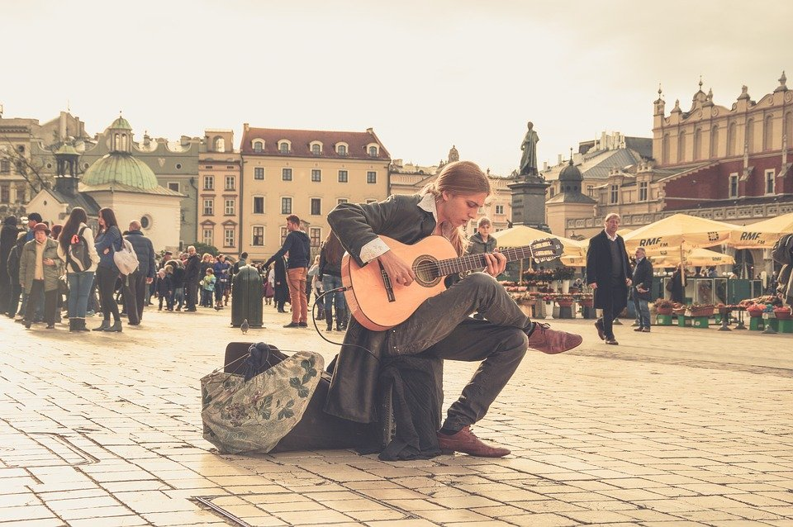
Performers, Chumari, 2009, CCBY3.0
performer
a person who entertains other people
Musician, Pexels, 2012, from Pixabay.

Slide 5
word | class | definition | sentence
performer | noun | a person who entertains other people | Mariam is an experienced concert performer.

Slide 6
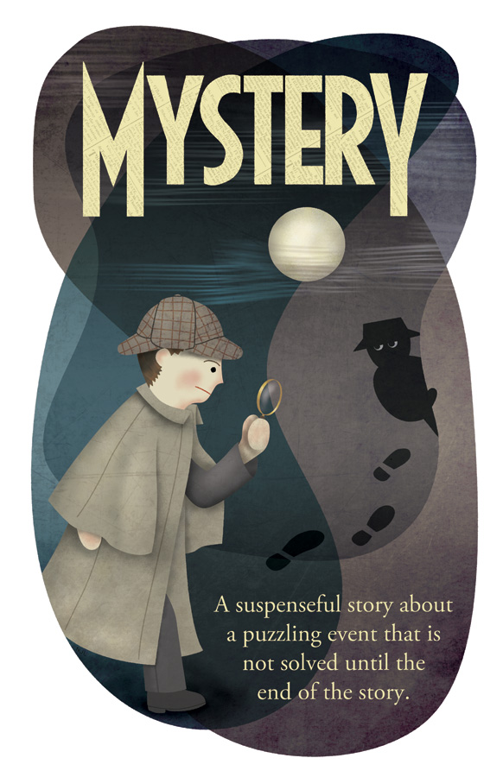
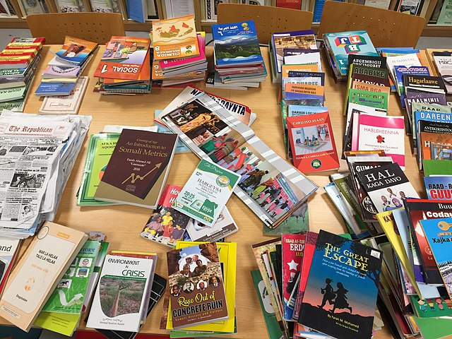
Books Somaliland, Vysotsky, 2019, CC BY-SA 4.0
genre
a style of art, music, or literature
Mystery Genre Poster, Nick Lee, 2011, CC BY 2.0

Slide 7
word | class | definition | sentence
genre | noun | a style of art, music, or literature. | I enjoy many different genres of literature. I often read mystery, non-fiction and poetry.

Slide 8
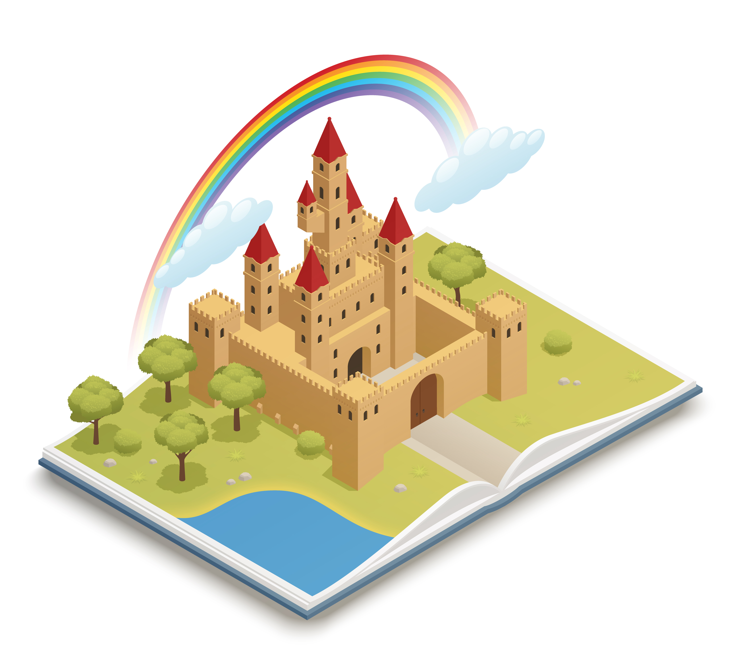
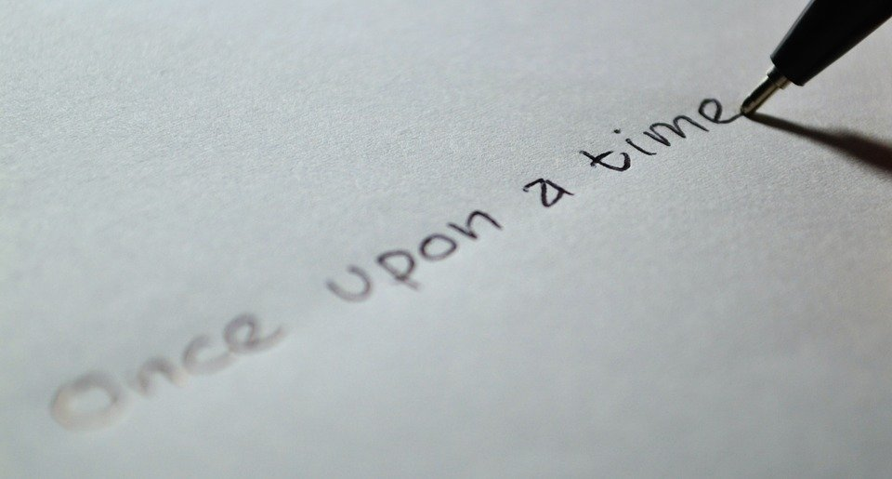
Fairy tale castle, Macrovector, 2019, from freepik.
fiction
texts that describe imaginary events and people
Untitled, Ramdlon, January 20,2015, from Pixabay

Slide 9
word | class | definition | sentence
fiction | noun | texts that describe imaginary events and people | The writer has a great imagination. He has written over twenty works of fiction.

Slide 10
Golden Hands Craft Book Series, Kyla Roma, 2012, CC BY-NC-ND 2.0
series
a set or sequence of related television, books or radio programmes
Untitled, Tumisu , September 19,2020 from Pixabay

Slide 11
word | class | definition | sentence
series | noun | a set or sequence of related television, books or radio programmes | I watched every episode of that comedy series last weekend. It was so funny!

Slide 12
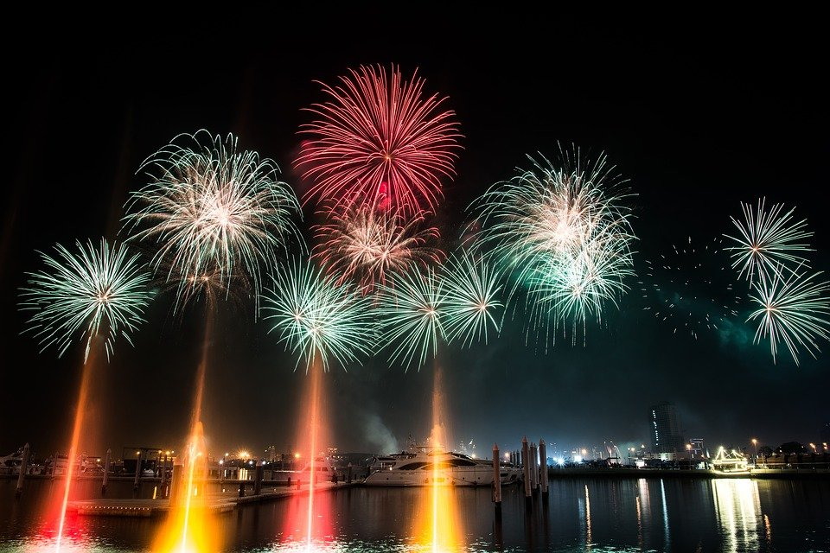
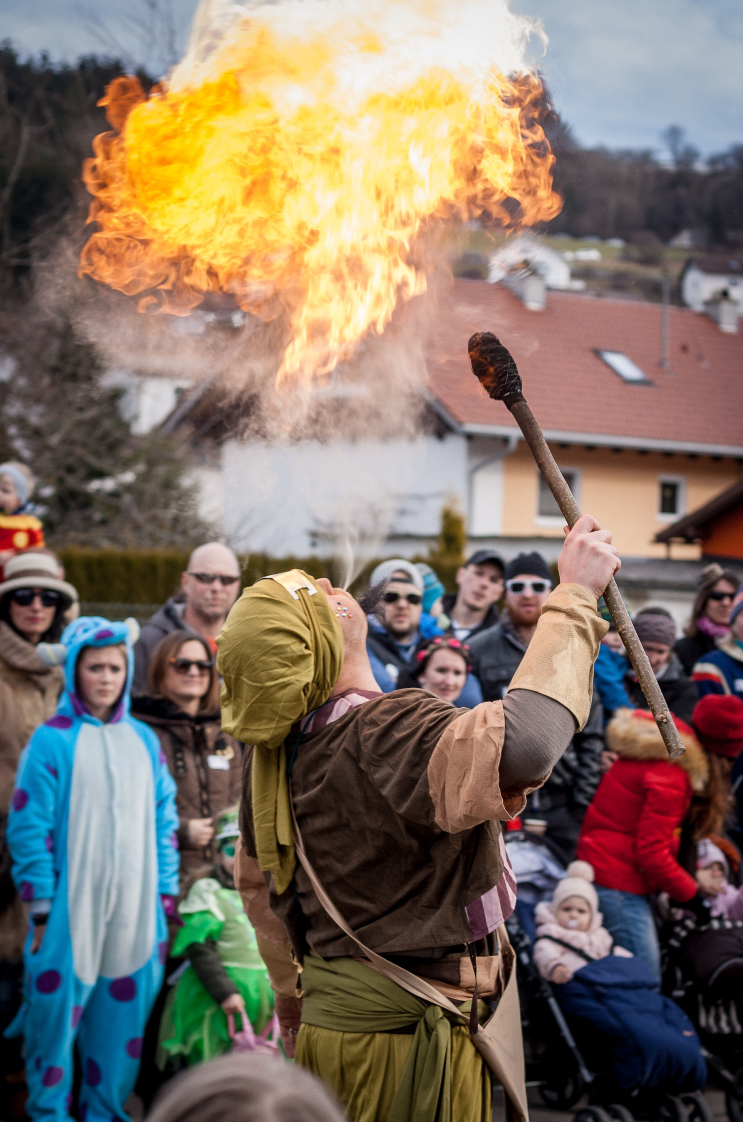
Untitled, Pexels, January 24,2014, from Pixabay
festival
a gathering of people to celebrate a person, place, event, or subject
Fire Eater, Steven Weirather, 2017, pixabay

Slide 13
word | class | definition | sentence
festival | noun | a gathering of people to celebrate a person, place, event, or subject | The art festival had many paintings from famous artists.

Slide 14
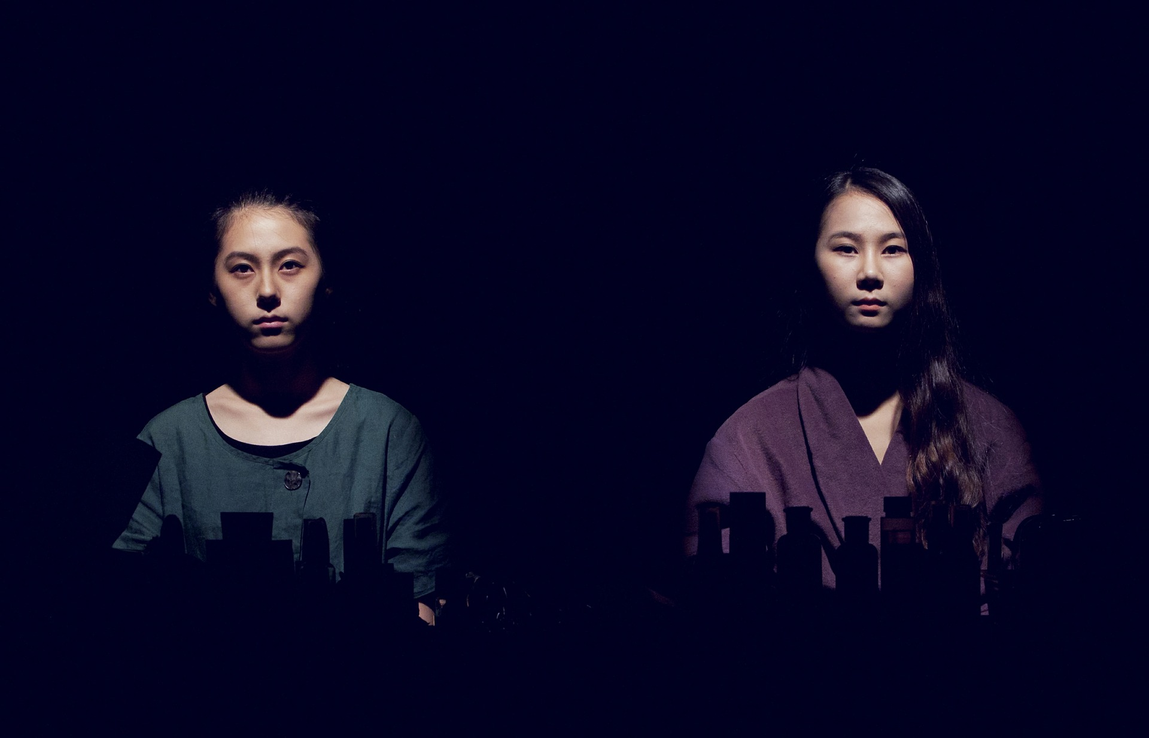
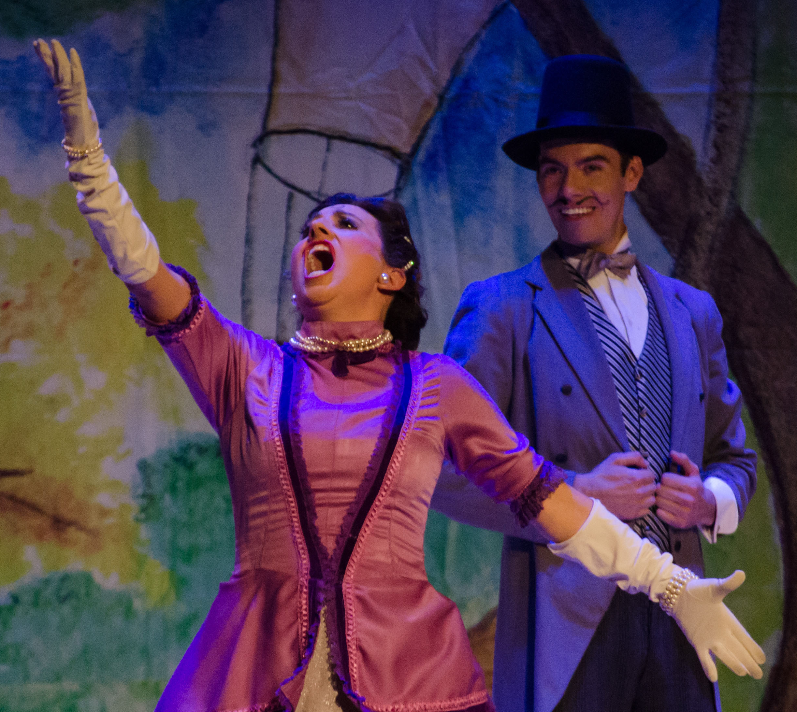
Characters, Bichter Choii, 2012, Pixabay.
character
a person in a book, film, poem or play
Tandas y tundas, Poleth Rivas/ Secretaría de Cultura CDMX, 2017, CC BY-SA 2.0

Slide 15
word | class | definition | sentence
character | noun | a gathering of people to celebrate a person, place, event, or subject | The art festival had many paintings from famous artists.

Slide 16
Part 2: Preparation – Grammar
Review this grammar for
the Skills Check

Slide 17
Is your school project finished Ali? Not yet, but I have been working on it!
Grammatical structure | Present perfect continuous tense have/ has + been + verb (ing)
Usage | In this case, it is used to talk about something that started in the past and is continuing in the present. It might continue in the future.
Meaning | He started working on his project in the past and is still working on it in the present. He might continue working on it in the future.
Other examples | Alia has been thinking about going on holiday. I haven’t been running today. What have you been doing?

Slide 18
I know that you have been struggling to complete your project on time. You should ask for help.
Grammatical structure | Present modals Subject + modal
Usage | To give advice.
Meaning | Because you can’t finish your project on time, it would be good for you to ask someone for help.
Other examples | The boys should study for their exams. He shouldn’t eat so many sweets.

Slide 19
Do you want another piece of cake? Although I am full, I’ll have another piece of cake.
Grammatical structure | Adverbial Linkers Appears at the beginning of a sentence.
Usage | Used to link complex ideas between two sentences. Ideas can be contrasting or reasons and results.
Meaning | My stomach is full so it is unlikely that I want more food. In contrast to this, I still want want another piece of cake, so I’ll have one.
Other examples | I didn’t like the price. Nevertheless, I bought the shoes. I’m trying to save money. Therefore, I won’t go to the mall.

Slide 20
My sister told me that this film was very good.
Grammatical structure | Reported statements
Usage | We use reported statements to repeat what someone had previously said.
Meaning | The speaker’s sister had told the speaker in a previous conversation, “It was a very good film”.
Other examples | He insisted that the shop give him discount on the mobile phone. My mother said that she could take us there. We suggested that they stay another day.

Slide 21
Now
Past
Present
Future
I had forgotten about my meeting with my teacher yesterday.
Grammatical structure | Past perfect simple
Usage | In this case it is used to describe an action that happened before another action in the past.
Meaning | The subject is explaining that he had planned a meeting with his teacher, but that he forgot to go when the time of the meeting arrived.
Other examples | Marwa had gone out when I arrived. I had finished my homework before I watched TV. They hadn’t taken their books, so they couldn’t study.

Slide 22
Part 3: Mini - research Task

Slide 23
Research it
Find out about a celebration or festival in another country
Summarise the information in your own words.
Then talk about it with 1 or 2 classmates.

Slide 24
Talk about it
Talk about celebrations/festivals. Ask these questions to two of your classmates or family members. Record their answers.
 | Person 1 | Person 2
Where is the celebration/festival? What does it involve?
Why is this celebration/festival important?
Would you like to attend this celebration/festival? Why? Or why not?
Ask your own question about celebrations/festivals.

Slide 25
Part 4: Top tips

Slide 26
Top tips
The Skills Check is made up of three sections.
Part 1 – Reading passage
- 6 multiple choice questions
- Question 7 is a reflection question which requires a written response. Justify your answer to the inference reading question by discussing other possible relevant answers, using evidence from the text or by explaining why you chose the answer that you did.

Slide 27
Top tips
Part 2 – MAZE
This assessment type is called a MAZE because it is a textual maze. Complete a short text by selecting the correct word or words. You may need to make connections between different parts of a text to be able to choose the correct answer.

Slide 28
Top tips
Part 3 - Writing
Short writing prompt
Write a paragraph in your own words.
You will get marks for:
writing something about each of the bullet points
using a paragraph that is structured the way your teacher has taught you
using vocabulary that is appropriate for the topic
using simple and complex sentences
- writing that contains very few errors in spelling
- writing that fulfils or goes beyond the require number of words

Slide 29
Follow us
ese.ae
Ese_ae

