Slide 1
English Skills Check
Level 3.2
Term 1 2021-2022
Federal Entity | هيئة اتحادية

Slide 2
Contents:
Part 1: Preparation - vocabulary
Part 2: Preparation - grammar
Part 3: Mini - research task
Part 4: Top tips
Level 3.2
Term 1 Academic Year 2021-2022

Slide 3
Part 1: Preparation – Vocabulary.
Learn these words for the skills check.

Slide 4
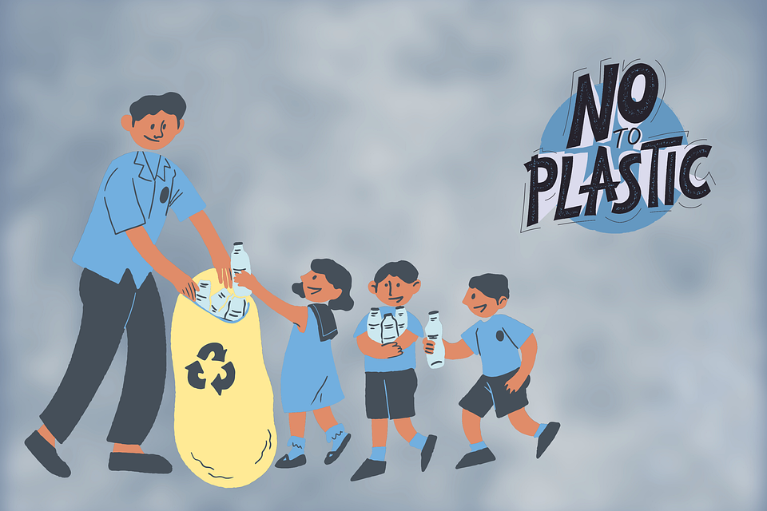
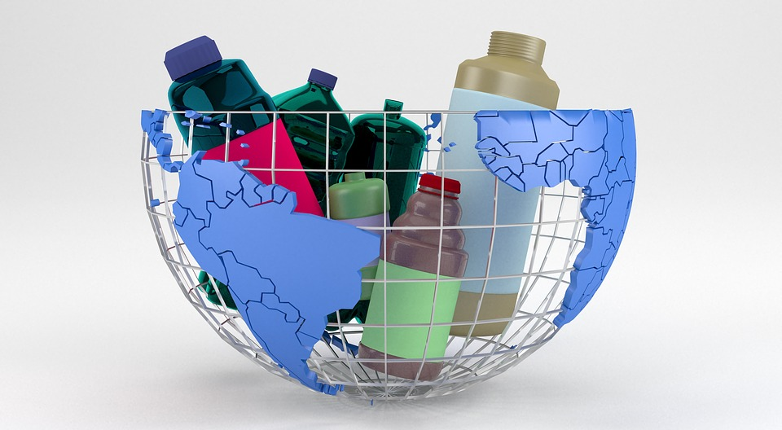
Kids recycling, Elf-Moondance, Sept. 21, 2021
recycling
putting paper, glass, plastic, etc. through a process so that it can be used again
recycling - QuinceCreative - Aug. 2, 2018

Slide 5
word | class | definition | sentence
recycling | noun | putting paper, glass, plastic, etc. through a process so that it can be used again | Recycling materials like paper, glass and plastic saves the environment.

Slide 6
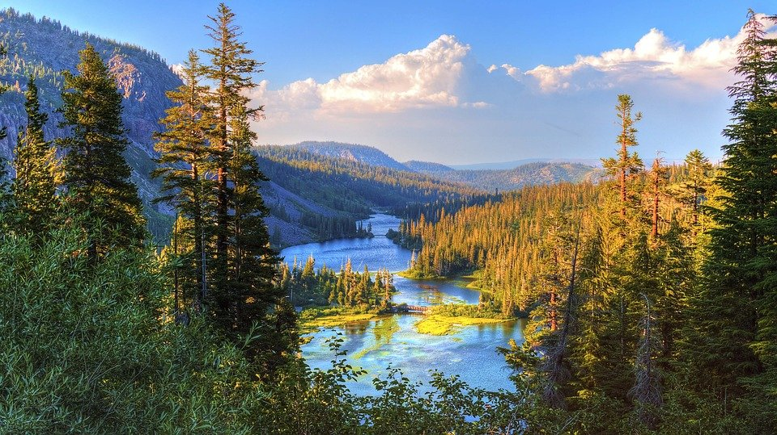
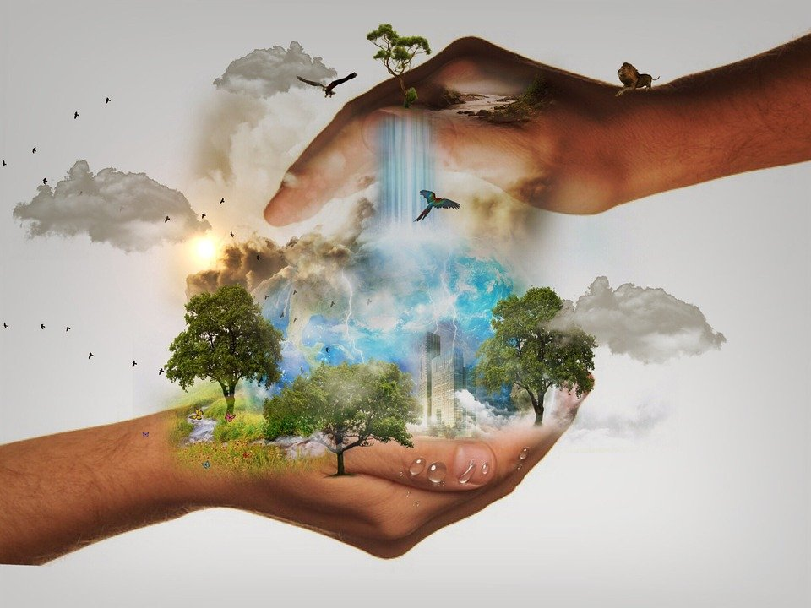
environment - Pexels - Nov. 22, 2016
environment
the air, land and water where people, animals and plants live
environment - Mysticsartdesign - Oct. 9, 2014

Slide 7
word | class | definition | sentence
environment | noun | the air, land and water where people, animals and plants live | Plants need a good environment to grow.

Slide 8
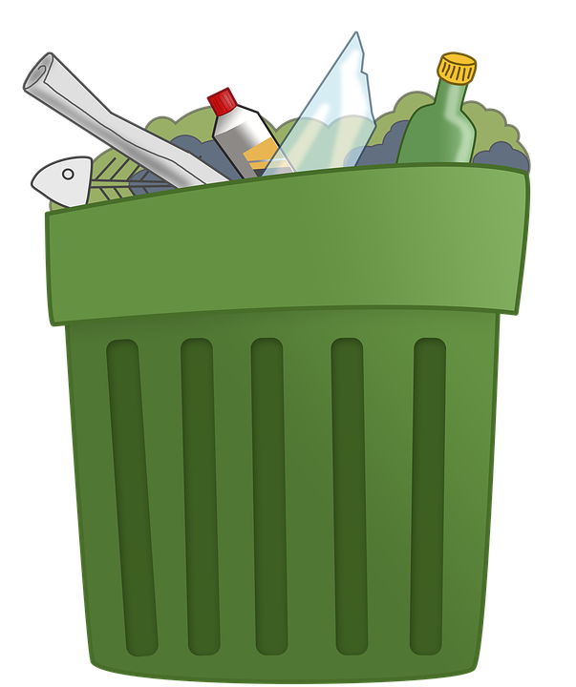
trash - Clker-Free-Vector-Images - April 12, 2012
trash
things that you throw away because you do not want them
Trash can - GraphicsSC - March 20, 2017

Slide 9
word | class | definition | sentence
trash | noun | things that you throw away because you do not want them | Alia is throwing the trash in the recycling bin.

Slide 10
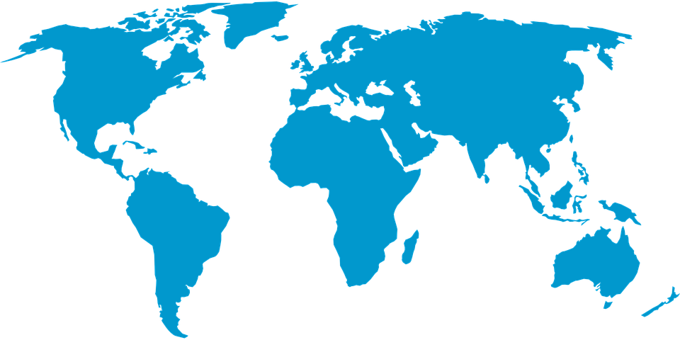
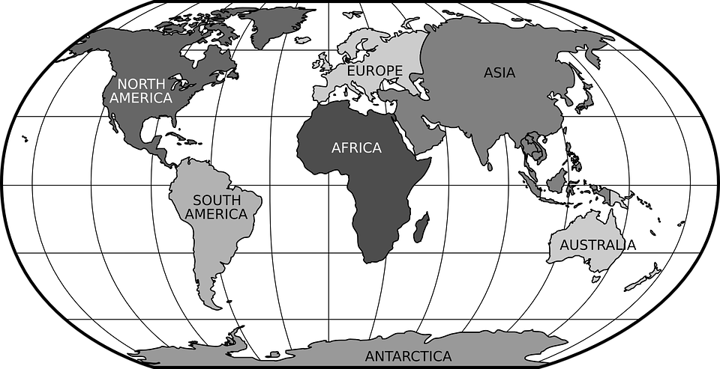
continents - Clker-Free-Vector-Images - May 7, 2014
continent
one of the seven main areas of land on the Earth, such as Asia, Africa, or Europe
Continents of the world - Clker-Free-Vector-Images - April 26, 2012

Slide 11
word | class | definition | sentence
continent | noun | one of the seven main areas of land on the Earth, such as Asia, Africa, or Europe | Asia and Africa are the two biggest continents.

Slide 12
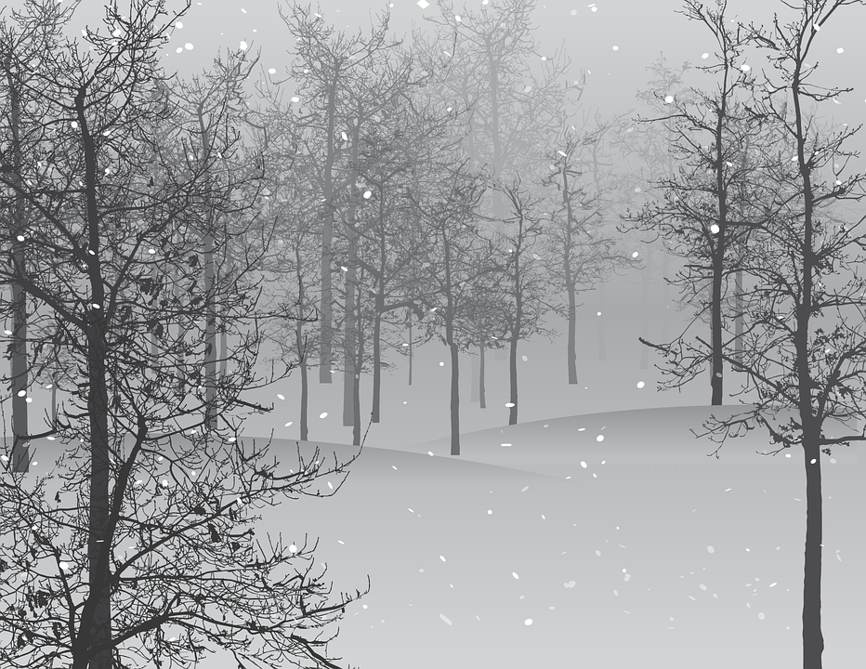
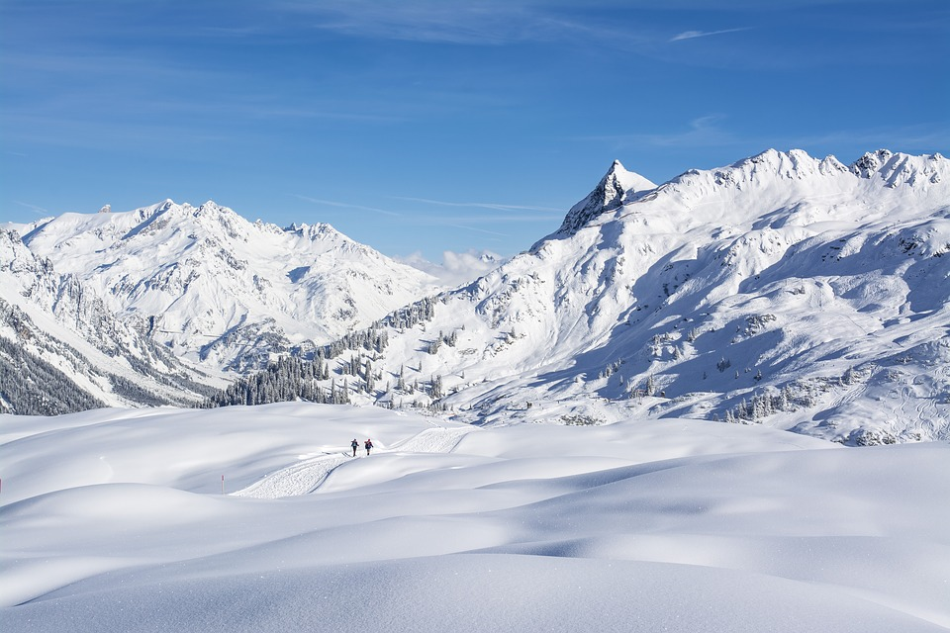
snow - Wild0ne - Nov. 24, 2016
snow
soft white pieces of frozen water that fall from the sky when the weather is cold
snow - gsibergerin - March 11, 2019

Slide 13
word | class | definition | sentence
snow | noun | soft white pieces of frozen water that fall from the sky when the weather is cold | Playing in the snow is so much fun.

Slide 14
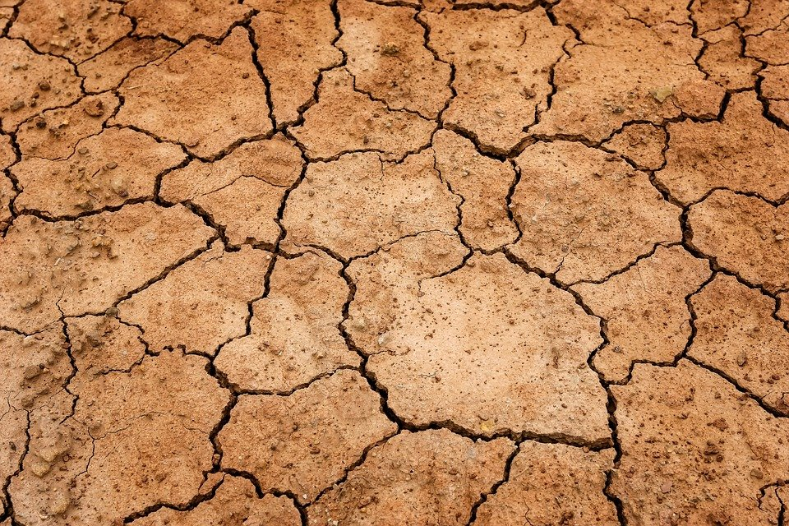
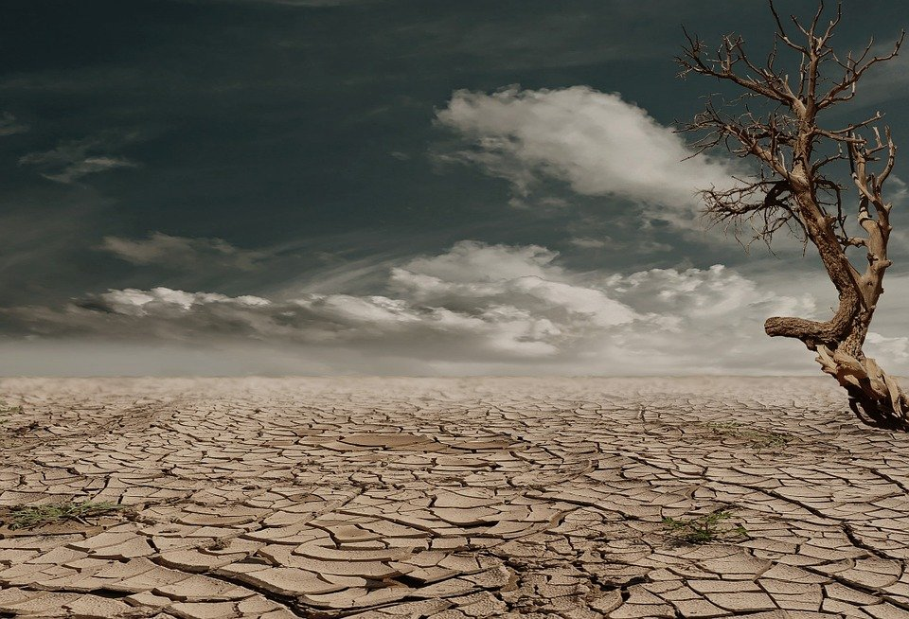
Dry, Tama66, April 27, 2018
dry
something that does not have water in it or on its surface
Dry land, _Marion, March 5, 2014

Slide 15
word | class | definition | sentence
dry | adjective | something that does not have water in it or on its surface | The desert is a very dry environment.

Slide 16
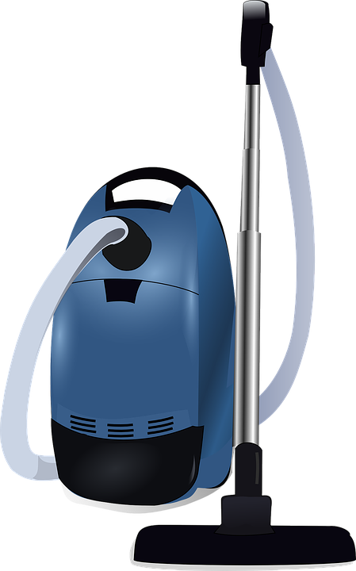
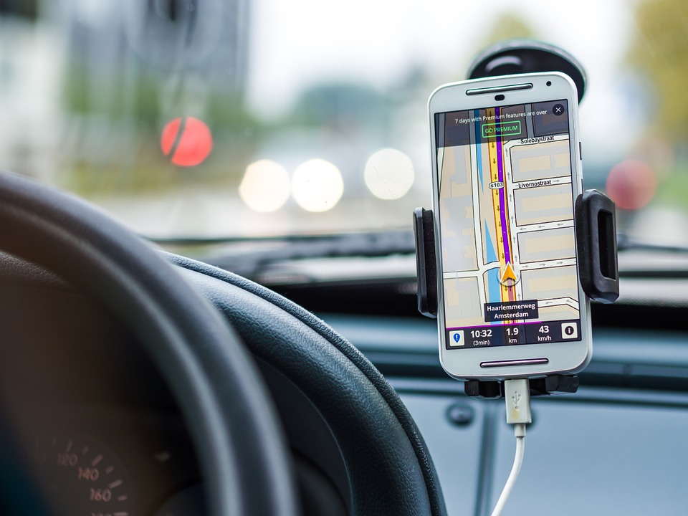
Vacuum - Clker-Free-Vector-Images - April 2, 2012
useful, Free-Photos, Feb. 3, 2016
useful
something that helps you do an activity more easily
GPS on Phone - DariuszSankowski - April 2, 2012

Slide 17
word | class | definition | sentence
useful | adjective | something that helps you do an activity more easily | Using a vacuum cleaner is useful. It makes cleaning so easy.

Slide 18
Part 2: Preparation – Grammar
Review this grammar for
the Skills Check

Slide 19
Does he go to school? Yes, he goes to school every day.
Grammatical structure | Present simple tense We use the base form of the verb and add -s or -es to the end.
Usage | We can use the present simple to talk about general facts.
Meaning | The boy is at school regularly. He was there yesterday, he is there today and he will be there tomorrow.
Other examples | Hind brushes her teeth twice a day. She drinks tea at breakfast. Salem loves to read books.

Slide 20
Big house, Clker-Free-Vector-Images, May 15, 2014
Look. That’s a big house.
Grammatical structure | Adjective + noun (I live in a big house) Verb to be + adjective (My house is big)
Usage | Adjectives describe nouns. Adjectives give us more information about a noun. Adjectives can be placed before a noun or after a noun. Order of adjectives: size – shape – age – color before the noun.
Meaning | Is the house small? No, it is big.
Other examples | Reem likes red apples. The car is new. She has curly black hair.

Slide 21
Time, Icons8_team, May 28, 2018
I will visit you on Monday.
Grammatical structure | Prepositions: time at, in, and on
Usage | Prepositions: time is used to show a relationship in time. at: can be used for precise times. in: can be used for months, years, decades, centuries, and long period of time. on: can be used for dates and days.
Meaning | The day I chose to visit you is Monday.
Other examples | I have my snack at 10:00 am. National Day is in December. We go to the beach on Fridays.

Slide 22
Time, Icons8_team, May 28, 2018
If babies are hungry, they cry.
Grammatical structure | Zero conditional If + present simple (condition clause), … present simple (result clause).
Usage | We use the zero conditional when we want to talk about facts or things that are generally true.
Meaning | Babies cry when they are hungry. That is a fact.
Other examples | If the weather is cool, we walk in the mountains. Teachers are happy when you do your work well. If it rains, we stay inside.

Slide 23
Part 3: Mini - research Task

Slide 24
Talk about it
Talk about your five senses. Ask these questions to two of your classmates or family members. Record their answers.
 | Person 1 | Person 2
Which sense helps you the most in class? Why?
What sense do you use the least? Why?
What would it be like to not have one of your senses?
Ask your own question about your five senses.

Slide 25
Part 4: Top tips

Slide 26
Top tips
The Skills Check is made up of three parts.
Part 1 – Reading passage
6 multiple choice questions
- Question 7 is a reflection question. It means you look at the text again and write the reason why you chose that answer for question 6.
What did the boy mean when he said he got an A on his test?
He took the test and answered all of the questions correctly.
He took the test and answered some of the questions correctly.
He took the test and did not answer any of the questions correctly.

Slide 27
Top tips
Part 2 – MAZE
This assessment type is called a MAZE because it is a descriptive maze. Complete a short text by selecting the correct word. You may need to make connections between two sentences or ideas to be able to choose the correct answer.

Slide 28
Top tips
Part 3 - Writing
- Picture prompt and 5 questions.
- Write 5 sentences in your own words to answer the questions.
You will get marks for:
- completing all tasks with simple and compound sentences (using and, but, because)
- using basic language structures
- using words you studied that are related to the topic
- using appropriate spacing and punctuation
- spelling words accurately and using punctuation

Slide 29
Follow us
ese.ae
Ese_ae

