Slide 1
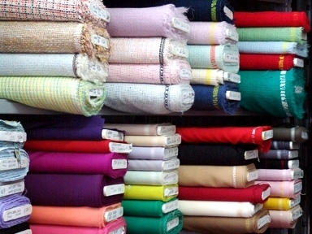
Lesson (8) What it is Made of
Notes:
NOTE:
To change the image on this slide, select the picture and delete it. Then click the Pictures icon in the placeholder to insert your own image.

Slide 2
Learning objectives:
Speaking: To talk about materials; to answer questions about materials using the present passive.
Reading: To read sentences about materials, and sentences that use the present passive.
Writing: To complete sentences about materials, and sentences that use the present passive.
Notes:
NOTE:
To change the image on this slide, select the picture and delete it. Then click the Pictures icon in the placeholder to insert your own image.

Slide 3
Key vocabulary:
cotton
wool
silk
linen
leather
gold
silver
plastic
Notes:
NOTE:
To change the image on this slide, select the picture and delete it. Then click the Pictures icon in the placeholder to insert your own image.

Slide 4
Notes:
NOTE:
To change the image on this slide, select the picture and delete it. Then click the Pictures icon in the placeholder to insert your own image.

Slide 5
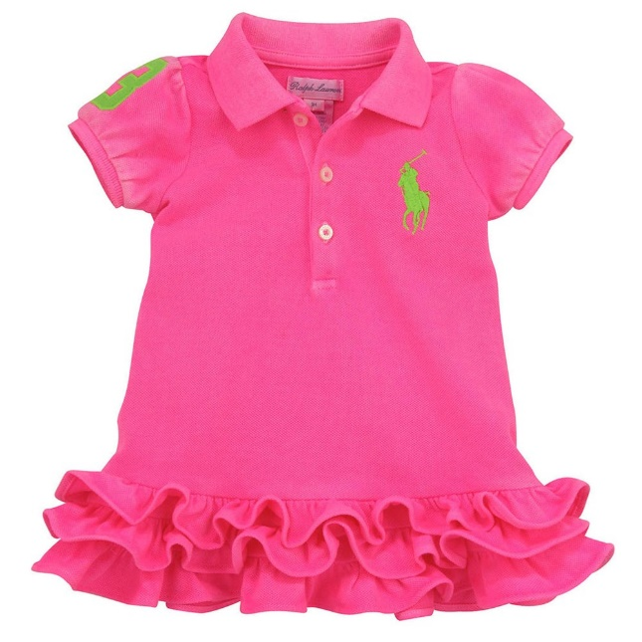
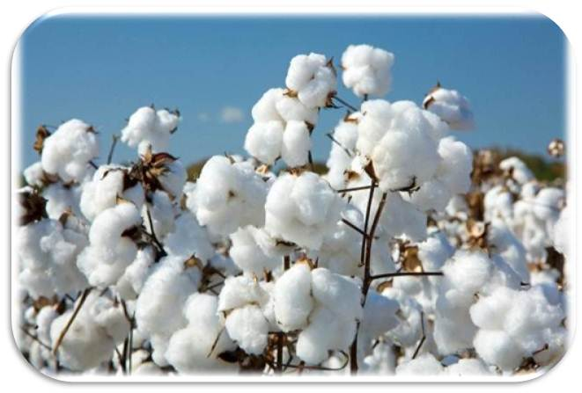
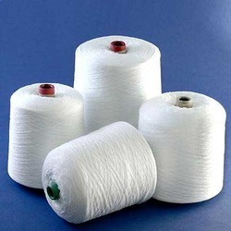
Natural
cotton clothes
cotton plant

Slide 6
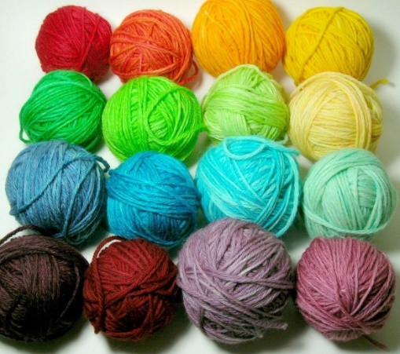
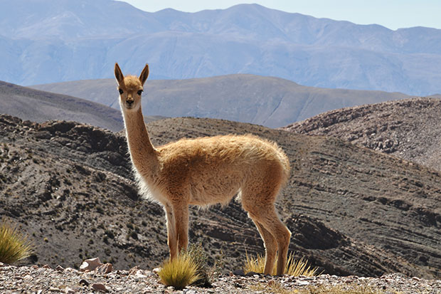
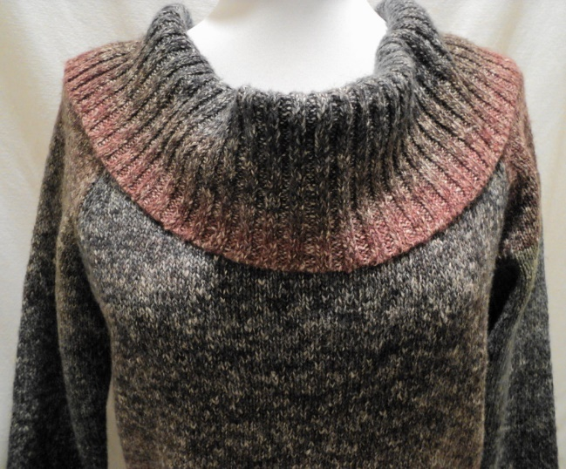
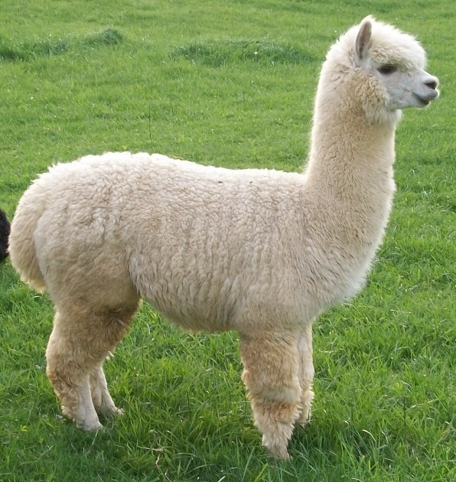
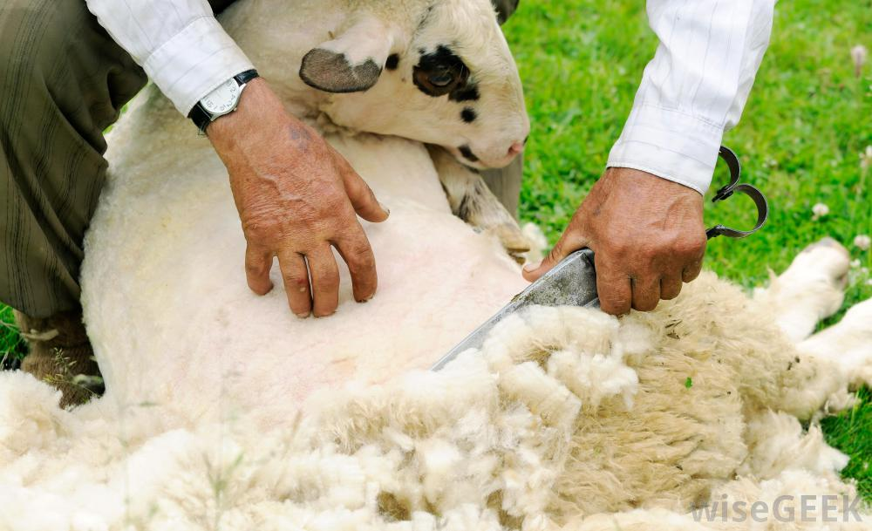
Natural
vicunas
wool clothes
alpaca
sheep

Slide 7
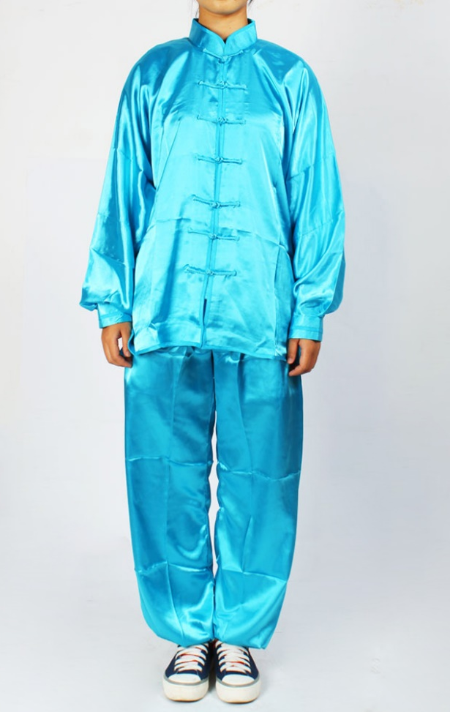
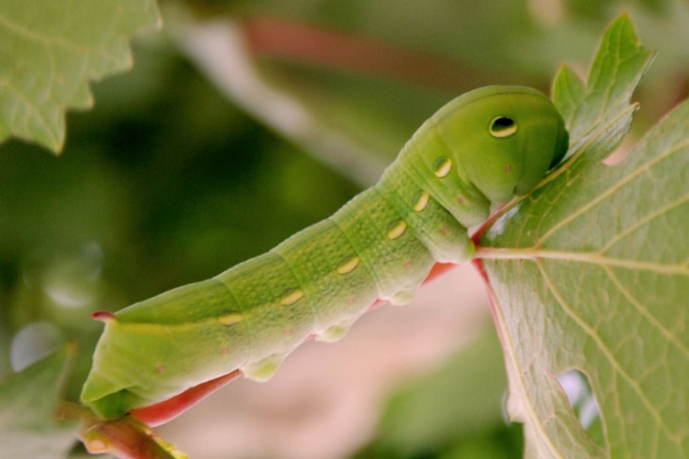
Natural
silk
silk worm

Slide 8
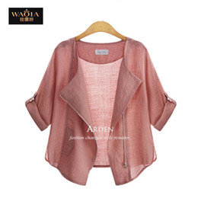
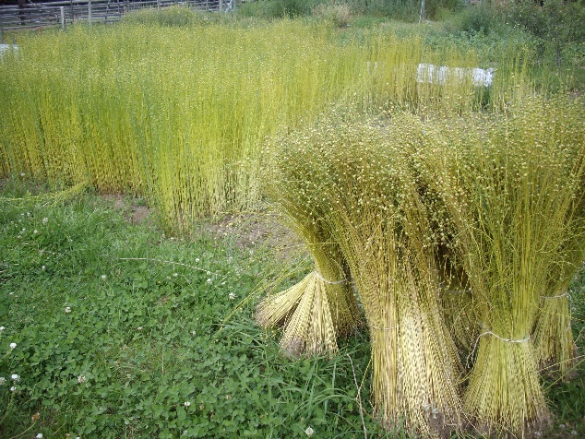
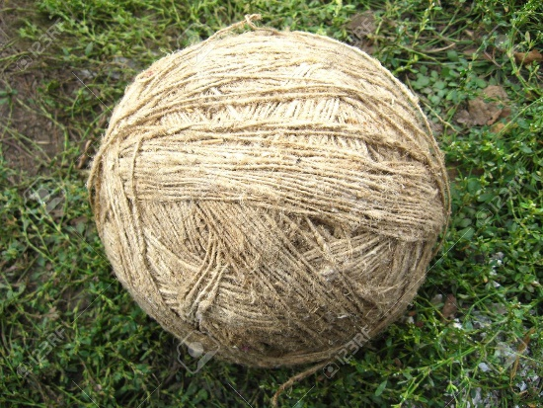
Natural
linen
flax
fiber

Slide 9
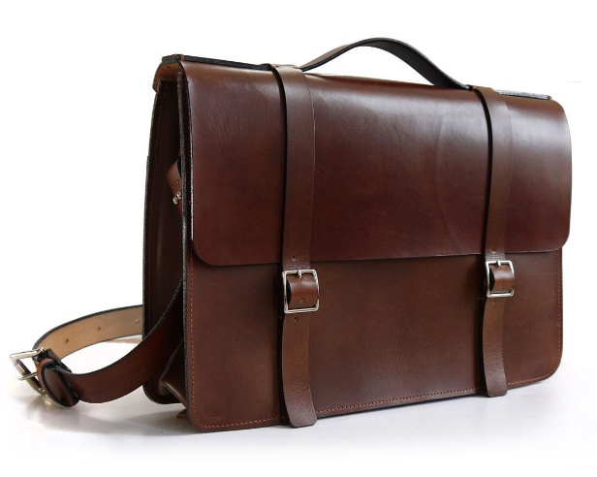
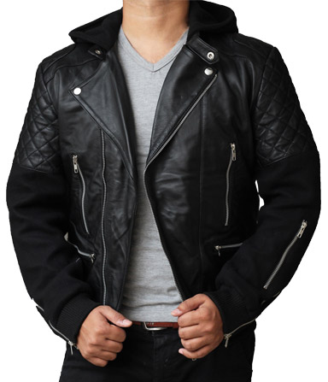
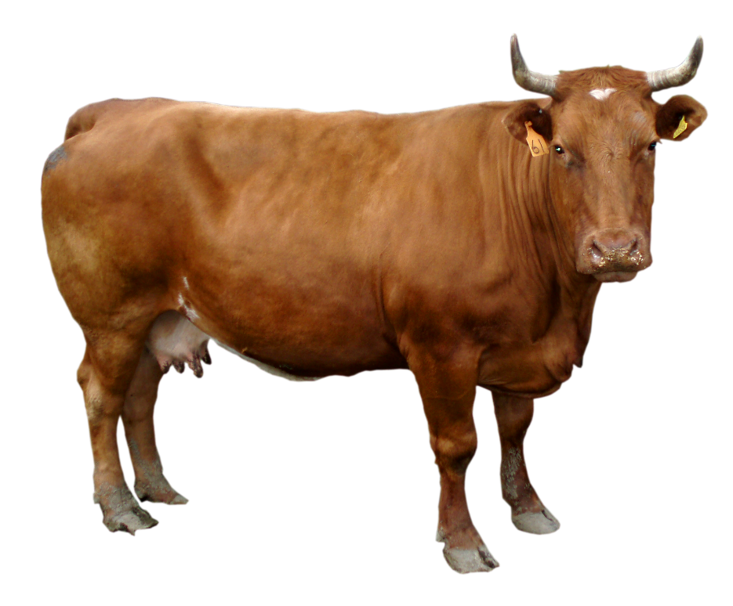
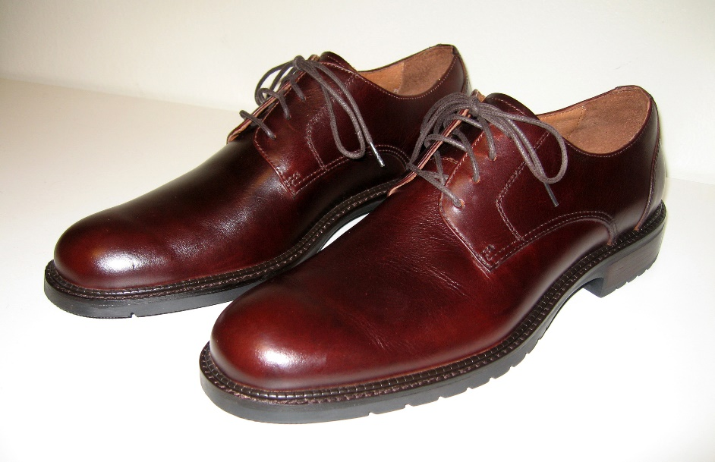
Natural
Leather product
cow

Slide 10
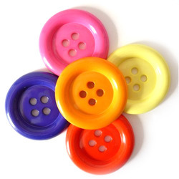
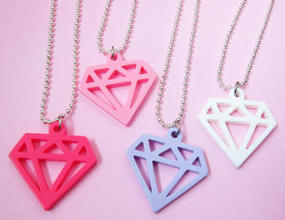
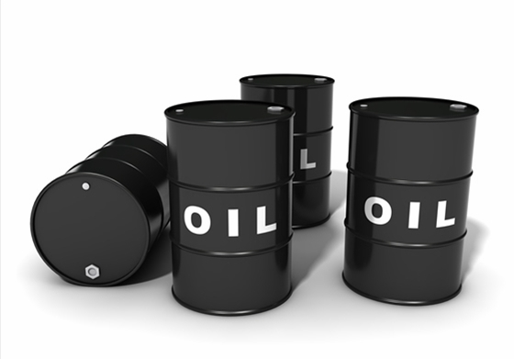
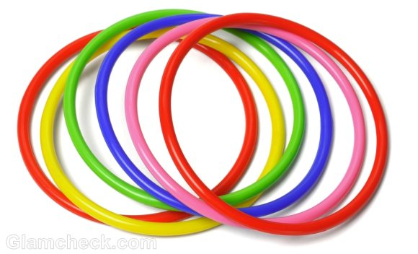
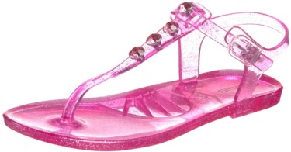
Synthetic - artificial
plastic product
oil

Slide 11
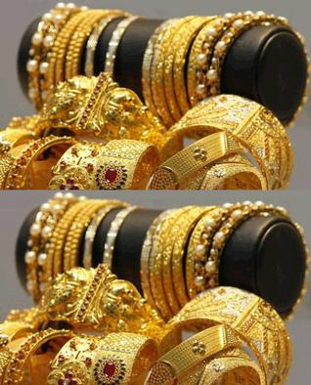
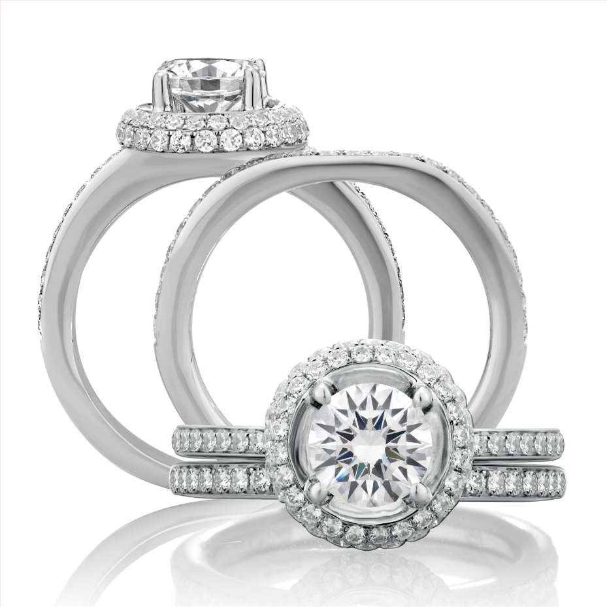
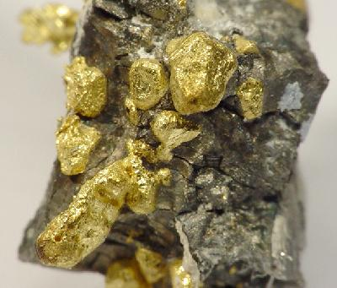
Synthetic - artificial
mineral
atoms
gold and silver

Slide 12
2 linen
3 cotton/cotton
4 wool
5 leather
6 plastic
7 gold and silver

Slide 13
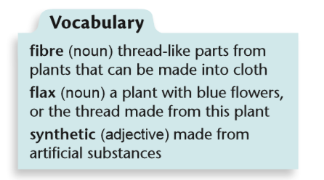

Slide 15
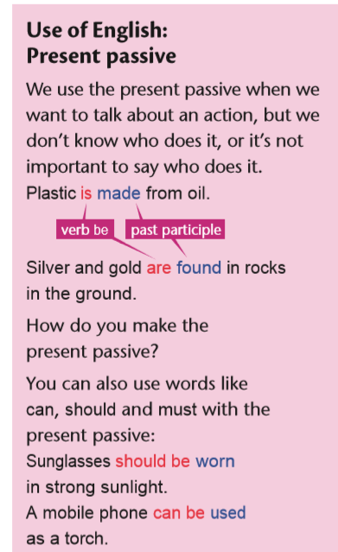
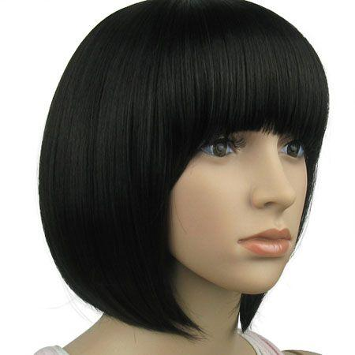
Active :
S + V ( present tense ) + O
Passive :
is
O + am + (p.p) + by + subject
are

Slide 16
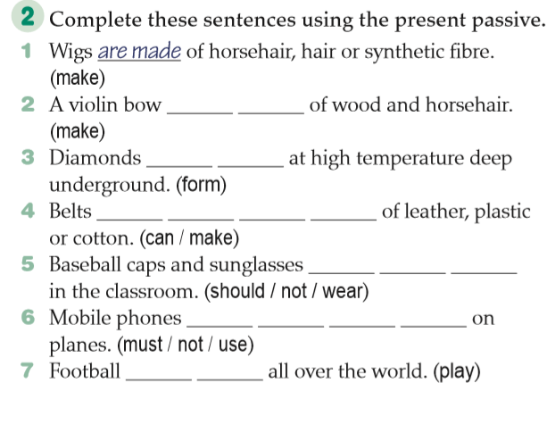

Slide 18
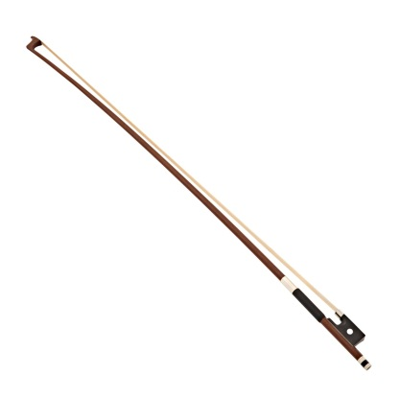
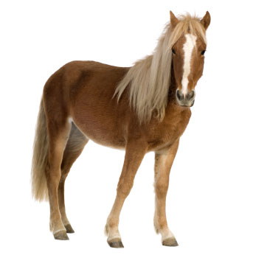
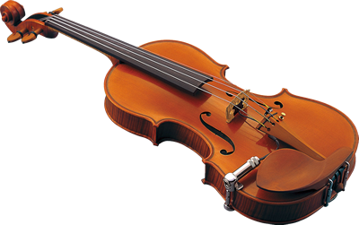
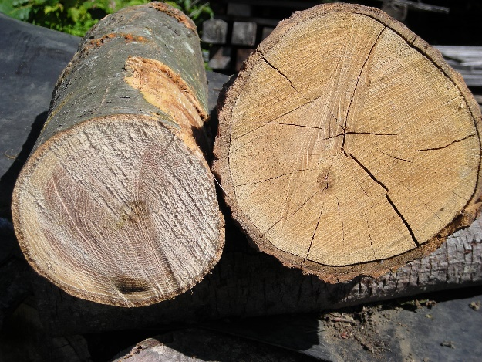
is made

Slide 19
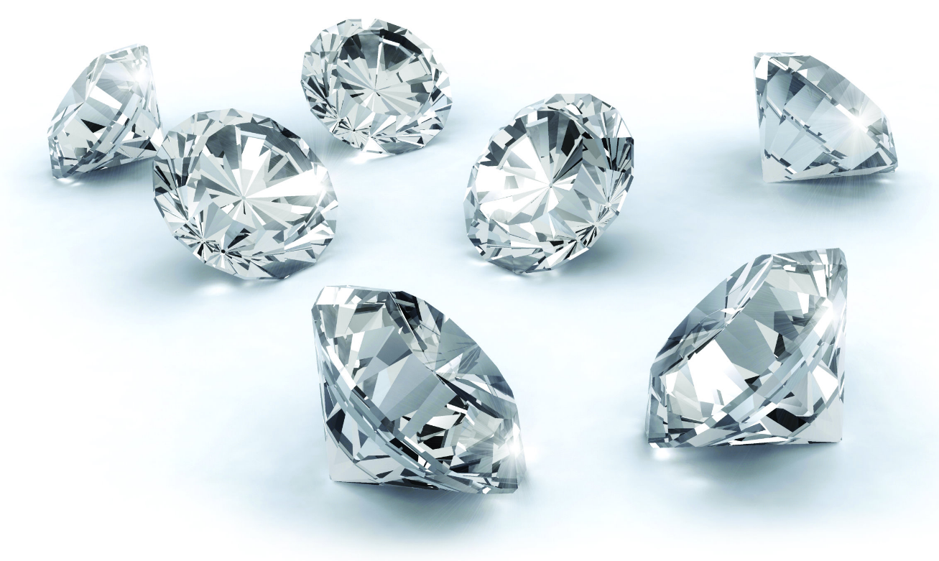
are formed

Slide 20
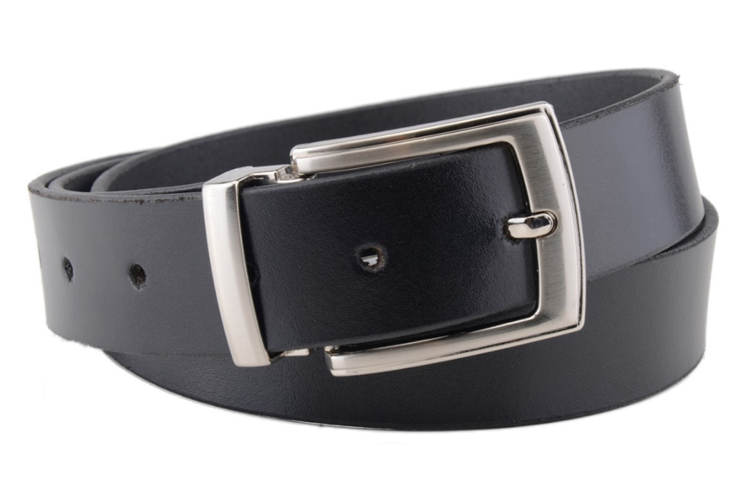
Can be made

Slide 21
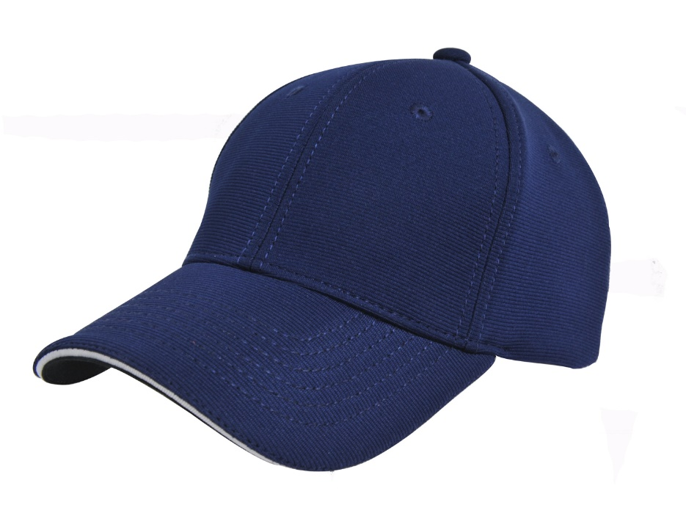
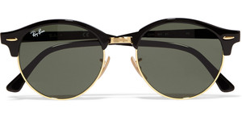
should not be worn

Slide 22
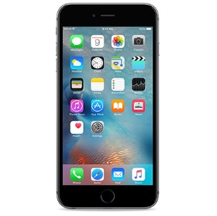
must not be used

Slide 23
is played

Slide 24
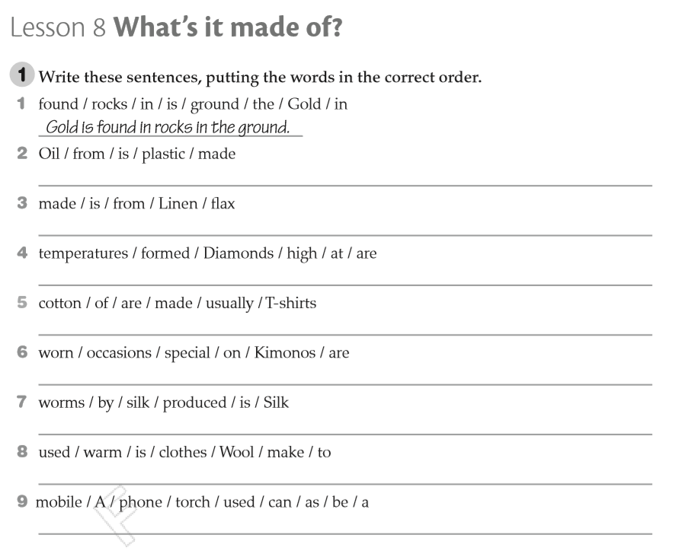
Plastic is made from oil.
Linen is made from flax.
Diamonds are formed at high temperatures.
T-shirts are usually made of cotton.
Kimonos are worn on special occasions.
Silk is produced by silk worms.
Wool is used to make warm clothes.
A mobile phone can be used as a torch.

