Slide 1
2021 – 2022
Term 1
Week :
Day:
Date: 21st Sept., 2021
Unit 2 Lesson 3-4
Alef Lesson 9

Slide 2
Online Learning Rules
No chatting during the lesson
Follow the
teacher’s rules
and do
the tasks
Mute the
microphone
until I
ask you
Be active
and
participate
Keep the liquids away from your laptop

Slide 4
Objective
01
02
listen to two learners for specific details about school life.
Use the present perfect tense. (Alef L11)

Slide 5
Teachers at the school have probably written the survey. New learners are going to answer it.
Coursebook – Page 16

Slide 6
Coursebook – Page 16
Science
English
History
Geography
The body, the skeleton and joints..
The ancient Greek.
The marks have been OK.
He got an A for Science
We do not know how Abdullah did in all subjects. He got an A for English
He joined the school orchestra.
No
Football
Volleyball
Yes. He kicked a football through the staffroom window.
Yes. He was 10 minutes
late for a lesson.
Yes. He spoke to him about the window.
Yes. He said, ‘Good morning, Abdullah’.
Yes

Slide 7
Coursebook – Page 17

Slide 8
Coursebook – Page 17

Slide 9
have had
have enjoyed
haven’t played
have been
Have enjoyed
Coursebook – Page 17

Slide 10
have enjoyed
have read
have done
Have you do
have enjoyed
Haven’t had
have you played
have played
Have the headteacher spoken
Have you enjoyed
have made
have enjoyed
Workbook – Page 19

Slide 11
Objective
01
02
listen to two learners for specific details about school life.
Use the present perfect simple. (Alef L11)

Slide 15
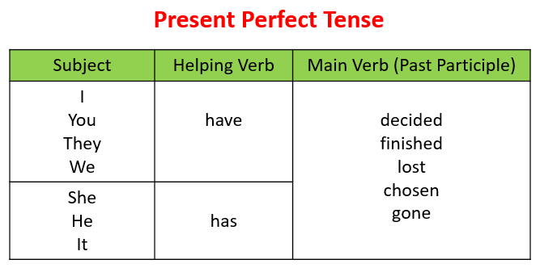
Plural
Singular

