Slide 1
Grade 4
Writing Programme
Task 1

Slide 2
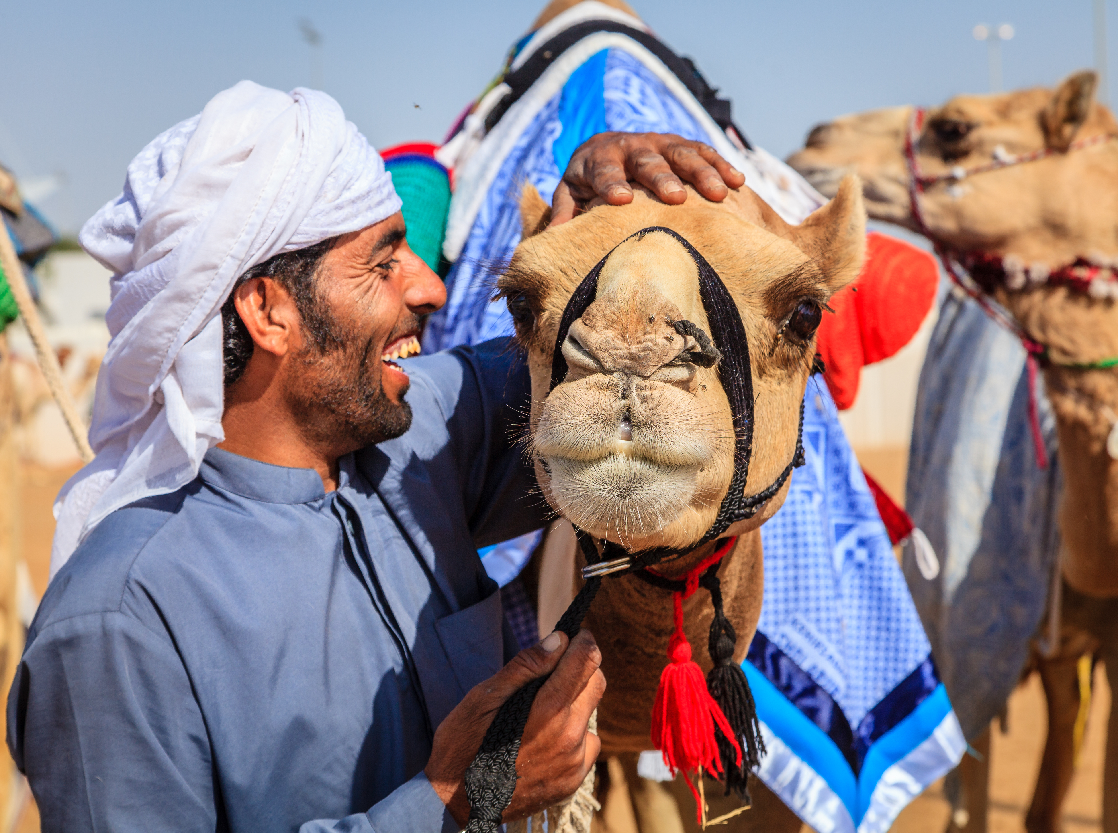
Activity 1 Answer the Questions
Who do you think the man in the picture is?
I think he is a camel farmer.
What do you think is happening in the picture?
I think he is taking care of the camels.
Do you think he cares about his camel? Why / why not?
Yes, he cares about his camel, because he is happy and excited in the picture.

Slide 3
Activity 2 Imagine
Imagine you are with this camel farmer and his camels.
Where are you?
I am in the dessert.
What are you doing?
I am taking care of camels.
What kind of person is the camel farmer?
He is a very caring and kind person.
Do you think that working with camels is hard work?
Yes, I think it is hard working, because It is hot, and he is lonely.

Slide 4
Activity 3 Fix the Sentences
Abdullah are a camel farmer, with ten camels in his caravan.
* Abdullah is a camel farmer, with ten camels in his caravan.
2. They walks in the desert every day, to get to different places. * They walk in the desert every day, to get to different places.
3. The camels carries a lot of things, like food, water and goods to sell at the market.
* camels carry a lot of things, like food, water and goods to sell at the market.
4. The job they do am hard work because it is very hot and lonely in the desert.
* The job that the camel farmer do is hard, because the weather is very hot and lonely in the desert.

Slide 5
Activity 4 Finish the Story
Abdullah and his camels walk through the desert every day.
Today, they have to bring some young camels across the desert. But there is a problem. One of the camels is lost!
Abdullah takes his strongest camel with him as he goes to look for the missing camel, he was searching for the lost camel, but he didn’t find it, then They went back and when they reached, they found the lost camel came back with the rest of camels, the camel farmer was so happy seeing the camel.

