Slide 1
English Language
Reading and Writing Prject
Level – 1.1

Slide 2
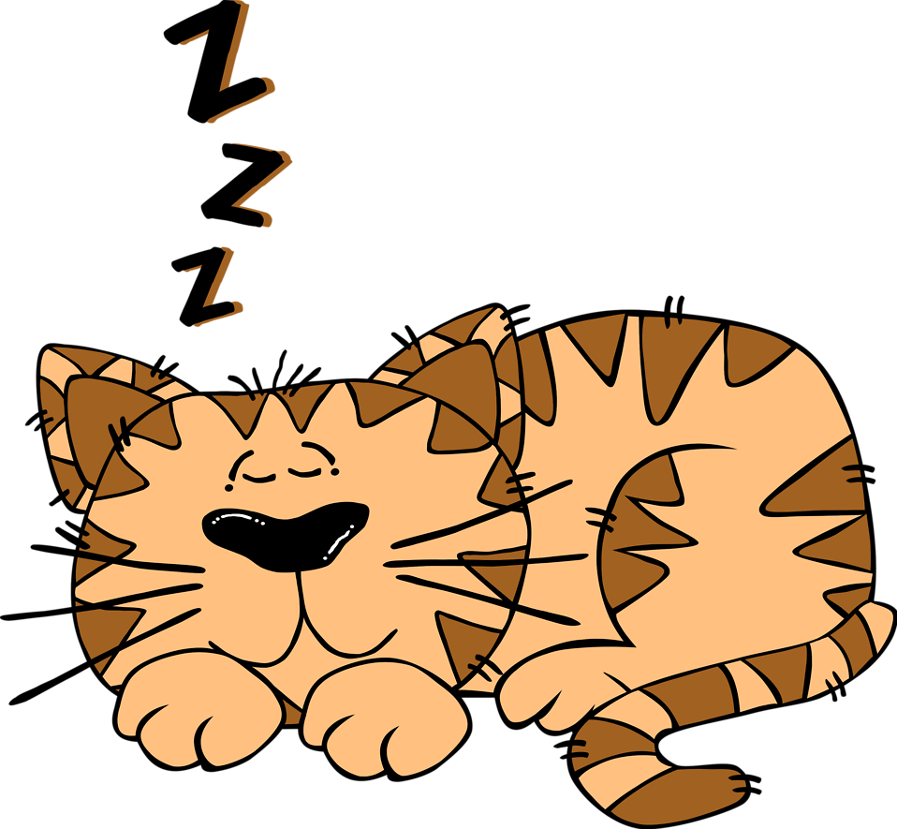
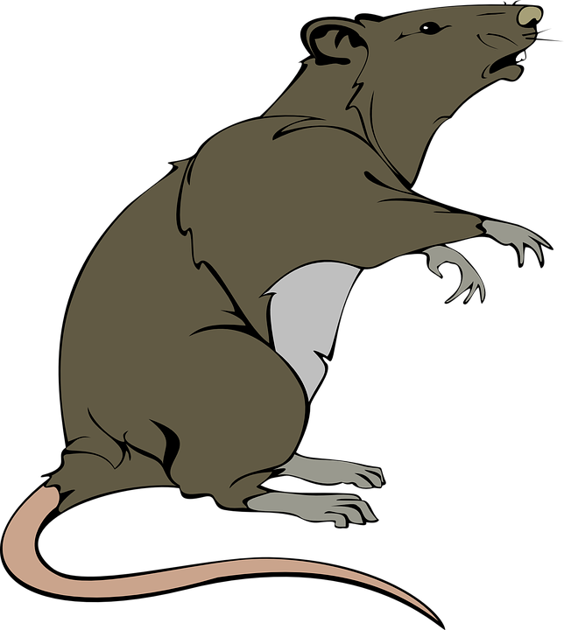
Project title: The Cat and the Rat

Slide 3
Objectives
Read and Understand the story.
Understand the meaning of the story.
Answer questions about a story.

Slide 5
cat
rat
sad
sleep
kind
Keywords

Slide 6
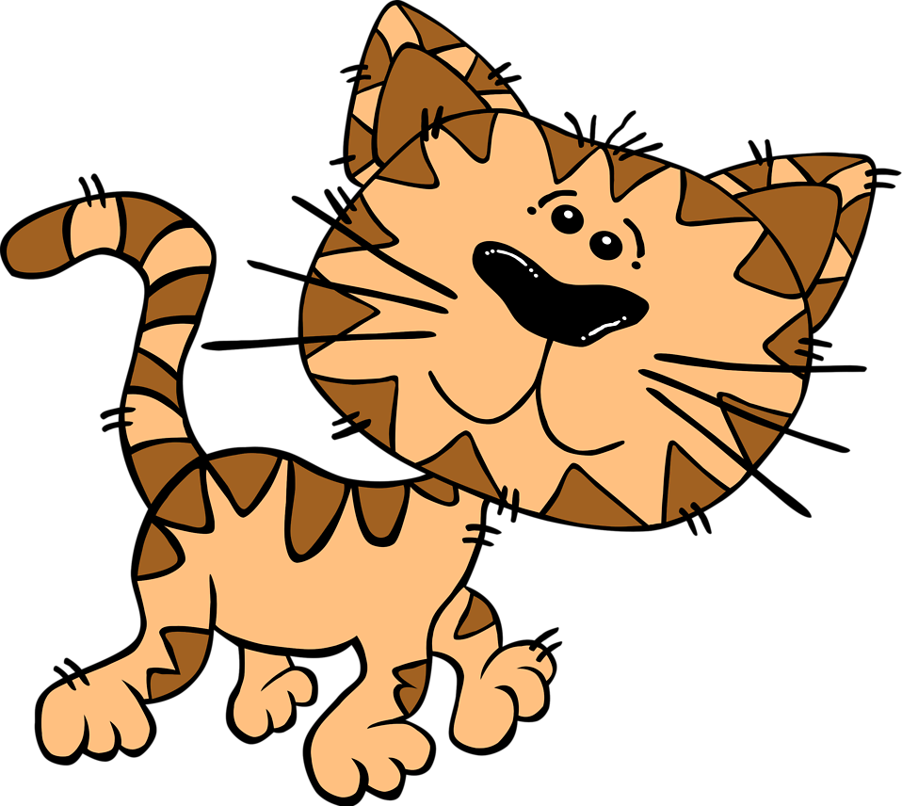
cat
A cat is an animal.

Slide 7
rat
A rat is an animal.

Slide 8
sad
Not happy.

Slide 9
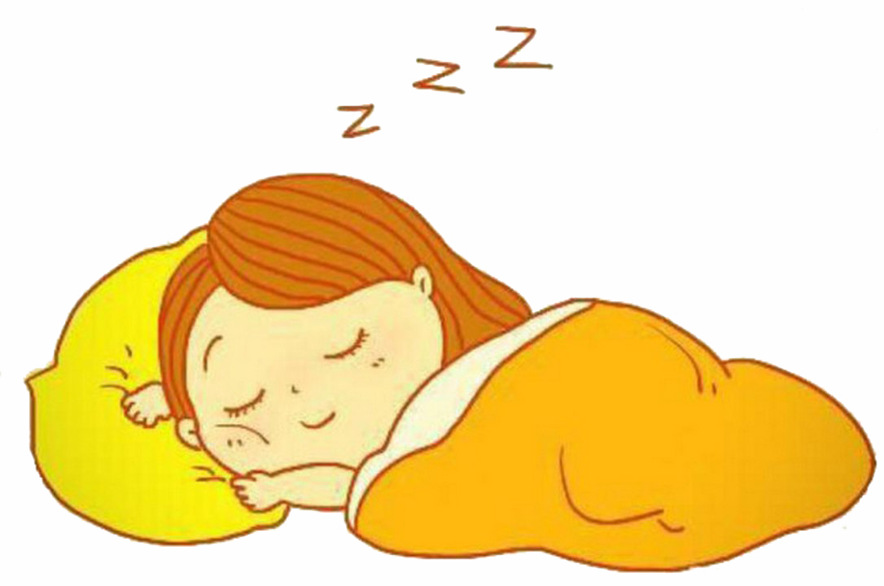
sleep
To rest your body when you are tired, close your eyes.

Slide 10
kind
To be friendly and do good things to others.

Slide 11
High Frequency Words
the was
is wanted
said come

Slide 12
Objectives
read and understand the story
understand the meaning of the story
answer questions about a story

Slide 13
The brown cat was in
the tree.

Slide 14
The cat says ‘meow’.

Slide 15
The cat sleeps in
the tree.

Slide 16
The rat went up the tree. It wanted to sleep.

Slide 17
”Go away” said the cat to the rat.

Slide 18
”No!” said the rat.
I can sit in the tree too.

Slide 19
“Ok, you can come up and sleep” said the cat.

Slide 20
The cat ate the rat.

Slide 21
owl
grasshopper
grumpy
jump
sleep
kind
Keywords

Slide 22
Questions:
Where was the cat sleeping?

Slide 23
Was the cat being kind to the rat?

Slide 24
Did you like the story?

Slide 26
sleep – rest your body with your eyes closed.
sad – a bad mood.
kind – to do good things to others.

